Slide 1

Studies on Exosomes in COVID-19
Shedding of Spike mRNA “Gene Therapy” Products
Potential
Mechanisms
MORTALITY Outcomes
Dr. Marian P. Laderoute,
Ph.D. Medical Sciences-Immunology
2024 06-01

Slide 2
“the clot shots”.
[https://www.midwesterndoctor.com/p/dissecting-the-new-york-times-plea?utm_source=substack&utm_medium=email]
High likelihood that there is a causal link between the injections of the COVID-19 mRNA gene therapy products and sudden early death involving myocardititis (median 3 days, average 6 days) [Hulscher N, Hodkinson R, Makis W, McCullough PA. Autopsy findings in cases of fatal COVID-19 vaccine-induced myocarditis. ESC Heart Fail. 2024 Jan 14. doi: 10.1002/ehf2.14680].
The rate of myocarditis reported to the FDA’s Vaccine Adverse Events Reporting System (VAERS) associated with the roll out of the mRNA COVID-19 gene therapy shots increased by 2300% in 2021, of which 3% resulted in death [Rose J, Hulscher N, McCullough PA. Determinants of COVID-19 vaccine-induced myocarditis. Ther Adv Drug Saf. 2024 Jan 27;15:20420986241226566. doi: 10.1177/20420986241226566. ]
There have been many calls for the halting of the use of mRNA vaccines until the problems of microclotting and myocarditis have been fully investigated; [for example, Mead MN, Seneff S, Wolfinger R, Rose J, Denhaerynck K, Kirsch S, McCullough PA. COVID-19 mRNA Vaccines: Lessons Learned from the Registrational Trials and Global Vaccination Campaign. Cureus. 2024 Jan 24;16(1):e52876. doi: 10.7759/cureus.52876. Retraction in: Cureus. 2024 Feb 26;16(2):r137.]
Others like myself, are of the opinion that the mRNA gene therapy “VACCINE” approach IS SO dangerous as a STEALTH BIOWEAPON that it and vaccine mandates should be banned forever, and this immediately written into the Canadian constitution.

Slide 3
I am bringing you my testimony based on
a career in
pandemic and infectious disease prevention
for Canadians since 1996.
I was hired into the Blood & Tissues Division in the Bureau of Biologics at Health Canada in 1996 in direct response to the interim report of the Krever Inquiry into the HIV-1 (over 1000 infections) and Hepatitis C (over 28,000 infections) Tainted Blood Scandal of the 80’s and 90’s.
Efforts here led to expert and public consultations¹ which resulted in the establishment of a ‘voluntary moratorium’ on xenotransplantation; the implantation of animal tissues into humans. In this way the issue of xenozoonotic infections causing a pandemic in Canada was alleviated.
1. Laderoute MP. Editor/Producer of “Report of the National Forum on Xenotransplantation: Clinical, Ethical and Regulatory Issues, November 1997”. https://publications.gc.ca/site/eng/9.686126/publication.html

Slide 4
Then I was hired as the Research Manager of the Blood Zoonotics Unit by the Laboratory Centre for Disease Control and tasked with the development of risk mitigation measures against emerging zoonotic diseases including the development of a blood donor screening test for unknown zoonotic diseases.
So, in our quest to examine the impact of “xenozoonoses” on the human immune system my research team identified the activation of the (elusive) foamy retrovirus of humans (HERV-K102) which generated foamy macrophages in response to viral infections.
Public Health Agency of Canada (PHAC) then issued patent applications worldwide for these blood donor screening tests and for the exploitation of HERV-K102 activation for pandemic preparedness.
We showed HERV-K102 was replication competent in vivo and in vitro and generated foamy macrophages that we now know mediate ‘trained (innate) immunity (TI)”.
TI provides more rapid-onset non-antigen-specific (heterologous) protection against pathogens and cancers which includes pathogen neutralizing INNATE antibodies and innate T cells that recognize surrogate markers: HERV-K102 envelope proteins on infected cells and which are captured on viruses as they bud from the infected cells. Moreover, it is believed that the HERV-K102 particles kill virus-infected cells and tumor cells by undergoing lytic infections. In contrast, in normal cells, HERV-K102 merely integrates and waits at the ready to pounce if the intruder (pathogen) enters the cells.

Slide 5
HERV-K102 particle entry into cells is able to provide an alternative means to not only activate but to quickly amplify the critical Type 1 interferon response needed for COVID-19 recovery [1-3] and explains how in a humanized mouse model of mild COVID-19 disease that ‘macrophages’ were somehow able to achieve this [4].
Russ E, Mikhalkevich N, Iordanskiy S. Expression of human endogenous retrovirus group K (HERV-K) HML-2 correlates with immune activation of macrophages and type I interferon response. Microbiol Spectr. 2023 Mar 2;11(2):e0443822. doi: 10.1128/spectrum.04438-22.
Russ E, Iordanskiy S. Endogenous retroviruses as modulators of innate immunity. Pathogens. 2023 Jan 19;12(2):162. doi: 10.3390/pathogens12020162.
Guo Y, Yang C, Liu Y, et al. High expression of HERV-K (HML-2) might stimulate interferon in COVID-19 patients. Viruses 2022, 14, 996. https://doi.org/10.3390/ v14050996.
Kenney DJ, O'Connell AK, Turcinovic J, et al. Humanized mice reveal a macrophage-enriched gene signature defining human lung tissue protection during SARS-CoV-2 infection. Cell Rep. 2022 Apr 19;39(3):110714. doi: 10.1016/j.celrep.2022.110714.

Slide 6
The most important evidence to indicate the HERV-K102 particles involved a protective response was; we discovered that a cohort of individuals resistant to HIV-1 acquisition had a five-fold increased HERV-K102 pro-viral copy number in their genomic DNA [the late Dr. Frank Plummer’s HESN; Commercial Sextrade Workers (CSW) of Nairobi, Kenya]. This argued that high HERV-K102 replication/pre-activation may strongly protect against HIV-1 infection where HIV-1 is a pandemic RNA virus.
Now, in the paper below¹ it is overwhelmingly suggested that foamy macrophages and HERV-K102 replication are key to the recovery from COVID-19, the disease caused by SARS-CoV-2, a second pandemic RNA virus.
Indeed, HERV-K102 at 1q22 may have helped ensure the survival of the human species from RNA epidemics prevalent at the time of encounters with other hominins who subsequently went extinct.¹
So HERV-K102 appears to be THE crucial host defence mechanism of macrophages promoting survival against pandemic RNA viruses.
1. Laderoute, M. Antibody dependent enhancement (ADE) of infection into macrophages validates the importance of HERV-K102 particle production for pandemic preparedness. Preprints 2023, 2023120185. https://doi.org/10.20944/preprints202312.0185.v1

Slide 7
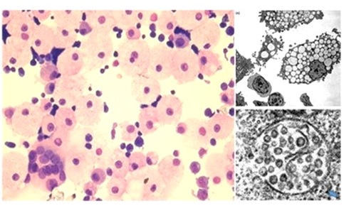
Laderoute MP, Larocque LJ, Giulivi A, Diaz-Mitoma F. Further evidence that human endogenous retrovirus K102 is a replication competent foamy virus that may antagonize HIV-1 replication. Open AIDS J. 2015 Dec 7;9:112-22. doi: 10.2174/1874613601509010112.
Laderoute MP, Giulivi A, Larocque L, et al. The replicative activity of human endogenous retrovirus K102 (HERV-K102) with HIV viremia. AIDS. 2007 Nov 30;21(18):2417-24. doi: 10.1097/QAD.0b013e3282f14d64.
HERV-K102 is the elusive foamy retrovirus of humans.
Russ E et al., Microbiol Spectr 2023.
Particles are produced in M1-like foamy macrophages where release is by lysis on day 6/7.
Produced by budding through the golgi creating vacuoles) and accumulate hundreds of particles per vacuole and hundreds of vacuoles in the M1-like foamy macrophages
Requires lots of lysine and cholesterol to produce
Release of particles is by a novel cytosol-initiated
Novel DNase-2 mechanism for apoptosis [Fischer H, et al. Holocrine secretion of sebum is a unique DNase2-dependent mode of programmed cell death. J Invest Dermatol. 2017 Mar;137(3):587-594. doi: 10.1016/j.jid.2016.10.017.]
100 nm immature particles (no condensed cores)
Have envelope spikes on surface
Density of 1.10 to 1.20 g/ml (iodixanol gradients )
Carry and use reverse transcriptase and integrase for replication in vivo and in vitro
Replication competent (functional REVERSE TRANSCRIPTASE and INTEGRASE

Slide 8
One needs to understand
“Antibody Dependent Enhancement (ADE) of Infection into Macrophages” in order to understand what shedding is and
the role of spike IgG1/3 antibody in generating
more lethal COVID-19 outcomes.
During natural infection, PROGRESSION to severe COVID-19 is associated with the ‘early’ onset of spike protein ANTIBODIES (as part of the B cell response of ADAPTIVE immunity) that occurs before the innate system has cleared/inactivated SARS-CoV-2 [1].
In other words, the spike IgG1/3 antibodies cause progression to severe COVID-19 when the SARS-CoV-2 virus is present and does not prevent disease.
So this raised a red flag as to why the COVID-19 vaccines would be designed to produce antibodies to the spike protein of SARS-CoV-2, as this would cause harm and not protect.
1. Laderoute, M. Antibody dependent enhancement (ADE) of infection into macrophages validates the importance of HERV-K102 particle production for pandemic preparedness. Preprints 2023, 2023120185. https://doi.org/10.20944/preprints202312.0185.v1

Slide 9
Monocytes/ macrophages do Not express ACE2 and thus,
entry of SARS-CoV-2 into macrophages is via ADE.
Upon the entry of SARS-CoV-2 into macrophages by ADE, this blocks the critical launch of the HERV-K102 protector system in macrophages needed for recovery/survival.
This is why the IgG1/3 antibodies to spike protein and ADE are so dangerous. It also explains how the COVID-19 vaccines were doomed not only to failure but to increased risks of death upon subsequent exposures to SARS-CoV-2.
NO adaptive immunity vaccine that generates antibodies to the RNA spike protein to an emerging pathogen can be considered safe due to the well-known problems of ADE.

Slide 10
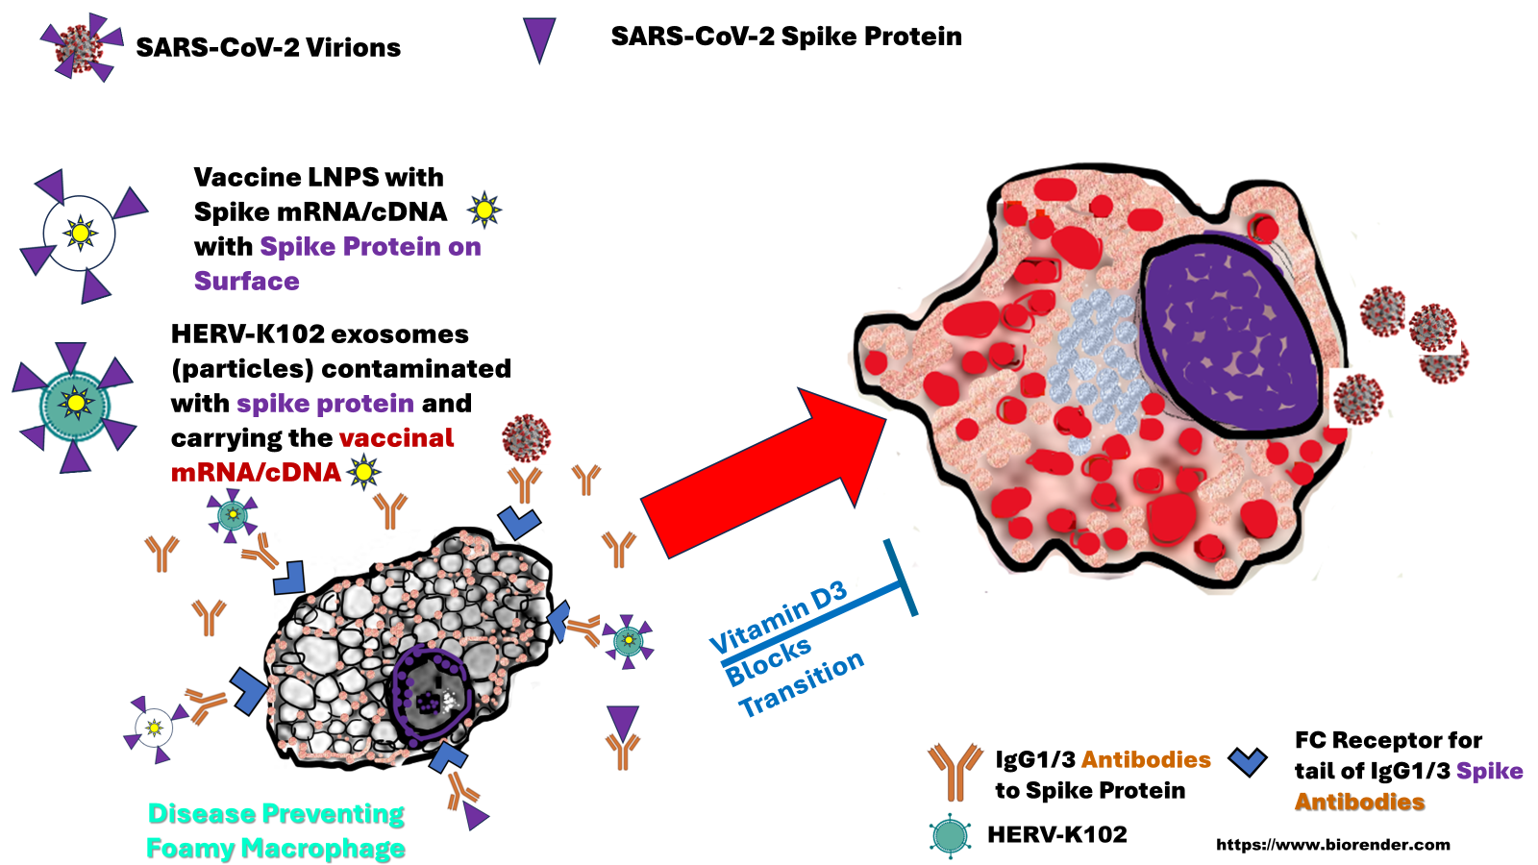
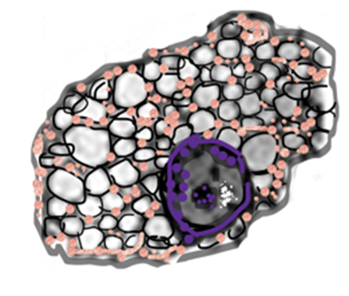
Disease Causing Foamy Macrophage with Lipid Bodies (Oil Red O Positive)
ADE
Protector Foamy Macrophage
Producing HERV-K102 Particles

Slide 11
Hypothesis: How to explain SHEDDING in the context of mRNA gene therapy products used as vaccines
The spike-laden LNPs are targeted to macrophages via ADE following the 2nd dose when the high levels of IgG1/3 antibodies to spike protein are made.
In the URT this means the HERV-K102 protector particles produced in foamy macrophages (sebocytes) are contaminated by the spike mRNA/cDNA and become laden with spike protein. Upon lysis and release of the contaminated exosomes they become covered with spike IgG1/3 antibodies. These complexes are shed to the outside of the mucosa as sebum.
Upon transfer to the new host in the microcirculation in the lungs, intense complement and platelet activation occur (exacerbated by the antigen-antibody complex which strongly activate complement and coagulation) setting off microclotting and myocarditis with a higher risk of death than the direct injection of the vaccine itself (stealth killing).

Slide 12
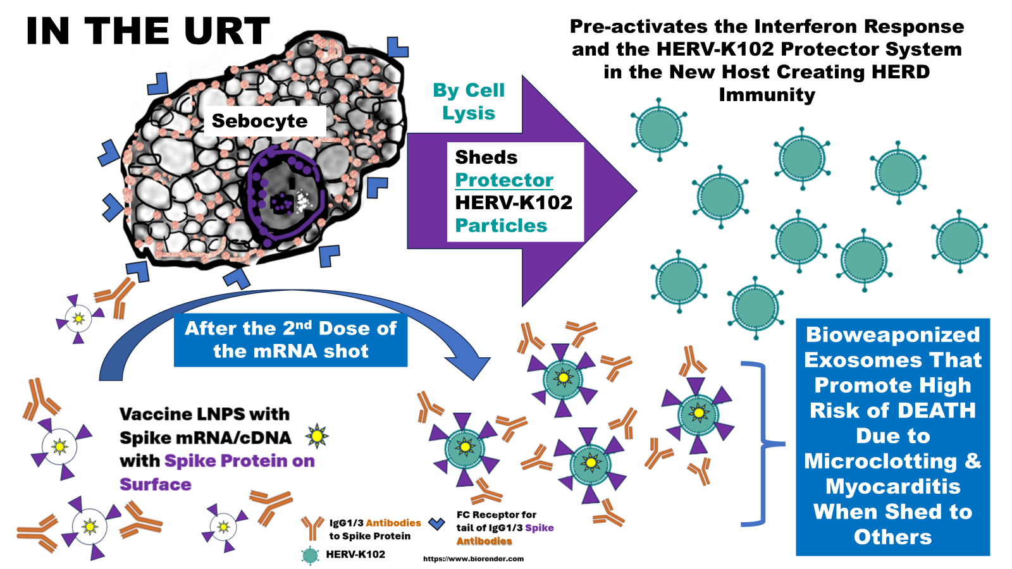
MY Hypothesis
ADE entry

Slide 13
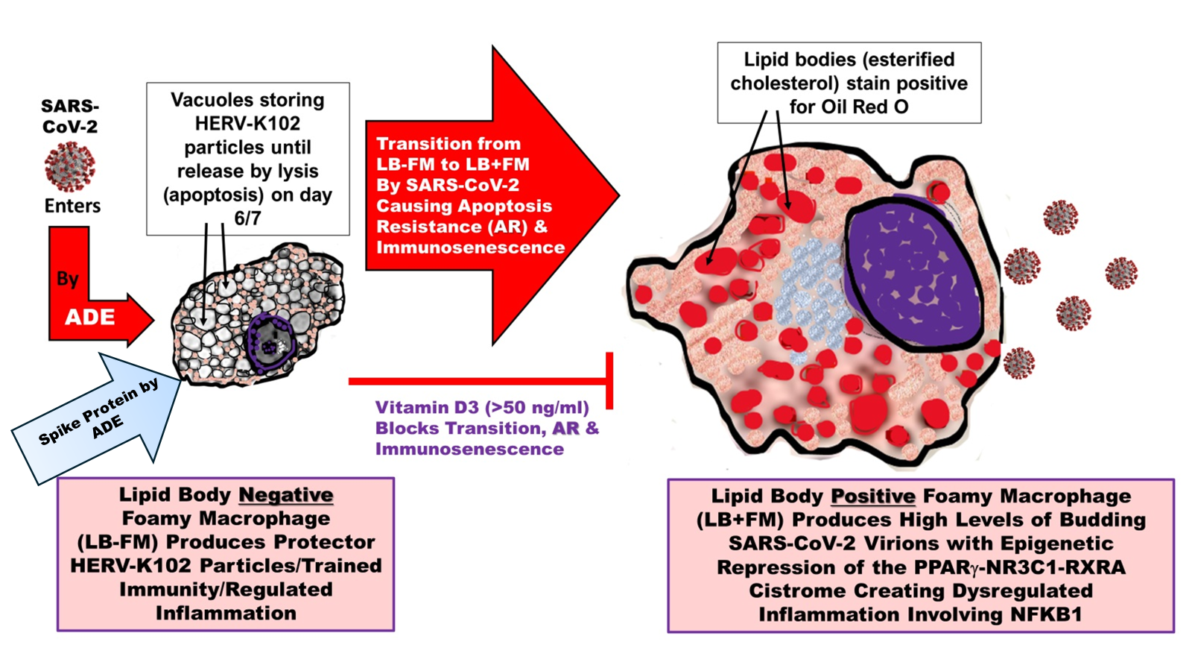
Vitamin D3 essentially downregulates adaptive immunity & favors innate immunity including the activation of HERV-K102 expression. Vit D3
blocks the ability of SARS-CoV-2 to convert the Protector FOAMY MACROPHAGES (LB-FM) into the DISEASE Progression Causing Foamy Macrophages (LB+FM)
[Dias SSG et al., PLoS Pathogens, 2020].
[Oh J et al., Circulation 2009].

Slide 14
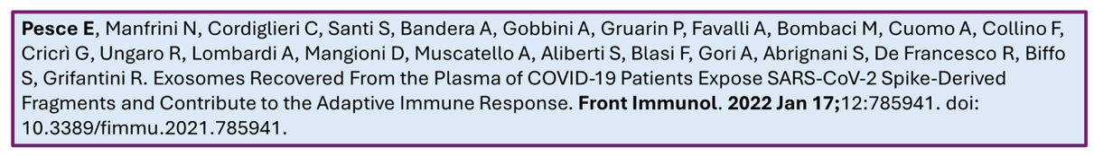
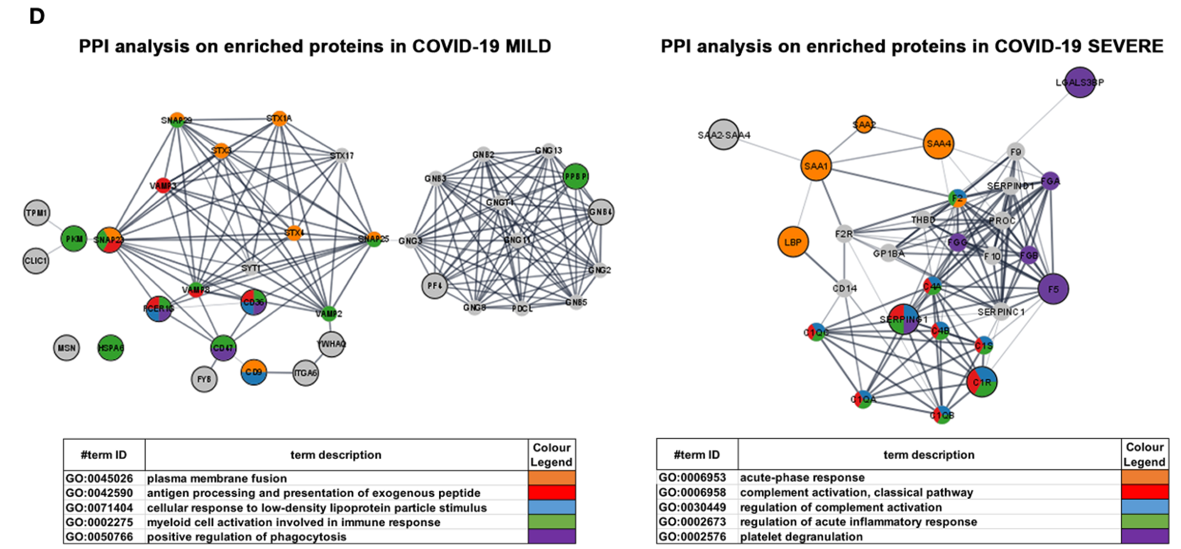
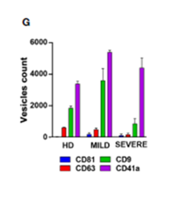
MOST EXOSOMES In Plasma From COVID-19 Patients are from Macrophages (CD9 positive)
CD9 Positive Exosomes (HERV-K102) from LB-Foamy Macrophages
(decrease by 75% with transition to Severe C19)
CD9 Positive Exosomes from LB+ Foamy Macrophages (Provoking Microclotting, Complement Activation & Dysregulated Inflammation)

Slide 15
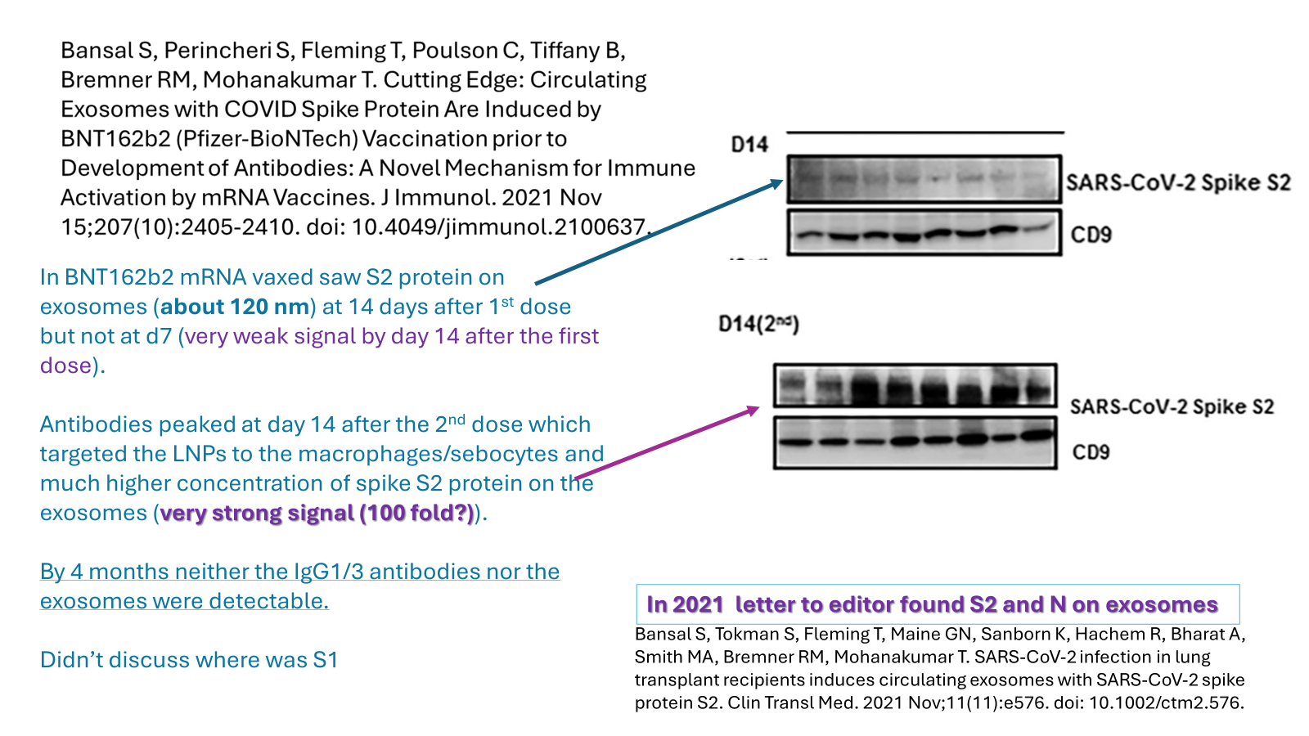
Shedding in the donor URT probably
lasts up to 3 months after vaccination
Kedl RM, Hsieh EWY, Morrison TE, Samayoa-Reyes G, Flaherty S, Jackson CL, Rochford R. Evidence for Aerosol Transfer of SARS-CoV-2-Specific Humoral Immunity. Immunohorizons. 2023 May 1;7(5):307-309. doi: 10.4049/immunohorizons.2300027.

Slide 16
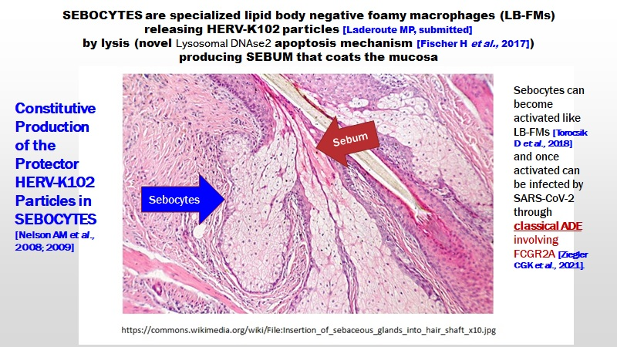
Endotoxin- LPS Role Promoting Bioweapon
Exosomes

Slide 17
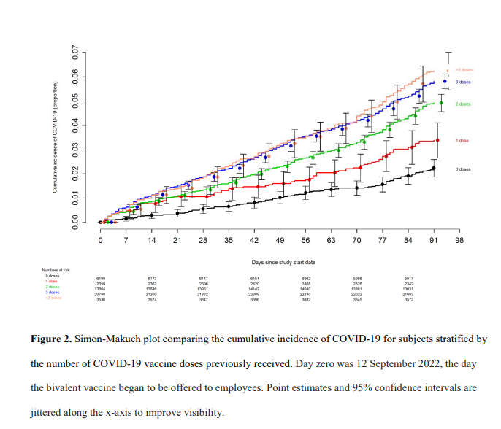
Shrestha NK, Shrestha P, Burke PC, Nowacki AS, Terpeluk P, Gordon SM. Coronavirus Disease 2019 Vaccine Boosting in Previously Infected or Vaccinated Individuals. Clin Infect Dis. 2022 Dec 19;75(12):2169-2177. doi: 10.1093/cid/ciac327.
The famous Cleveland Clinic data implies that the spike IgG1/3 in the URT is not converted to IgG4 even after multiple boosters.

Slide 18
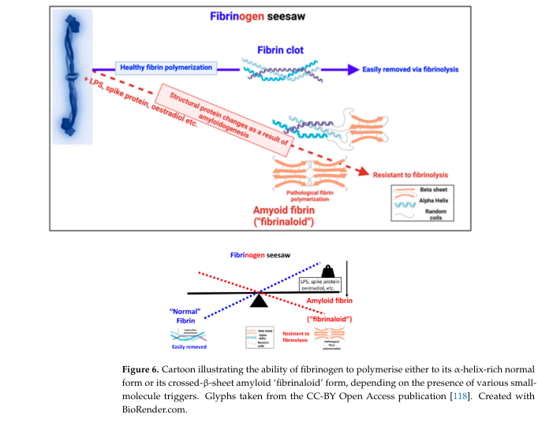
The clotting caused by the Wuhan spike protein involves abnormal “microclotting” that is made more dangerous due to the clot’s resistance to fibrinolysis.
LPS = endotoxin also a role in
formation of the white
fibrinaloid clots and microclots.
Kell DB, Lip GYH, Pretorius E. Fibrinaloid Microclots and Atrial Fibrillation. Biomedicines. 2024 Apr 17;12(4):891. doi: 10.3390/biomedicines12040891.

Slide 19

There are numerous reports of symptoms and pathologies identical to the adverse effects of mRNA vaccines in unvaccinated persons in contact with freshly vaccinated persons.

Slide 20
Is there any evidence that shedding has caused excess deaths
or any evidence for
sudden unexpected deaths?

Slide 21
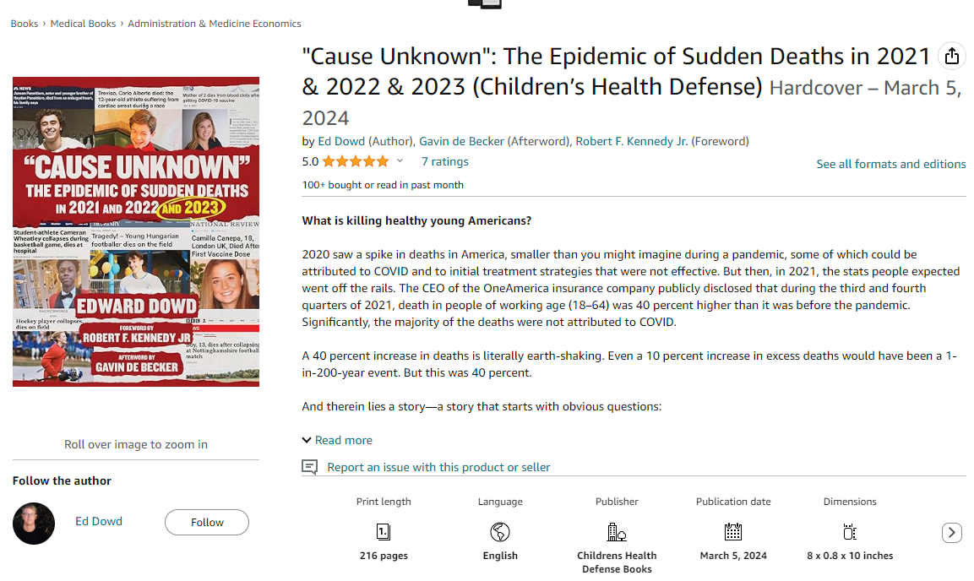

Sudden Adult Death Syndrome (SADS)

Slide 22
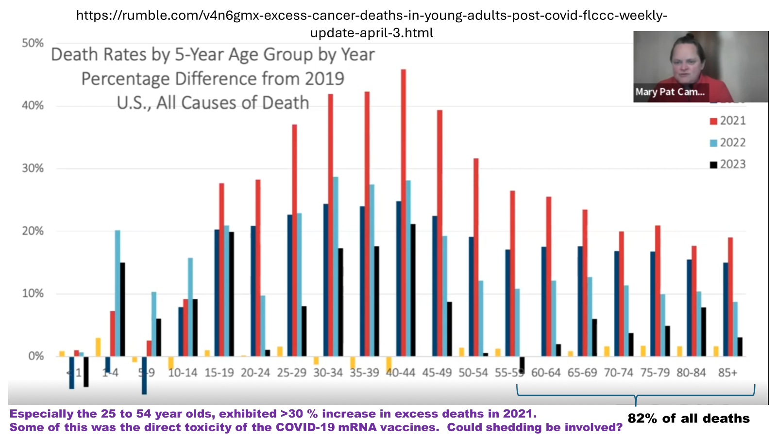
Mary Pat Campbell
https://covid19criticalcare.com/wp-content/uploads/2024/04/Campbell-presentation-FLCCC-webinar.pdf

Slide 23
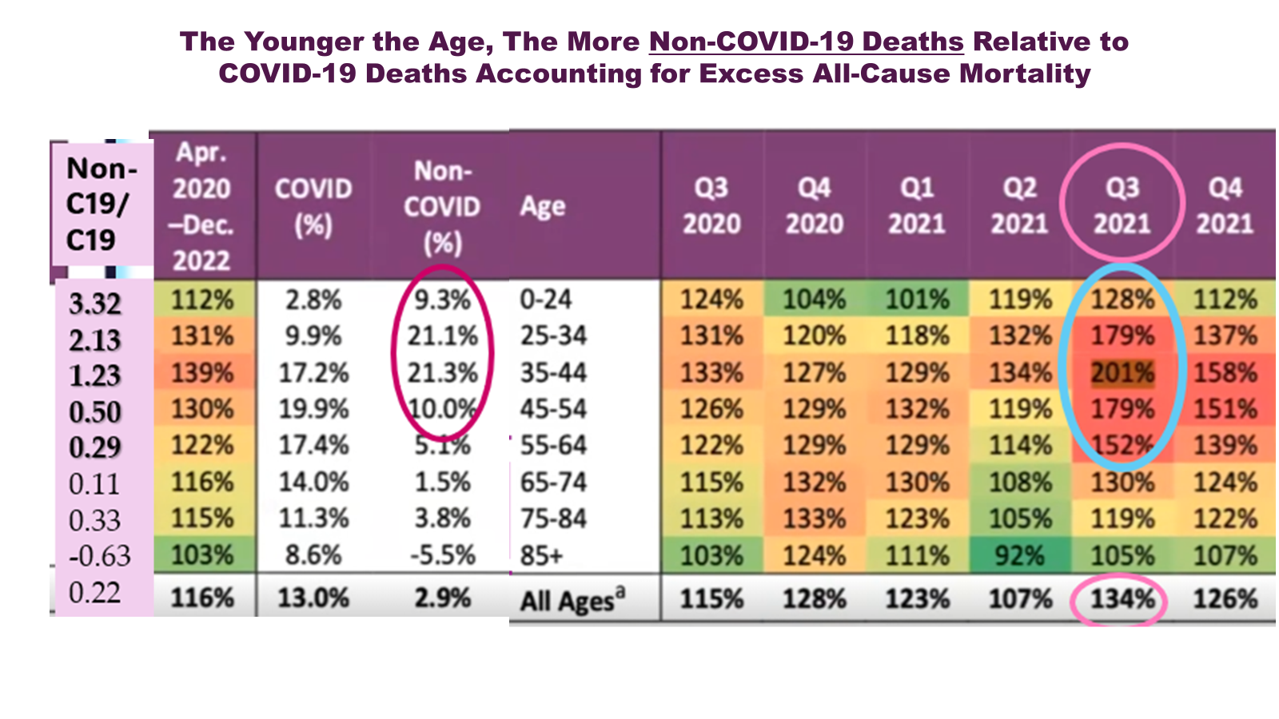
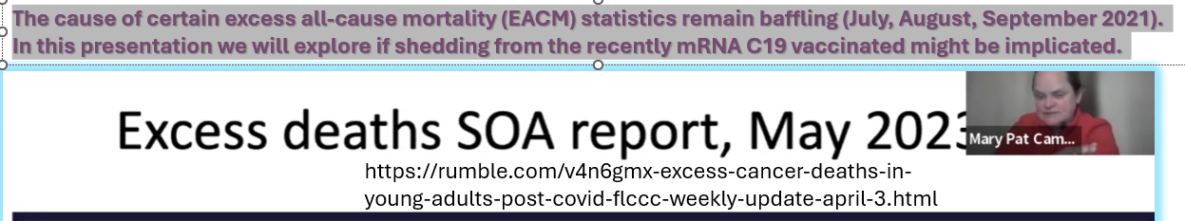
During the height of the pandemic, the Non-C19/C19 death ratio provides an index of Excess Non-C19 Deaths
Index
SOA =Society of Actuaries

Slide 24
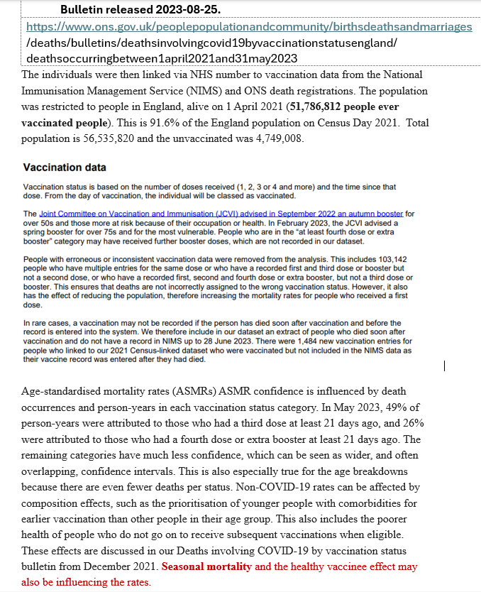
The ONS data does not lump vaccine deaths up to 14 days after a dose as unvaccinated. Deaths on the day of vaccination count as vaccination associated deaths.
However, according to Prof. Fenton and colleagues, for the “ever vaccinated totals provided by the ONS”, it appears here that the data has been manipulated to essentially discount the deaths in the first 14 days following vaccination.
“Fenton N, Neil M, Craig C, McLachlan S. What the ONS mortality COVID-19 surveillance data can tell us about vaccine safety and efficacy. In: Too Many Dead- An Inquiry Into Australia’s Excess Mortality (© Australian Medical Professionals Society) Red Union Publishing, Bowen Hills QLD 4006, Australia, 2023. pp 470. [https://8630368.fs1.hubspotusercontent-na1.net/hubfs/8630368/Lite_Too-Many-Dead-PDF-with-Cover-MQ-16112023%20(2).pdf ]”
However, this problem is easily overcome by manually adding up all the individual ASMRs for each vaccination category per month as shown in the next slide.

Slide 25
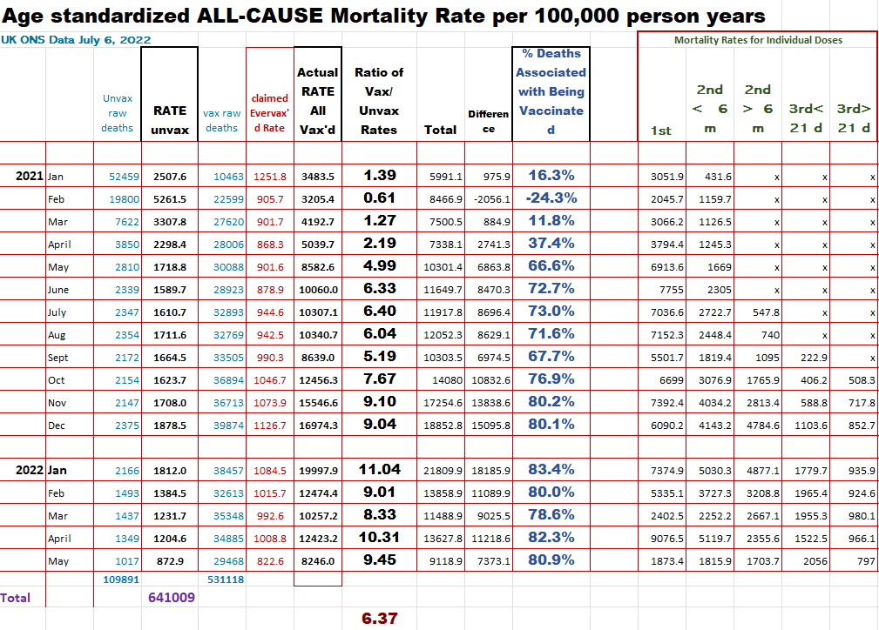

Slide 26
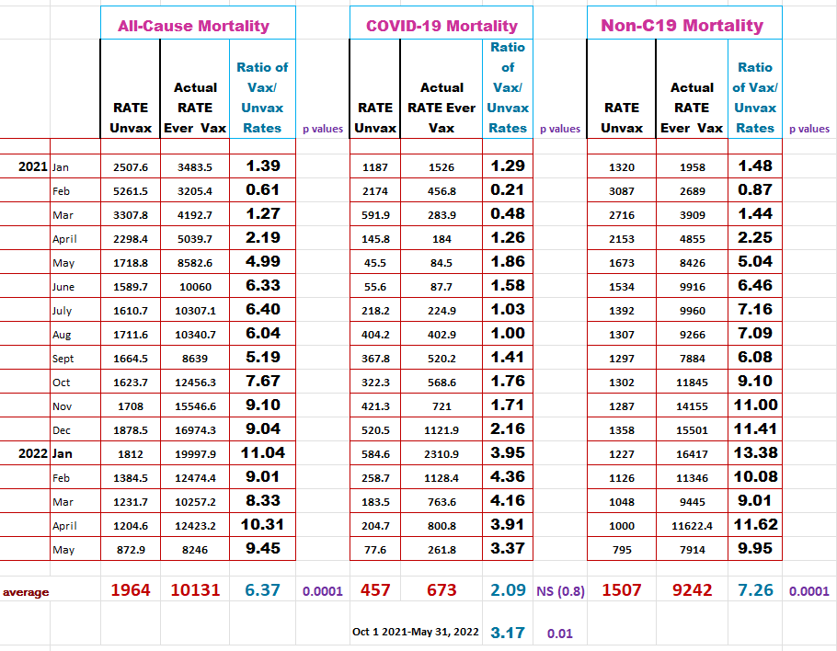
TABLE 1. UK Office for National Statistics (ONS) England Monthly Age-Standardized Mortality Rates (ASMRs) per 100,000 Person-Years and Vaccinated (Vax) to Unvaccinated (Unvax) Rate Ratios for January 1, 2021 to May 31, 2022 for Both Sexes and All Ages 10+ *
The “Actual Rate Ever Vax” refers to recompiled data where all the ASMRs in the different categories of vaccination were manually added up to yield a total, because the ‘Ever vaccinated’ totals provided by the ONS were manipulated.
NB: There were 71,318 vaccination associated deaths that were excluded because details were missing for the second dose but not the first or third dose. #
#https://www.ons.gov.uk/peoplepopulationandcommunity/birthsdeathsandmarriages/deaths/bulletins/deathsinvolvingcovid19byvaccinationstatusengland/previousReleases
*https://www.ons.gov.uk/peoplepopulationandcommunity/birthsdeathsandmarriages/deaths/datasets/deathsbyvaccinationstatusengland

Slide 27
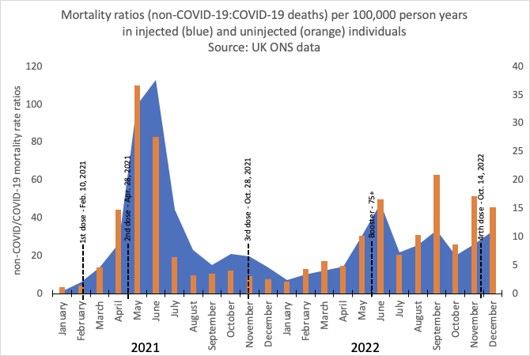
ENGLAND: Influence of Vaccination on the Unvaccinated
Scale for the Orange (uninjected)
INDEX for Excess NON-C19 Mortality =
Non-C19 mortality/C19 Mortality
Scale for the Blue (injected)
Graph by Dr. Jessica Rose

Slide 28
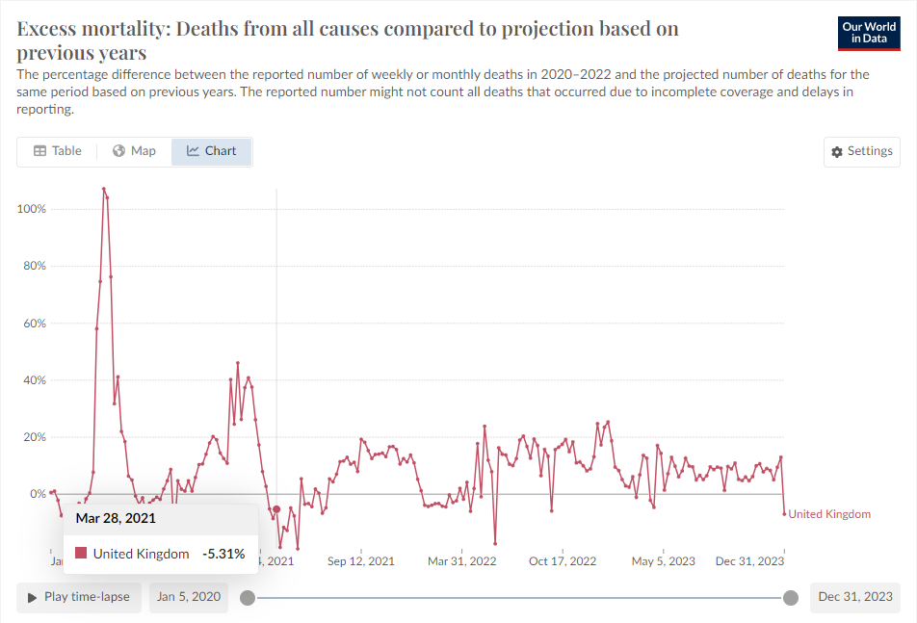


Omicron induces trained innate immunity providing
heterologous protection against all-cause mortality!
There were two key periods when negative excess all-cause mortality was observed in the UK.
First dose of mRNA induces trained innate immunity providing heterologous protection against all-cause mortality!

Slide 29
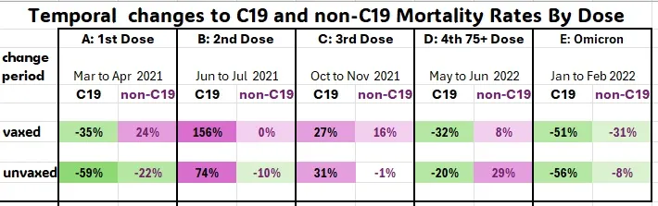
Laderoute MP. The Marvels of the HERV-K102 Virus-Anti-Virus Protection System of Humans Including Shed (Horizontal) Population Protection (and the Harms of Gene Therapy Shedding), March 5, 2024. https://hervk102.substack.com/p/the-marvels-of-the-herv-k102-virus.
ONS Data For England
Around the time that about 50% of the 65 to 75 years of age had received a particular dose, what immediately happened to the mortality rates about 10-14 days later ?
NB: Omicron [E] decreased mortality rates in both the vaxed and unvaxed for C19 and non-C19. The same thing happened for the first Pfizer-BIoNTech mRNA dose [A] except the vaccine was toxic and induced non-C19 deaths.
The data in A is the first evidence consistent with HERV-K102 particle protection being horizontally transmitted. On the other hand, these exosomes can be contaminated by gene therapy products and can be deadly when shed especially related to the generation of the spike IgG1/3 after the second dose (B & C) to the unvaccinated.

Slide 30
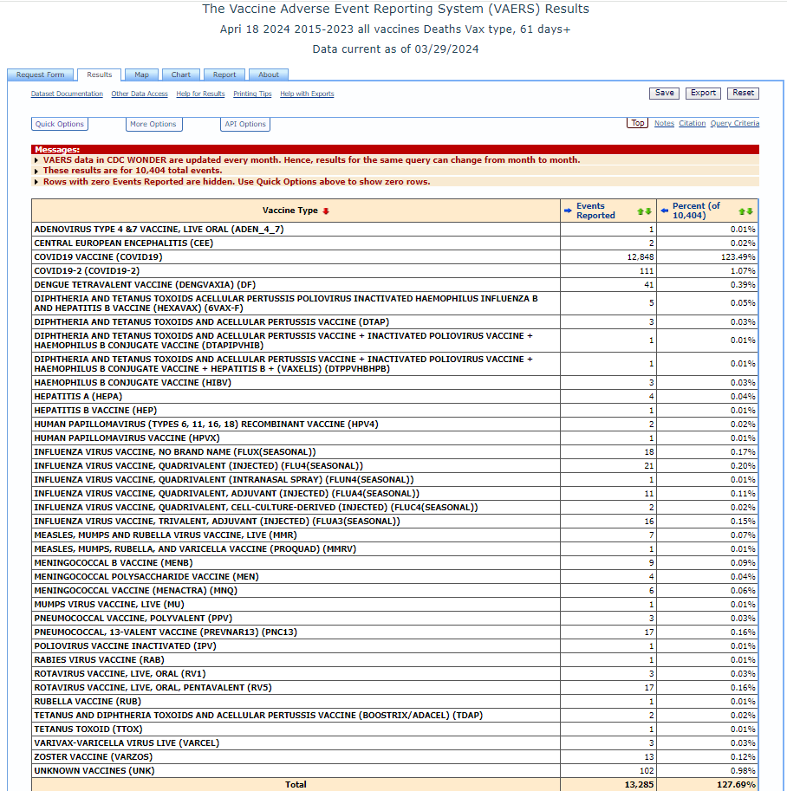
It is extremely rare for a traditional vaccine to have deaths reported beyond 60 days after the last dose since shedding is not a known or common problem with vaccines that use “antigens”.
Also some of these deaths for the COVID-19 vaccines involved SARS-CoV-2 infections indicating a problem with breakthrough infections not found for traditional vaccines.
So late onset deaths (>63 days) could be due to SARS-CoV-2 infection, shedding, or both.
However, in the ONS database the deaths that involved SARS-CoV-2 infection are captured separately under COVID-19 deaths. Therefore, this simplified the issue and allowed me to use the > 63 days approach to gauge shedding.

Slide 31
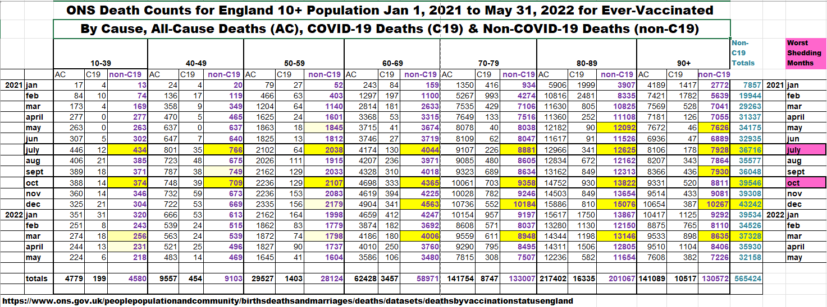
Putative
https://www.ons.gov.uk/peoplepopulationandcommunity/birthsdeathsandmarriages/deaths/
Death Counts from Table 8.
Only the all-cause (AC) and the C19 were provided so I had to calculate the number of non-C19 deaths in each age category for each month to give us the totals. Here I have highlighted the peaks in the non-C19 death counts in yellow.
There were two highest impact shedding months increasing the non-COVID-19 deaths across all ages: July 2021 (the second dose to the elderly) and October 2021 (the third dose to the elderly).

Slide 32
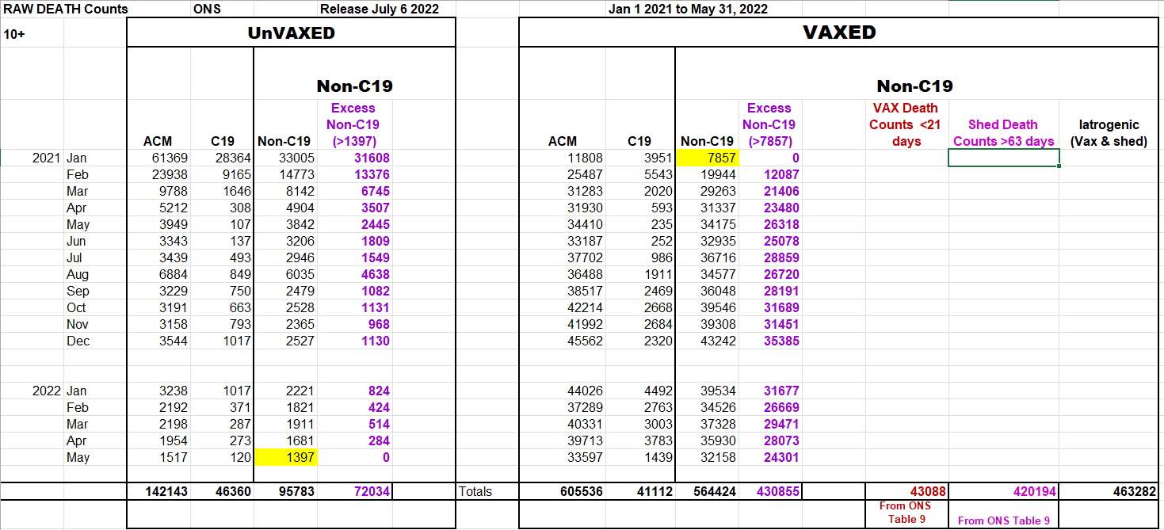
Estimation of Shedding Deaths in England for the Unvaccinated (UnVaxed) and the Vaccinated (Vaxed) for the first 17 months of the Pfizer-BioNTech Rollout
Shedding
deaths
Shedding
deaths
Lowest Non-C19 death counts ( to estimate background deaths).

Slide 33
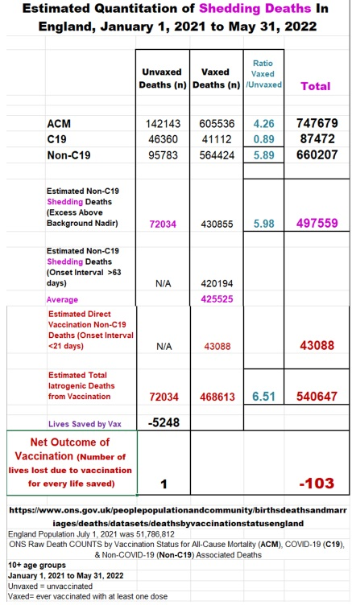
The % of non-C19 deaths due to shedding was estimated in the unvaccinated at 75.2%, for the vaccinated it was 75.4% and for both it was 75.36%.
However, according to the ONS Bulletin there were an additional 71,318 vax related deaths that were excluded as the details of the first dose and 3rd were provided but not for the second dose. If we assume 75 % of these deaths were due to shedding then there were an additional 53,489 shedding deaths, for a total of
551,048 total shedding deaths in England over 17 months.
The total for iatrogenic is now 551,048 (shedding) plus 43,088 (direct vaccine deaths) for a total of 594,136 iatrogenic deaths.
England had a 6.79-fold (594,136/87,472) increased vaccination associated deaths over COVID-19 deaths for the first 17 months of the vaccine rollout.
According to Dr. Wilson Sy of Australia, about 74% of the excess deaths in Australia were caused by the intervention, the COVID-19 mRNA vaccines. Thus, Australia did not suffer a COVID-19 pandemic but an iatrogenic pandemic relating to the use of gene therapy products inappropriately as vaccines.
[Sy, W. Australian COVID-19 pandemic: A Bradford Hill analysis of iatrogenic excess mortality. In: Too Many Dead- An Inquiry Into Australia’s Excess Mortality (© Australian Medical Professionals Society) Red Union Publishing , Bowen Hills QLD 4006, Australia, 2023. pp 470.
https://8630368.fs1.hubspotusercontent-na1.net/hubfs/8630368/Lite_Too-Many-Dead-PDF-with-Cover-MQ-16112023%20(2).pdf].
Data from Our World in Data shows for 29 countries that the vaccination associated deaths on average were 1.7- fold higher than the number of deaths associated with SARS-CoV-2 infection (2021 to 2023).
Sakura K, 2024, OSFPreprints: globally, “excess deaths due to vaccination were higher than COVID-19 deaths”. [https://doi.org/10.31219/osf.io/zv6j8].

Slide 34
Estimated Excess (Iatrogenic) Non-C19 Deaths Due to COVID-19 Vaccination in Canada 2021-2023 # : Iatrogenic/COVID-19 Death Ratio for Canada for 2021 to 2023 was 2.1
COVID-19 Deaths (from Stats Canada for 2021, 2022 while OECD for 2023) | Data Source: Years Used to Estimate Background Deaths | Excess All-Cause Deaths | Excess Non-C19 Deaths | Early Direct Vaccination Deaths @9.2 % | Shedding Deaths @90.8%
40,825 | Stats Canada (compared with 2018 + 2019 =285,503) | 115,611 | 74,786 | 6,880 | 67,905
39,736* | OECD (compared with 2015 - 2019 =276,408) | 135,930 | 95,105 | 8,750 | 86,355
40,281 | Average | 125,771 | 85,490 | 7,865 | 77,645
https://stats.oecd.org/Index.aspx?DatasetCode=HEALTH_STAT
https://www150.statcan.gc.ca/t1/tbl1/en/tv.action?pid=1310039401
# COVID-19 2023 deaths were based on OECD deaths up to week 36 for 2023 (28,400 excess deaths with 4,613 C19 deaths) prorated for the year (40,896 excess deaths with 6643 C19 deaths) *Our World in Data Suggests 39,736 COVID-19 Deaths
@ Based on findings for England, the portions of Iatrogenic deaths due to the early direct effects of the vaccine (9.2%) or due to shedding (90.8%).

Slide 35
Only the mRNA or adenovirus DNA vaccines induce the IgG1/3 spike antibodies in the URT. [Guerrieri M, et al., Vaccines (Basel), Dec 2021. Aksyuk AA, et al., Cell Rep Med,Dec 2022.]
Shedders of the bioweapons comes from those who have had at least 2 doses of the mRNA gene therapy products.
In blood get conversion of dangerous spike IgG1/3 to IgG4 at 6 months after 2nd dose or with the 3rd dose. However, the conversion to IgG4 is not the case with adenovirus (Ad) vaccines. [Irrgang P et al., Science Immunology, Dec 2022]. This helps to explain the higher risk of microclotting/myocarditis for the adenovirus COVID-19 vaccines, why they were sequentially pulled from the market, and why they are no longer being produced.
People who may be at the highest risk of shedding are those who were infected before receiving the COVID-19 mRNA gene therapy shots because IN THE BLOOD they do not switch the dangerous spike IgG1/3 to IgG4 [Kiszel P et al., August 2023].
The younger one is the more likely they were not vaccinated until after they were naturally infected. Thus, a higher proportion of the younger population may have been at increased risk of early vaccination injury as well as shedding deaths due to the persistence of complement binding spike IgG1/3 ANTIBODIES.

Slide 36
To help mitigate the risk of dying from emerging or pandemic RNA viruses:*
keep your Vitamin D3 levels optimal,
adopt a healthy lifestyle, weight, and maintain a healthy blood pressure,
where required (such as those with comorbidities/hypertension), reverse & prevent immunosenescence of macrophages with alpha-fetoprotein antagonists such as: daily zinc, genistein, 7 keto-DHEA (in USA but not legal in Canada), ivermectin [Laderoute M, Open Heart, May 10, 2021. https://openheart.bmj.com/content/8/1/e001655.responses], near infrared, etc.
AVOID adaptive immunity vaccines that generate IgG1/3 spike antibodies to the RNA virus because they cause ADE infection of macrophages and likely abolish HERV-K102 trained innate immunity needed for SURVIVAL.
In my opinion, NEVER ACCEPT an mRNA gene therapy product as a “vaccine”.
* These recommendations should not be viewed as medical advice but as general scientific opinions.

Slide 37
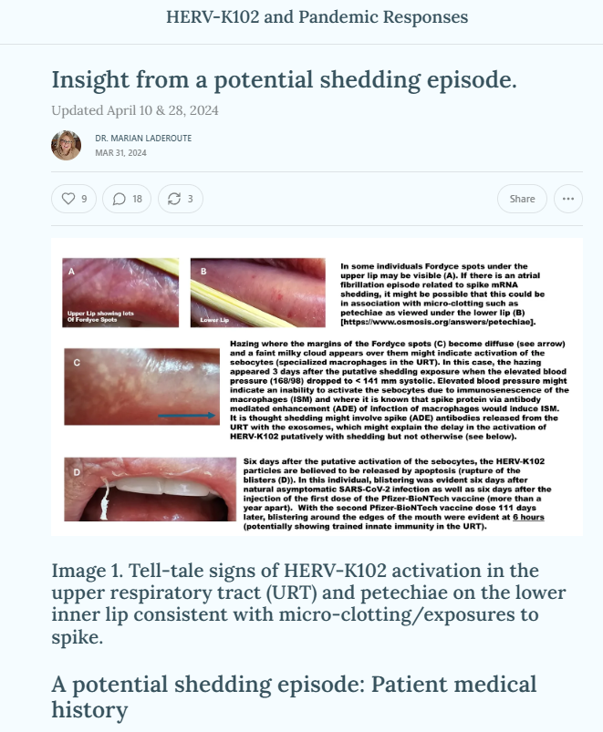
https://hervk102.substack.com/p/can-shedding-be-clinically-distinguished
I have posted a case study that provides some valuable insight on the symptoms of shedding and what might be done to minimize the risks of death.

Slide 38
Summary
Evidence is provided that shockingly suggests shedding of bioweaponized HERV-K102 exosomes from sebaceous glands in the URT may have been the single most important cause of death during the years 2021, 2022 and 2023 in terms of pandemic/excess deaths.
Generally, the iatrogenic deaths associated with vaccination (early direct vaccine deaths and later onset shedding deaths) were about 1.7 fold higher than the levels of death due to COVID-19 in 2021 to 2023.
These were stealth deaths involving a bioweaponized gene therapy shot that was inappropriately used as a vaccine. Many of these persons would not realize what was happening and would have died suddenly or at least unexpectantly since susceptibility was not per se related to older age or poorer health status. Rather, what mattered was whether or not, the person had been infected with SARS-CoV-2 prior to receiving at least 2 doses of the mRNA vaccines. This explained why the excess risk of death was found in all age groups (and relatively higher for the younger adults; ie., 25 to 54 age groups).
In addition to workers dropping out of the medical professions due to vaccine mandates/censorship, iatrogenic injuries and deaths may have contributed to the current shortage of nurses and doctors because they too were likely infected prior to mRNA vaccination which placed them at higher risk.

Slide 39
Based on my expertise these would be my recommendations for consideration:
Governments need to link the mortality rate and raw death count databases to the COVID-19 vaccination record to help determine the true risks versus benefits of the COVID-19 vaccines.
In my opinion the alleged fraud of Pfizer regarding the use of clean LNPs for clinical trials using process 1 and dirty ones for mass vaccination using process 2, could be further pursued in the courts with the purpose of recovery of taxpayer dollars to help deal with compensation to the vaccination injured or killed.
It is very clear that the risks of the mRNA gene therapy technology well exceeded the benefits in England and the use of such products on a mass scale could be considered by some as being akin to genocide. Consideration might be given to amend the Canadian Charter of Rights and Freedoms to ban forever the use of mRNA gene therapy products as “vaccines” in humans and animals.
There may be a need to examine if the mandating of vaccines and/or any other medical interventions might be viewed as unconstitutional given the risks of shedding particularly to the unvaccinated.
To keep the blood, organs and tissue supply safe it may be useful to support the further development, evaluation and validation of using HERV-K102 activation (PCR and/or by serology) as a screening tool to guard against emerging or unknown pathogens (including novel toxins like the spike protein or even endotoxin) that may be transmitted via these biologics.
Clearly there is a need to fund research on the risk of mRNA (LNPs) and cDNA (viral vector) gene therapy products for impact on the contamination of HERV-K102 particles (regardless of purpose of the gene therapy) including the issue of the isotypes of antibodies such as spike antibodies in the URT.
More research is needed on the protection mechanisms of the HERV-K102 protector system: including what besides vitamin D3 favours HERV-K102 and how the immunosenescence of macrophages inhibits its activity.

Slide 40
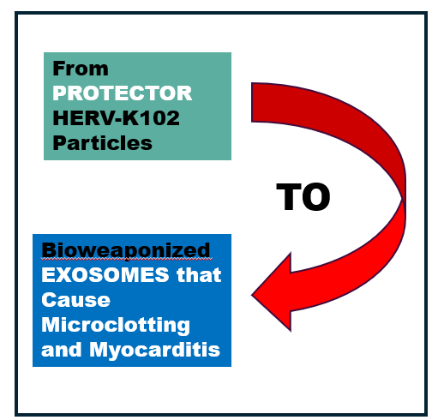
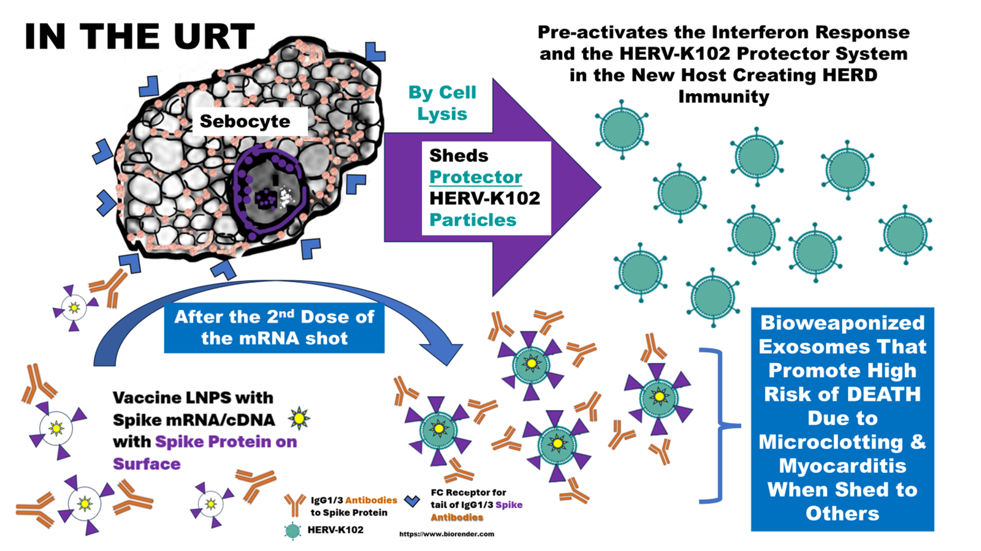
‘mRNA gene therapy vaccine’
is an oxymoron.
HERD Immunity
Deaths

Slide 42
Abstract: Note I am also submitting the “Laderoute MP, Preprint, 2023 v.2 manuscript as part of my testimony”.
Inexplicably, shedding studies were not performed nor required for the EUA or approvals of the COVID-19 mRNA gene therapy injections. In this expert witness testimony, Dr. Laderoute, who’s career since 1996 has focused on the prevention of pandemics as employed at Health Canada following the Krever Inquiry and subsequently as the Research Manager of the Blood Zoonotics Unit of the Public Health Agency of Canada, enlightens us on the issue of shedding and how it might be measured. Starting with actuarial (life insurance) data, Dr. Laderoute argues that the non-C19 over C19 mortality ratios can provide an index of the level of excess non-C19 mortality when the pandemic remains active. Using this index, she reveals that the excess non-C19 mortality in the non-vaccinated in England appears to be tightly controlled and temporally corelated with excess mortality in the vaccinated, upon the second and subsequent inoculations, which she offers is strongly suggestive of shedding (Slide 27).
To explain this phenomenon, she invokes the notion that the development of spike specific IgG1/3 antibodies in the upper respiratory tract (URT) by the second and subsequent doses of the mRNA gene therapy shots mediates the targeting of the lipid nanoparticles (LNPs) to highly specialized foamy macrophages in the URT called sebocytes. The higher the level of antibody, the more the LNPs are targeted to the sebocytes and the more the exosomes express higher levels of spike protein. Ordinarily, sebocytes constitutively produce and release the protector HERV-K102 foamy retrovirus particles (exosomes) to the mucosa surface. It is thought these shed HERV-K102 particles transmit protection to third parties to establish herd immunity in advance of emerging and pandemic viruses. However, in individuals who receive 2 or more COVID-19 mRNA gene therapy shots, the HERV-K102 protector particles putatively become contaminated with spike mRNA gene therapy sequences and become densely covered in spike protein [as shown by Bansal S et al., 2021, Slide 15 ]. Accordingly, Dr. Laderoute argues it is likely, once the bioweaponized exosomes are released by lysis as sebum, the spike IgG1/3 antibodies in the URT (which apparently do not transition to the less dangerous IgG4) bind to and render these shed exosomes very dangerous to the new host. The latter is because the exosomes covered in IgG1/3 antibody from the URT behave as immune complex bombs that bind complement, cause platelet aggregation, and strongly activate microclotting upon arrival deep in the microcirculation in the lungs of the new host and which may be implicated in Sudden Adult Death Syndrome (SADS).
The shedding numbers for England covering January 1, 2021 to May 31, 2022, as revealed by Dr. Laderoute indicates there may have been 551,048 shedding deaths where the number of COVID-19 deaths at 87,472 pale in comparison. Shockingly, over 72,000 shedding deaths may have occurred in the unvaccinated. The notion that shedding may be more lethal (551,048 deaths) than the early vaccination deaths (43,088) was corroborated by examining USA FDA VAERS data on the COVID-19 mRNA gene therapy vaccines. This demonstrated a higher fatality rate for the microclotting/myocarditis related symptoms that had symptom onset beyond 120 days than those where the symptom onset was 14 days or less (although a partial role of SARS-CoV-2 breakthrough infection could not be ruled out for the shedding deaths) (see Slide 44).
The estimates for Canada suggest while there may have been 40,281 COVID-19 deaths from 2021 to 2023, there may have been 77,645 shedding deaths, and about 7,865 early direct vaccination deaths in the first 21 days for a total of about 85,490 iatrogenic deaths POTENTIALLY caused by the COVID-19 vaccines (Slide 34). Various reasons why the shedding deaths to C19 deaths in England were higher that in Canada (2.1-fold) are provided as an appendix (see Slide 43).
By providing this expert testimony, Dr. Laderoute hopes to galvanize efforts to have the mRNA gene therapy shots banned from use as potential vaccines in humans and animals and to also outlaw vaccine mandates. As a previous chemistry and manufacturing reviewer for Health Canada, she offers an explanation in slide 45 of the significance of the difference between the Pfizer-BioNTech LNPs used for clinical trials (very clean) versus those used internationally for the inoculation of the masses (very dirty with probable high levels of endotoxin and spike protein on the exosomes, both which contribute to microclotting risks). In slide 36, on the topic of risk mitigation during pandemics, aside from ensuring optimal vitamin D levels and reversing the immunosenescence of macrophages if present, the author strongly suggests avoiding any adaptive immunity vaccines during active pandemics and refusing mRNA gene therapy products as vaccines. Finally, Dr. Laderoute also notes that had public health agencies provided real time assessments of the actual risks of the Pfizer mRNA vaccines, such as by the corrected UK ONS data (Slide 26), no country would have proceeded with the administration of the mRNA vaccines and the question of shedding would have been a moot point.

Slide 43
Appendix.
There may be multiple reasons why the shedding deaths to C19 deaths in England were higher (6.3-fold) than in Canada (1.9-fold).
First, the data for England (first 17 months of the vaccine roll-out) was shorter than the time span for Canada (36 months) and focused at a time when shedding would have been maximal.
Second, Canada used a variety of COVID-19 vaccines (a mix of cDNA adenovirus and mRNA vaccines) which would have reduced the
level of shedding whereas in the UK it was mostly the Pfizer-BioNTech vaccine from the outset.
Third, Health Canada maintains a lot release program for biologicals and Pfizer-BioNTech may have sent better quality lots to Canada (less endotoxin and/or spike protein per dose) which could explain the differences between England and Canada in the number of iatrogenic deaths and the number of shedding deaths estimated. For example, the sending of better quality (uncontaminated) products to Canada versus the USA was previously observed with the heparin recall in 2008 [Hedlund KD, et al. The heparin recall of 2008. Perfusion. 2013 Jan;28(1):61-5. doi: 10.1177/0267659112462274.].
Fourth, Canada postponed the second dose of the mRNA vaccine (up to 120 days [https://www.cbc.ca/news/health/canada-covid-19-vaccine-delay-risk-1.593913] ) for longer periods than the UK (up to 84 days [Imai N et al., Lancet Public Health, February 2023]) which may have resulted in fewer shedding deaths in 2021 in Canada.
Fifth, the population in Canada is spread over larger areas, reducing the risks of shedding encounters.
Sixth, the average pre-pandemic ASMR per 100,000 was higher in the UK (825) when compared with Canada (718) reflecting a higher intrinsic susceptibility to death [https://stats.oecd.org/index.aspx?queryid=104676].

Slide 44
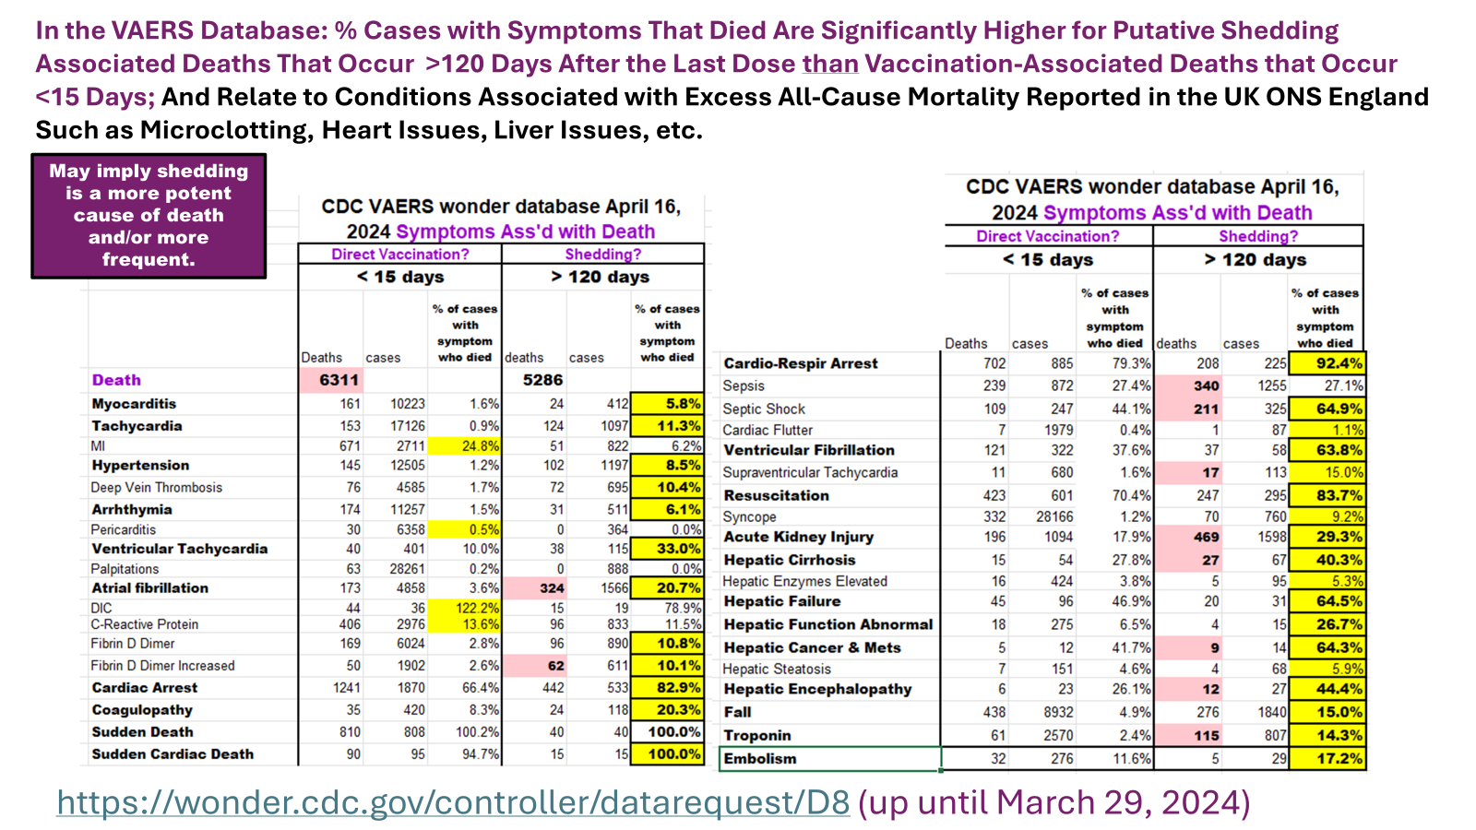
For the COVID-19 mRNA vaccines

Slide 45
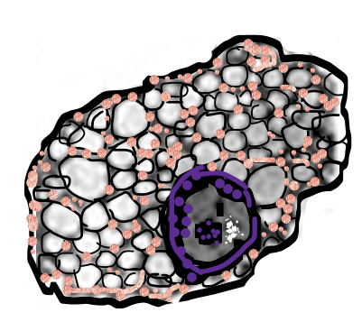







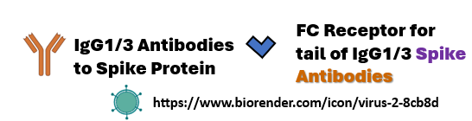
Alleged Intentional Deception & Fraud by Pfizer-BioNTech
LNPs with PCR’d spike mRNA
Used for Clinical Trials (no spike protein on the LNP surface, no or little endotoxin, no cDNAs, no SV40 sequences, no plasmids)
Sebocytes in URT
ADE Mediated
URT: Bioweaponized HERV-K102 Exosomes
DIRTY LNPs used for mass vaccinations were made in cultures of E. coli (extreme very high levels of endotoxins,# contaminated with cDNAs, plasmids and SV40 sequences)
# “It is very difficult to remove endotoxins from products”. https://www.fda.gov/inspections-compliance-enforcement-and-criminal-investigations/inspection-technical-guides/bacterial-endotoxinspyrogens

Slide 46
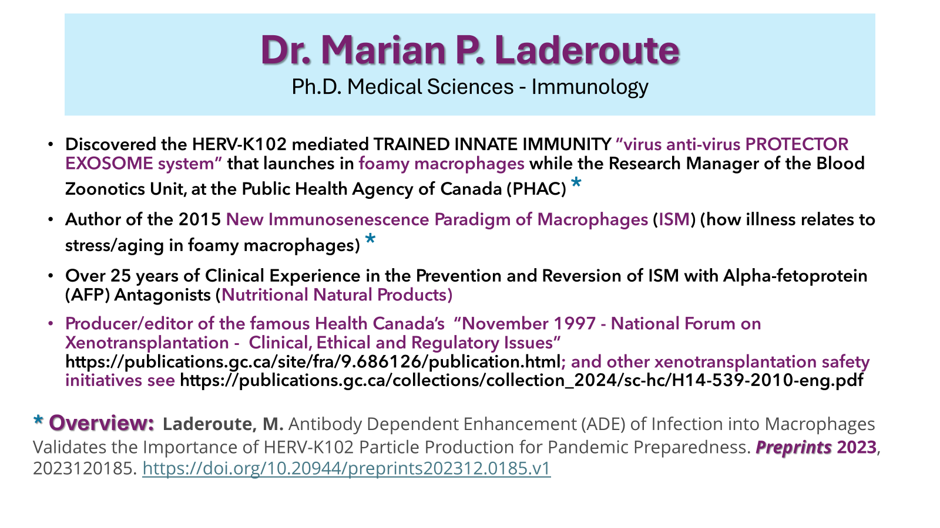

Slide 47


Slide 48
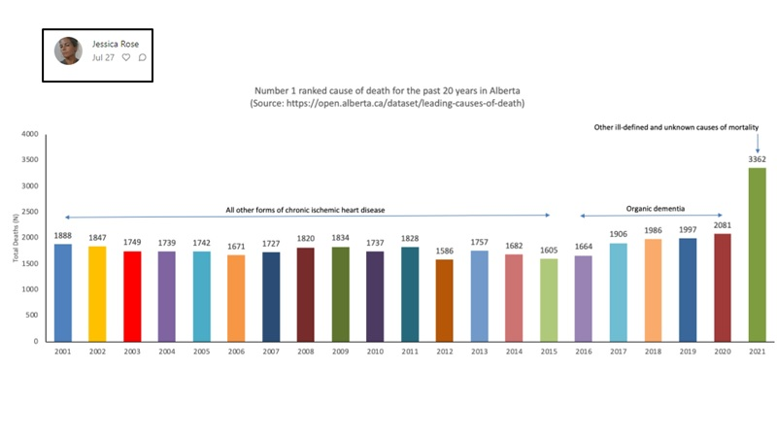
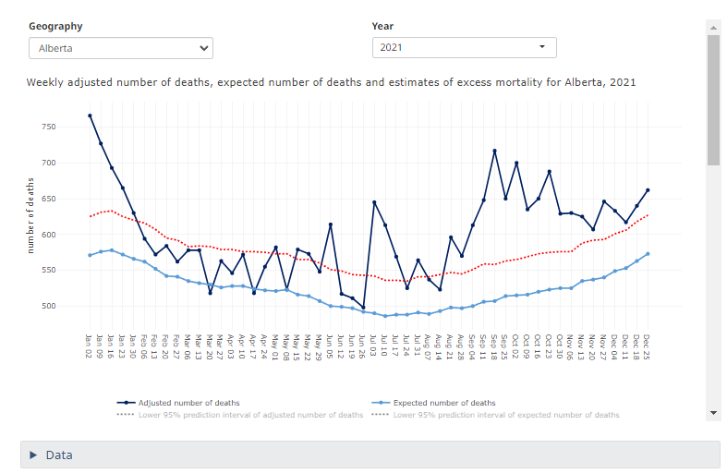
The number one cause of death in
Alberta for 2021 was “Cause Unknown”.
With major peaks in July and October 2021.
https://www150.statcan.gc.ca/n1/pub/71-607-x/71-607-x2021028-eng.htm

Slide 49
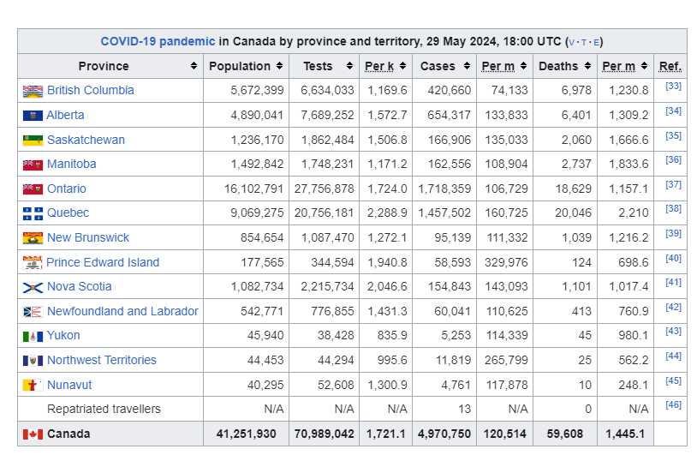
https://en.wikipedia.org/wiki/COVID-19_pandemic_in_Canada

Slide 50
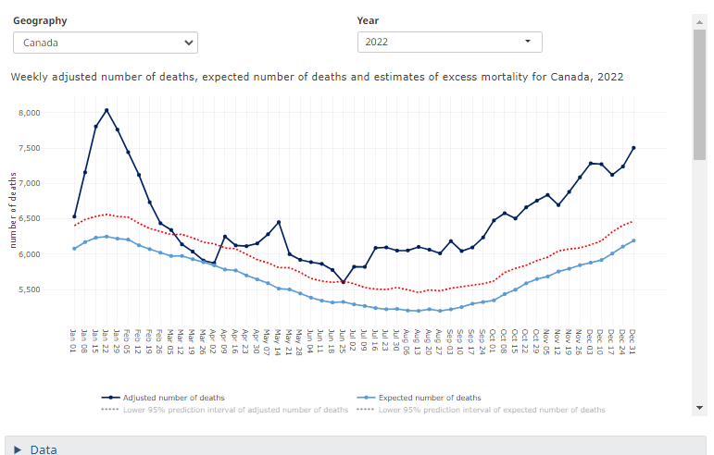
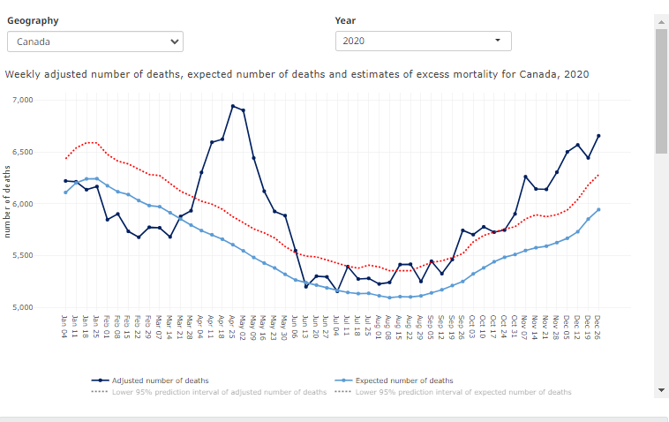
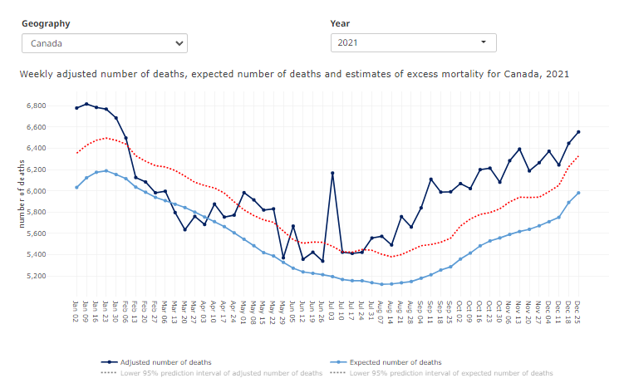
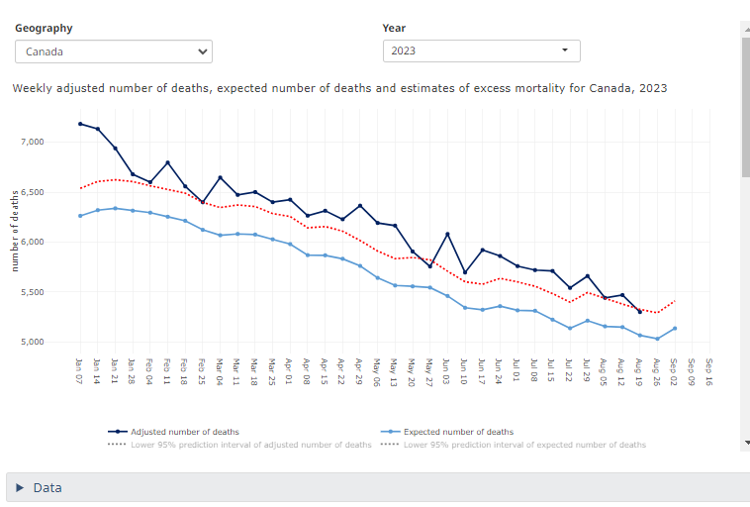
https://www150.statcan.gc.ca/n1/pub/71-607-x/71-607-x2021028-eng.htm

