Slide 2
The Brain Drain:
The Toxic Assault on our Children’s Food
Michelle Perro, MD, DHom
October 2024
www.gmoscience.org

Slide 3
Are Canadian Children Well?

Slide 4
Autism spectrum disorder: Highlights from the 2019 Canadian Health Survey on
children and youth:
1 in 50 or 2% Canadian children or 2%
30% of children aged 2-17 are obese
Asthma disproportionately affects children and youth. In 2011/12, the proportion of children and youth with asthma was 62% greater than adults (including seniors)
[PHAC CDIIF2016]

Slide 5
https://health-infobase.canada.ca/datalab/asthma-blog.html#did

Slide 7
N phosphonomethyl glycine
More than 80% of urine samples drawn from children and adults in a US health study contained glyphosate; a
weed-killing herbicide linked
to cancer.
Scientists have found this "...disturbing" and "concerning."
.
https://wwwn.cdc.gov/Nchs/Nhanes/2013-2014/SSGLYP_H.htm

Slide 8
Liver Disease Epidemic
Glyphosate Excretion is Associated With Steatohepatitis and Advanced Liver Fibrosis in Patients With Fatty Liver Disease
Mills, PJ, et al.
PMID: 30954713

Slide 9
Parts per billion?
Multiomics reveal non-alcoholic fatty liver disease in rats following chronic exposure to an ultra-low dose of Roundup herbicide
Mesnage R., et al.
PMID: 28067231
Rats administered 0.1 ppb (4 ng/kg/day daily intake Roundup)
Study over 2 years
Metabolome analysis showed lipotoxic conditions and oxidative stress

Slide 10
Liver Disease Epidemic
Nonalcoholic Fatty Liver Disease in Children
Sweeny K F and Lee CK.
PMID: 35465068
1/3 of children with obesity have NAFLD
8% of children have lean NAFLD
NAFLD can progress to NASH
NASH can progress to cirrhosis, even in children
Children are aysmptomatic
No discussion of diet or environmental factors
Increased interest in the role of the microbiome and NAFLD
A meta-analysis of current research on the role of probiotics as a treatment for NAFLD showed significant improvement (PMID: 31124558)
The prevalence of NAFLD in children is approximately 13%

Slide 11
"Children are more heavily exposed to pesticides, than adults because pound-for-pound they drink more water, eat more food and breathe more air...children have many years of future life when they can develop diseases with long incubation periods such as cancer. This is particularly a concern with the herbicide, glyphosate."
Dr. Philip Landrigan
READ MORE

Slide 13
https://www.youtube.com/watch?v=w9YcIH0YKVU

Slide 16
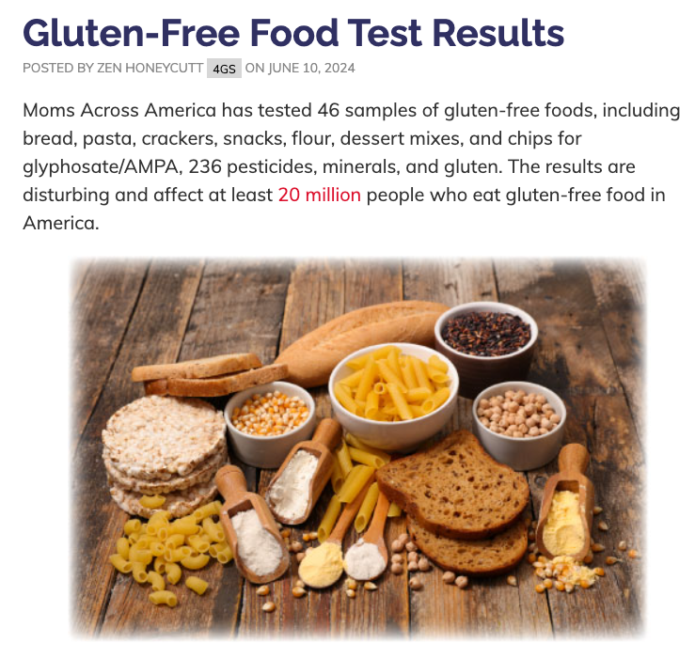

Slide 17
Add a littlehttps://www.momsacrossamerica.com/glyphosate_in_hummus_and_chickpea_products

Slide 18
https://www.ewg.org/news-insights/news-release/2018/10/roundup-breakfast-part-2-new-tests-weed-killer-found-all-kids

Slide 19
Glyphosate
01
Carcinogen
Disrupts enzymes, ie., mitochondria
Decreases serotonin and dopamine
05
08
02
Dysregulates the shikimate pathway
Causes changes in behavior in mice
06
Alters the microbiome
09
Linked to Parkinson's
03
07
Causes leaky gut
Disrupts phosphatidyl choline
10
Disrupts cytochrome p450
04

Slide 20
Glyphosate
Increases proinflammatory signals
11
Endocrine disruptor
15
12
Causes NAFLD
16
Causes metabolic changes
Causes respiratory issues in farmers
13
17
Associated with energy changes
14
Linked to genetic damage
18
Known metal chelator

Slide 21
https://drjockers.com/glyphosate-what-is-it-testing-and-detox-strategies/

Slide 22
Glyphosate and the Brain
Autism-like Behaviors in Male Juvenile Offspring after Maternal Glyphosate Exposure
Yaoyu Pu, et. al. 2021
PMID: 27957319
"Conclusions: ...that the exposure of glyphosate during pregnancy and lactation may cause ASD-like behavioral abnormalities in male juvenile offspring.”

Slide 23
Glyphosate and the Brain
"...Maternal exposure to high levels of glyphosate causes ASD-like behavioral abnormalities and abnormal composition of gut microbiota in juvenile offspring, and that increased activity of sEH might play a role in ASD-like behaviors in offspring after maternal glyphosate exposure."
Maternal glyphosate exposure causes autism-like behaviors in offspring through increased expression of soluble epoxide hydrolase (sEH)
Yaoyu Pu., et al. 2020
PMID: 32398374
sEH inhibition can improve cognitive decline, improve neuroinflammation, and help amyloid pathology (AD)
Mechanism is inhibition of brain inflammation

Slide 24
Glyphosate and the Microbiome
Glyphosate is an antibiotic
US Patent 7,771,736
Effective against Lactobacilli, Bifidobacteria, and Enterococcal species
Resistant against Clostridium species and Salmonella
Affects the microbes via the shikimate pathway; needed to make aromatic amino acids
These proteins are necessary in producing neurotransmitters

Slide 25
Leaky Gut
Leaky Brain
What happens in the gut,
doesn’t stay in the gut

Slide 26
Glyphosate and the Brain
Nearly 3000 individuals with ASD enrolled from CA Central Valley
Risk of ASD was associated with prenatal exposure to glyphosate, chlorpyrifos, diazinon, malathion, avermectin and permethrin
ASD wilth intellectual disability was highest for glyphosate exposure
Prenatal and infant exposure to ambient pesticides and autism spectrum disorder in children: population based case-control study
Ondine S Von Ehrenstein, O S, et al. 2019
PMID: 30894343
"Findings suggest that an offspring's risk of autism spectrum disorder increases following prenatal exposure to ambient pesticides within 2000 m of their mother's residence during pregnancy, compared with offspring of women from the same agricultural region without such exposure."

Slide 27
Glyphosate and the Kidney
CKD of Unknown Origin in Central America: The Case for a Mesoamerican Nephropathy
Correa-Rotter R., et al.
PMID: 24412050
An epidemic of chronic kidney disease of unknown origin emerged in Central America, India and Sri Lanka
The cause of the disease in unknown

Slide 28
Glyphosate is a
Chelator
The chelating ability of glyphosate also extends to toxic metals
Glyphosate forms stable chelates with toxic metals that are ingested in food and water or absorbed through the skin
Glyphosate-heavy metal chelates reach and damage the kidney
Accumulation can persist for years
Chelates may not be detected by common lab methods which only detect free glyphosate

Slide 29
How to Detox
From Glyphosate

Slide 30
Sulfur-rich foods
Eggs, cheese, onions, garlic
Glyphosate depletes sulfur and affects sulfate detox pathways

Slide 31
Fermented Foods &
Probiotics
Live cultures with acetobacter: Apple cider vinegar, sauerkraut, kimchi, kombucha, some cheeses, some yogurt/kefir
A study in the J of Env and Analytical Toxicology (Dec. 2014): A charcoal-sauerkraut juice combination and humic acids reduced glyphosate excretion in the urine and led to improved health of the animals.
Sandor Katz (https://www.youtube.com/watch?v=TQMJFfOFse4)

Slide 32
Organic!
Glyphosate binds metals, particularly manganese
Mn important for mitochondrial function, gut health, bone development, and cognition

Slide 33
Plant Extracts
Support sulfate transport
Barberries
Dandelion greens
Burdock root

Slide 34
Remember...
What 's tested is not what's in the product
Dose does not make the poison: Non-linear effects
No studies on expsoures to multiple pesiticides

Slide 36
Glyphosate and Aluminum
Mechanism
Empirical Data Confirm Autism Symptoms Related to Aluminum and Acetaminophen Exposure
Seneff S., et al. 2012
https://doi.org/10.3390/e14112227
Glyphosate promotes growth of C. diff which produces p-cresol in gut
P-cresol promotes Al uptake by cells (and is a biomarker for ASD)
P-cresol is involved in CKD which leads to Al retention and cognitive changes
Glyphosate cages Al to promote entry as a calcium mimetic

Slide 38
How to Clear Aluminum
Preventive effect of Coriandrum sativum
(aka cilantro or Chinese parsley) on aluminum deposition in ICR Mice
Aga M., et al.
PMID: 11535365
View More

Slide 39
Cilantro and Chlorella

Slide 41
We can do better!!

Slide 42
Canadian School Lunch

Slide 43
What to do?

Slide 44
Regain the Brain Terrain

Slide 45
Scientists link ultra-processed food to increased dementia risk
Li H., et al
DOI:10.1212/WNL.0000000000871
Ultra-processed food (UPF)
People who ate the highest amounts had the greatest risks
Large study from the UK
72,000 people, 55 years and older that did not have dementia at the start of the study, followed for 10 years.
An increase of 10% in daily intake of UPF increased dementia risk by 25%
Small and manageable changes make a difference
Complicated; challenge in categorizing foods as unprocessed, minimally processed and ultra-processed
https://www.foodnavigator.com/Article/2022/07/29/scientists-link-ultra-processed-food-to-increased-dementia-risk

Slide 46
Glyphosate: Coup de Grace
Glyphosate infiltrates the brain and increases pro-inflammatory cytokine TNFα: implications for neurodegenerative disorders
Winstone JK, et al.
DOI: https://doi.org/10.1186/s12974-022-02544-5
Glyphosate crosses the blood-brain barrier into the brain
It increases levels of TNF⍺; has a dual role, enhancing immunity to protect the brain
When dysregulated, neuroinflammation can result (ASD, AD)
Glyphosate also increases the production of soluble beta amyloid (Aβ); reduces viability of neurons
? of expression of genes related to neurodegenerative disease
https://gmwatch.org/en/106-news/latest-news/20080

Slide 47
Glyphosate: Coup de Grace
Urinary Glyphosate, 2,4-D and DEET Biomarkers in Relation to Neurobehavioral Performance in Ecuadorian Adolescents in the ESPINA Cohort
Briana Chronister, et al. 2023
DOI: https://doi.org/10.1186/s12974-022-02544-5
Glyphosate was detected in 98 percent of participants
2,4-D was detected in 66 percent of participants
Higher amounts of 2,4-D in urine were associated with lower neurobehavioral performance (attention/ inhibitory control, memory/learning, and language)
Glyphosate concentration in urine was associated with lower scores in social perception
DEET metabolites were not associated with neurobehavioral performance

Slide 48
www.organicvalley.coop/blog/kendra-klein-reducing-exposure-to-pesticides/

Slide 49
Glyphosate

Slide 51
Toxic Metals in Infant Formula Study
01
04
40 samples tested - aluminum, arsenic, cadmium, lead, mercury
The source: corns syrup solids and vegetable oils
02
05
Organic, conventional, US, abroad, cow/goat
Few studies on toxic synergistic effects of metals/pesticides
03
06
Aluminum in 100% - 4,000-40,000 times higher than other metals
Enfamil Soy tested the worst
04
Lead in 100% of the samples

Slide 52
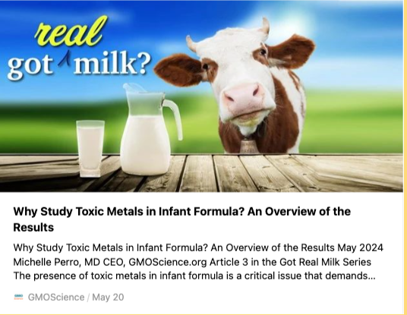

Slide 54
GMO Soybean Oil
Effect of Genetically Modified Soybean Oil Consumption on Biochemical and Histological Changes of Liver and Kidney in Rats
Horyie Taheri, et al. 2024
https://doi.org/10.34172/ijdrc.2024.e11
90-day treatment with transgenic soy-based oil caused significant organ changes in the liver and kidneys of rats.

Slide 55
More research
????????
We are solutionaries

Slide 61
Coming
Soon

