Slide 1
Testimony by Dr. Paul Thomas MD

Slide 2
Paul Thomas, M.D. CV / Biography
BA Biology: University of the Pacific 1979
MS Biology: University of the Pacific 1981
MD Dartmouth Medical School 1985
Completed 3-year Pediatric Residency (UCSF & UCSD) 1988
Teaching Residents and Medical Students (Associate Professor OHSU) 1988-1993
Private Practice (Westside Pediatrics) 1993- 2008
Owner / Pediatrician of Integrative Pediatrics 2008-2022
Board Certified Pediatrician 1990 – 2020
Board Certified Addiction Medicine 2010 – 2020
Educator 1988 - present

Slide 3
Author:
“The Vaccine-Friendly Plan” 2016,
“The Addiction Spectrum 2018”
“VAX FACTS: What You Need to Know if you are Considering Vaccinating Your Child” 2024.
Publications:
“Acute exposure and chronic retention of aluminum in three vaccine schedules and effects of genetic
and environmental variation,”
“Relative Incidence of Office Visits and Cumulative Rates of Billed Diagnoses Along the Axis of Vaccination.”
"Vaccine Practice Payment Schedules Create Perverse Incentives for Unnecessary Medical Procedures
– at What Cost to Patients?
Host of Shows:
1. “With the Wind: Science Revealed” covering COVID, childhood vaccines, and health and wellness
at www.doctorsandscience.com.
2. “Good Morning CHD: Pediatric Perspectives”
Coach and Educator https://www.kidsfirst4ever.com

Slide 4
DISCLAIMER
Dr Paul is retired and not licensed
Nothing presented is intended to diagnose or treat
Consider this information as educational and …
Part of your informed consent process regarding vaccines.
This Testimony answers the question:
ARE CHILDREN SAFE IN CANADA?

Slide 5
What We Are Told – THE LIES…
Vaccines are Safe and Effective
Vaccines are extensively tested for safety
Safety testing uses a control group
VAERS & post licensure screening would pick up danger signals
Safety testing looks at key health outcomes
Serious side effects are 1/million
Without vaccines we would go back to the dark ages
The entire schedule is safe all the time for all children
Kids can handle 10,000 antigens (vaccines) at once
You can vaccinate when children are sick
The amount of aluminum in vaccines is harmless (less than in formula).
Vaccine ingredients are safe.
Vaccinating is being responsible for the Greater Good
Vaccinated Children are healthier than unvaccinated children. Vaccinate to protect grandma and the vulnerable.

Slide 6
Did you Know – THE FACTS…
Every childhood vaccine kills more children than the diseases for which we vaccinate. Effectiveness is often zero.
Safety testing is virtually non-existent due to several tricks:
There is NEVER a control group using saline placebo
VAERS picks up at best 1% of danger signals
Safety testing looks at limited preselected health measures (often insignificant) – never all health outcomes
Serious side effects are generally in the 5-10% range with most children being adversely affected (not recognized)
Flush toilets and refrigeration ended the infectious disease “dark ages”
The entire schedule has never been tested for safety & the CDC, FDA, Public Health, etc. have never done vaxxed/un-vaxxed
It is the toxins/ adjuvants in the vaccines & immune activation that cause the harm (not the antigens)
Vaccinating when children are sick is dangerous
0.1 – 0.3 % of ingested aluminum is absorbed making injected aluminum (100% absorbed) especially dangerous
Vaccine ingredients are known to be dangerous.
Vaccinating is being responsible for the Greater Good is a LIE unless depopulation is your agenda.
Vaccinated Children are 4-8X sicker than unvaccinated children.

Slide 7
Our Children are Sick
54% percent of American children are chronically ill
13% of America’s children are in special education
1/6 children has a developmental disorder
Millions with allergies, asthma & deadly peanut allergies
11% have attention deficit hyperactivity disorder (ADHD)
15,000 diagnosed with cancer annually
1/35 has autism
Infant mortality (SIDS, SUDI etc.) in America highest of high-income countries
https://childrenshealthdefense.org/campaign-restore-child-health/

Slide 8
Autism Prevalence USA (CDC Data)
1 in 36
1 in 59
1 in 68
1 in 88
1 in 125
1 in 110
1 in 110
1 in 110
1 in 1,000
1 in 10,000

Slide 9
CANADA Childhood Vaccines (36 by 18 mos.)
already have if they are 6 years old: Annual flu shot PLUS:
2 months old
DTaP-HB-IPV-Hib: Diphtheria, Tetanus, Pertussis (Whooping Cough), Hepatitis B, Polio, Haemophilus Influenzae type B (Hib)
Men-C-C: Meningococcal Disease
Pneu-C-13: Pneumococcal
Rota: Rotavirus
4 months old
DTaP-HB-IPV-Hib: Diphtheria, Tetanus, Pertussis (Whooping Cough), Hepatitis B, Polio, Haemophilus Influenzae type B (Hib)
Pneu-C-13: Pneumococcal
Rota: Rotavirus
6 months old
DTaP-HB-IPV-Hib: Diphtheria, Tetanus, Pertussis (Whooping Cough), Hepatitis B, Polio, Haemophilus Influenzae type B (Hib)
12 months old
Men-C-C: Meningococcal Disease
MMR: Measles, Mumps, Rubella
Pneu-C-13: Pneumococcal
Var: Varicella (Chickenpox)
18 months old
DTaP-IPV-Hib: Diphtheria, Tetanus, Pertussis (Whooping Cough), Polio, Haemophilus Influenzae type B (Hib)
4-6 years
DTaP-IPV: Diphtheria, Tetanus, Pertussis (Whooping Cough), Polio
MMRV: Measles, Mumps, Rubella, Varicella (Chickenpox)

Slide 10
VACCINE-FRIENDLY PLAN DATA Integrative Pediatrics 2008 - 2015
Approach # Autism/ASD Lost Dx
Group 1 V-F PLAN 1098 0 3
Group 2 No Vax. 238 0 0
Group 3 Most Vax. 894 15 (1/60) 5

Slide 11
https://www.mdpi.com/1660-4601/17/22/8674/pdf

Slide 13
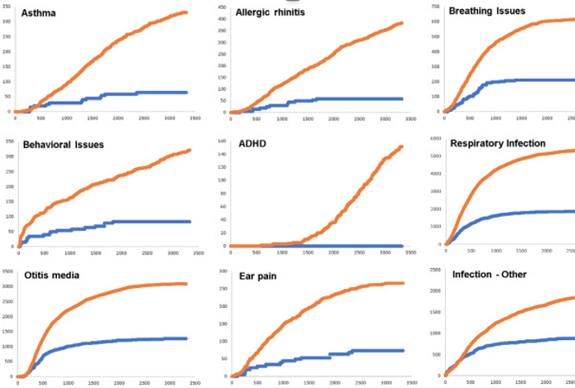
Vaccinated (ORANGE) Unvaccinated (BLUE)
The Vaccinated Followed the Vaccine-Friendly Plan!

Slide 14
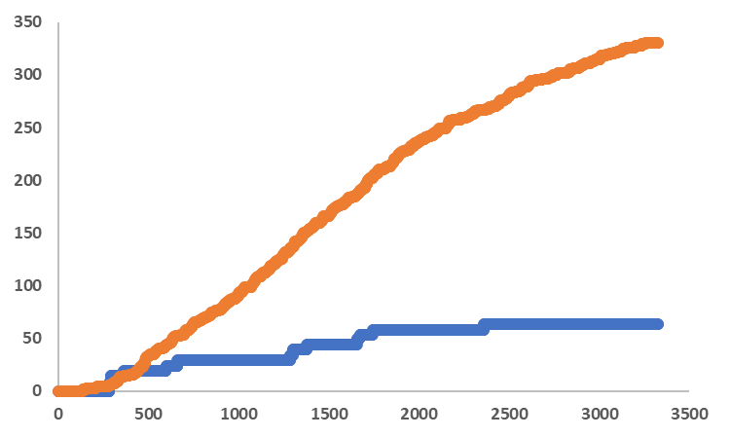
Asthma Vaccinated
Asthma Unvaccinated
Cumulative
Office Visits
# Office Visits
Days of Life

Slide 15
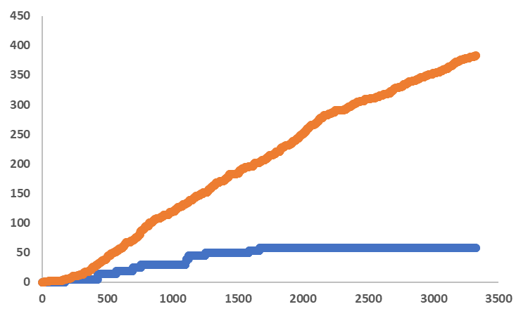
Allergic Rhinitis Vaccinated
Allergic Rhinitis Unvaccinated
Cumulative
# Office Visits

Slide 16
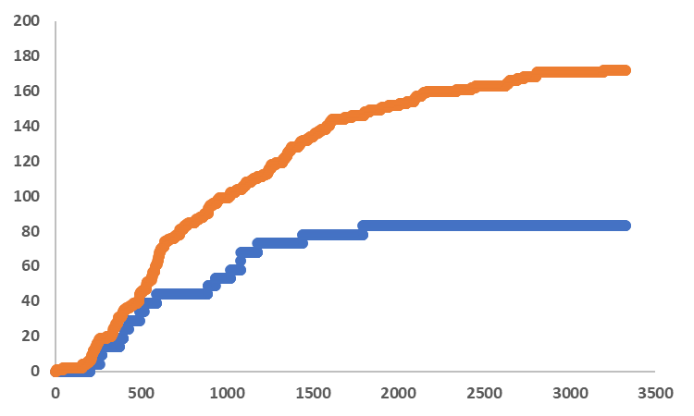
Urticaria Vaccinated
Urticaria Unvaccinated
Cumulative
# Office Visits

Slide 17
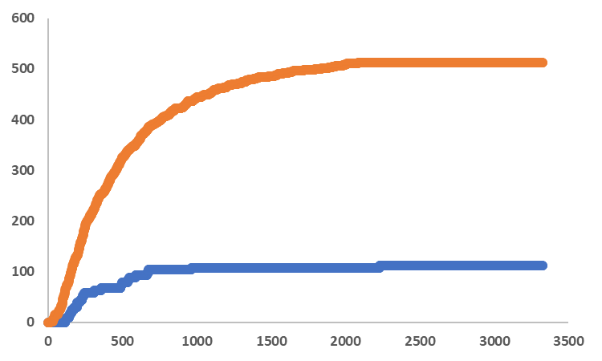
Eczema Vaccinated
Eczema Unvaccinated
Cumulative
# Office Visits

Slide 18
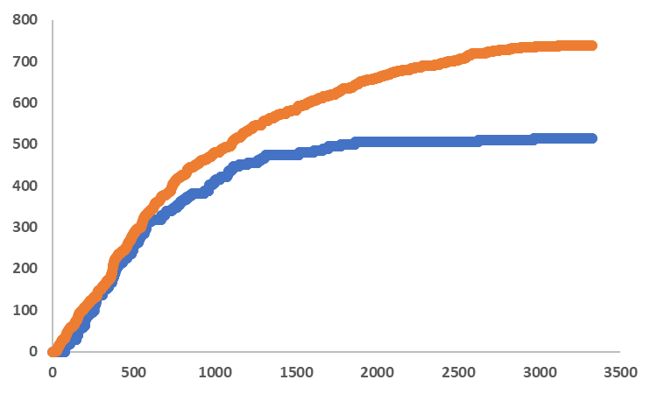
Dermatitis Vaccinated
Dermatitis Unvaccinated
Cumulative
# Office Visits

Slide 19
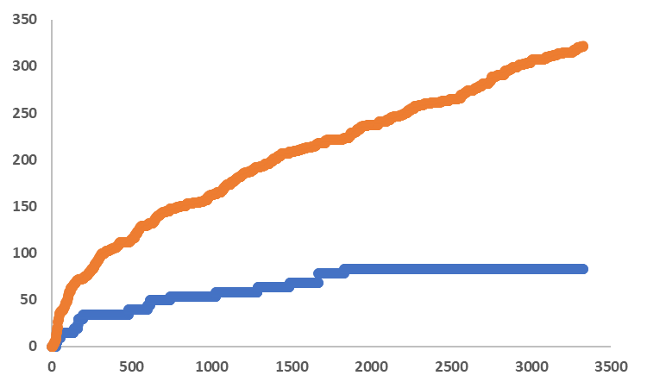
Behavioral issues Vaccinated
Behavioral issues Unvaccinated
Cumulative
# Office Visits

Slide 20
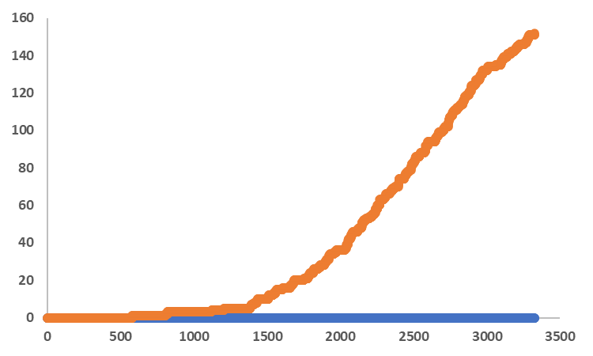
ADHD Vaccinated
ADHD Unvaccinated Unvaccinated
Cumulative
# Office Visits

Slide 21
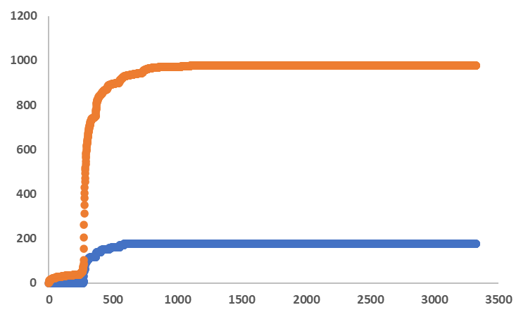
Anemia Vaccinated
Anemia Unvaccinated
Cumulative
# Office Visits

Slide 22
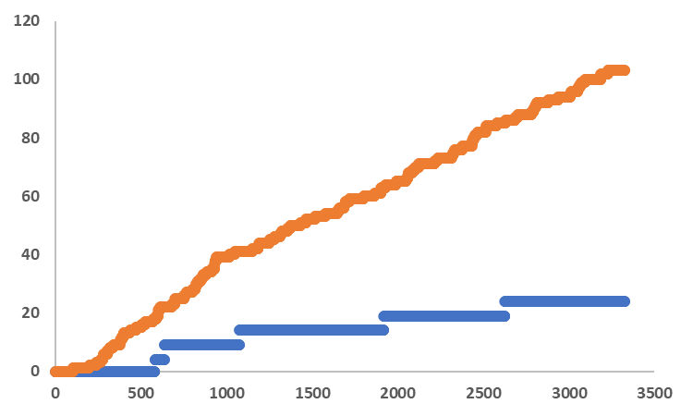
Sinusitis Vaccinated
Sinusitis Unvaccinated
Cumulative
# Office Visits

Slide 23
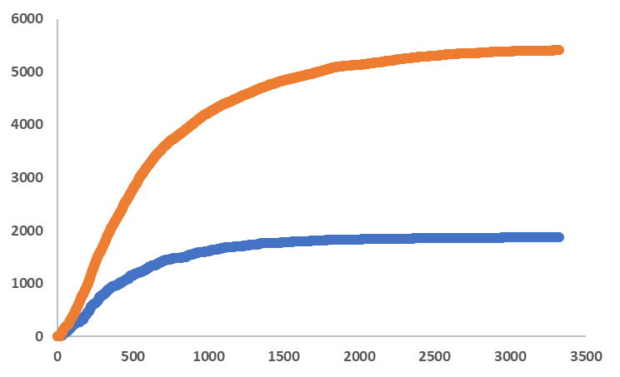
Respiratory infection Vaccinated
Respiratory infection Unvaccinated
Cumulative
# Office Visits

Slide 24
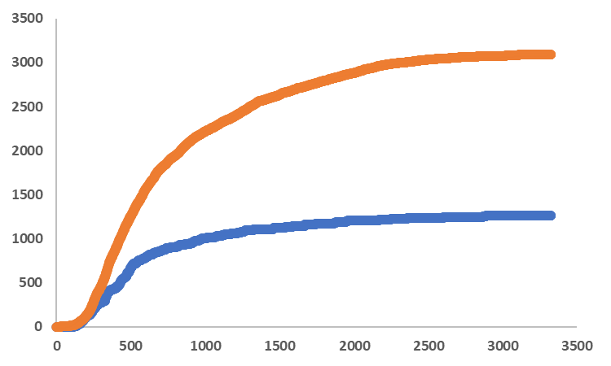
Otitis media Vaccinated
Otitis media Unvaccinated
Cumulative
# Office Visits

Slide 25
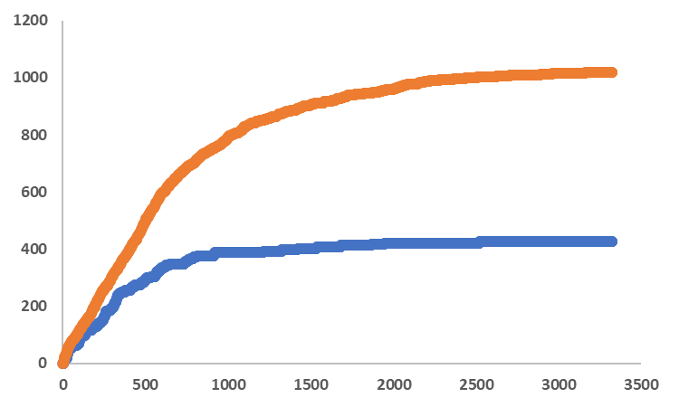
Conjunctivitis Vaccinated
Conjunctivitis Unvaccinated
Cumulative
# Office Visits

Slide 26
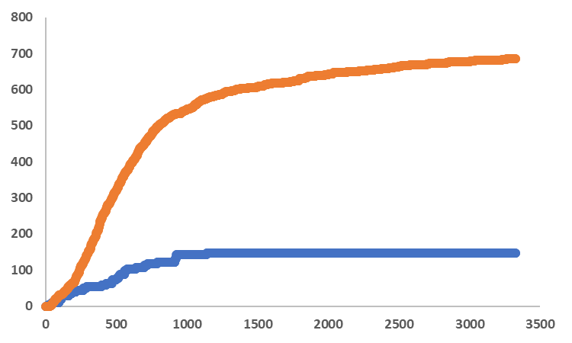
Gastroenteritis Vaccinated
Gastroenteritis Unvaccinated
Cumulative
# Office Visits

Slide 27
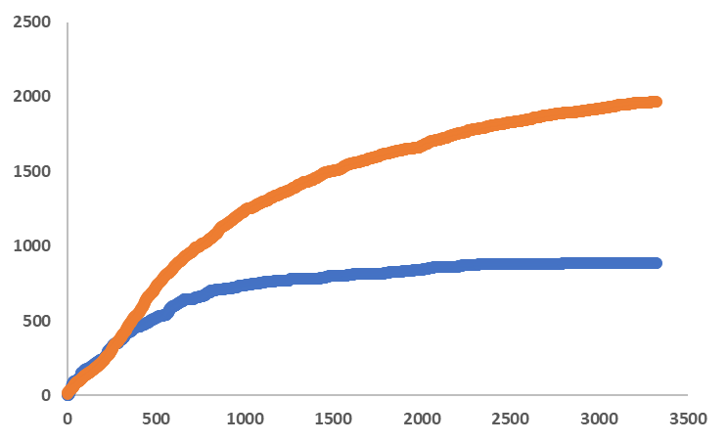
Infection - other Vaccinated
Infection - other Unvaccinated
Cumulative
# Office Visits

Slide 29
How many entirely unvaccinated “controls” in the USA? 99.74% of Americans in 2020 had been exposed to vaccines. 0.26% unvaccinated
The control group!
Number of American States Surveyed: 48 a total of 1,482 qualified (unvaccinated post-birth) parties were surveyed. The only two (2) States that were not surveyed, were Iowa and Mississippi.
Total Surveyed (All Countries Sampled): 1,544
thecontrolgroup.org

Slide 34
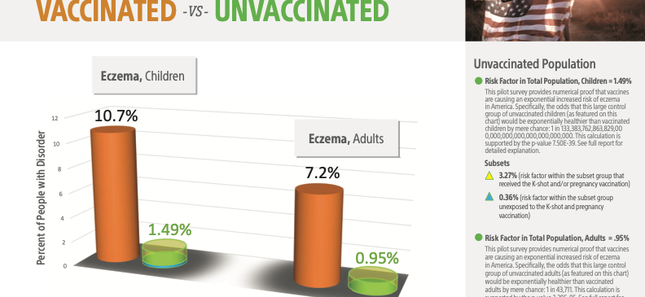

Slide 35
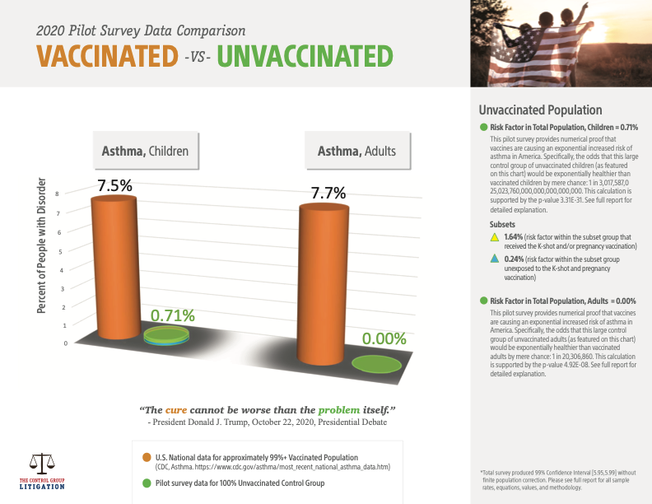

Slide 36
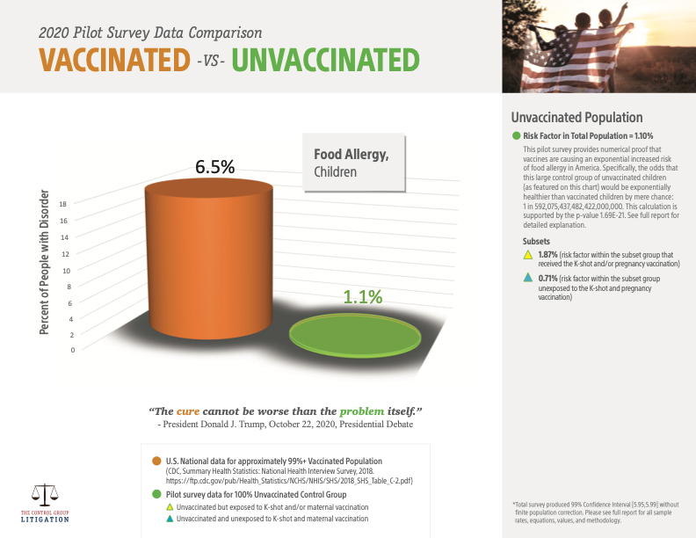

Slide 40
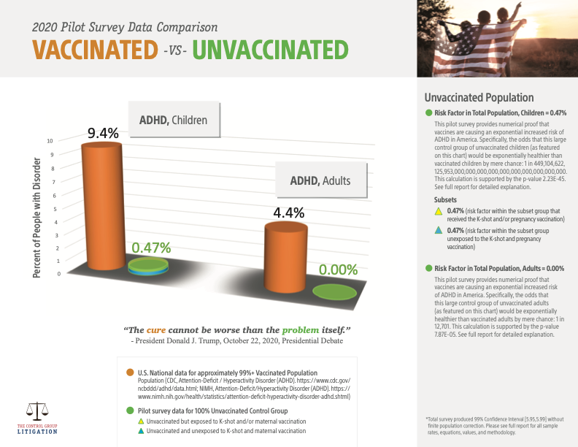

Slide 46
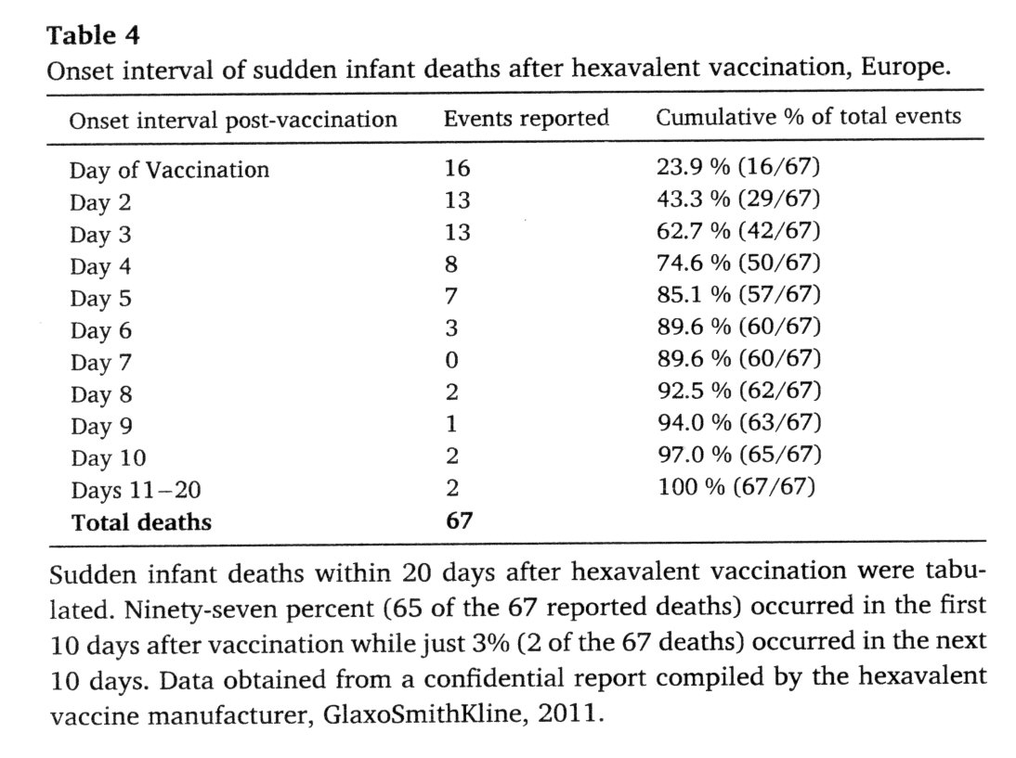
Confidential Report by Vaccine Manufacturer
97% of sudden infant deaths occurred in the first 10 days.
Just 3% occurred
in the next 10 days
Copyright © NZM. All Rights Reserved.

Slide 47
Vaccinations =
INFANT DEATHS
Between 1990 and 2019,
2,605 infant deaths were reported
in VAERS, 78.3% of these deaths
occurring within a week of vaccination!

Slide 48
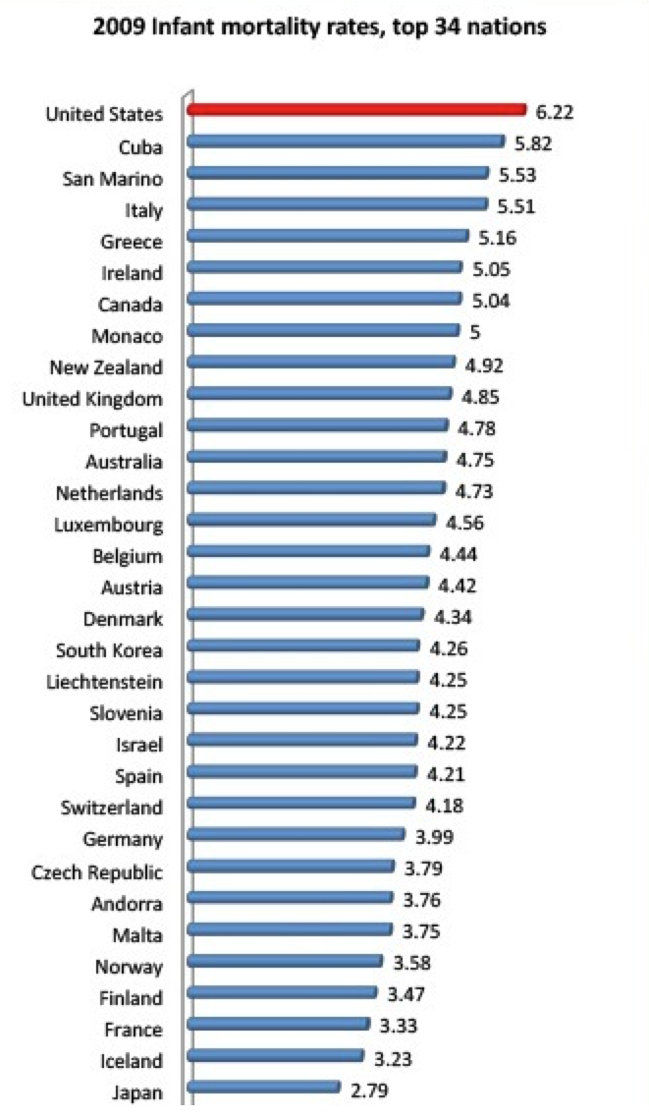

Slide 49
Infant Mortality - Number of Vaccines

Slide 51
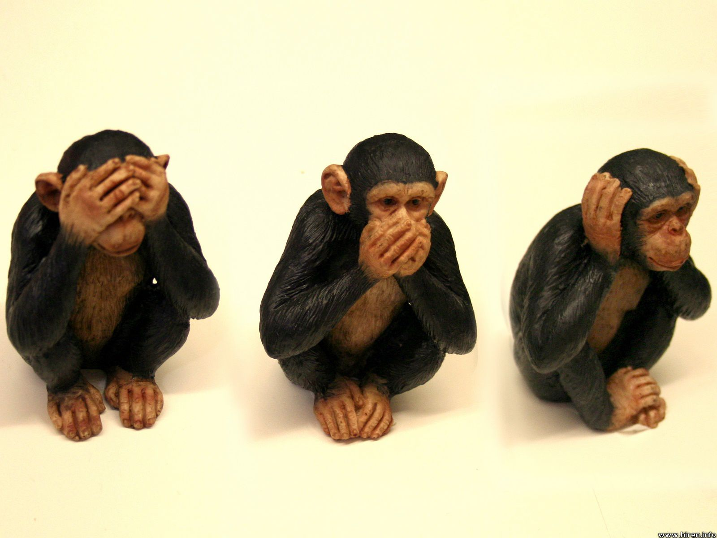
OTHER VAXXED – UNVAXXED STUDIES
This Photo by Unknown Author is licensed under CC BY

Slide 58
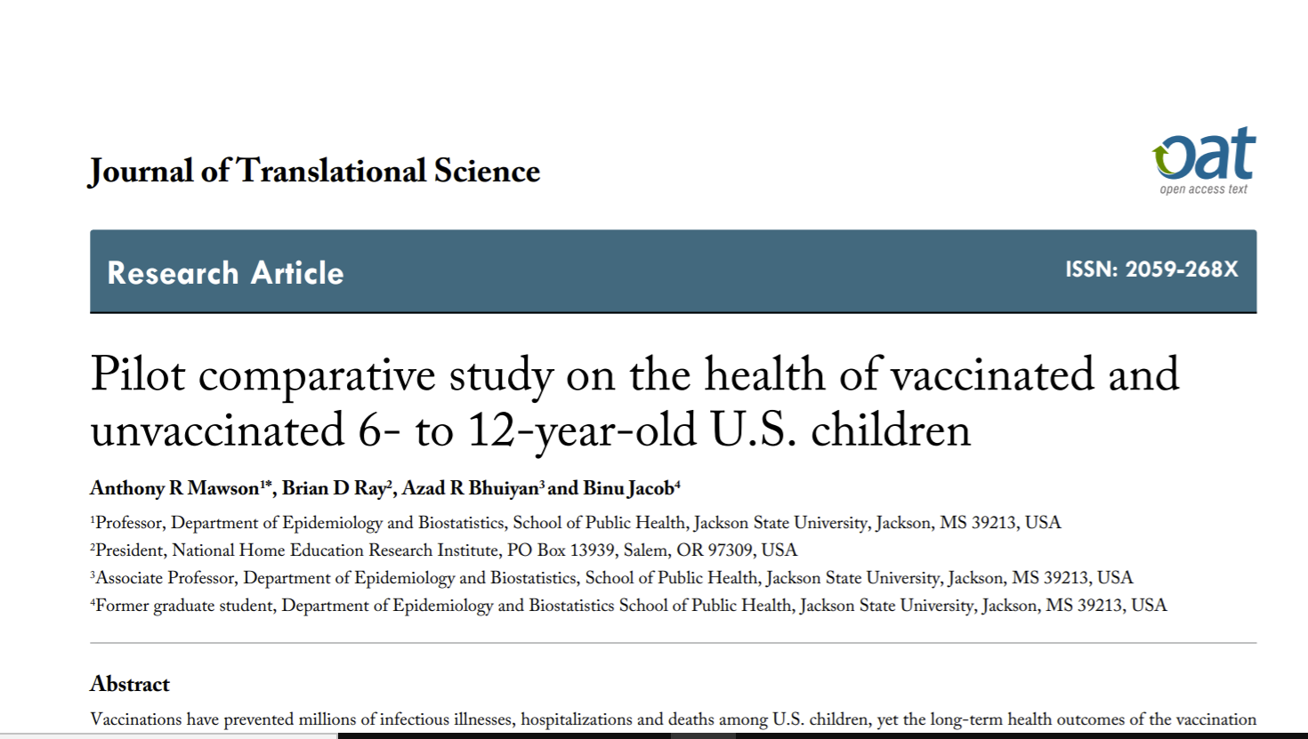
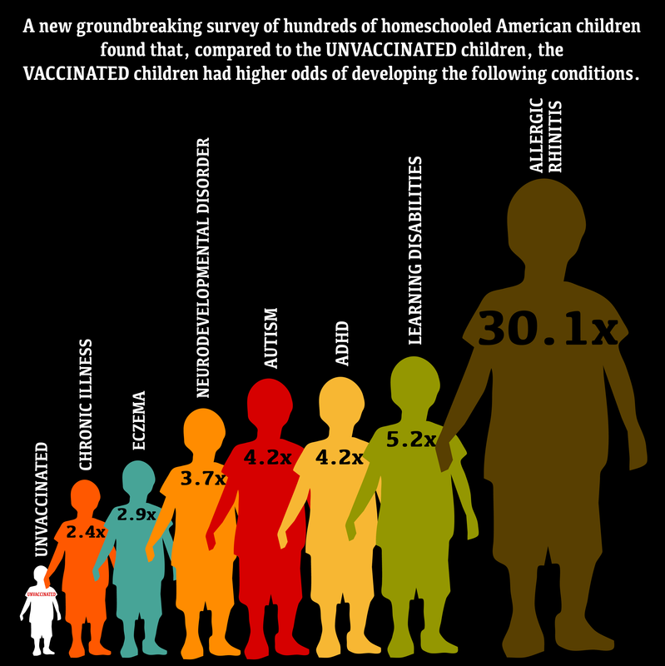
VAXXED-UNVAXXED
Relative rates of medical conditions for vaccinated children when compared to unvaccinated children.

Slide 59
Health Outcomes of Vaccinated versus Unvaccinated Children Brian Hooker & Neil Miller
Diagnosis | Vaccinated Cases/Total | Unvaccinated Cases/Total | Odds Ratio (95% CI) | P-value
Developmental Delay | 153/1407 (10.9%) | 34/630 (5.4%) | 2.18 (1.47 – 3.24) | 0.0001
Asthma | 67/1412 (4.7%) | 7/629 (1.1%) | 4.49 (2.04 – 9.88) | 0.0002
Ear Infection | 324/1116 (29.0%) | 104/533 (19.5%) | 2.13 (1.63 – 2.78) | <0.0001
Gastrointestinal Disorder | 55/1382 (4.0%) | 18/619 (2.9%) | 1.47 (0.84 – 2.57) | 0.17
Head Injury | 93/1398 (6.7%) | 31/627 (4.9%) | 1.26 (0.82 – 1.94) | 0.29
https://journals.sagepub.com/doi/pdf/10.1177/2050312120925344

Slide 60
Hooker-Miller, Vaccinated vs. Unvaccinated (2021 study)
Table 5. Fully vaccinated children vs. unvaccinated children
All p-values are
highly significant.
• Vaccinated children were significantly more likely than unvaccinated children to develop adverse health conditions.
DOI: 10.15761/JTS.1000459
Copyright © NZM. All Rights Reserved.

Slide 61
Correlation does NOT equal Causation
Statistical, epidemiological studies cannot prove causation!
Causation:
Event follows the vaccine
Numerous reports and studies document the same occurrence
There is a plausible mechanism (direct toxicity & Immune activation)

Slide 62
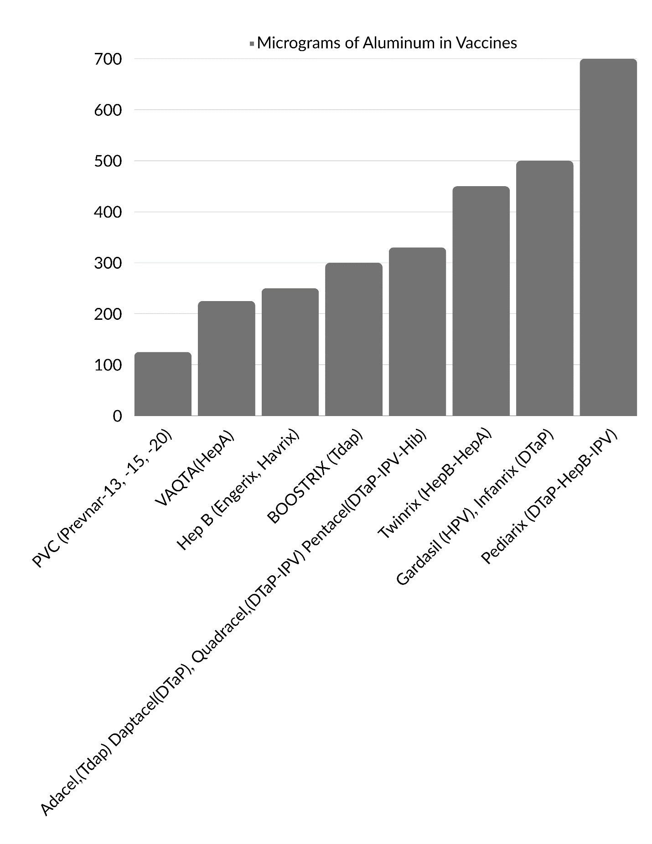
HOW MUCH ALUMINUM
Is in the childhood vaccines?

Slide 63
How much Aluminum is Safe to Inject?
1. FDA limit for parenteral aluminum (IV/IM) at 5 micrograms/Kg/d
¼ of injected aluminum is present at 2 weeks.
Half life of this aluminum present at 2 weeks is 7 years
Hepatitis B vaccine in first month of life = 300% increased autism
http://www.ncbi.nlm.nih.gov/pmc/articles/PMC3208446/
http://www.nejm.org/doi/full/10.1056/NEJM198702053160602
http://www.ncbi.nlm.nih.gov/pubmed/7779460
Wu et.al. 2013 “Chronic hepatitis B infection in adolescents who received
primary infantile vaccination”.

Slide 64
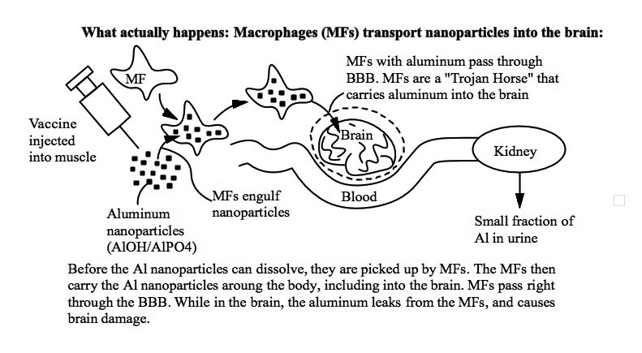
MACROPHAGES (MFs) TRANSPORT
Vaccinepapers.org

Slide 66
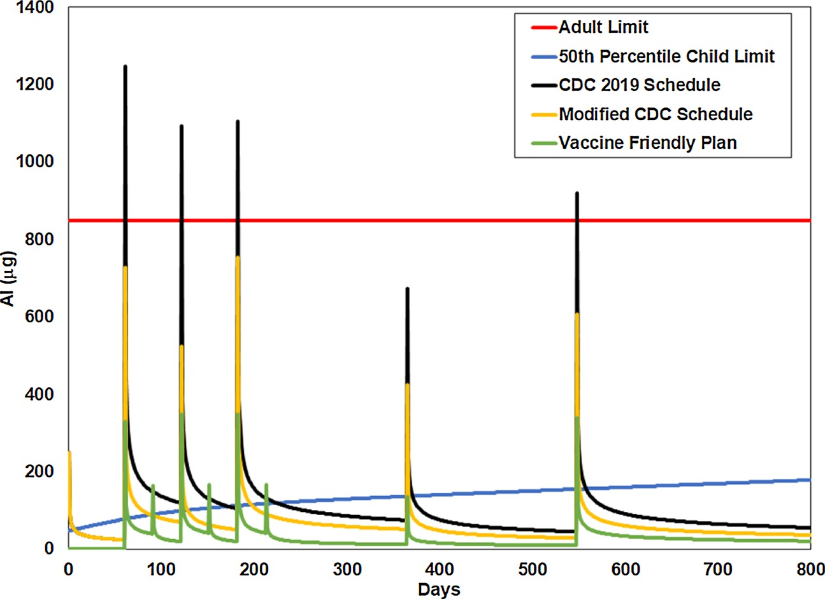
Acute exposure and chronic retention of aluminum in three vaccine schedules
and effects of genetic and environmental variation
https://www.sciencedirect.com/science/article/pii/S0946672X19305784?via%3Dihub

Slide 67
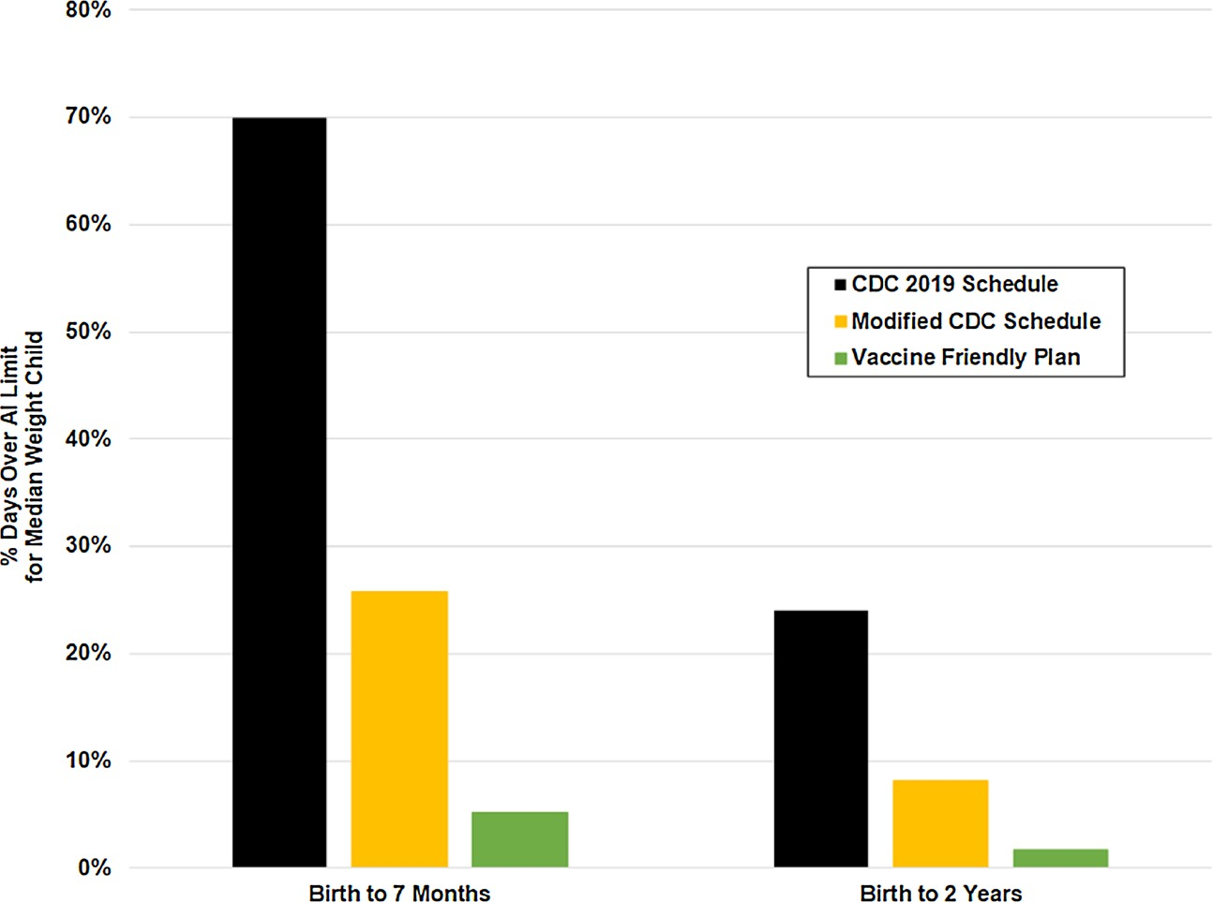
Fig. 3. Percent Days Over aluminum Limit (%alumTox) Birth to 7 Months and 2 Years.
https://doi.org/10.1016/j.jtemb.2019.126444

Slide 68
IMMUNE ACTIVATION and BRAIN INJURY
autism (and schizophrenia and epilepsy).
(30% of autistics have epilepsy).
autism, epilepsy, schizophrenia, depression, attention-deficit disorder and other mental illnesses.
Infection during pregnancy has been associated with an increased incidence of autism and schizophrenia
Immune activation affects brain development by shifting the Th1/Th2 immune balance increasing interleukin-6 (IL-6) cytokine expression
“The presence of neuro-inflammatory changes…suggests that this may be a common pathogenic mechanism in some patients with autism.” - Dr Vargas et al. of Johns Hopkins U., 2005 (PMID: 15546155) 9
Notes:
Causatoin is well establieshed in the literature Let’s talk about the mechanism of how autism develops in the human body. Early on we had studies that show that immune activation – say from viral infections can affect the developeing brain of the fetus. We know that infection is associated with IL-6 and that IL-6 can have severe impact on the devekoping brain. It makes sense bc ) Proper brain development is critically dependent on the right balance of cytokines which are highly regulated in the brain. If during brain development don’t have right level of cytokines, the brain will be dmaged/ defective. In the sstudies of animals, symptoms maps perfectly to autism . Pre pulse inhibition has to do with regulation of stimulus input – down regulates so not as sensitive (causes synapses to be too stimulating where startle reflex is normally abated, autistics and schizo startle all the time with limited regulation) ; w iL-6 exposure, causes pverproduction of stimulation of synapses

Slide 69
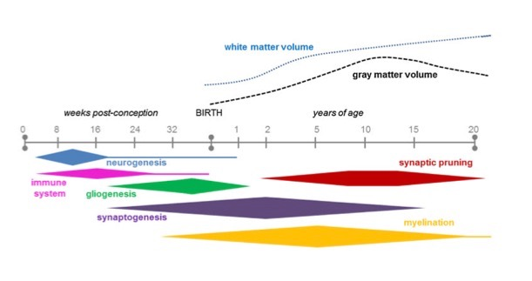
SYNAPTOGENESIS
Notes:
Notice synpatogeneisis is most intese during first year

Slide 70
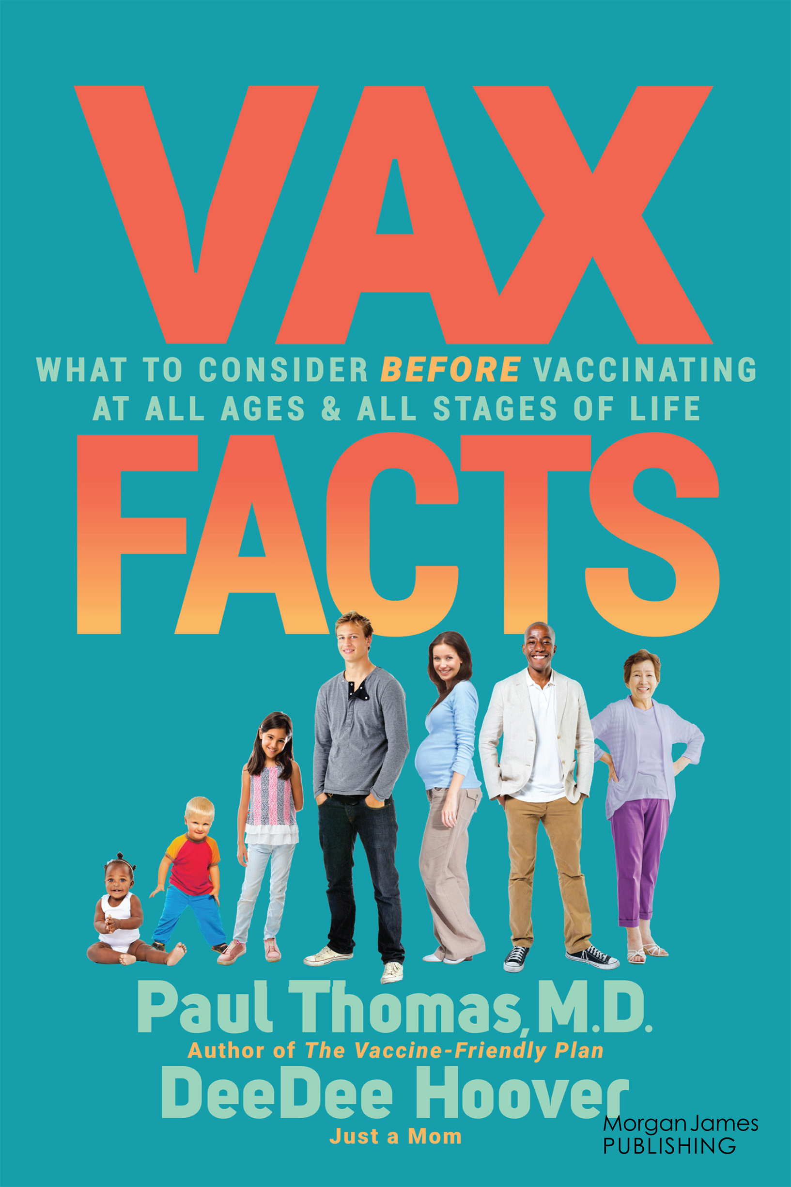
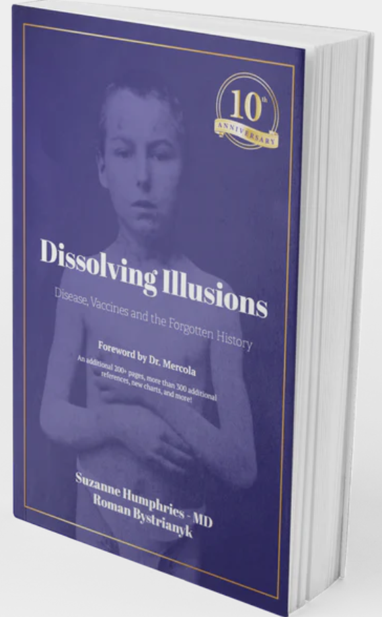
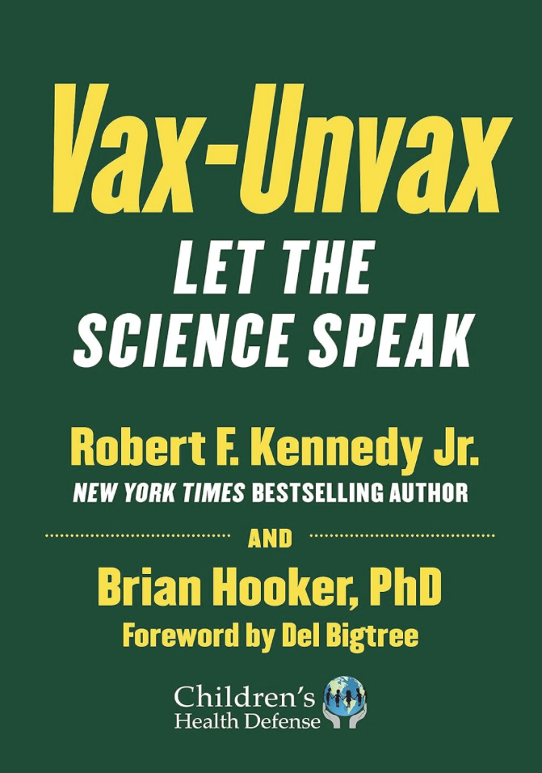
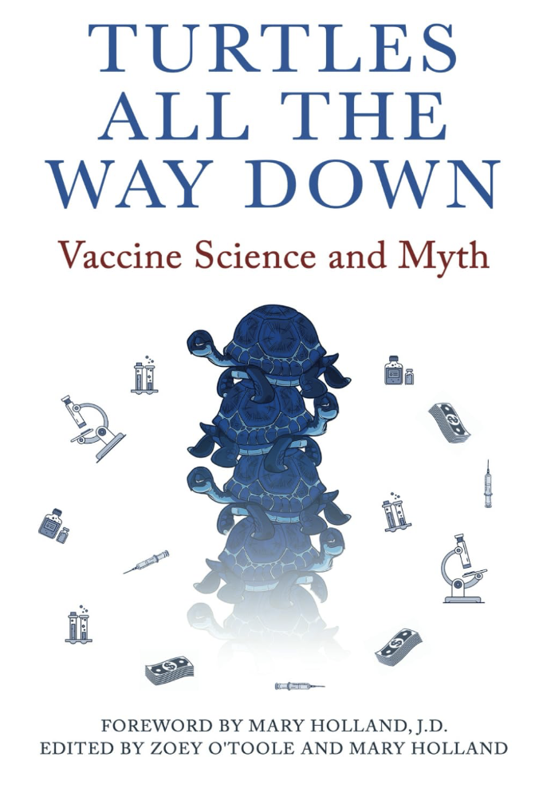
ALUMINUM
Must own books that illustrate beyond a doubt:
We don’t need to fear the diseases for which we have vaccines
No vaccines had proper safety testing, or saline placebos
Lots of peer reviewed studies show vaccine harm when compared to the unvaccinated.
Why refusing all vaccines is a highly educated and informed choice that makes sense.
AL | TOX

Slide 71
VAERS Vaccine Adverse Event Reporting System
Managed by CDC and FDA per National Childhood Vaccine Injury Act of 1986 (started in 1990)
To detect adverse events, hot lots and evaluate safety
Vaccine manufacturers, health professionals & public can report
CDC was to monitor for safety signals
Captures 1% of actual events (Harvard Pilgrim Study)

Slide 72
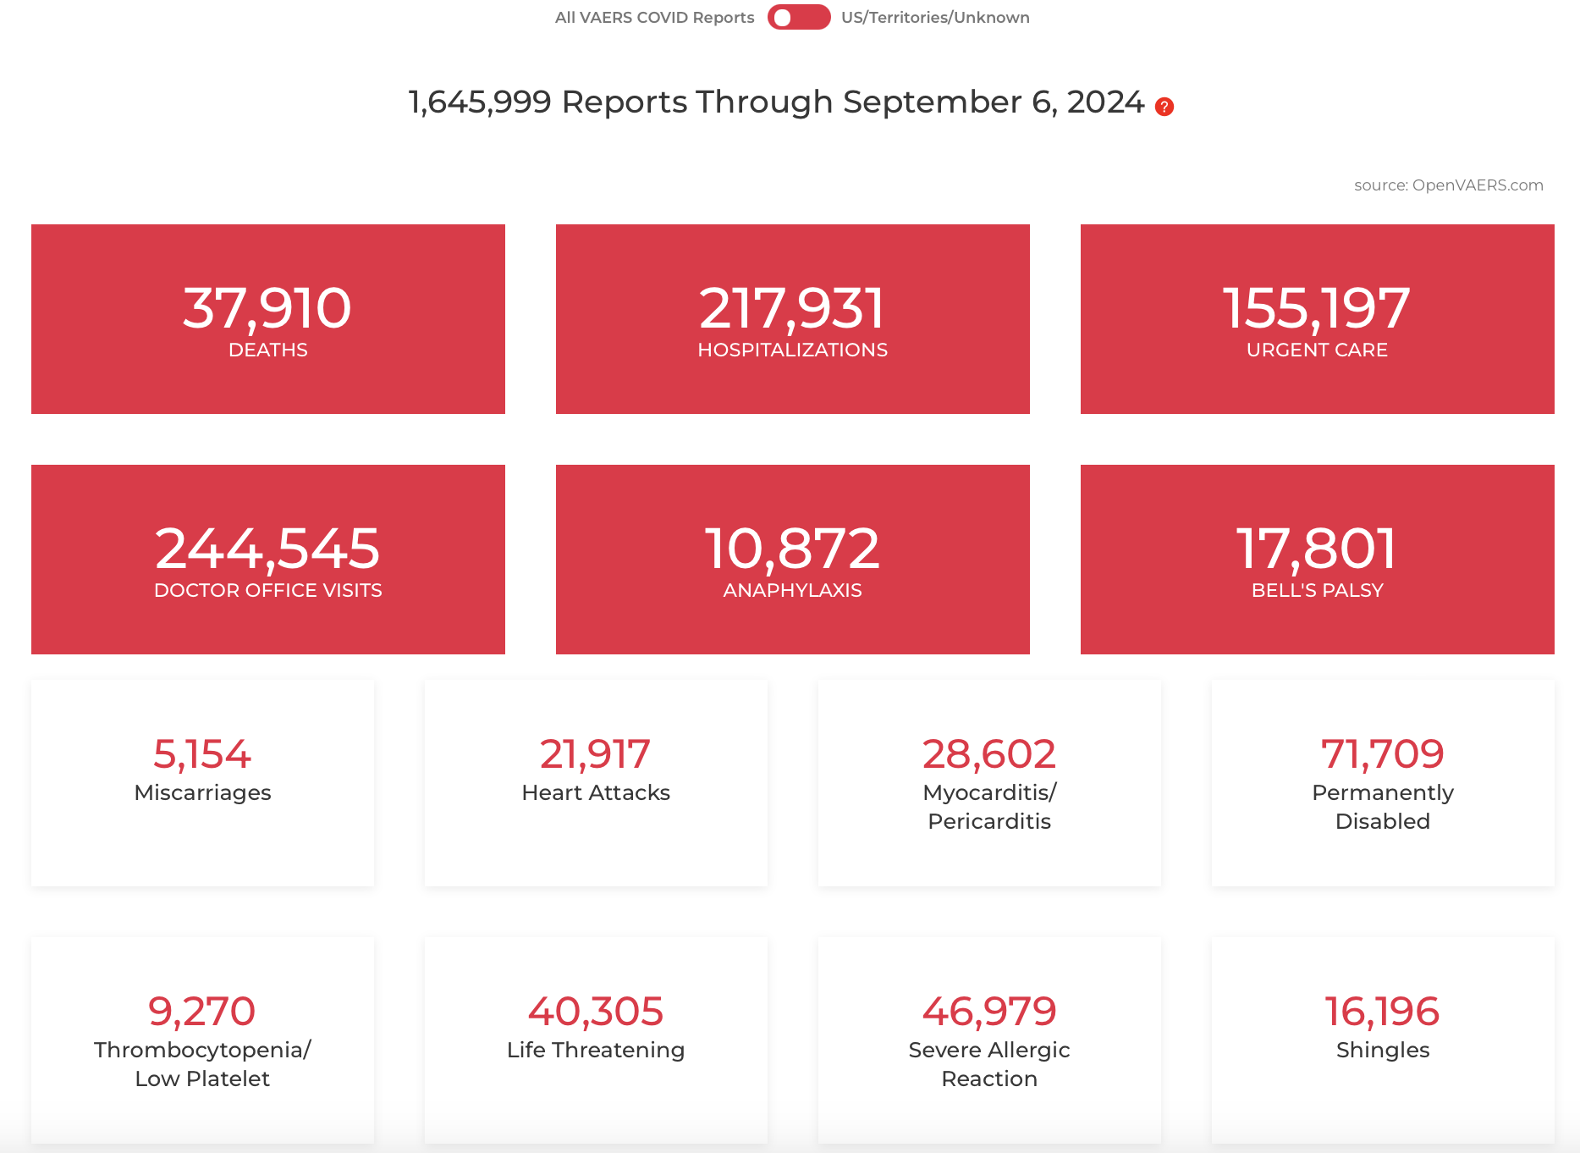

Slide 73
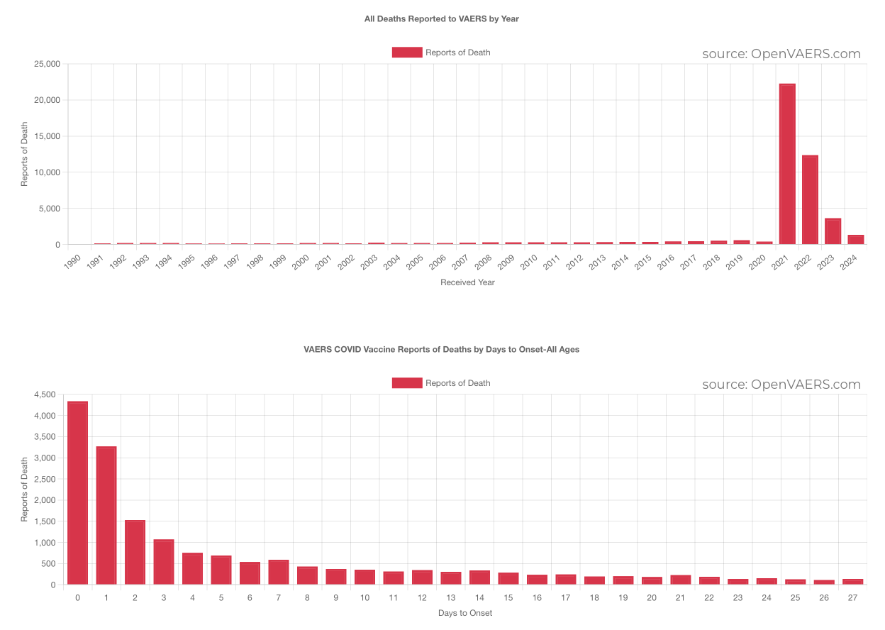

Slide 74
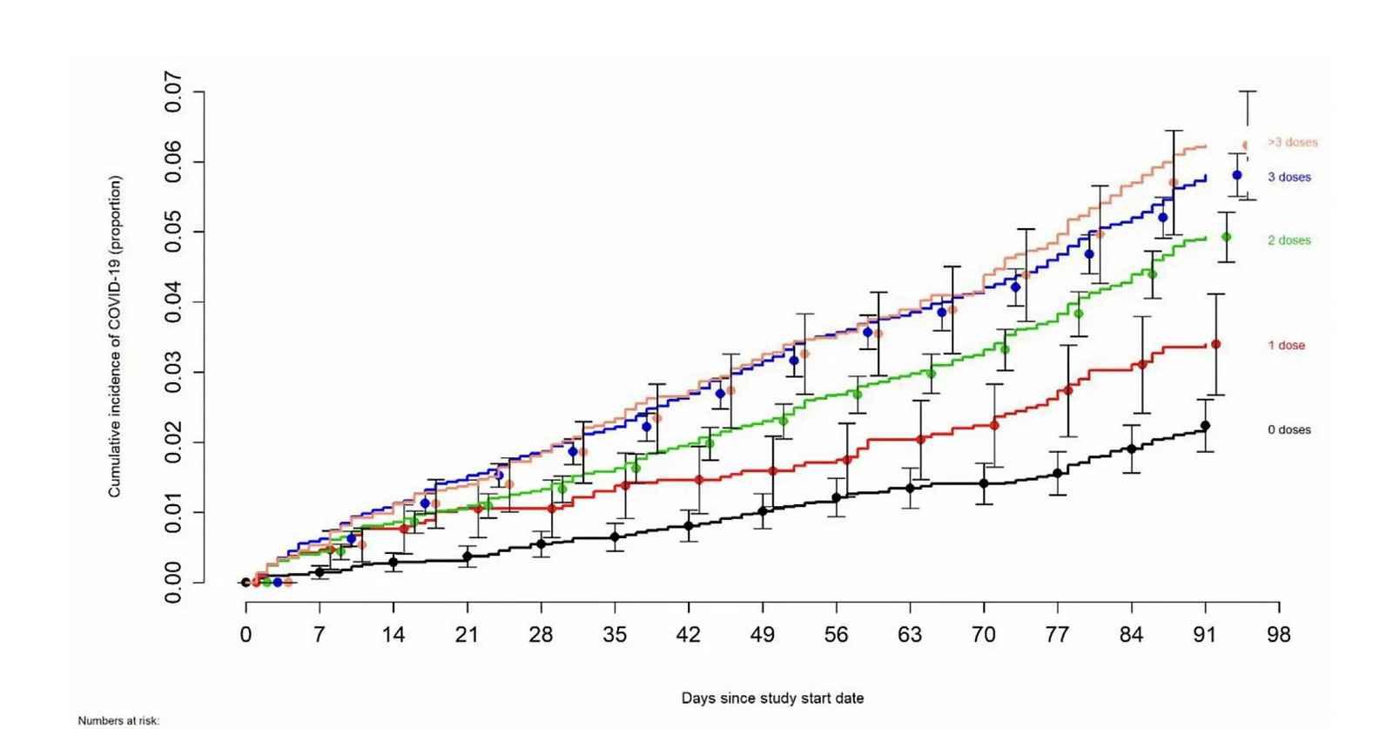
Cleveland Clinic data: The more vaccinated got sick with COVID more often
https://academic.oup.com/ofid/article/10/6/ofad209/7131292

Slide 75
Vaccines Deaths vs Deaths from Diseases for which we have Vaccines
Disease Disease Risk of Death Vaccine death risk
Diphtheria < 1 / 4,823,154 <76,341
Tetanus < 1 / 105,339 “
Pertussis < 1 / 6,947 “
Polio < 1 / 50 billion <1/214,973
Measles < 1 / 106,506,429 <1/108,666
Mumps < 1 / 40,371,594 “
Rubella ZERO to negligible “
Varicella < 1 / 32,331,860 <1/202,398
Hepatitis A < 1 / 1,667,135 <1/72,948
Hepatitis B < 1 / 305,465 <1/96,314
Hib < 1 / 1,494,710 <1/45,966
Pneumococcal < 1 / 236,562 <1/50,056
Meningococcal < 1 / 821,925 <1/141,124
Influenza < 1 / 135,905 <1/15,702

Slide 76
ARE CHILDREN SAFE IN CANADA? They Can Be – If we reject the One Size Fits All Vaccine Schedule & trust children’s NATURAL IMMUNE SYSTEM
“If you do what everyone else does, you get what everyone else gets.”
Paul Thomas MD
THANK-YOU

