Slide 1
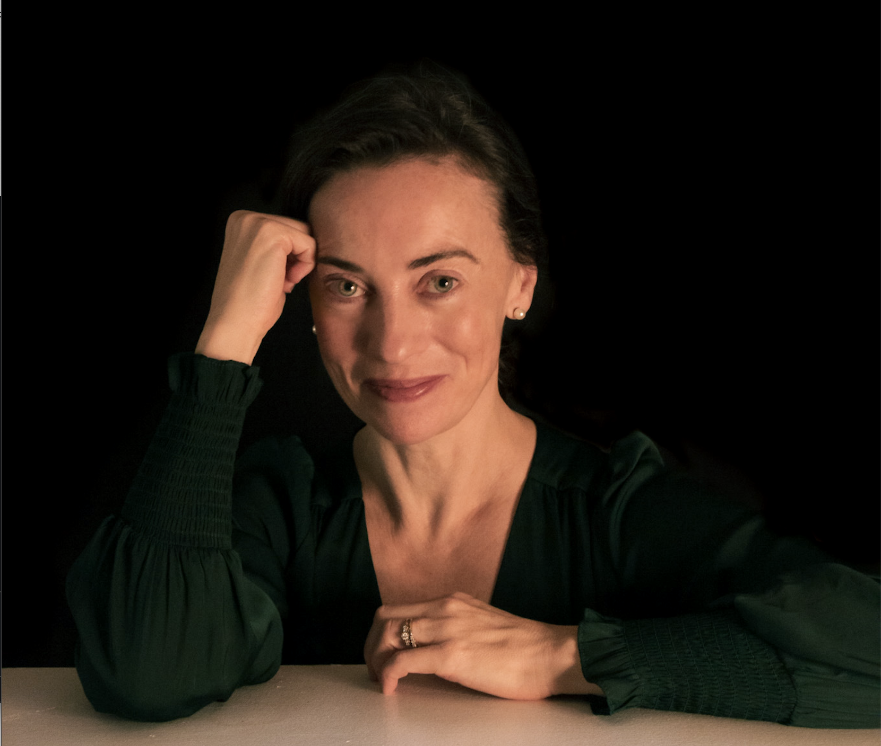
Dr. Julie Ponesse
“Canadian children are not only unsafe but at greater risk across more spectra of life — physical, psychological, social, and spiritual — than quite possibly at any other point in Canadian history.
What makes this an ethical problem is that the harm is both egregious and preventable, perpetrated and sustained by the very people and institutions that are supposed to protect them.”
Caption
PhD (Ethics and Ancient Philosophy, Western), Masters (Bioethics, University of Toronto)
Thursday, October 17, 2024

Slide 2
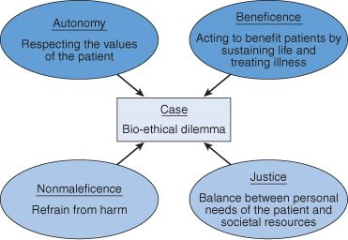
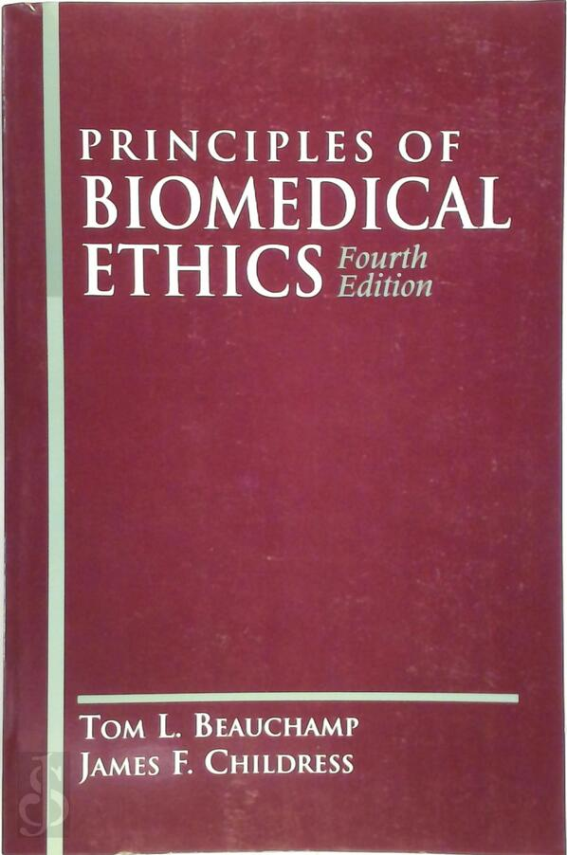
Background:
Taught over 30 different ethics classes to humanities, medicine, nursing, business, and engineering students at universities in Canada and the US for 20 years
Four Principles of Bioethics (1979) (autonomy, nonmaleficence, beneficence, justice)

Slide 3
What does it mean to say children are (are not) safe?
2 key components:
Safety is a function of immunity from danger or risk
Children are uniquely vulnerable because of inherent and developing incapacities
“Children are a vulnerable population because they lack the autonomy and decision making capacity to ethically and legally consent to participate in research and to understand and assume risks of research, and because of inequalities of power between adults and children.” (Presidential Commission for the Study of Bioethical Issues, 2016)

Slide 4
Physical risks:
The rate of obesity has nearly tripled over the last 30 years —> Increased risk of high blood pressure, heart disease, stroke, Type-2 diabetes, cancer, musculoskeletal disorders
“all-cause mortality” in children has risen consistently over the last 5 years, 8.2 to 10.4 children/100, 000 ages 5-9 (Statistics Canada)

Slide 5
Physical risks (vaccine-related harms):
Aim: monitor Pfizer-BioNTech booster safety in persons 12-17 years old
Results: 75% suffered from adverse events (including fatigue, headache, muscle pain and elevated troponin-T levels)
20% so severe that the young person was unable to go to work or school
As of 2022, 81% of children 5-17 years of age had received at least one dose of a Covid-19 vaccine
“No new adverse events have been identified to date with the use of the XBB.1.5 COVID-19 vaccines.” (https://www.canada.ca/en/public-health/services/publications/vaccines-immunization/national-advisory-committee-immunization-guidance-covid-19-vaccines-fall-2024.html#a7)

Slide 6
Lifestyle risks:
17% of Canadian children live in poverty
1/3 get the recommended 60 min/day of physical activity.
Presence of a child in the household —> increased consumption of alcohol, junk food, and time on the internet (https://www150.statcan.gc.ca/n1/daily-quotidien/220420/dq220420e-eng.htm)
“Kids 9-13 years old: ultra-processed foods – the bulk of products marketed to children – make up nearly 60% of their diets. Diets high in ultra-processed foods including sugary drinks are linked to an increased risk of cardiovascular disease, stroke, diabetes, cancers, tooth decay and mortality later in life. In 2019 alone, dietary risk factors contributed to 36,000 deaths in Canada.” (https://www.heartandstroke.ca/what-we-do/media-centre/news-releases/prime-ministers-promise-to-stop-junk-food-marketers-from-targeting-kids-falters)
Fluoride-treated water: fluoridation at 0.7 mg/L “poses an unreasonable risk of reduced IQ in children.” (https://www.foodandwaterwatch.org/wp-content/uploads/2024/09/2024.09.24-Opinion.pdf)

Slide 7
Mental health risks:
Currently, 1/50 children and teens are diagnosed with autism
Depression has doubled compared to pre-pandemic rates
Youth aged 15-24: fastest growing opioid poisoning hospitalization rates: youth aged 1-14: suicide is the third leading cause of death
1 in 4 young people say they always/often feel lonely

Slide 8
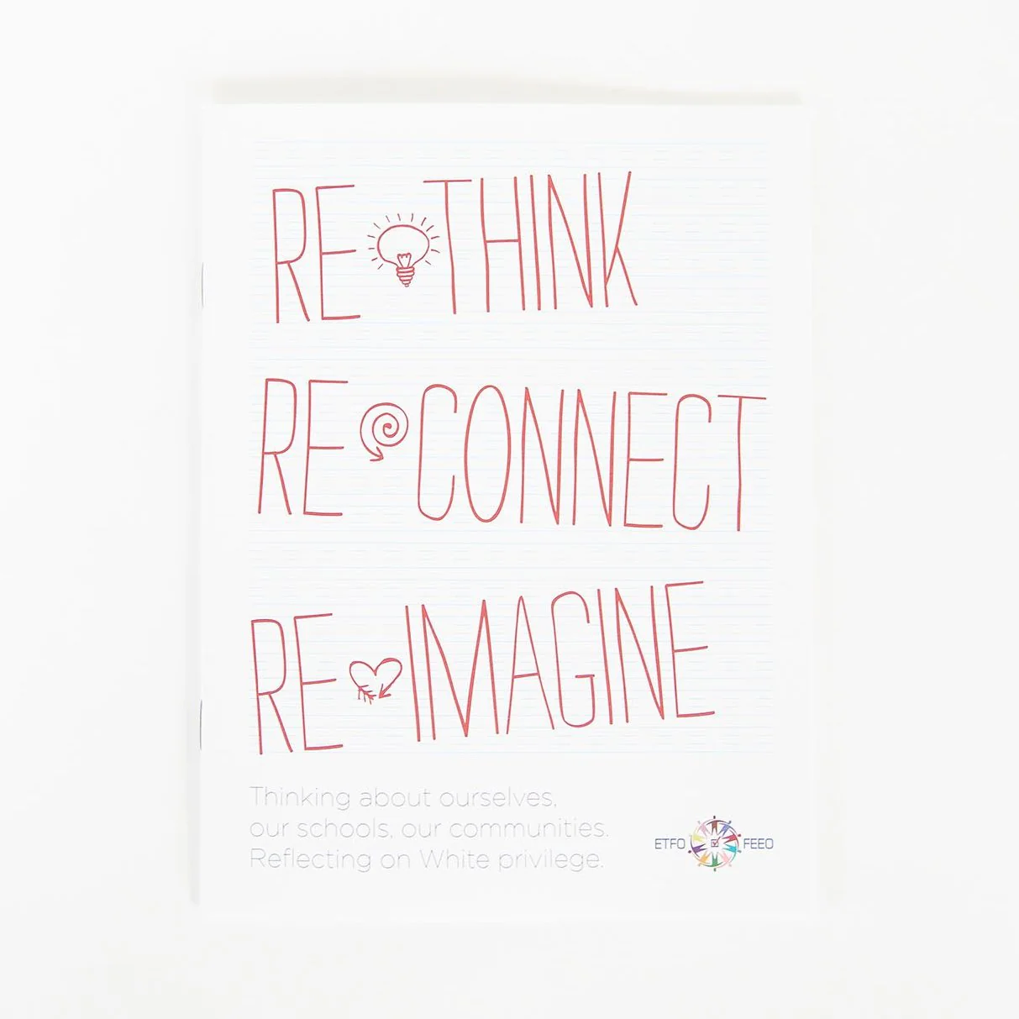
Ideological risks (“Critical race theory”):
July 2022: the Elementary Teachers Federation of Ontario (ETFO) distributed pre-made lesson plans on “white privilege” (part of critical race theory)

Slide 9
Ideological risks (“gender identity”):
McGill University” “Preferred First Name Procedure” (PFNP) defines gender as “the sense of self-identification of a person, and how they relate to (or don’t relate to) societal norms of femininity, masculinity, or any mix thereof.”
The Ontario Human Rights Commission defines “gender identity” as “each person’s internal and individual experience of gender.”
Bill C-16: adds “gender identity” to the Canadian Human Rights Act, and to sections of the Criminal Code dealing with hate speech and hate crimes
Caption

Slide 10
Ethical protections for children:
Preamble to the UN Convention on the Rights of the Child (ratified by Canada, 1991): “childhood is entitled to special care and assistance.”
“In all actions concerning children, whether undertaken by public or private social welfare institutions, courts of law, administrative authorities or legislative bodies, the best interests of the child shall be a primary consideration.” (Article 3)
The right “… to express his/her own views freely in all matters affecting the child” (Article 12).
Geneva Declaration of the Rights of the Child (1924 ad 1959), The International Covenant on Civil and Political Rights (articles 23 and 24)

Slide 11
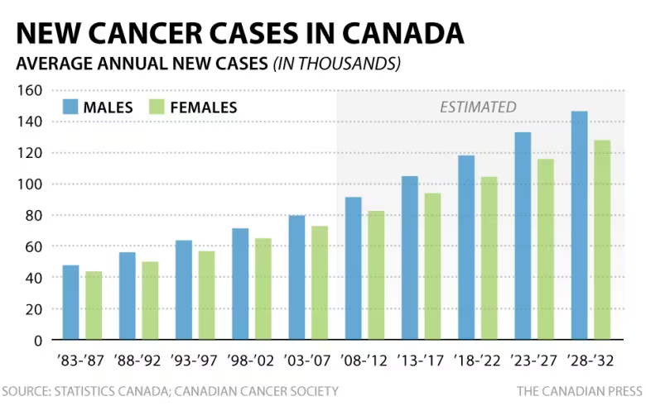
Example: cancer —> ethical violation
Paediatric cancer rates are on the rise
Increasingly accepted view: cancer is a metabolic disease
Risk factors such as obesity increase a child’s chance of developing cancer later in life
Connection between “sugar consumption and obesity, high blood lipid levels, visceral adiposity, fatty liver disease, insulin resistance, type 2 diabetes, cardiovascular disease, and metabolic syndrome.” (Statistics Canada)
Convention on the Rights of the Child: “childhood is entitled to special care.”

Slide 12
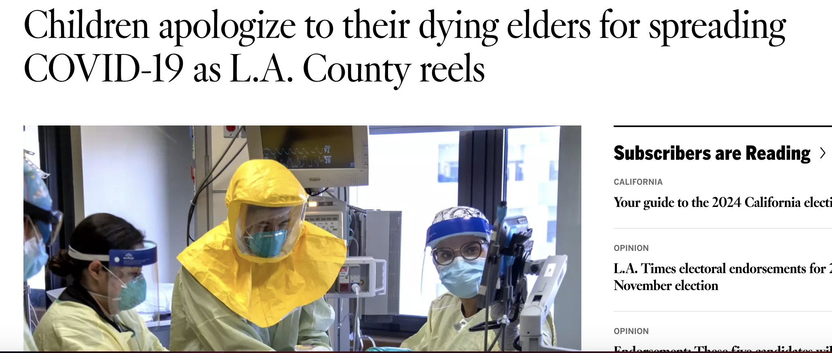
What happened?
Shift in the bioethics literature in terms of how children are treated as research participants
Nuremberg Code, the Declaration of Helsinki prioritized the safety of children as research participants
The Ethics of Research Involving Minors (2018): “the exclusion of minors from research …precludes the potential for beneficial medical advances.”
Executive summary by Dahlberg described children not as “vulnerable subjects’” but as “active research partners.”

Slide 13
“Regulatory capture”
The subversion of regulatory agencies (e.g. FDA, Health Canada) by the firms (e.g. Pfizer, Moderna) they regulate
1992: US Congress passed the Prescription Drug User Fee Act, allowing the FDA to collect funds from companies that “produce certain human drug and biological products”
Pharmaceutical companies currently fund the Medical Research Council of Canada, spend on average $2 billion marketing drugs directly to physicians, pharmacists and the public.

Slide 14
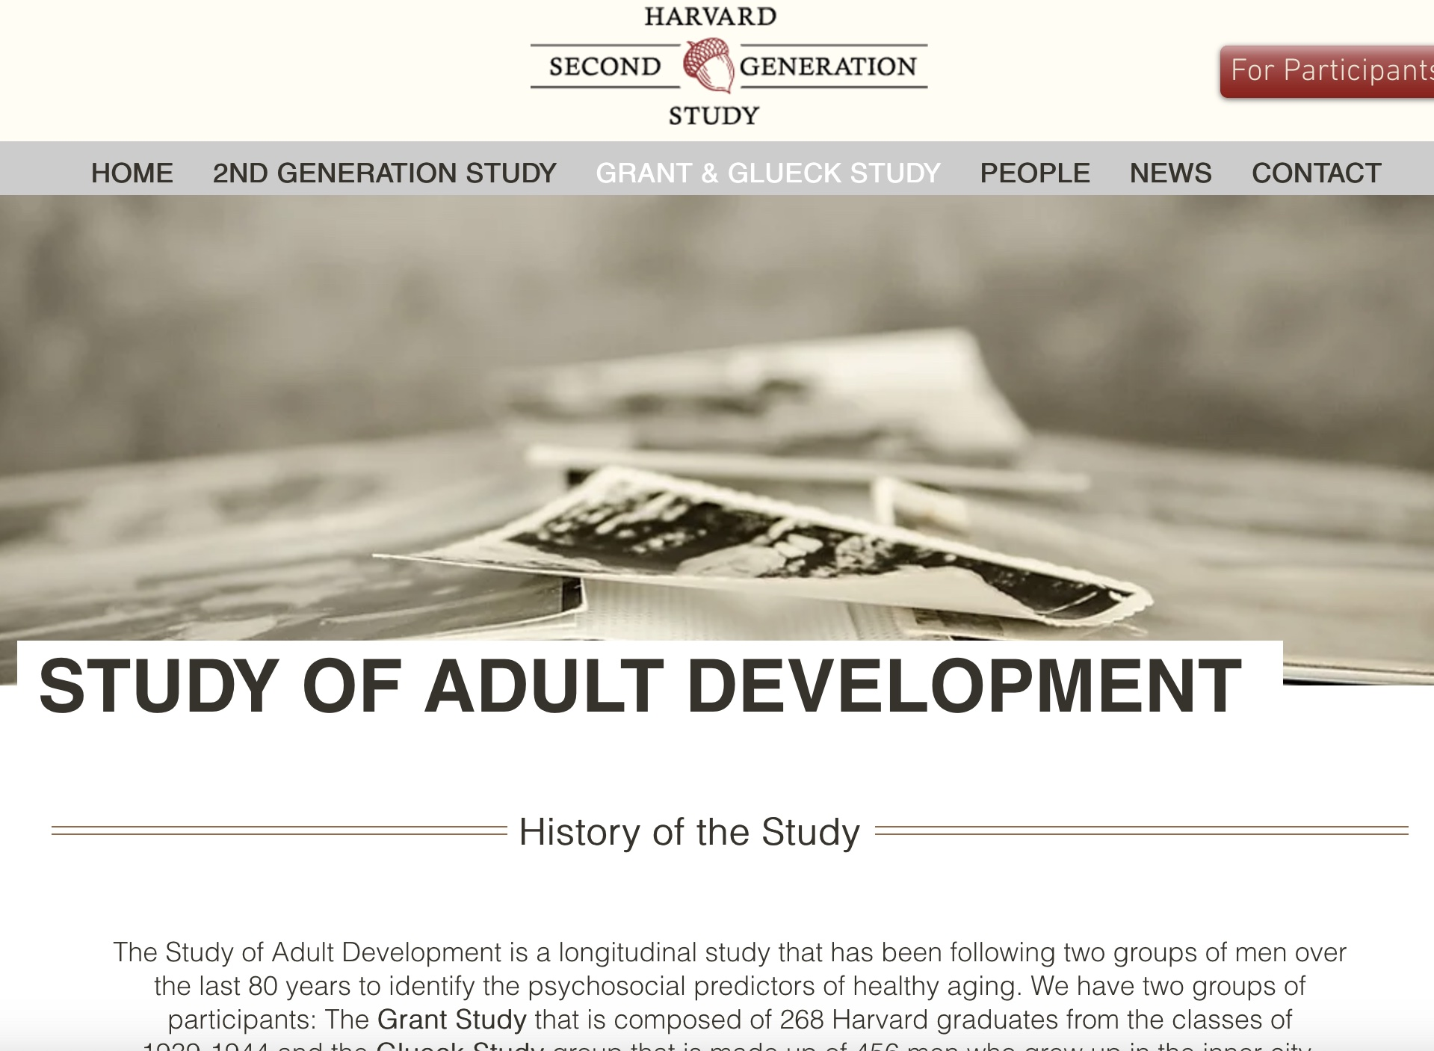
How can we make our children safer?
Children’s rights are inviolable —> make choices accordingly
Question everything
Re-allocate time to our children
Canadian Health Measures Survey: for every 20 min. increase in a parent’s physical activity, child’s activity increases by 5-10 min.
University of Minnesota analysis of study (https://ww1.prweb.com/prfiles/2014/02/22/11608927/children-with-chores-at-home-University-of-Minnesota.pdf), 80-year longitudinal (https://www.adultdevelopmentstudy.org/grantandglueckstudy)
Caption

Slide 15
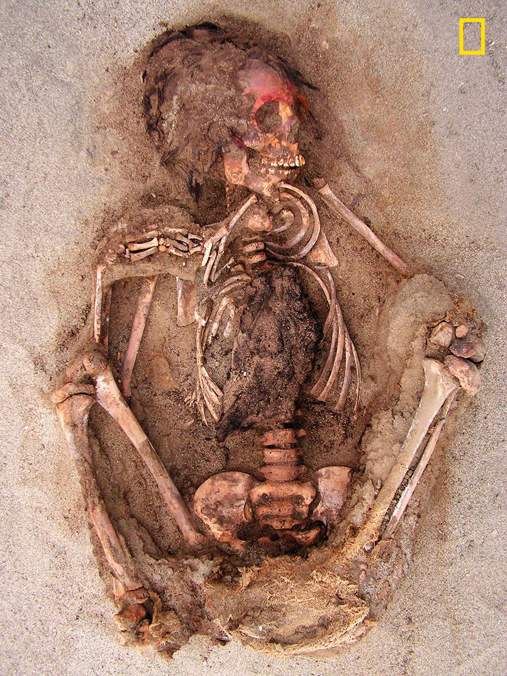
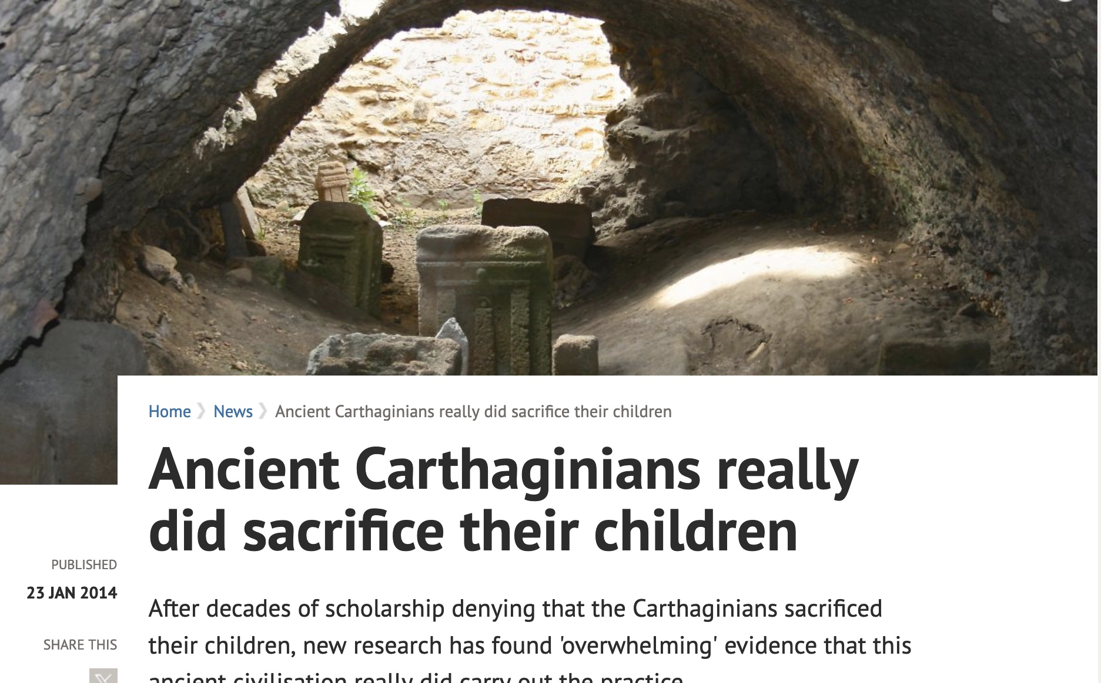
Historical cases of child sacrifice
Child’s remains,
Las Llamas
Carthaginian tophets (800 BC - 146 BC)
https://www.ox.ac.uk/news/2014-01-23-ancient-carthaginians-really-did-sacrifice-their-children#:~:text=Children%2520%E2%80%93%2520both%2520male%2520and%2520female,in%2520Sicily%252C%2520Sardinia%2520and%2520Malta
Las Llamas burial site (16th c) contains remains of 140 ritualistically sacrificed 5-14 year-olds
“They were possibly offering the gods the most important thing they had as a society, and the most important thing is children because they represent the future,” Gabriel Prieto, archaeology professor, Peru’s National University of Trujillo
Caption

