Slide 1
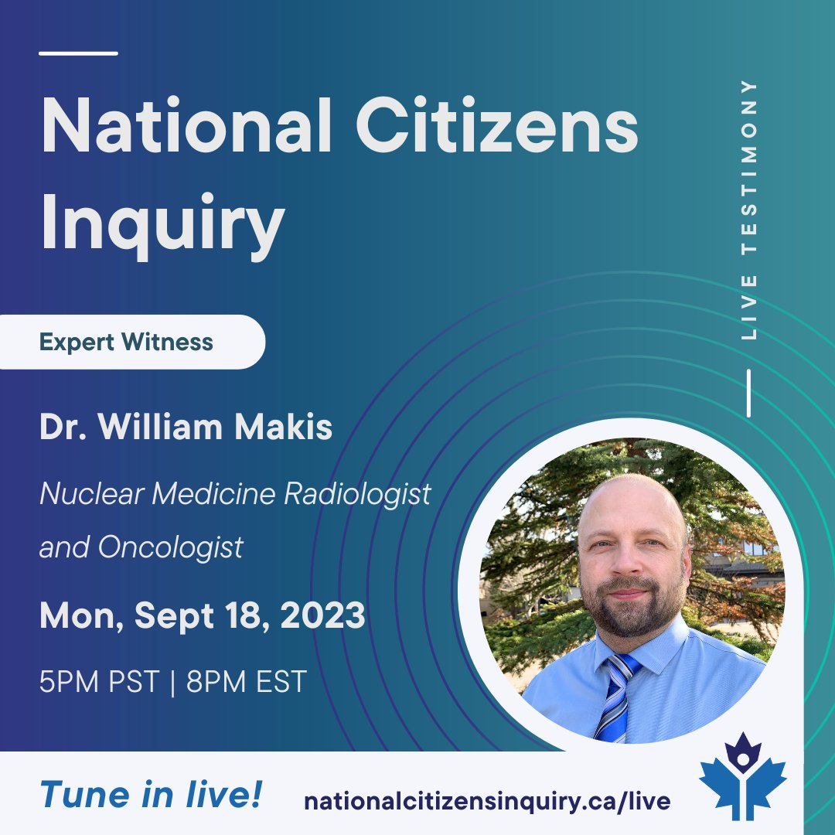

Slide 2
COVID-19 Vaccine mandates

Slide 4
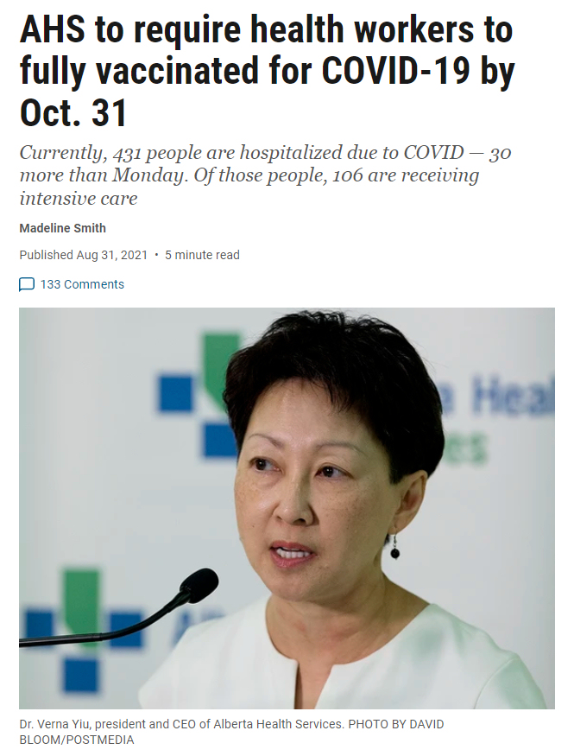
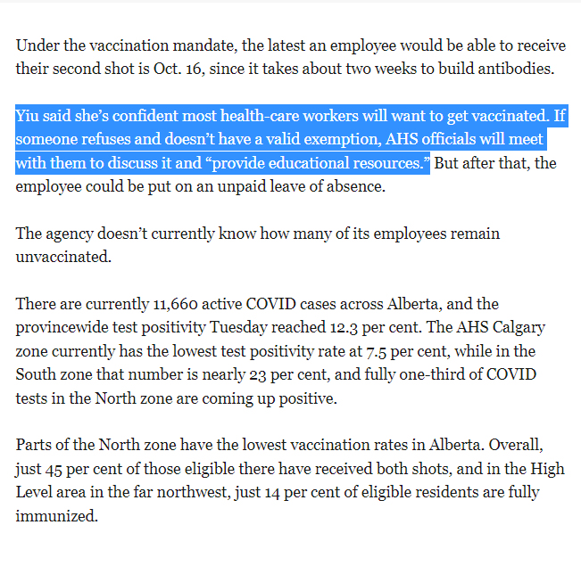

Slide 5
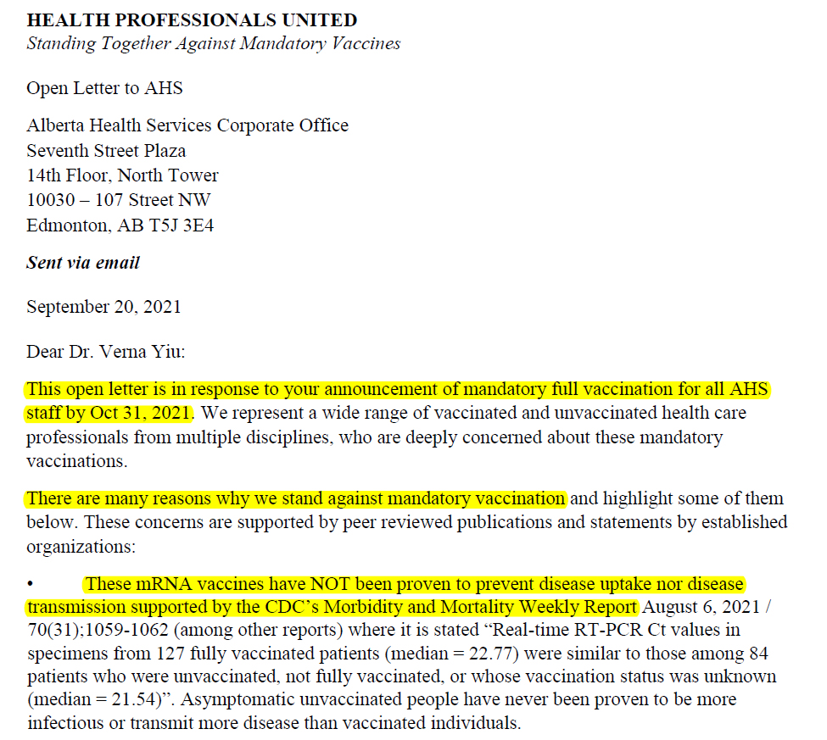

Slide 6
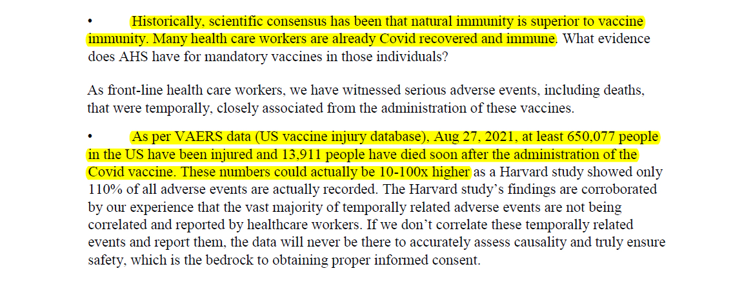

Slide 7
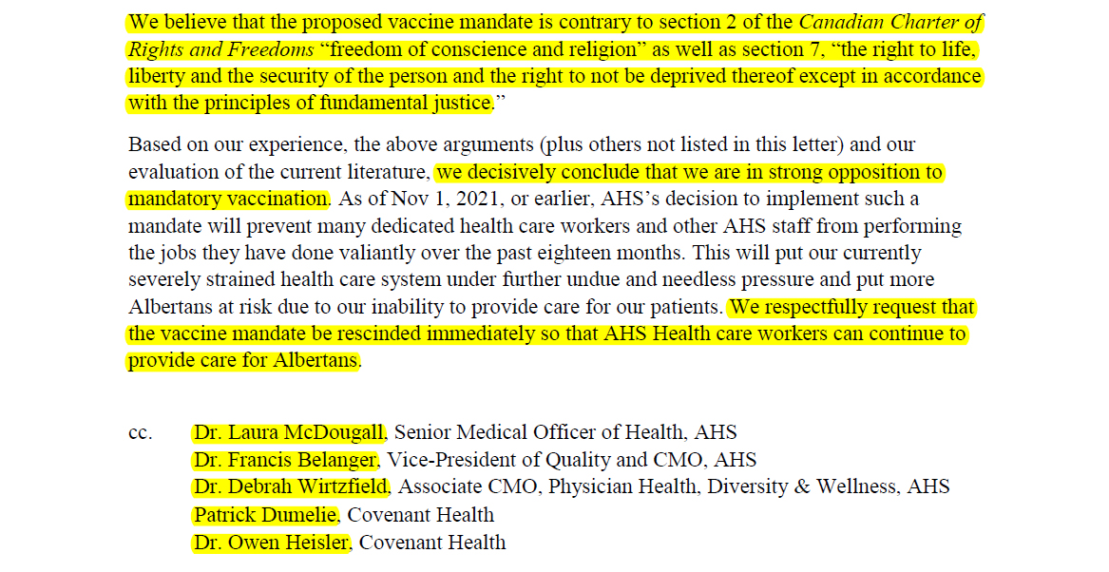

Slide 8
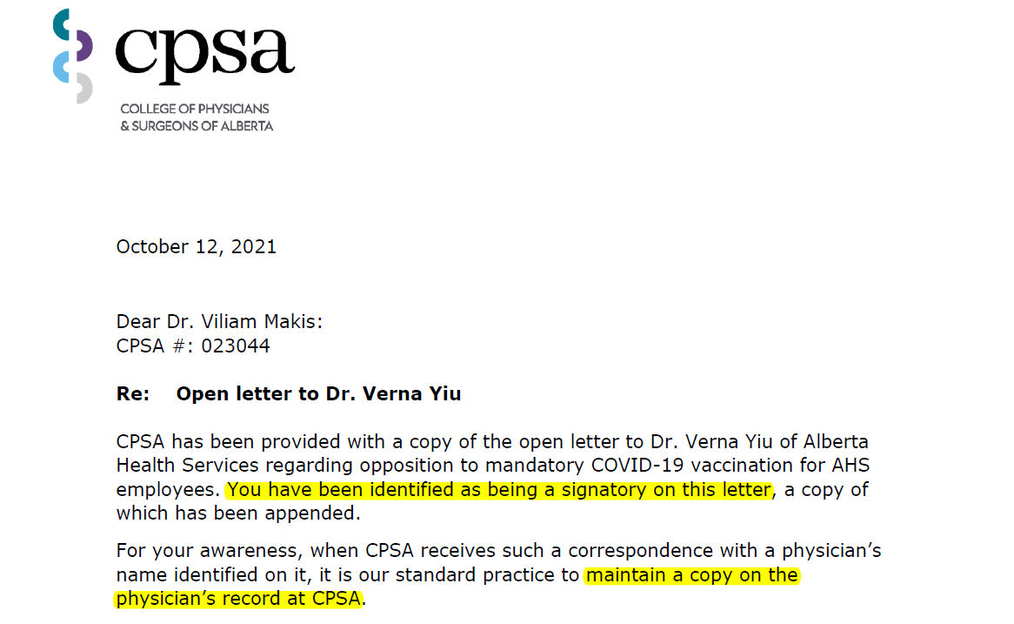
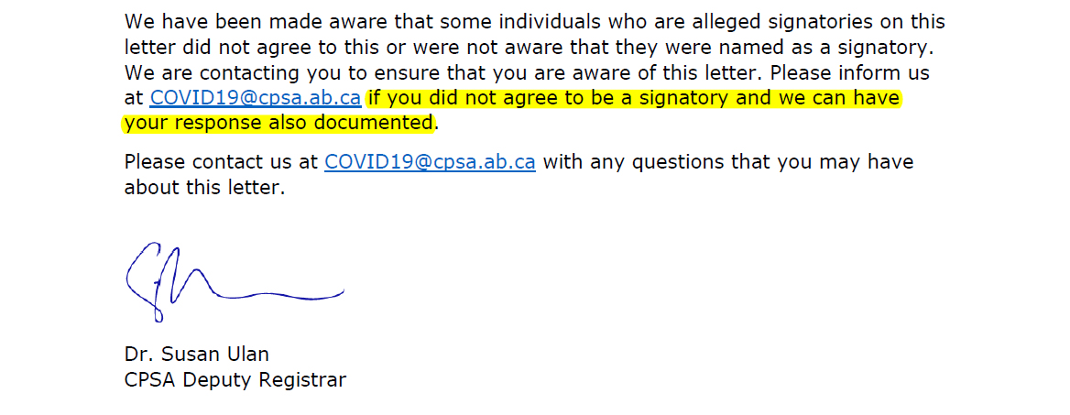

Slide 9
Canadian doctor sudden deaths since the rollout of COVID-19 vaccines in Dec.2020

Slide 10
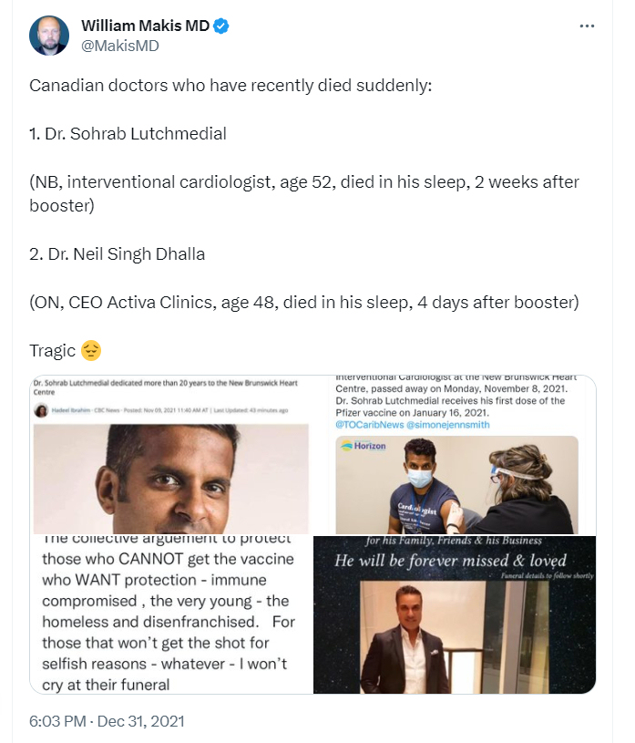

Slide 11
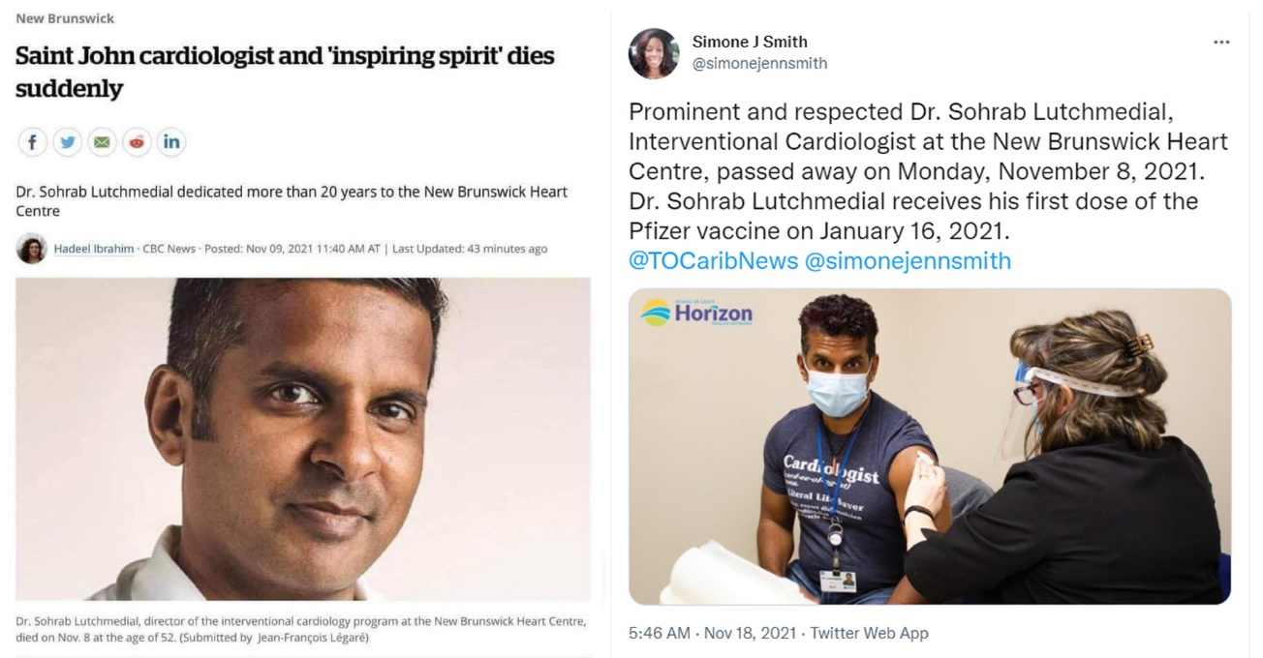
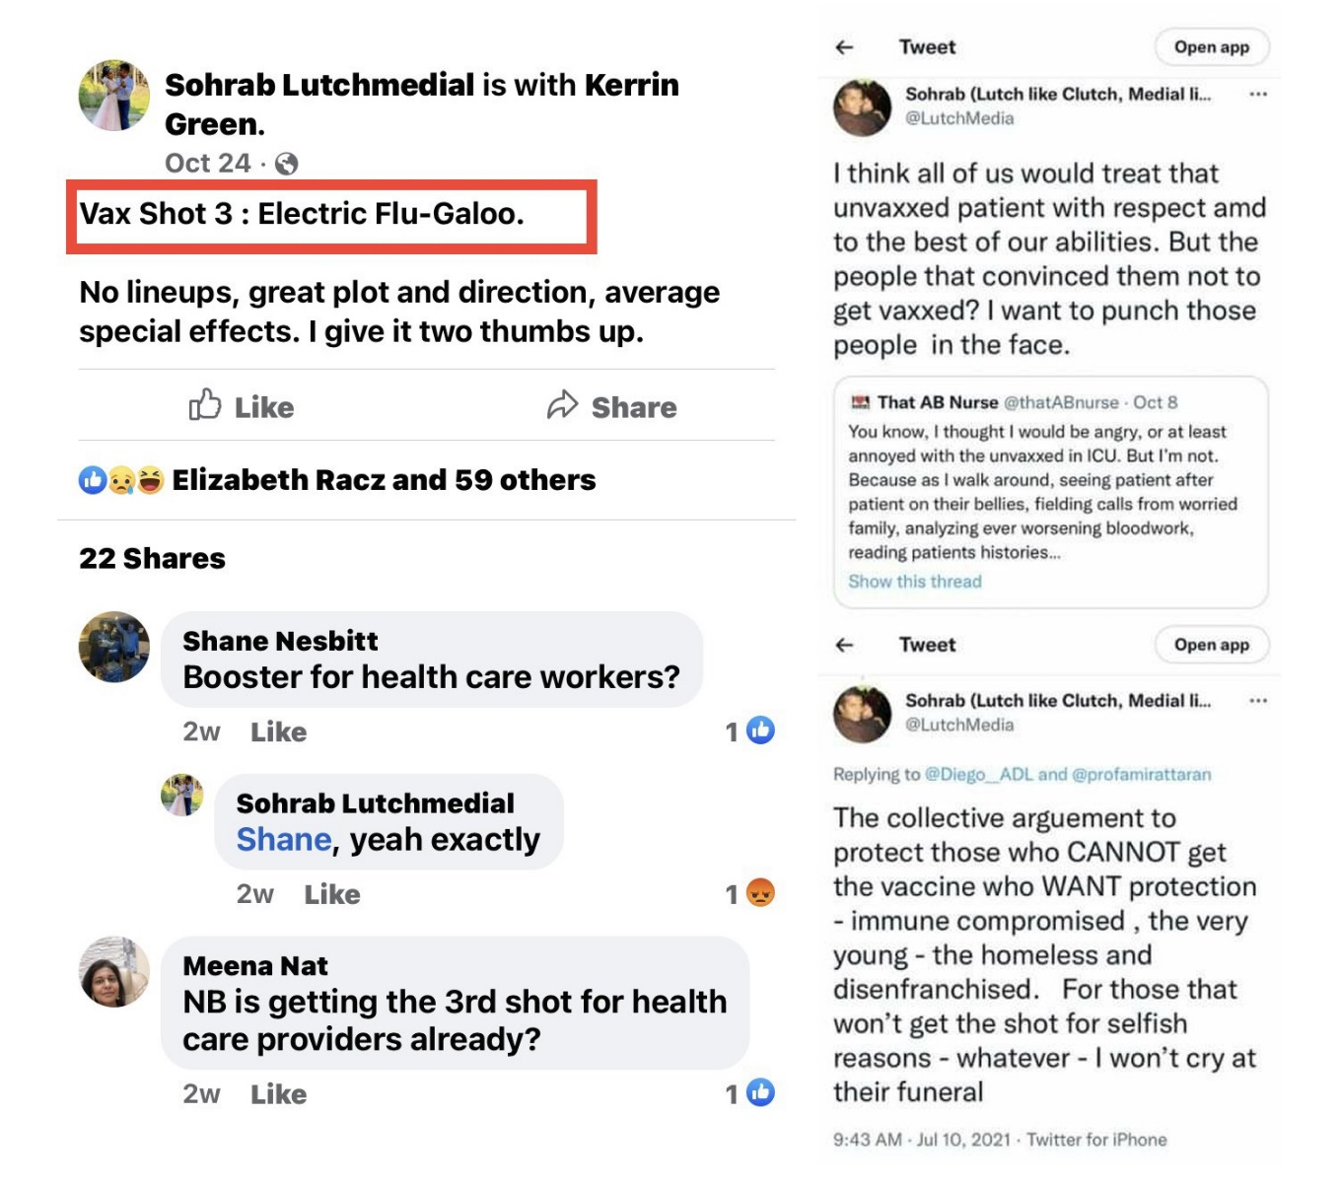

Slide 12
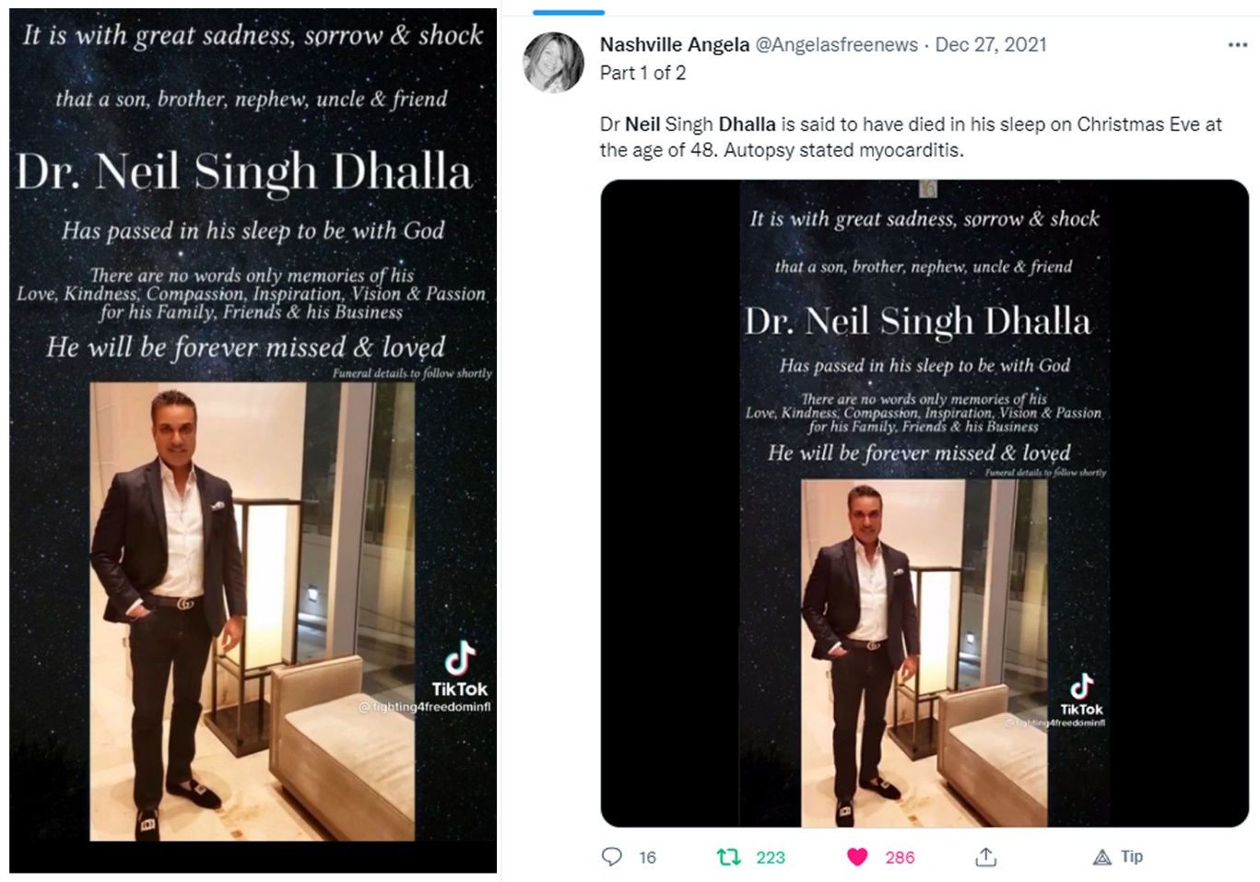
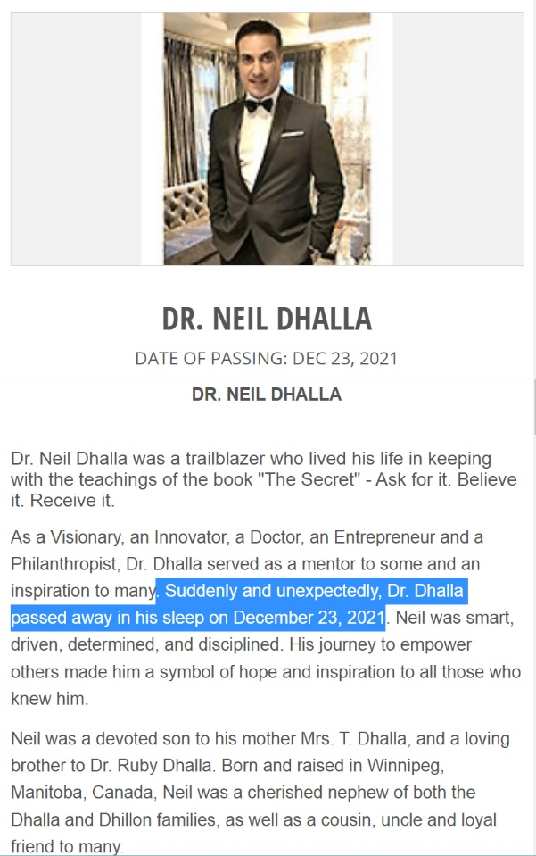

Slide 13
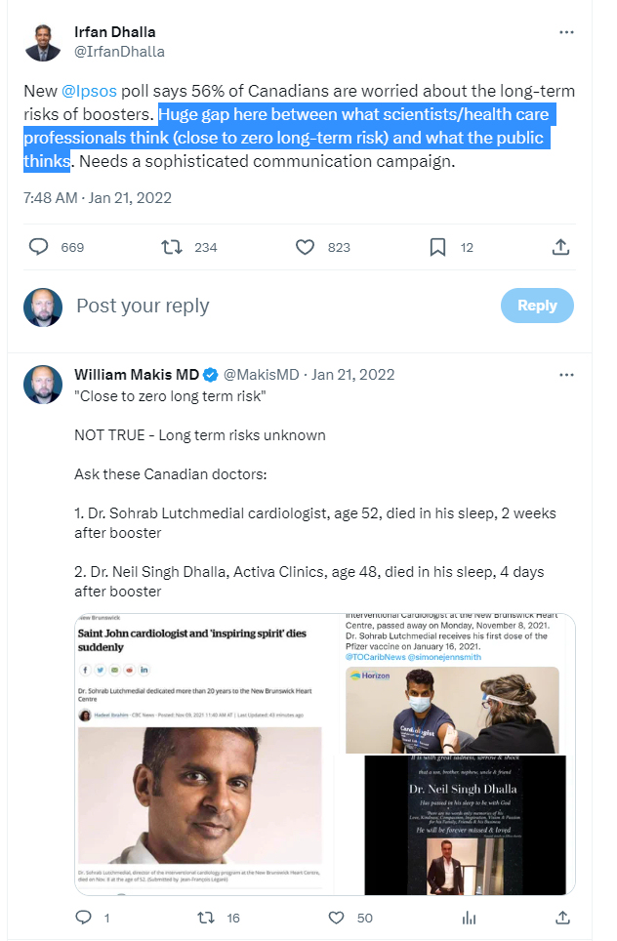
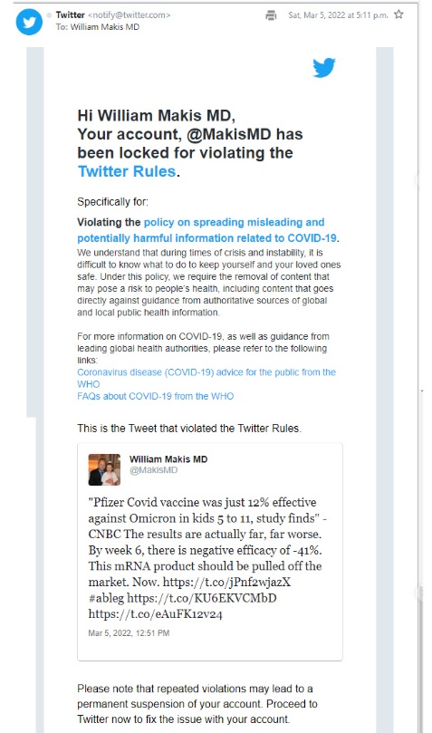

Slide 14
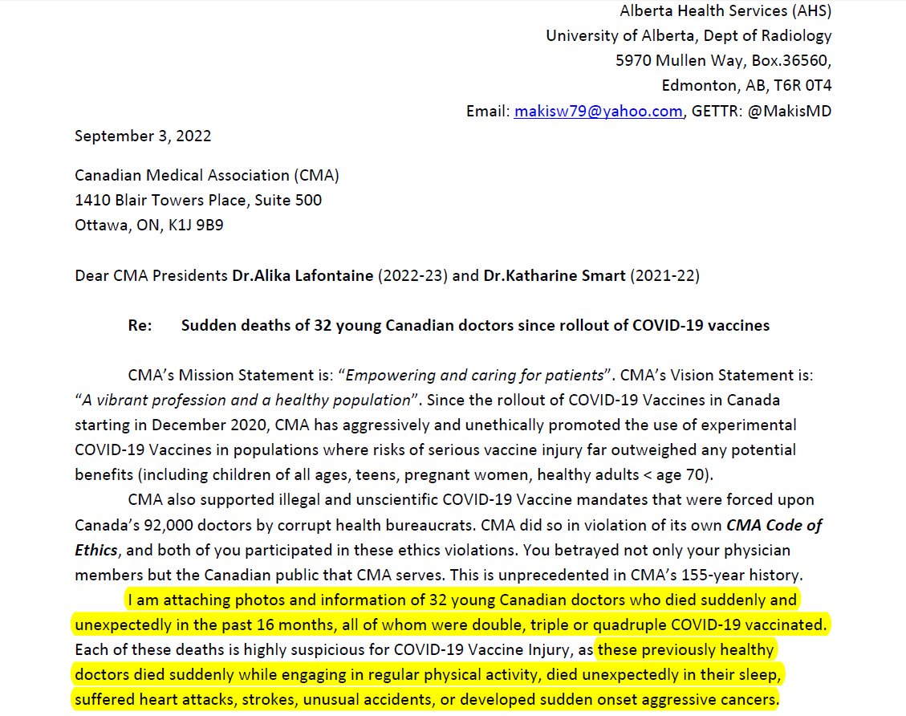

Slide 15
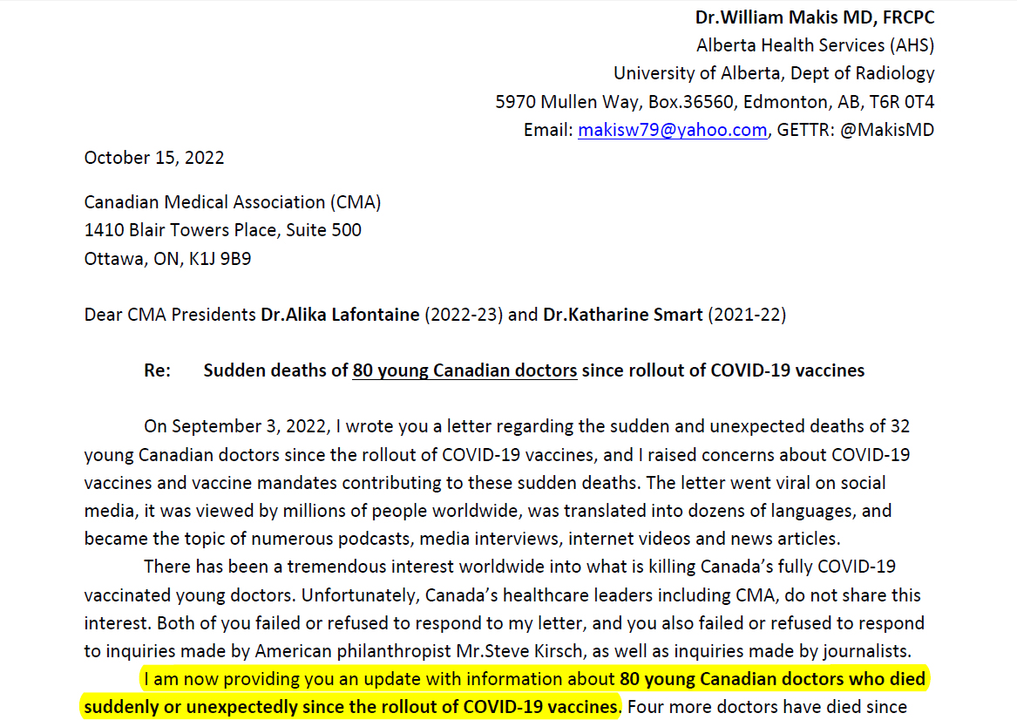

Slide 17
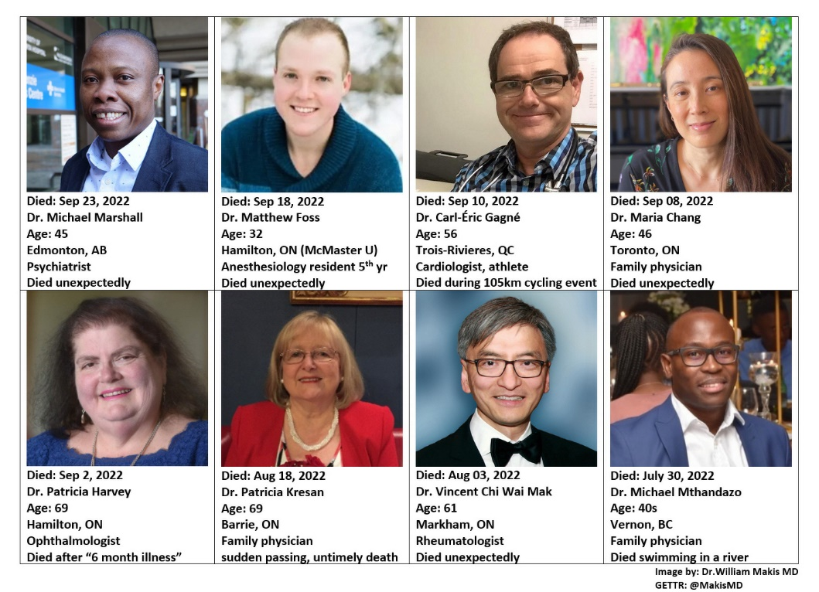

Slide 18
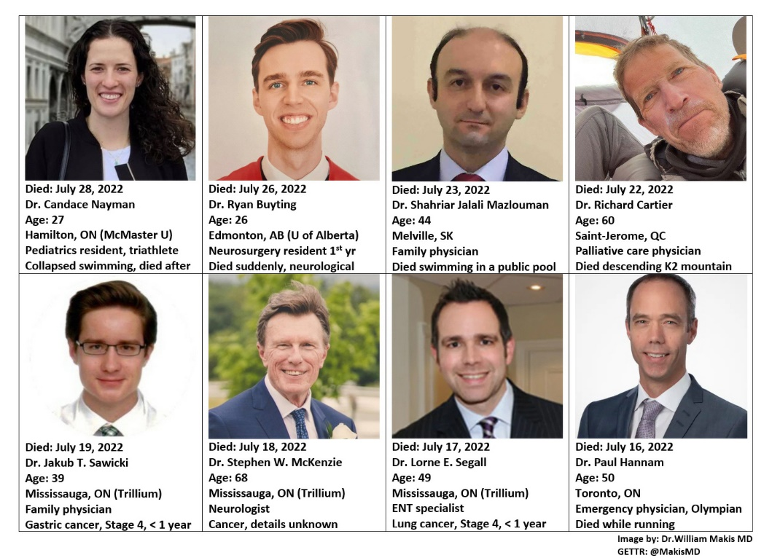

Slide 19
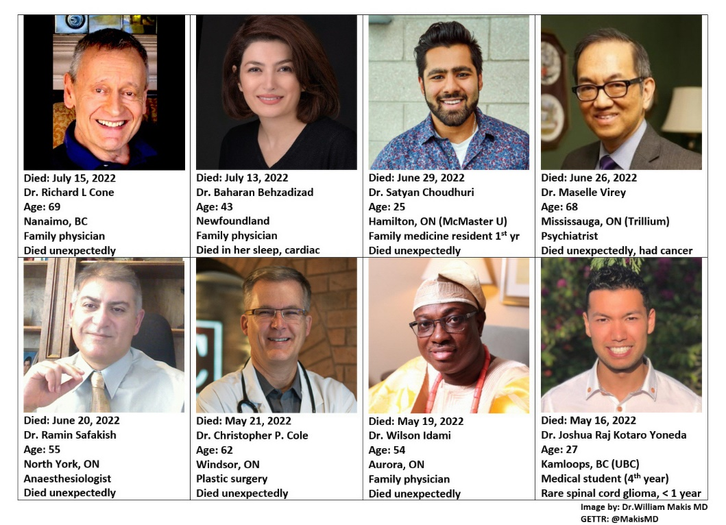

Slide 20
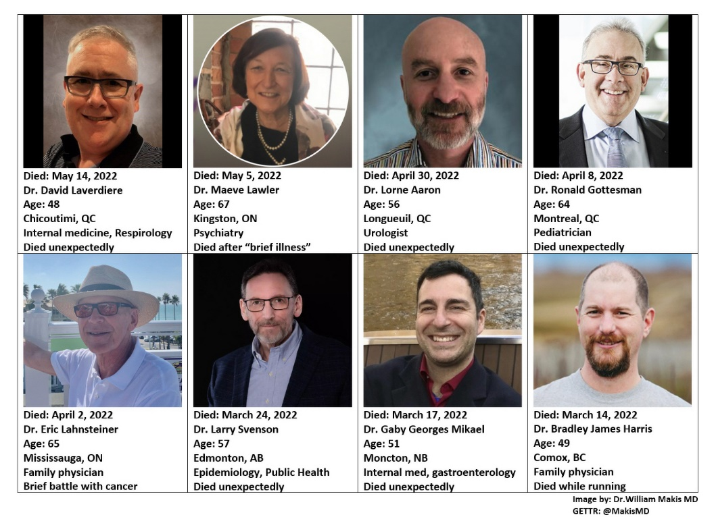

Slide 21
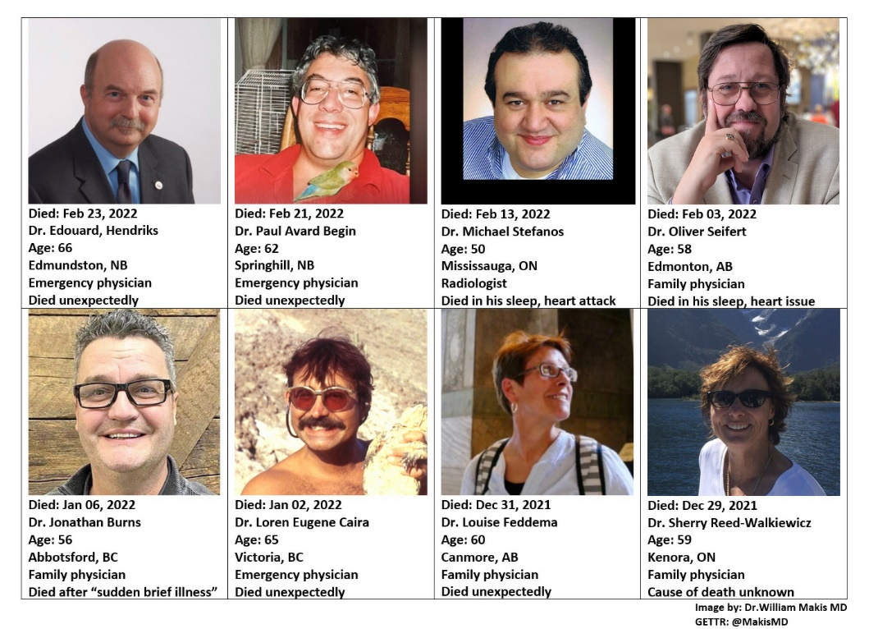

Slide 22
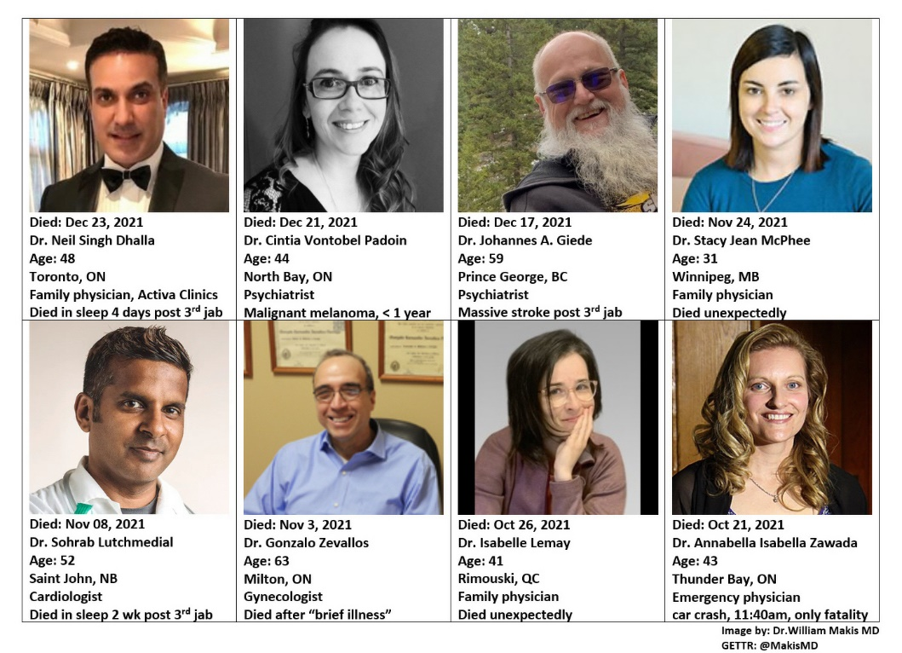

Slide 23
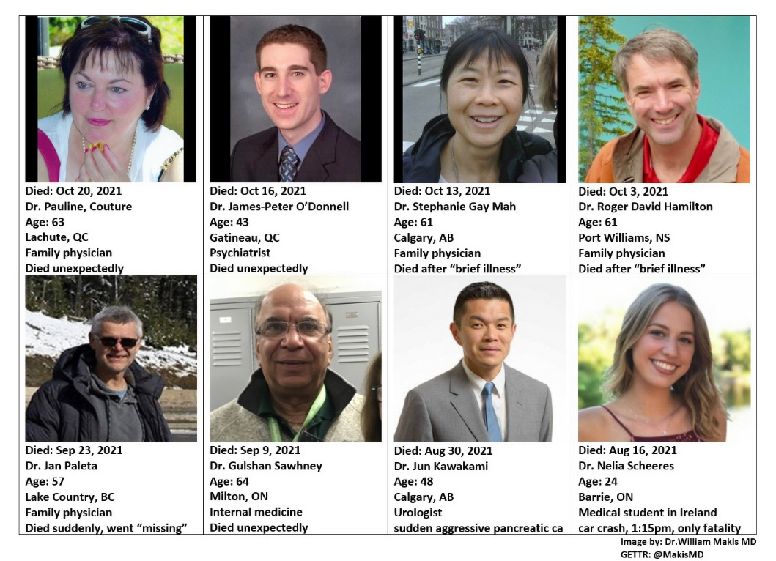

Slide 24
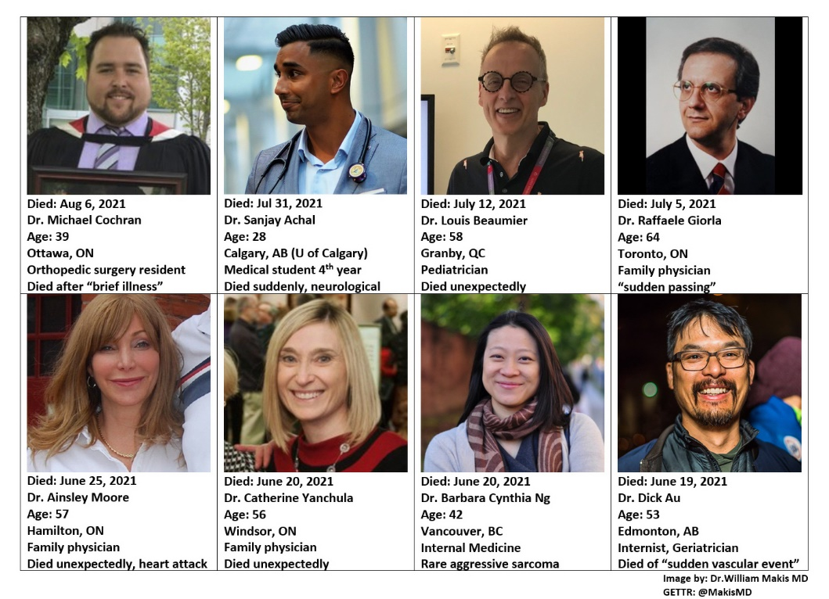

Slide 25
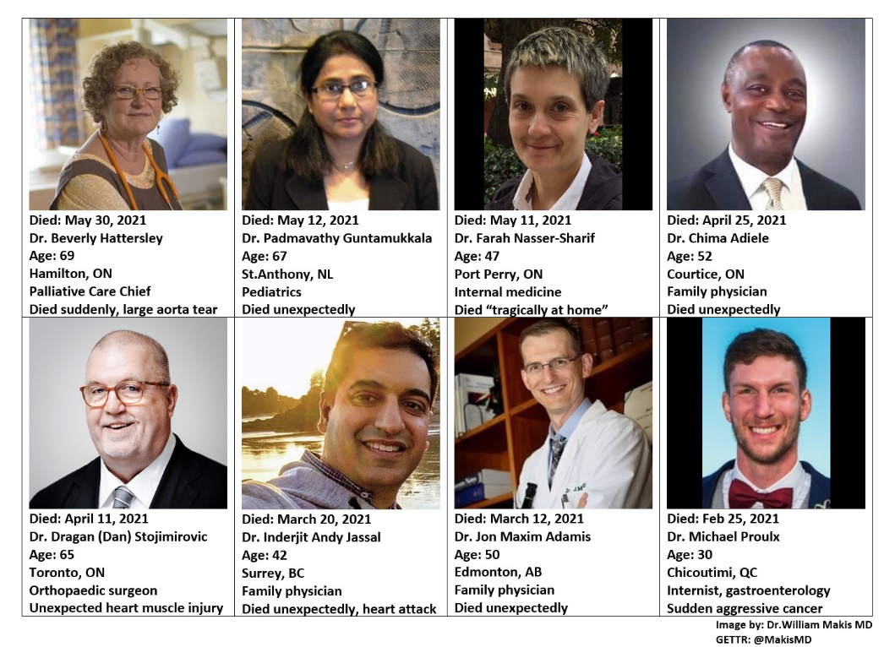

Slide 26
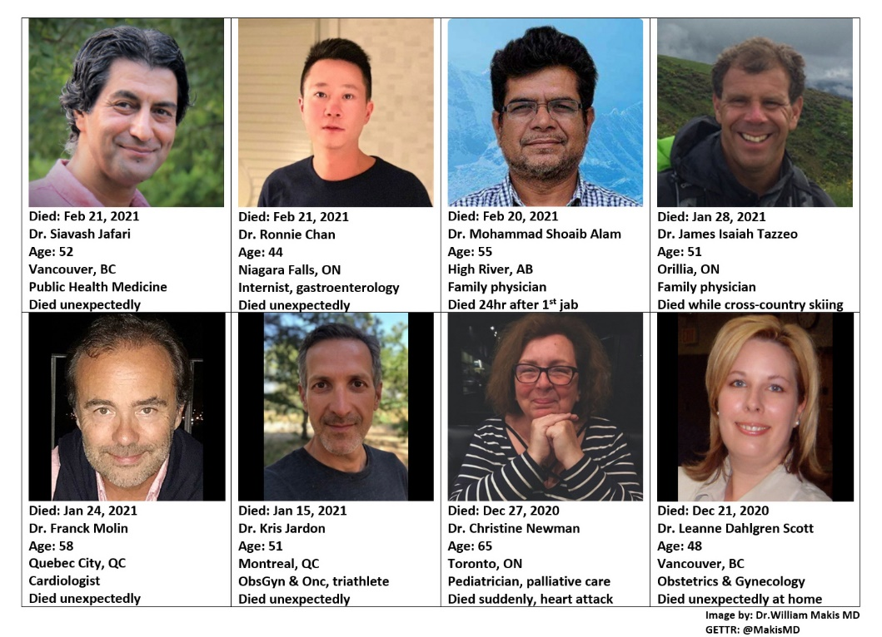

Slide 27
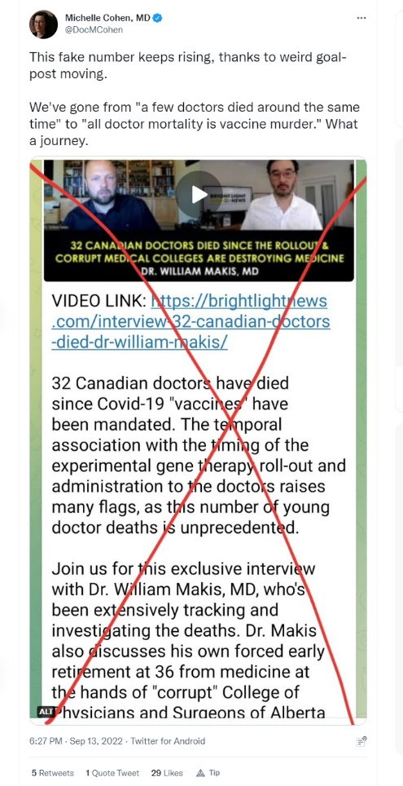
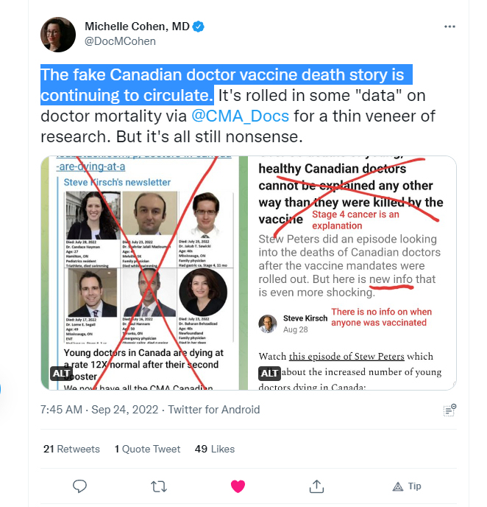
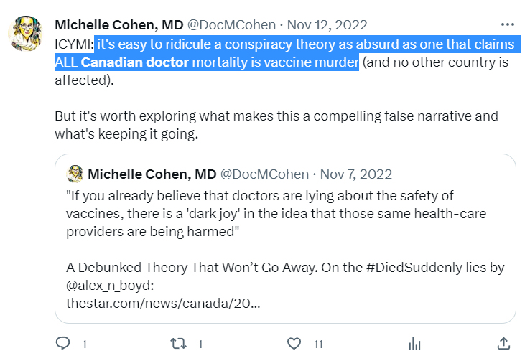
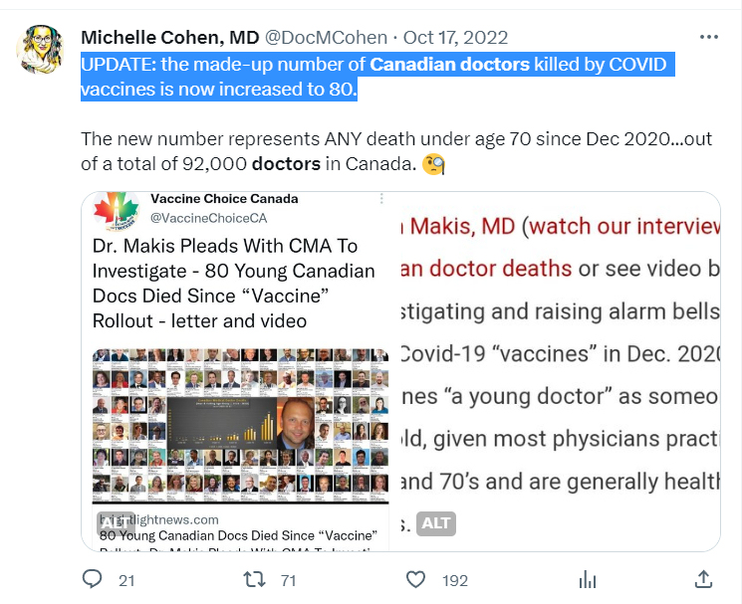
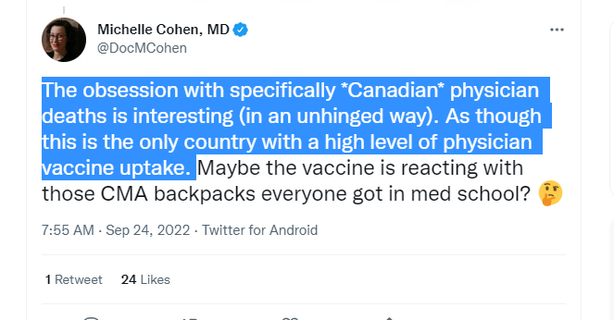

Slide 28
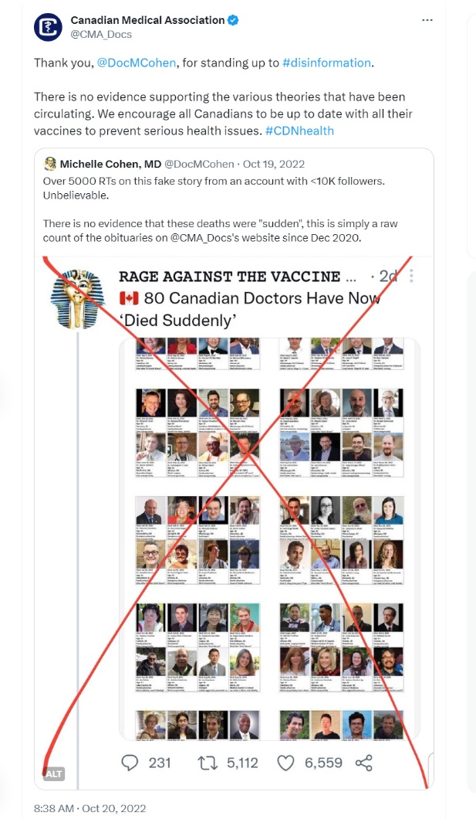

Slide 29
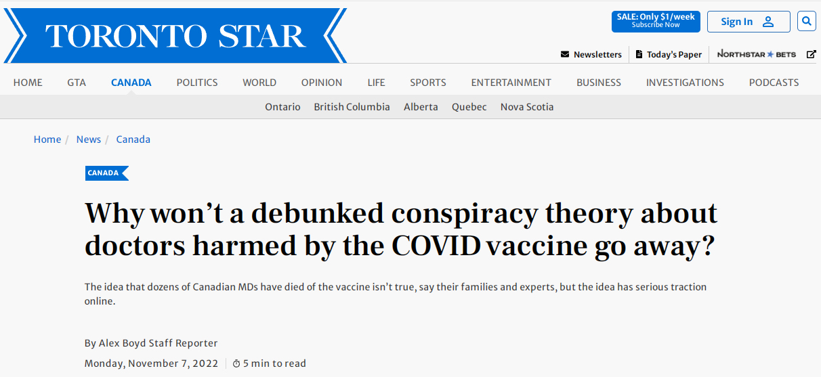
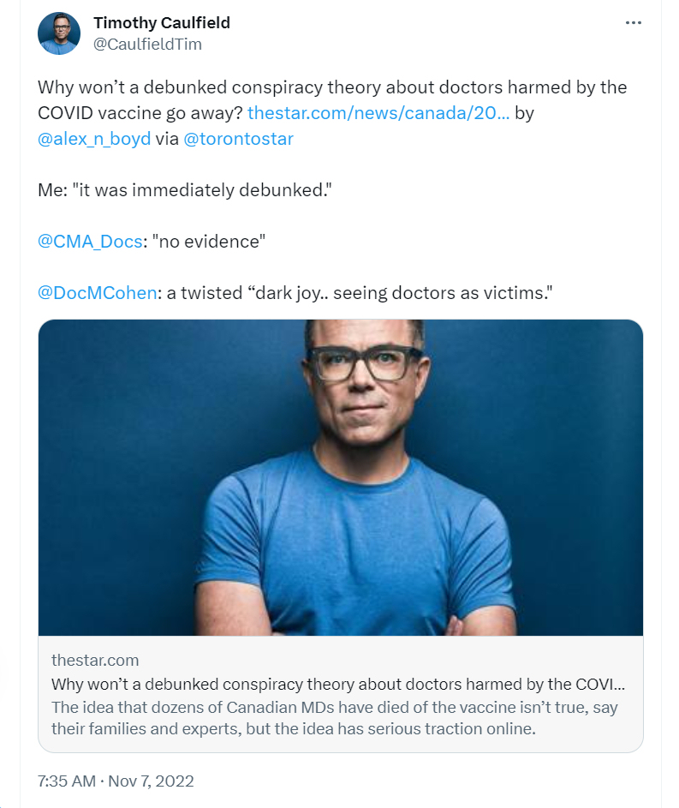

Slide 30
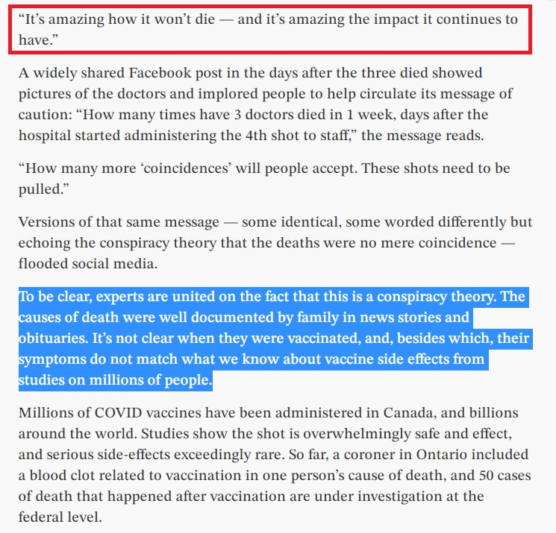
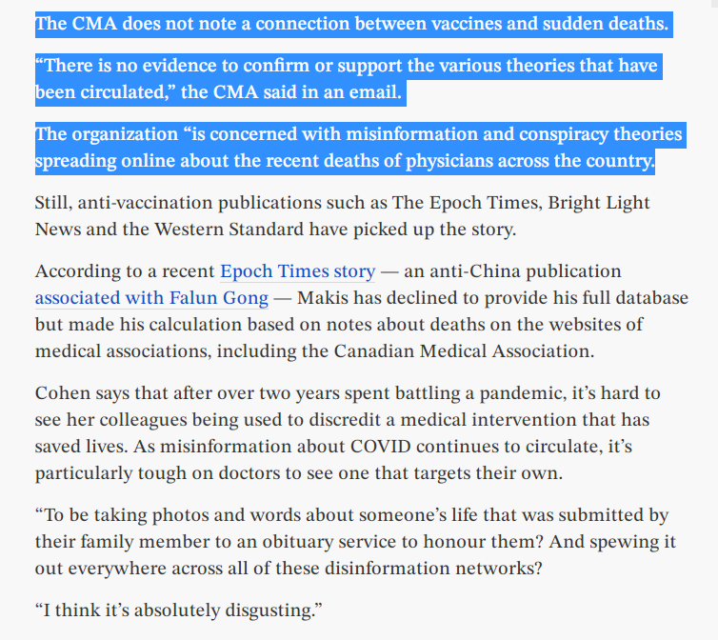

Slide 31
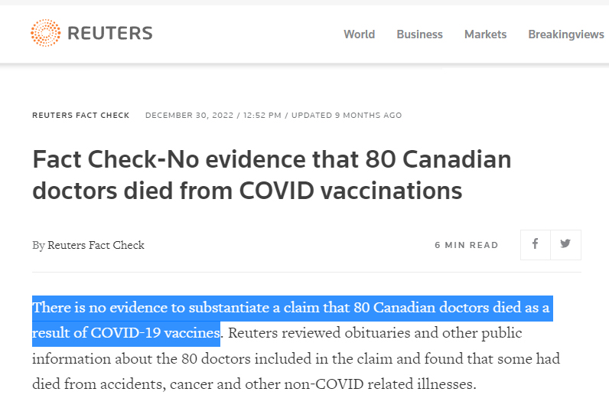
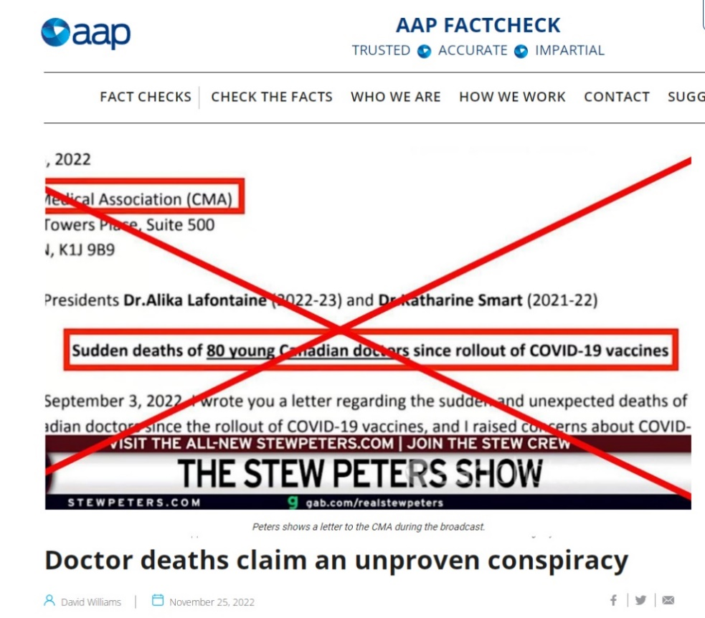

Slide 32
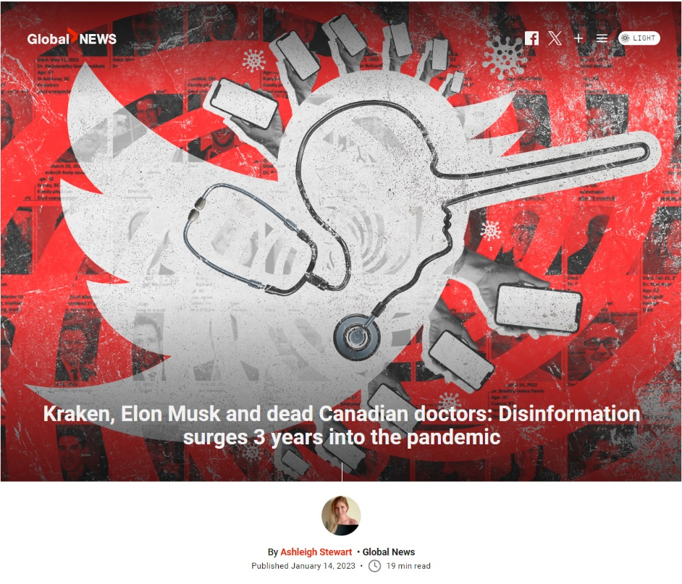
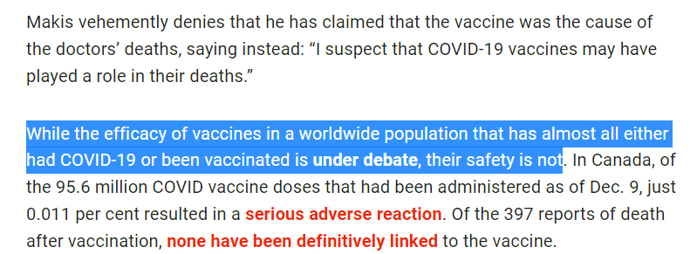

Slide 33
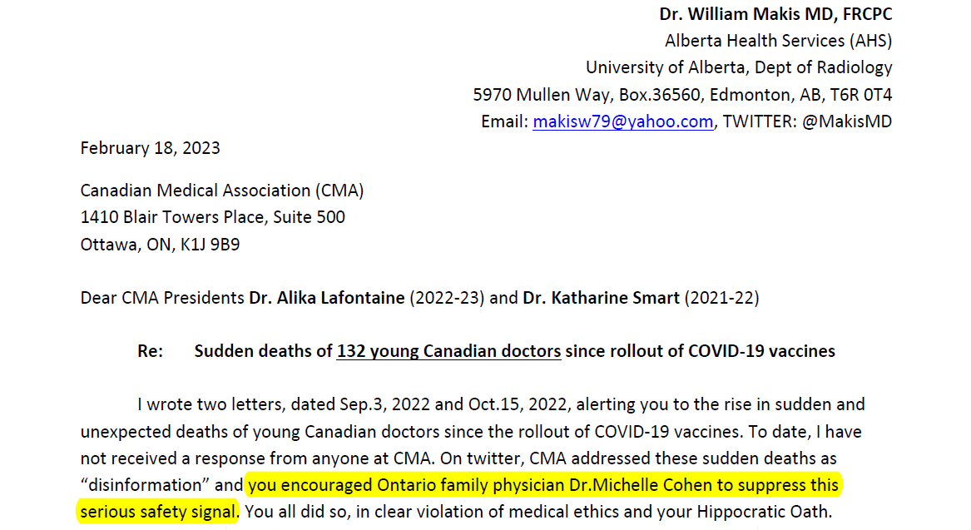
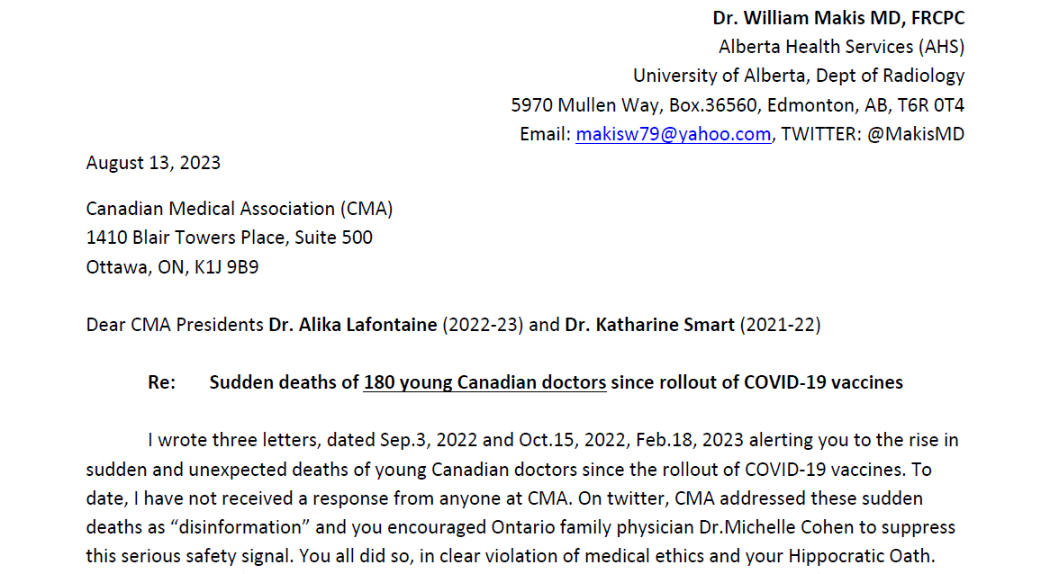
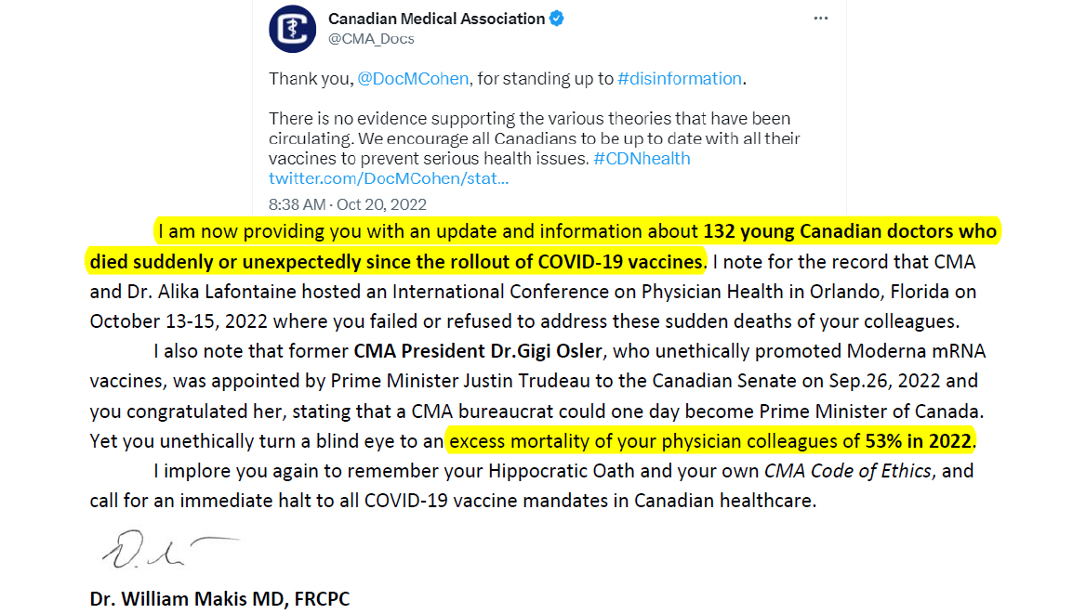

Slide 34
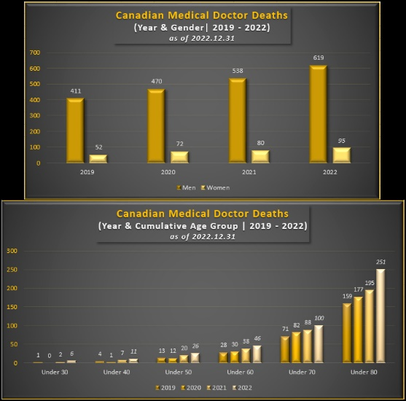

Slide 37
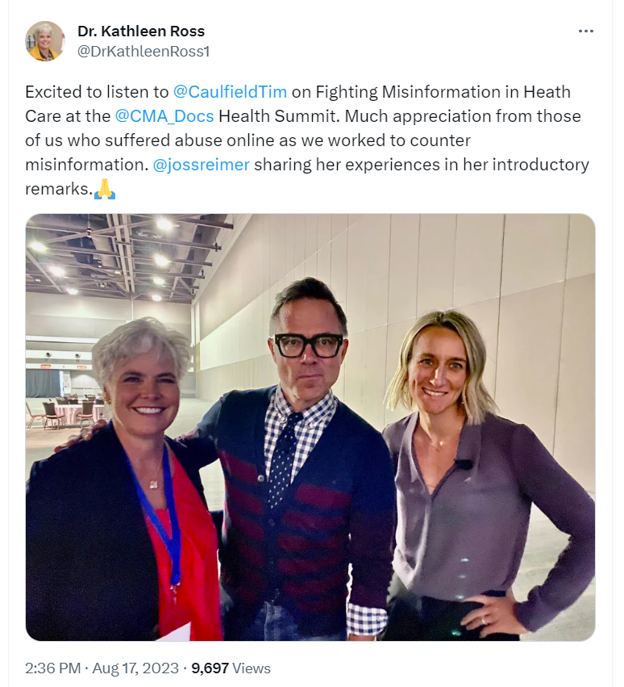
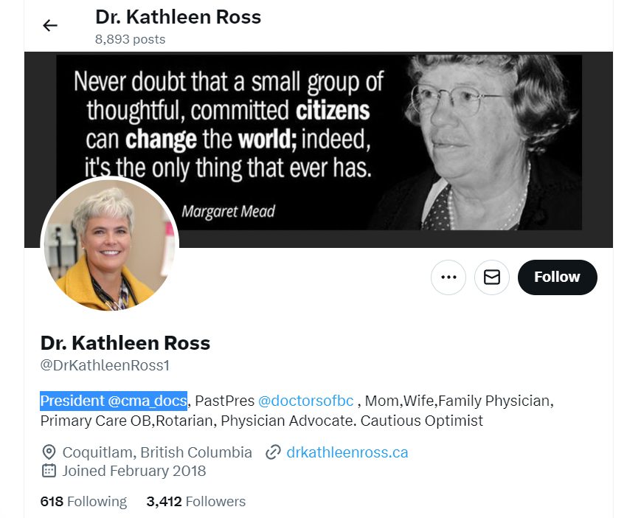
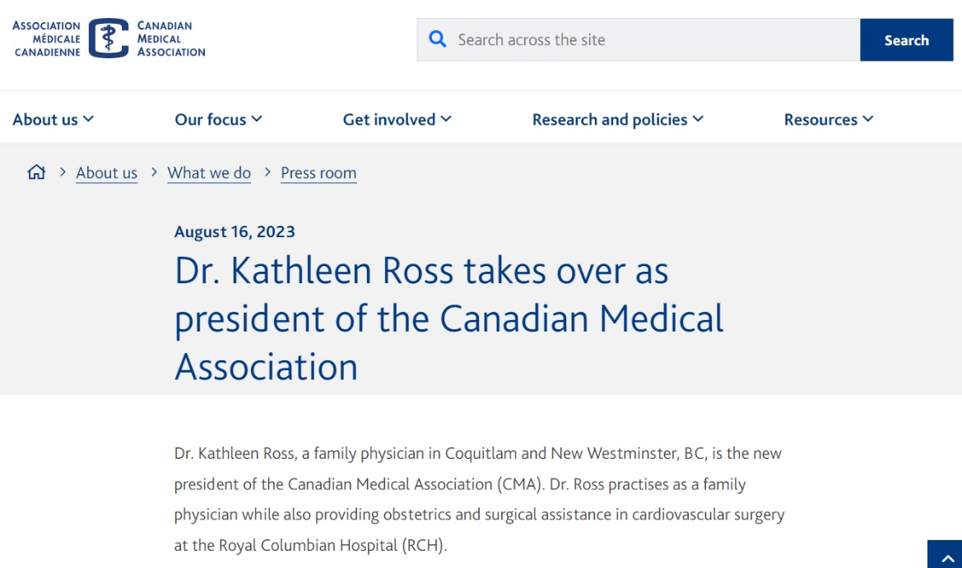

Slide 39
Alberta government deleted COVID-19 Vaccine outcome data during 2021-2022 from alberta.ca

Slide 40
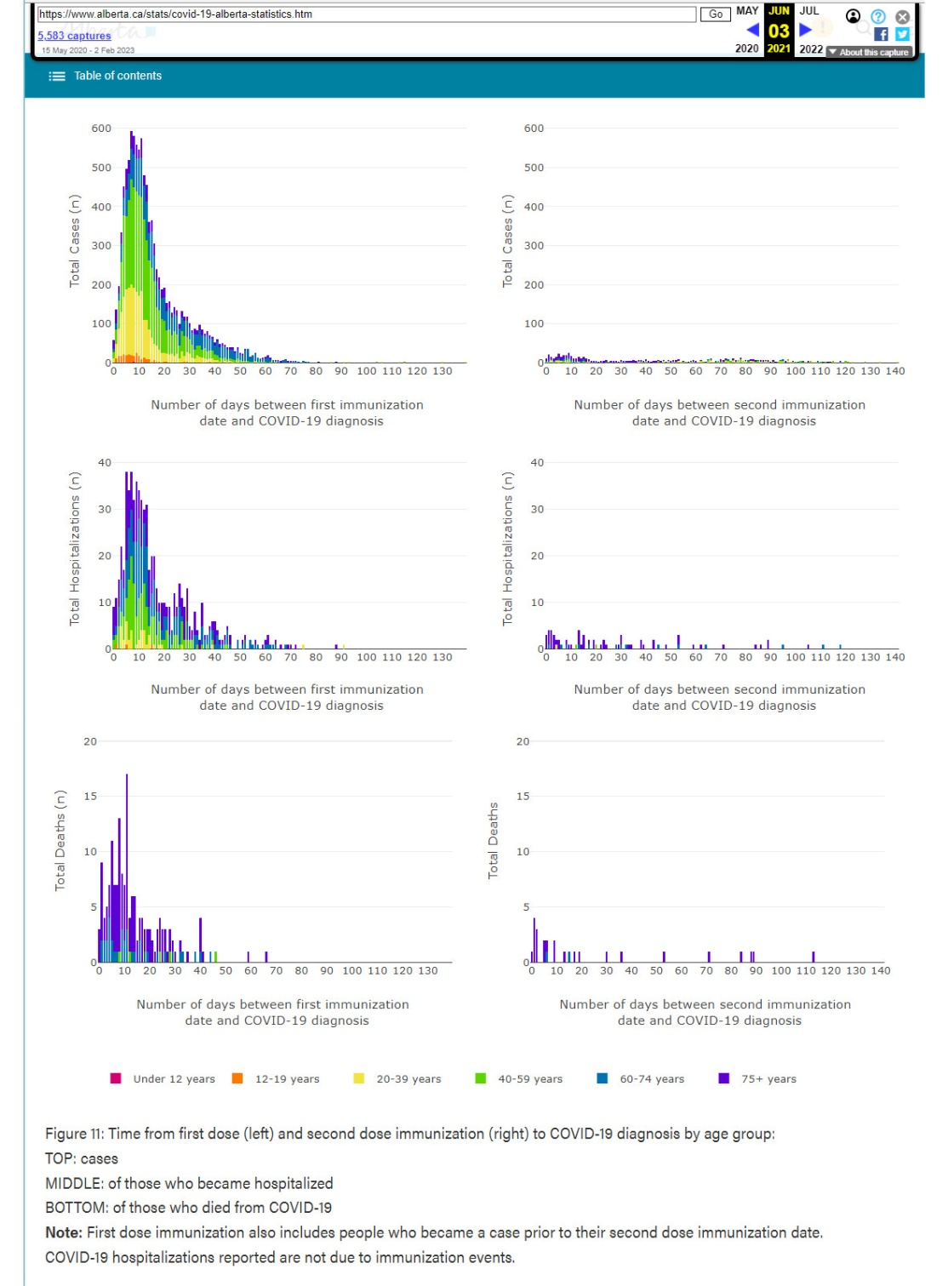
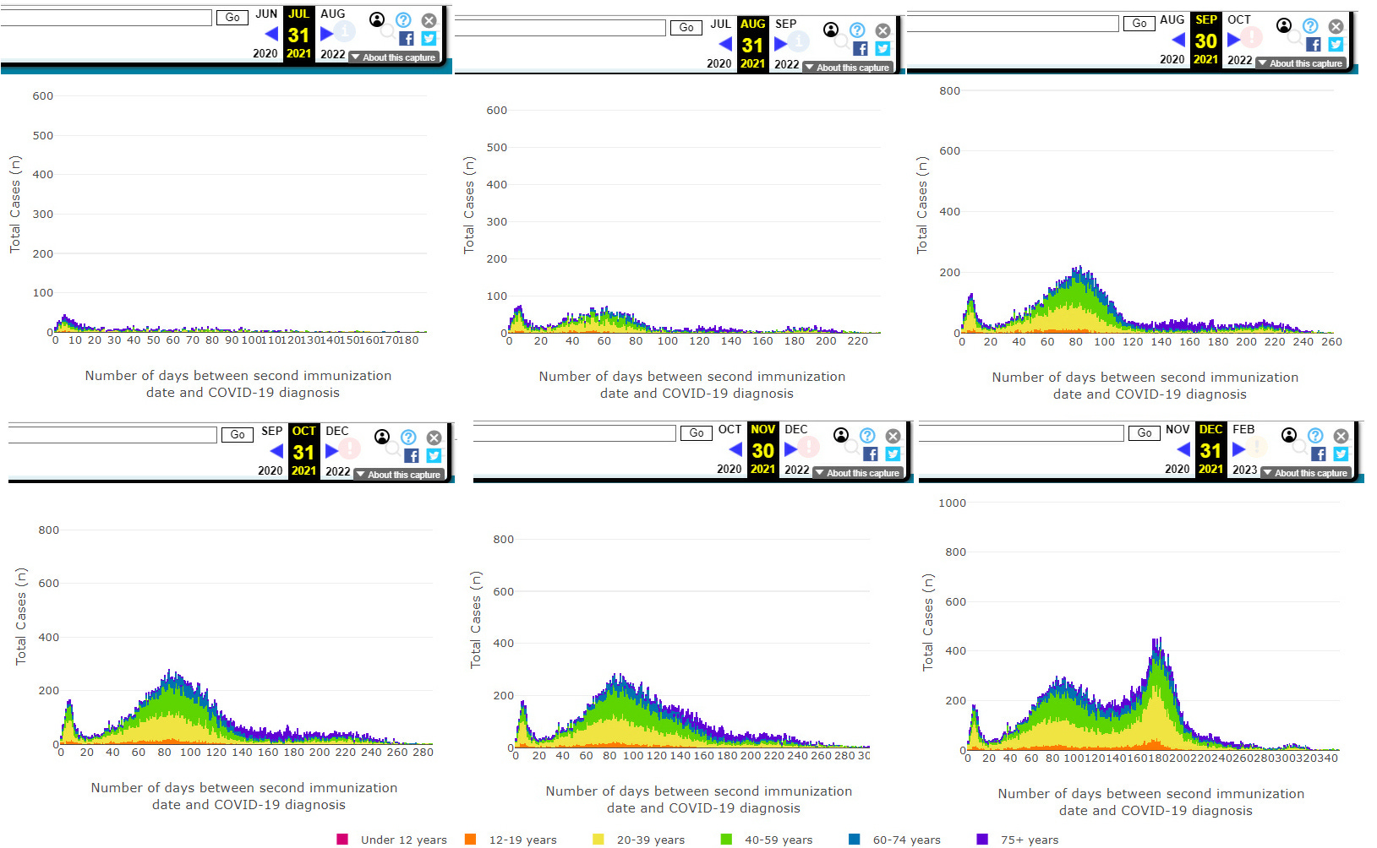
Alberta government deletes COVID-19 Vaccine outcome data
Double vaccinated show evidence of immune system injury which increases over time.

Slide 41
Alberta government deletes COVID-19 Vaccine outcome data

Slide 42
Alberta government deletes COVID-19 Vaccine outcome data
Figure 11 was deleted by Alberta government on January 14, 2022

Slide 43
Alberta government deletes COVID-19 Vaccine outcome data

Slide 44
Alberta government deletes COVID-19 Vaccine outcome data

Slide 45
Alberta government deletes COVID-19 Vaccine outcome data
Figure 10 was deleted by Alberta government on March 23, 2022

Slide 46
Alberta government deletes COVID-19 Vaccine outcome data
Table 2 was deleted by Alberta government on July 21, 2022
(81% of hospitalized were vaccinated up from 72% in Mar.31, 2022)

Slide 47
Alberta government deletes COVID-19 Vaccine outcome data
Table 7 was deleted by Alberta government on July 21, 2022 (69.2% of ICU were vaccinated up from 48.2% in March 31, 2022)

Slide 48
Alberta government deletes COVID-19 Vaccine outcome data
Table 10 was deleted by Alberta government on July 21, 2022 (83.4% deaths were vaccinated up from 68.9% in March 31, 2022)

Slide 49
BC government deletes COVID-19 Vaccine outcome data
Data Deleted by BC government on July 28, 2023 (89% deaths were vaccinated)

Slide 50
BC government deletes COVID-19 Vaccine outcome data

Slide 51
COVID-19 mRNA Vaccine induced Turbo Cancers

Slide 52
mRNA vaccine induced Turbo Cancer

Slide 53
COVID-19 vaccine induced Turbo Cancer

Slide 54
Turbo Cancer

Slide 56
Turbo Cancer

Slide 57
Turbo Cancer
Turbo cancer features:
seen in young individuals
presents at Stage 4
very rapid growth
highly metastatic
resistant to conventional chemotherapy, radiation therapy
types: lymphoma, glioblastoma (brain), breast, colon, lung cancer
Leukemia is most aggressive, diagnosis to death is weeks, days or hours.
Many turbo cancers kill in 3-6 months after diagnosis
Breast, colon and lung kill in about 6-12 months.
affects vaccine mandated professions: doctors, nurses, teachers, police, military

Slide 58
Sudden deaths following COVID-19 vaccination

Slide 59
Sudden deaths and COVID-19 mRNA vaccines
Largest review of autopsies of sudden deaths of COVID-19 vaccinated individuals:
325 autopsy cases
Mean time from COVID-19 vaccination to death: 14.3 days
74% of deaths due to vaccine
53% cardiovascular
17% hematological
8% were respiratory
7% were multiple organ systems
censored by Lancet (removed from preprint server after 24hr)
currently under peer review

Slide 60
Sudden deaths and COVID-19 mRNA vaccines
Largest review of autopsies of myocarditis deaths of COVID-19 vaccinated individuals:
28 autopsy cases
Mean time from COVID-19 vaccination to death: 6.2 days
100% of myocarditis deaths due to vaccine
currently under peer review

Slide 61
“I call for the immediate suspension of the use of COVID-19 mRNA vaccines, especially in children of all ages and in pregnant women.”
“There is a substantial body of evidence of serious adverse events including deaths, caused by or contributed to by COVID-19 vaccines and it is my conclusion that these pharmaceutical products are neither safe nor effective.”
“I call for the immediate suspension of all remaining COVID-19 vaccine mandates, especially in healthcare.”
“I call on my Canadian physician colleagues to find their voice and courage to stand up for their patients, for their Hippocratic Oath, and for the ethical practice of medicine.”
“I am calling for immediate investigations into COVID-19 vaccine injuries and deaths, including thorough autopsies of all sudden or unexplained deaths after vaccination.”
“We need immediate research into diagnostics and treatments for those who have been COVID-19 vaccine injured.”
Email: makisw79@yahoo.com
Substack: makismd.substack.com
Twitter/X: twitter.com/MakisMD
Instagram: wmakismd

