Slide 1
NATIONAL CITIZENS’ INQUIRY A Small-Town Lawyer’s Perspective
Maurice
Gatien
May 18, 2023

Slide 2
Executive Summary
Introduction & Overview
Intimidation – The Process is the Punishment
The Clown Deals
The BOLD Lie Technique
Numbers – Myth & Reality
Charter of Rights
Hope for the Future
Perspective

Slide 3
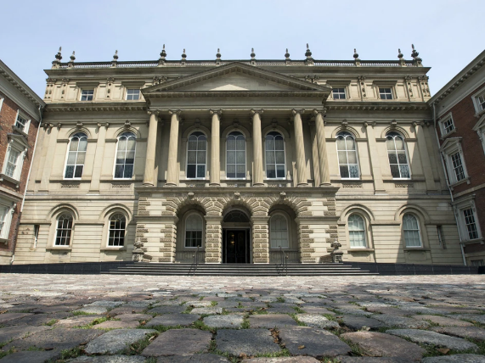
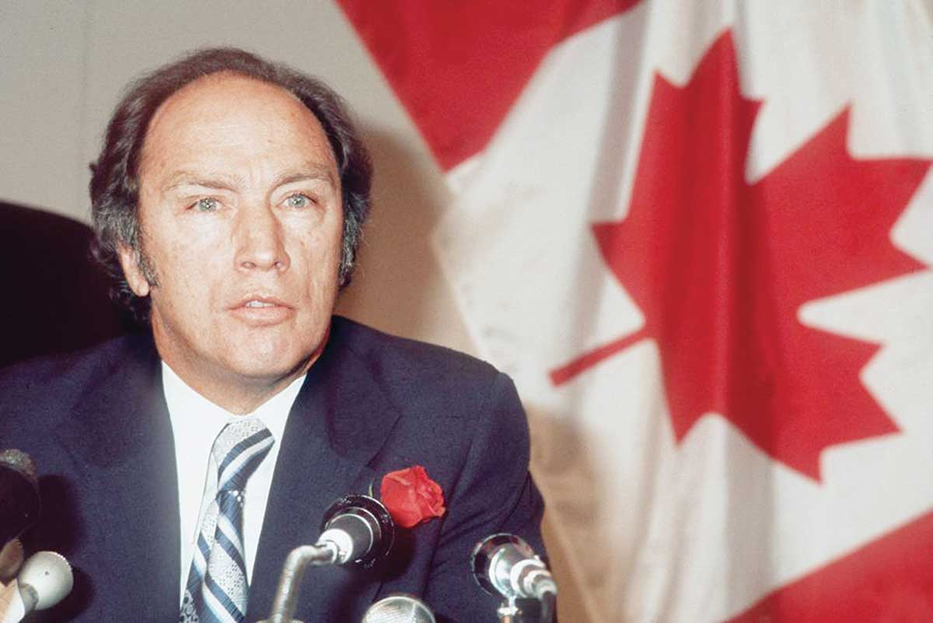
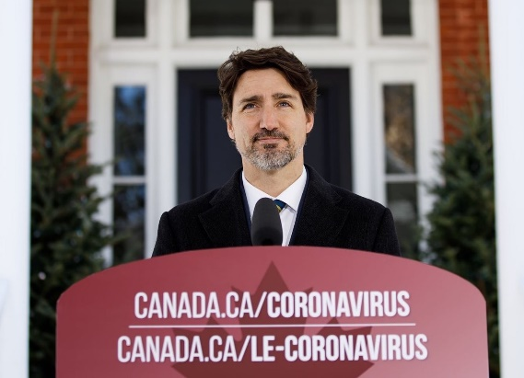
Introduction:Respecting the Many, Not Just the Few
Graduated from the last class to attend Osgoode Hall Law School downtown location in 1969
Suspension by LSO – September 29th 2022
Potluck Supper in a barn – Dunvegan – January 27th 2023
Farmer facing the Powerful
Pierre Trudeau – the father: 1982 Enactment of the Charter
Justin Trudeau – the son: 2022 Enactment of Emergency Act -

Slide 4
Intimidation: the Process is the Punishment (1)
Defending an Anthem Singer and a Small Business Owner under Reopening Ontario Act:
Up to 1 year in jail
Up to $100,000 fine
Defending people from Bullying and Intimidation – Shield against Harassment
Doxing of Home Address
Threats, assault, vehicle theft & vehicle sabotage
Walk to Ottawa in freezing cold of February – to protest against violence vs. lawyers

Slide 5
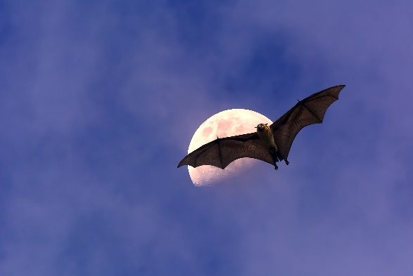
Intimidation: the Process is the Punishment (2)
Blocking of paid ads describing actual local Covid stats – Suppression of the “Good News”
$10,000 Reward for Bat #2
$1 for every $1B made by Pfizer – raising money for Women’s Shelters
Intimidation: LSO complaints
PM’s Privy Council Office
Vaccine Extremists - Demonization
Adjudicator came from law firm that represents: Pfizer, Moderna, Astra-Zeneca, CPSO, College of Psychologists, CMPA
Satirical & Scathing Treatment of Pfizer Profits and of Bat Theory

Slide 6
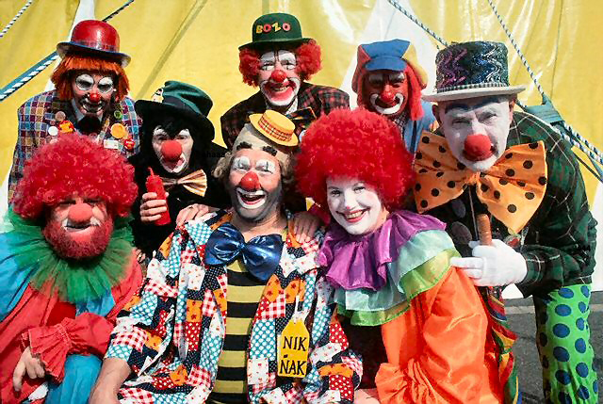
The CLOWN DEALS (1)
Normal Negotiations:
50-50 to 55-45 split
Mutual Respect
Long-term & Short-Term considerations
In-house vs Out-source
TTC, OTC, Hydro
Big Pharma Fines History – Need for Caution
Self-testing – no medical or law school uses this method
Self-marked exams
90 days instead of 3 years

Slide 7
The CLOWN DEALS (2)
Benefits to vaccine makers:
Contributions to R&D
All Vaccine Jab Costs paid
All Marketing Costs paid
Massive (free) support from Media + Censorship
No Liability
No vaccine injury reporting
Mandates
Doctors – Threat to Licenses
Self-tested authorizations
NO stock options, no sharing, no royalties for Taxpayer. NOTHING.

Slide 8
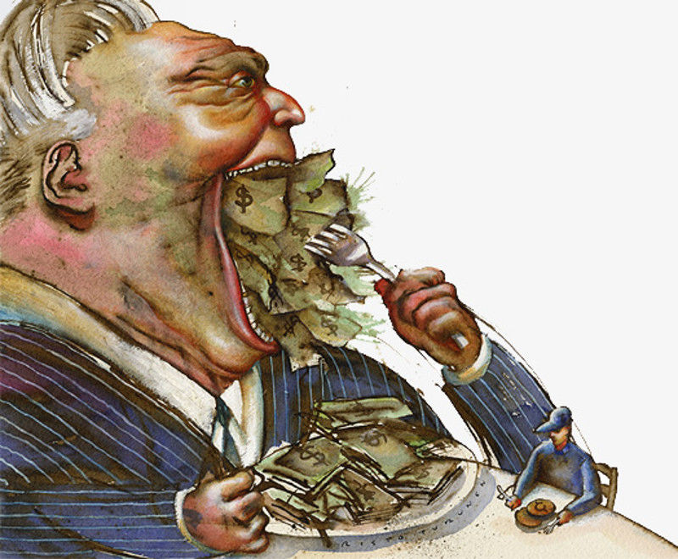
The BOLD Lie Technique (1)
Office Tower with Ghost Tenants
The PARIS Con after WWI
Madoff Scam
Mortgage Bundling Con - 2008
Many Other Cons: Bre-Ex, Nortel, FTX, etc.
Same Pattern: BOLD Lie
Why the BOLD Lie works:
Naivety & Reciprocity
Consequences of discovery

Slide 9
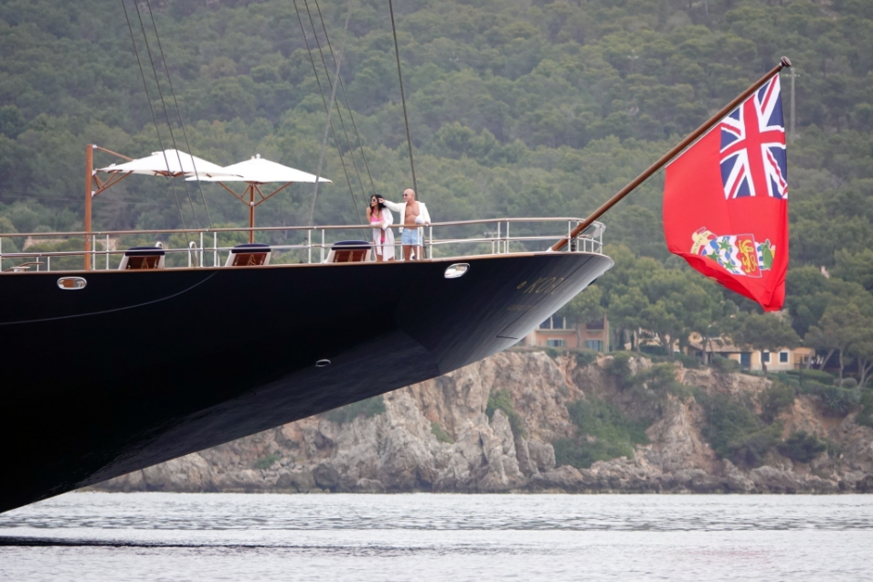
The BOLD Lie Technique (2)
2020: Geyser Pharma & Gil Bates
2019 Income: USD$16B
Celebration on Yacht
Drowning Man – Fear of Dying
Rope to rescue: $1.50/ft cost = $30.00/ft price
Covid = Two (2) BOLD Lies
#1: You are going to DIE
#2: Only the Vaccines will save you
NO promotion of good health
Gyms closed. Liquor stores open
Massive wealth transfer
Yachts & private jets on back-order
Ferrari & Lamborghini sales Up
New Billionaires by the dozens

Slide 10
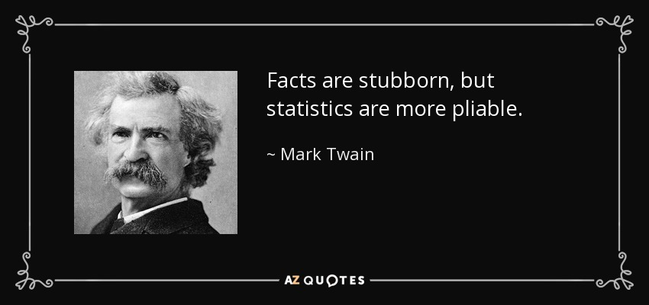
The Numbers: The Myth and the Reality
Anecdotal: Interaction with local lawyers, nurses, EMTs, police despatchers, teachers
Statistical: Eastern Ontario Health Unit Region: 213,000 people. Covid deaths: 96/yr. Zero deaths under Age 40.
Co-Morbidities Not Tracked.
Ottawa Health Unit Region: 1,017,000 people. Covid deaths: 355/yr.
Niagara Health Unit Region: 478,000 people. Covid deaths: 197/yr.
York Health Unit: 1,173,000 people. Covid deaths: 388/yr
ONTARIO: 15.3 million people. Covid deaths: 5,470/yr.
Average yearly rate: UNDER Four (4) one-hundredths of 1 percent
Pandemic or Panemic? Good vs. Bad News

Slide 11
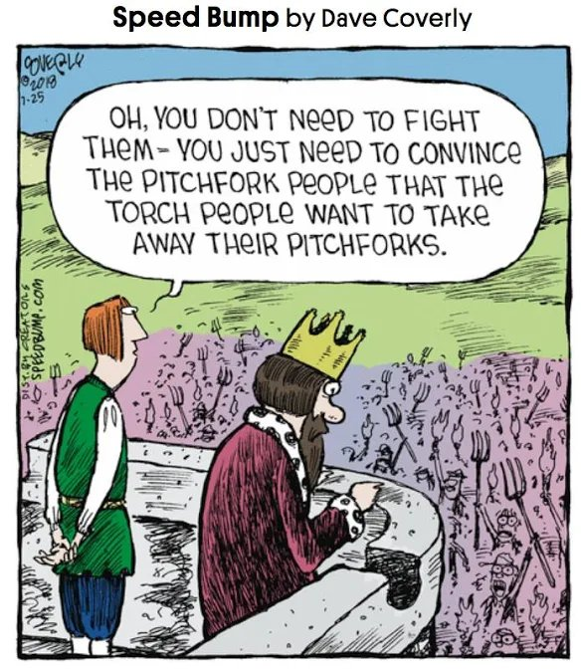
Charter of Rights – Brief History (1)
1215 (after a War): the Magna Carta
Short list of rights
Just 25 People – Just 25 Lords & Barons
Magna Carta rescinded in 1216 – re-affirmed in 1217 (after another war)
In 1600’s – Divine Rights of Kings – another war
In 1911 Parliament Act passed - House of Lords approval no longer needed
In Canada, constitution repatriated from England in 1982 and Charter of Rights implemented
Rights of Commoners – day-by-day, month-by-month, year-by-year – all rescinded in a matter of days in March 2020 based on panic & fear

Slide 12
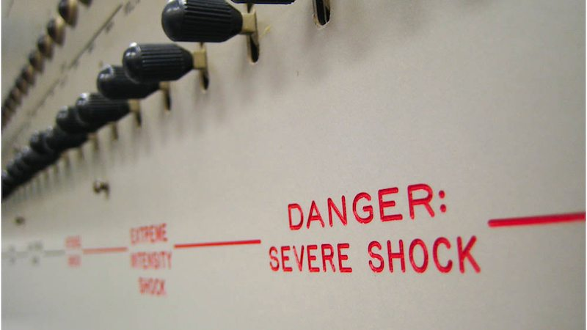
Charter of Rights – Brief History (2)
Ongoing sophistication of Advertising & Propaganda – since WWI
Expanding platforms: newspaper, radio, TV, phones, internet – 24/7
Human bandwidth – cluttering the shelf-space with junk info
Experiments in Manipulation:
Milgram Experiments
Elevator Conformity Experiments
Stanford Prisoner Experiments
1930’s Germany – lawyers & judges first to purge. Midwives, the last.
Capturing the positions of Trust
News Silos – Divide & Conquer

Slide 13
HOPE for the Future – Meeting the Challenges
Clown Deals: Case Studies in Law & Business Schools
Law Societies – robust courses: Charter Rights, Ethics
Colleges of Physicians:
Code of Ethics – Informed Consent
Health expertise – Nutrition, Breathing, best practices
Historians: Corruption as Influencer
Journalism Schools: focus on evidence + avoiding censorship
Media: focus on good health and positives in the news/weather
Education: teaching foundational values and useful life skills in HS – a FILTER
Teaching about the Few and the Many

Slide 14
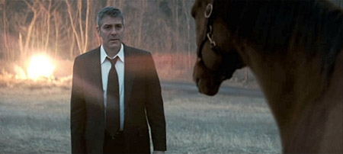
Perspective
Mindfulness about importance of:
Guardrails: Critical thinking/Rule of Law
The Many and the Few – Dynamic Balance
Shakespeare: “First, Let’s kill all the lawyers”
Intended as compliment: to describe first thing a tyrant would try to do
Lawyers have critical role to play as protectors of the Many, at times at the expense of the Few
Most satisfying moments of past 3 years:
Helping vaccine injured – Lancaster Meet-up at Grocery Store
Walking to Ottawa – the last 5k
Helping the Anthem Singer

Slide 15
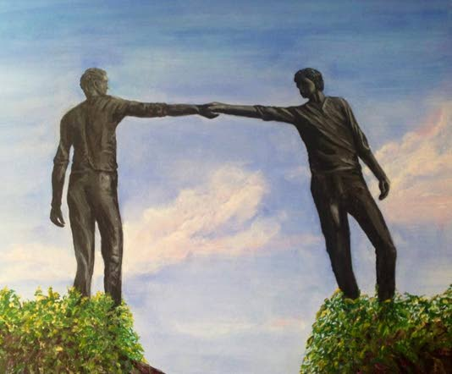
Inspirations
Follow up questions
mauricegatien@proton.me
No man is an island, Entire of itself. Each is a piece of the continent, A part of the main…
Each man's death diminishes me, For I am involved in mankind. Therefore, send not to know For whom the bell tolls, It tolls for thee. (John Donne)
Voltaire: Il faut s’occuper de son Jardin – We must cultivate our own Garden.
Gratitude: Thank you for the efforts of everyone today and in other sessions.

