Slide 1
National Citizens Inquiry
Testimony of Dr. Stephen Malthouse
Ottawa, May 17, 2023

Slide 2
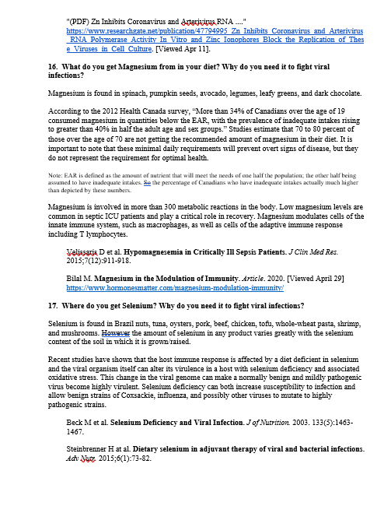
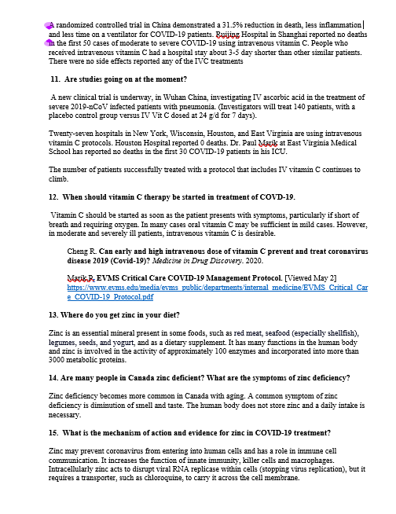
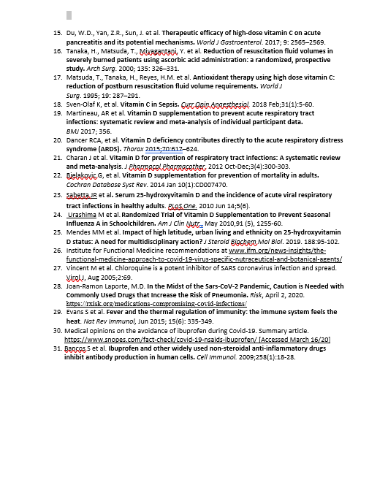
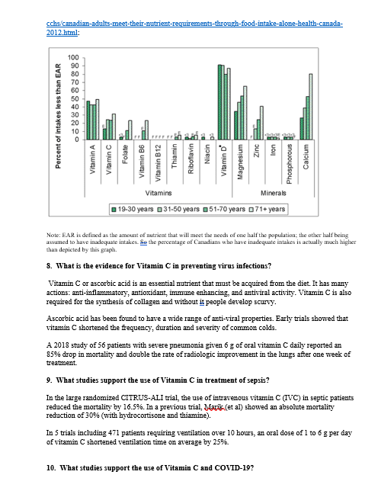
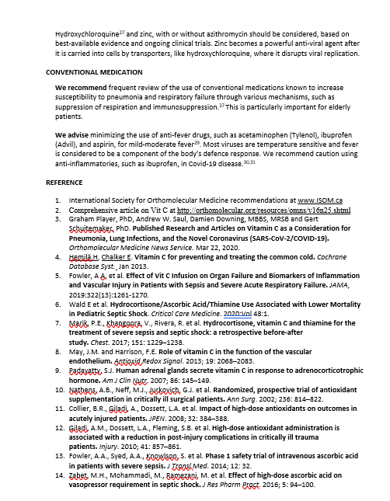
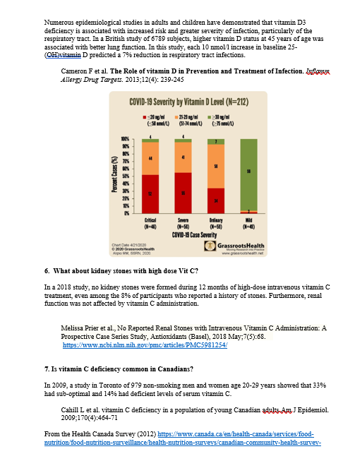
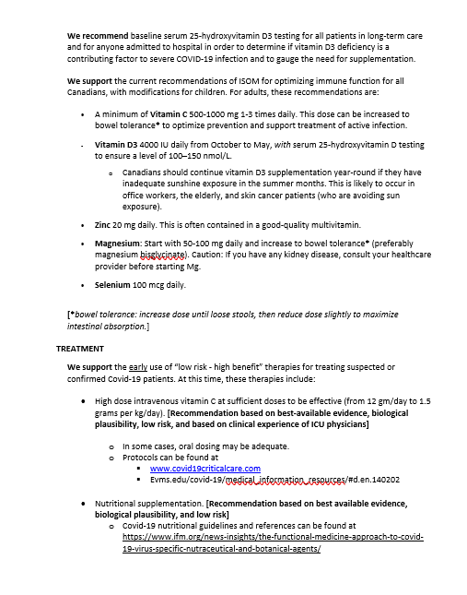
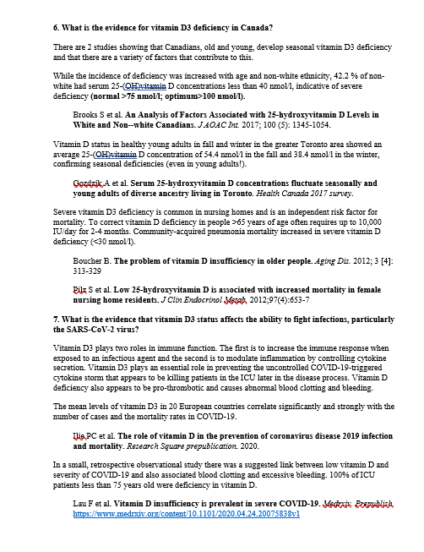
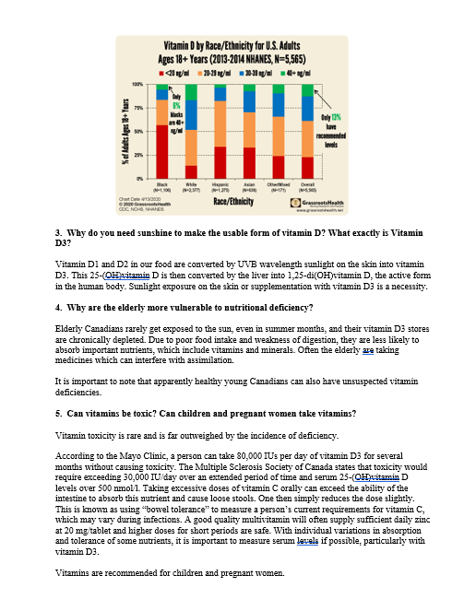
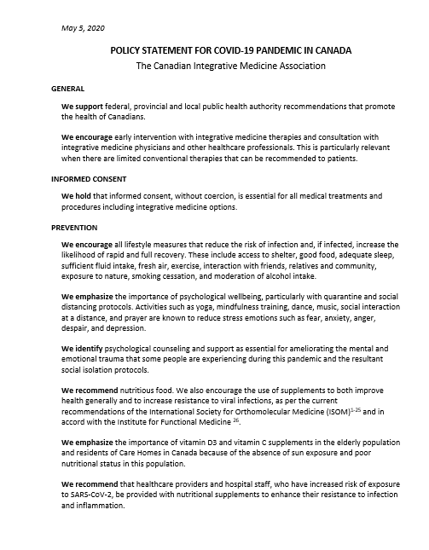
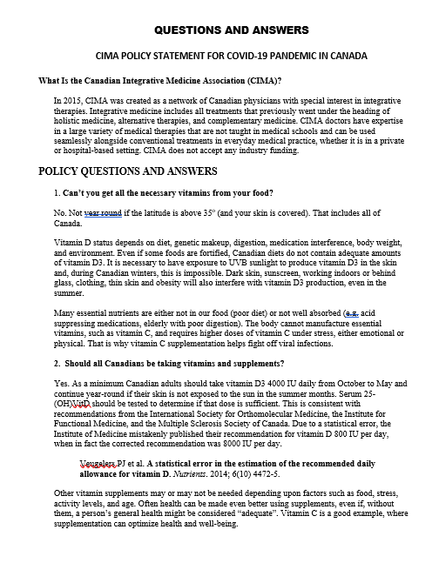

Slide 3
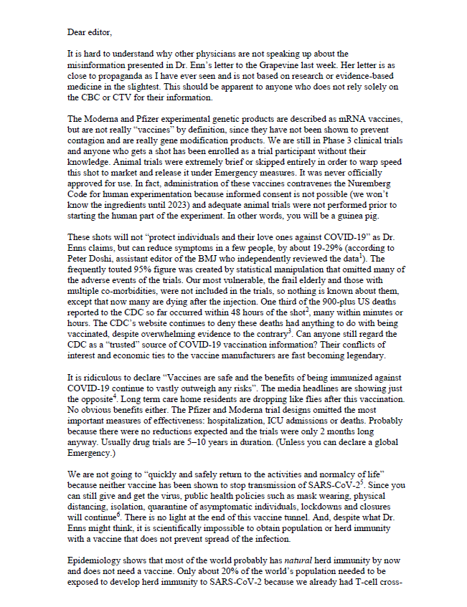
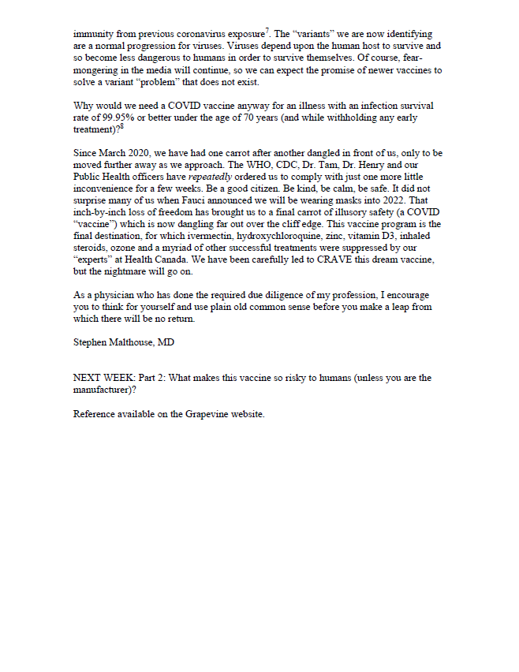

Slide 4
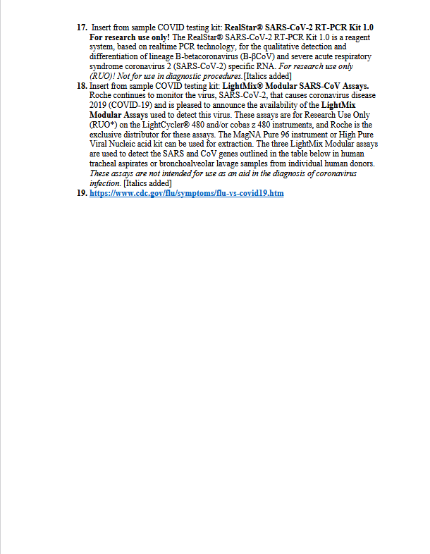
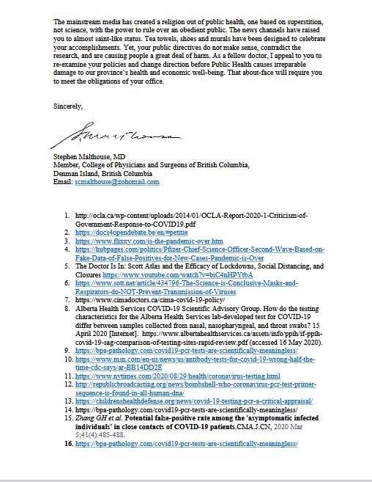
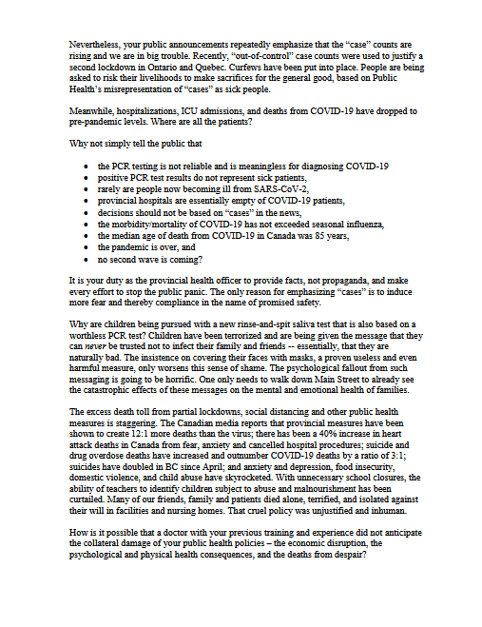
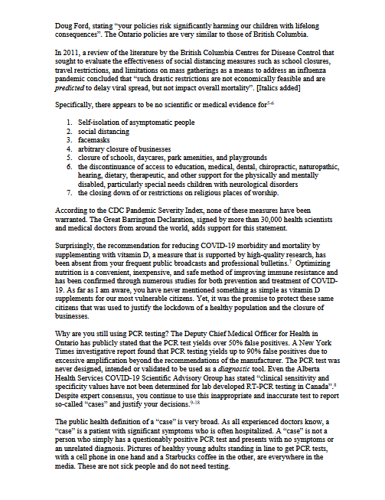
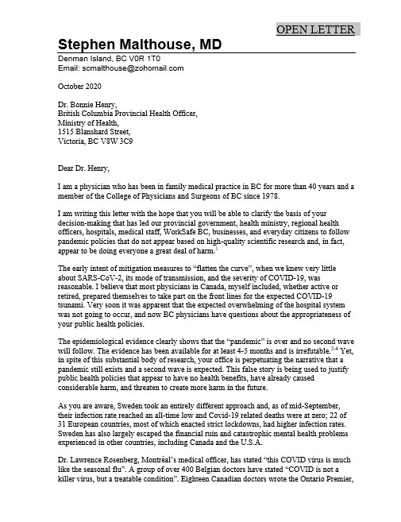

Slide 6
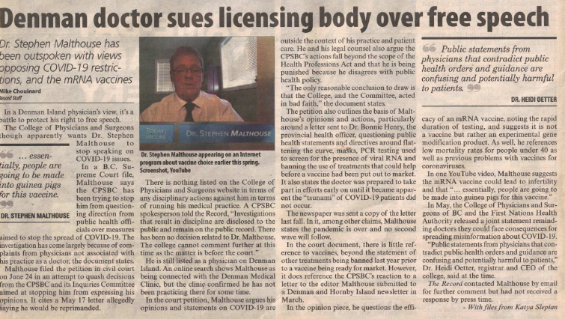

Slide 7
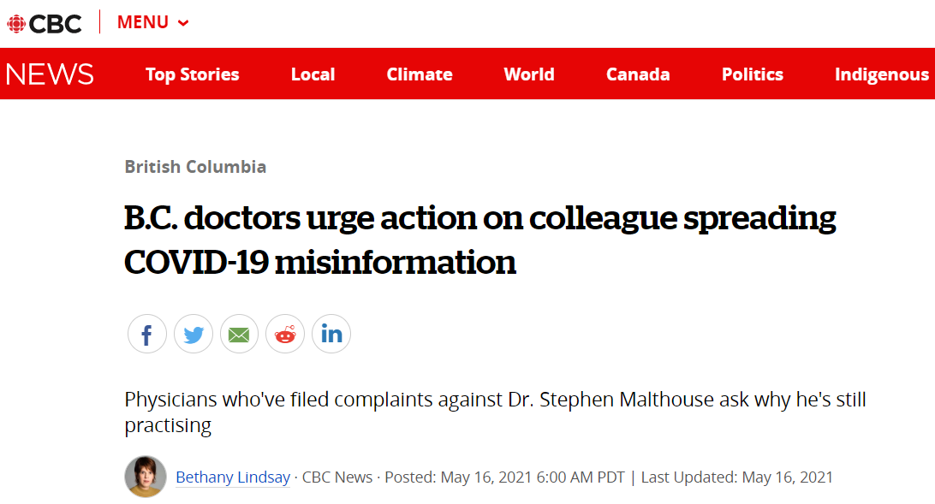

Slide 14
Educate 4 Vaccinate The COVID-19 Vaccines – Protecting our Children
Doctors Road Tour

Slide 16
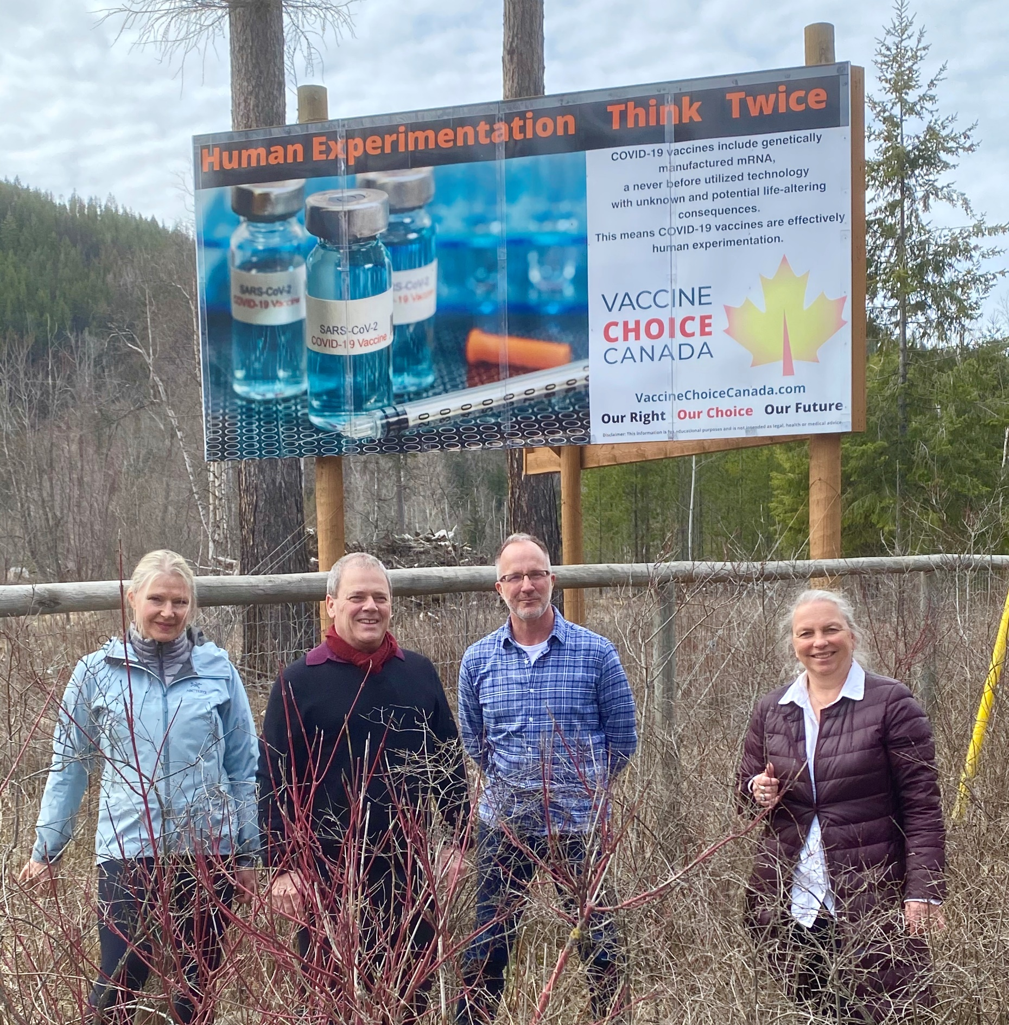

Slide 17
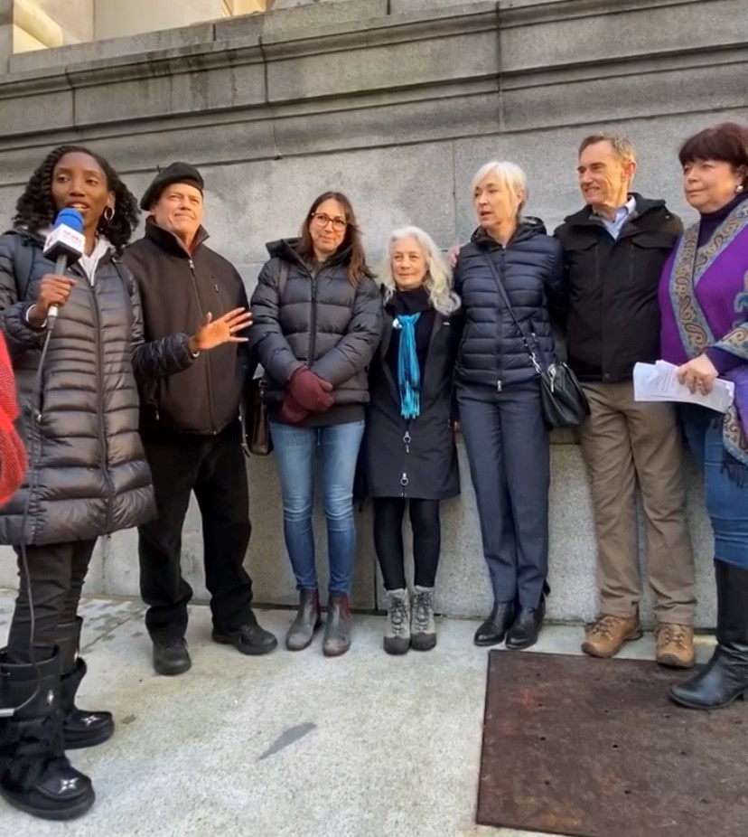

Slide 18
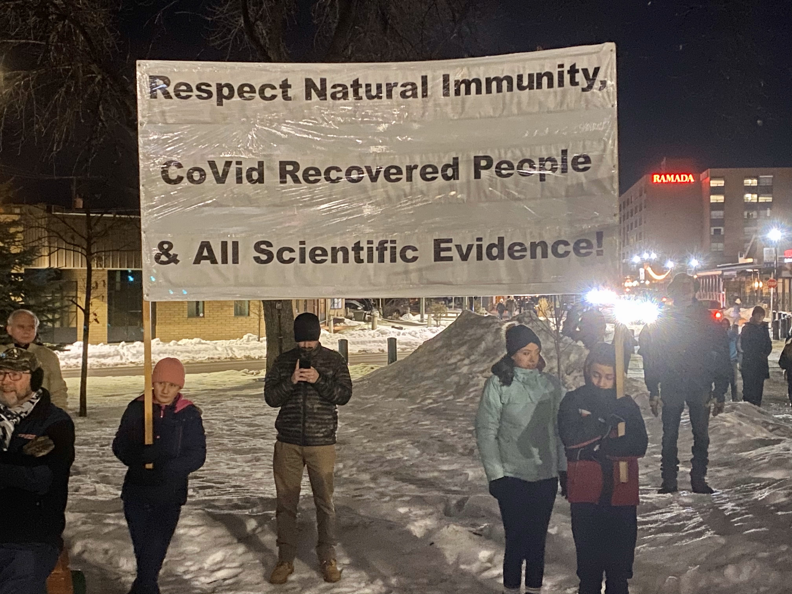

Slide 19
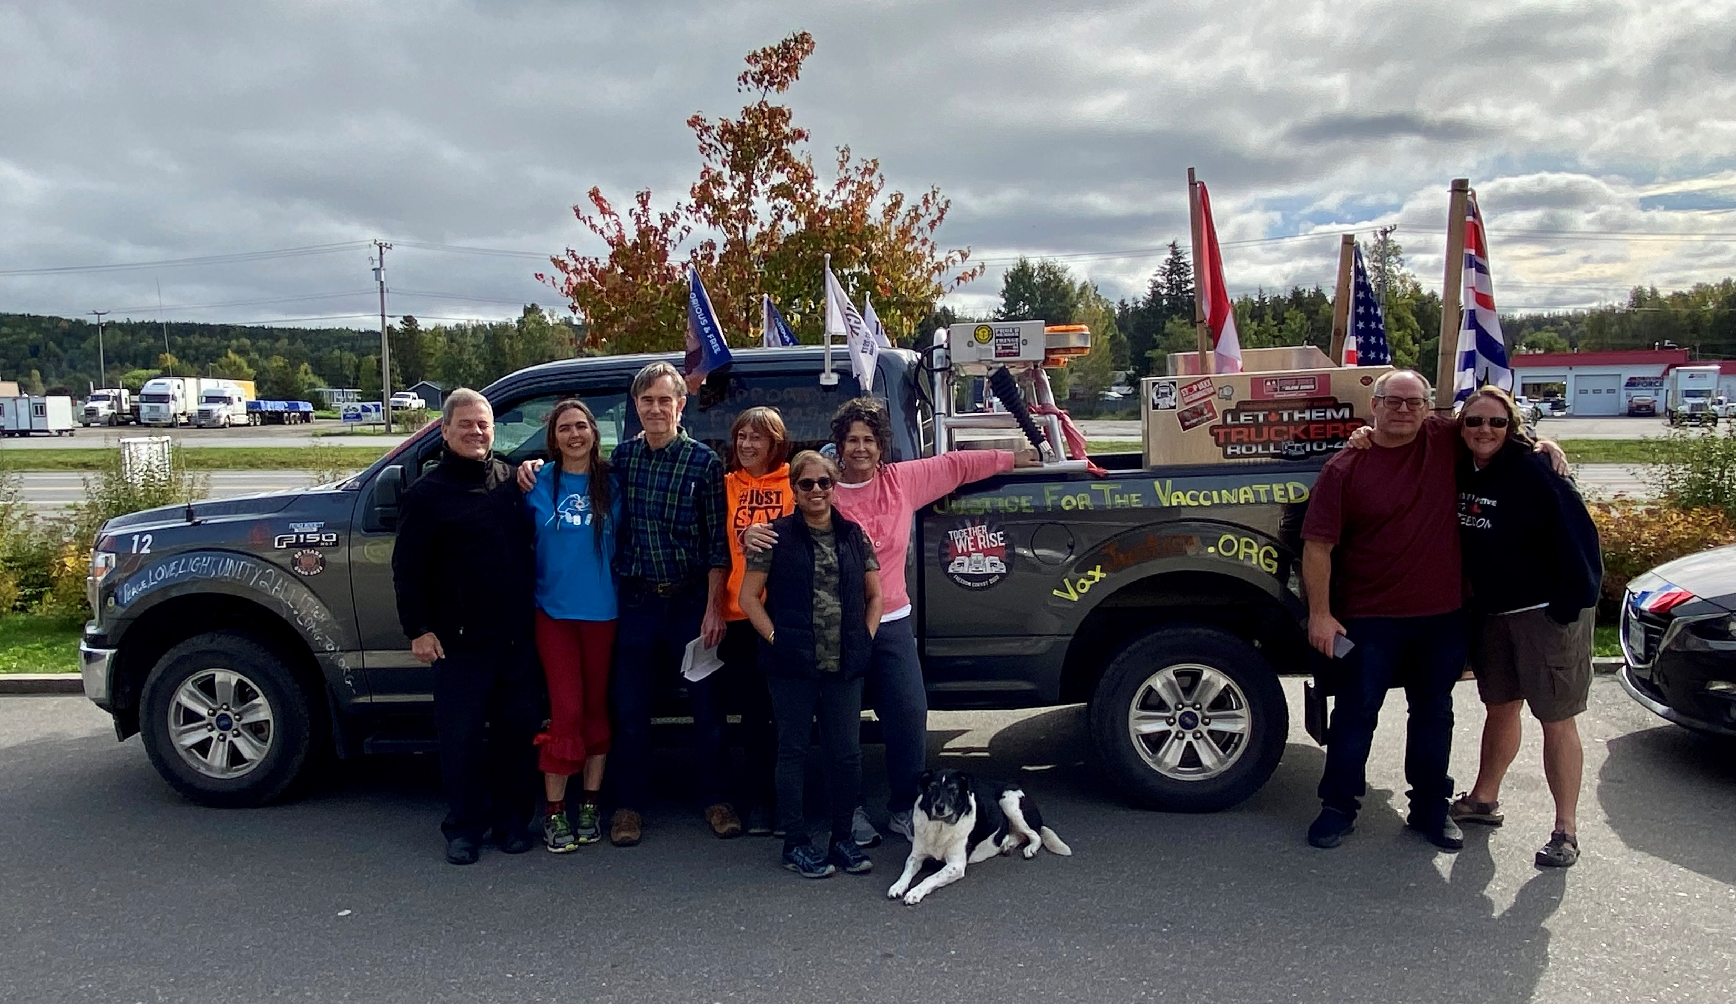

Slide 20
MyCVA.ca

Slide 22
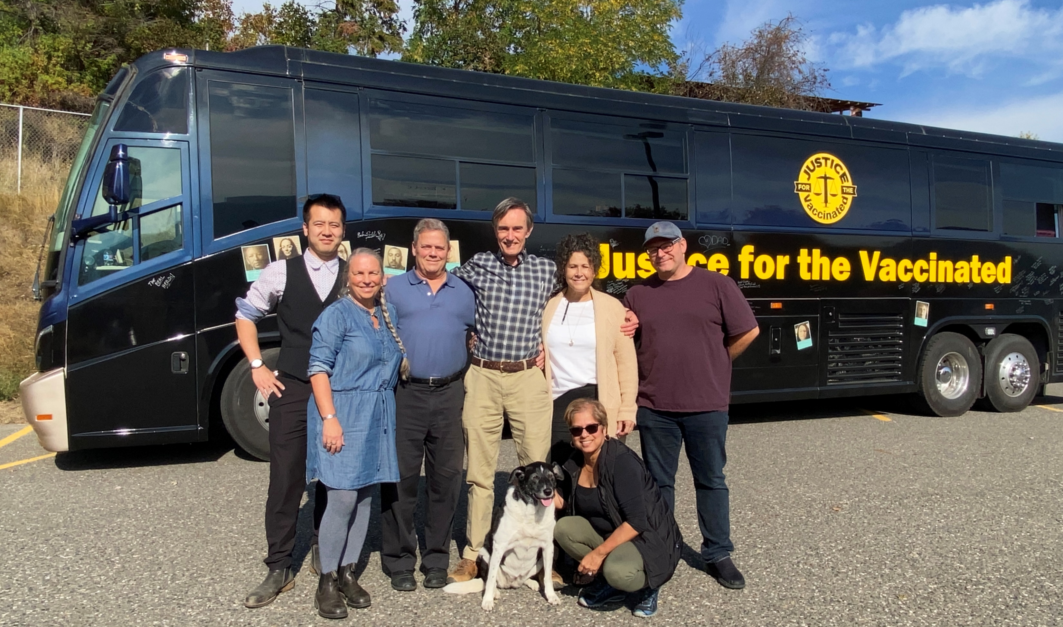

Slide 23
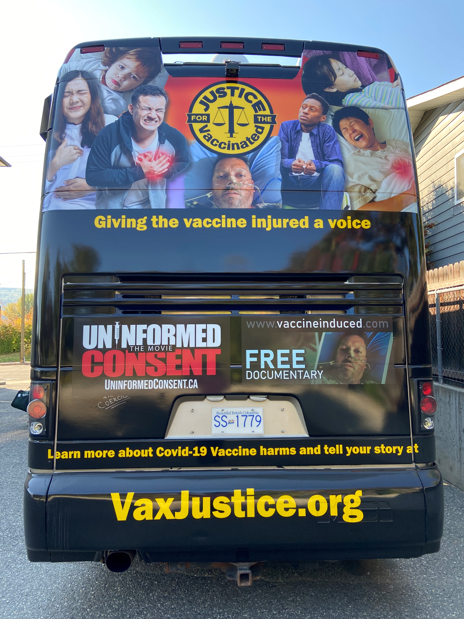

Slide 24
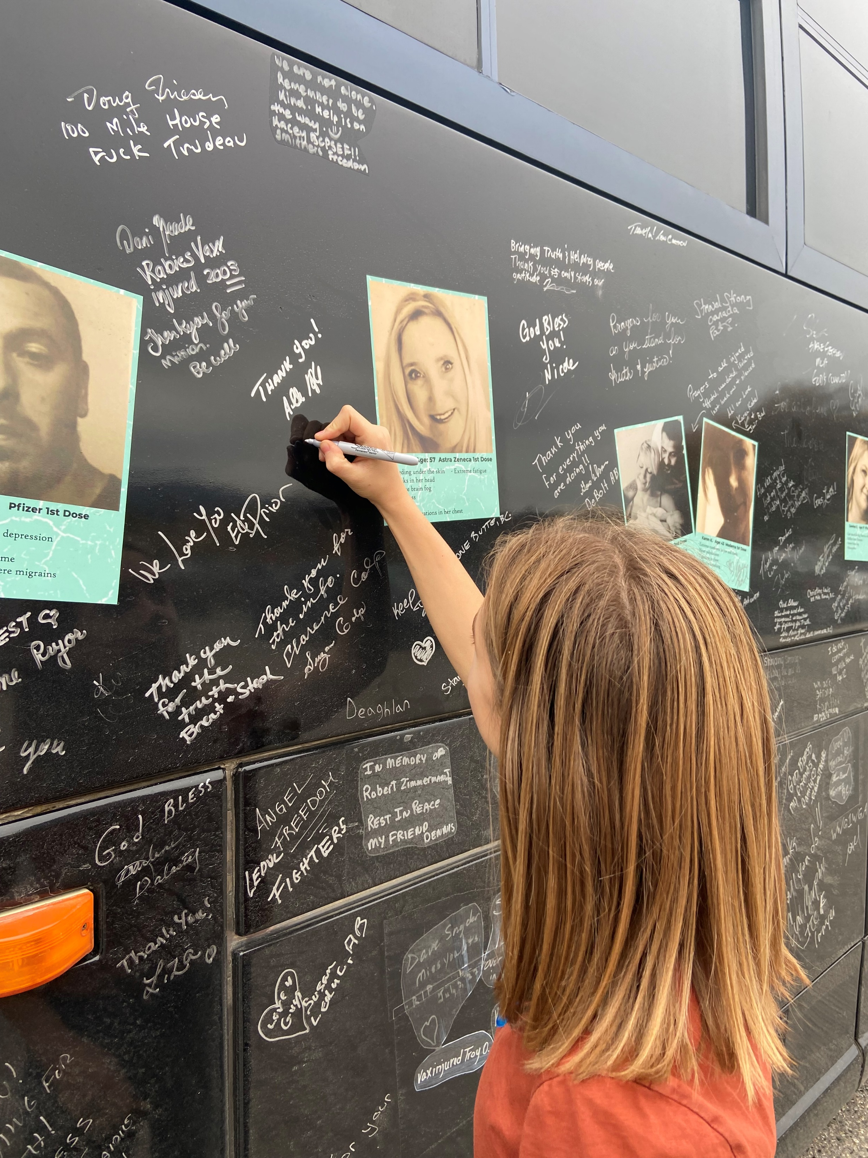

Slide 25
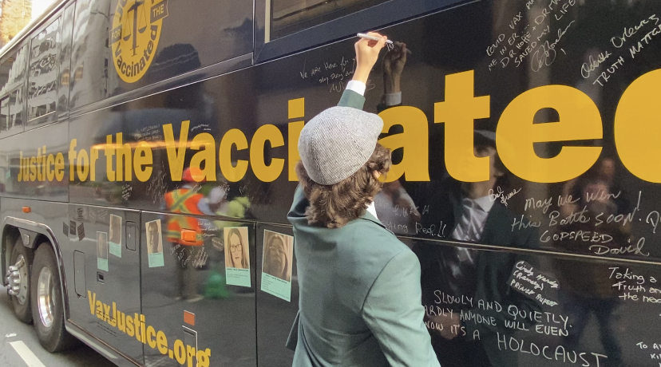

Slide 26
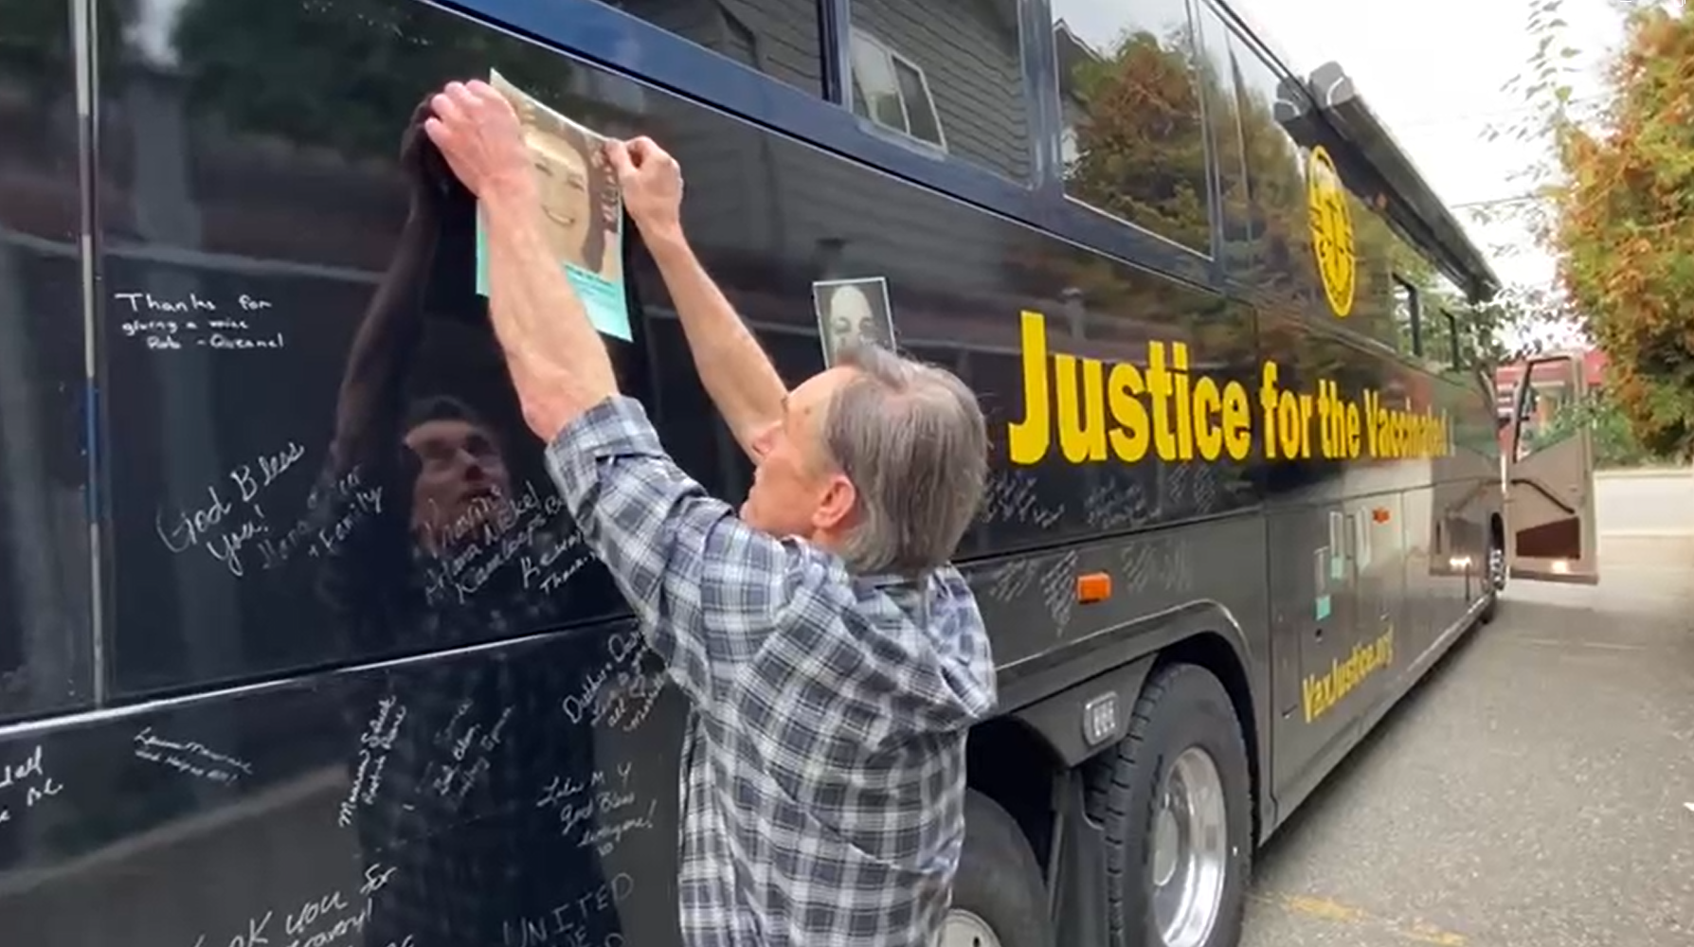

Slide 27
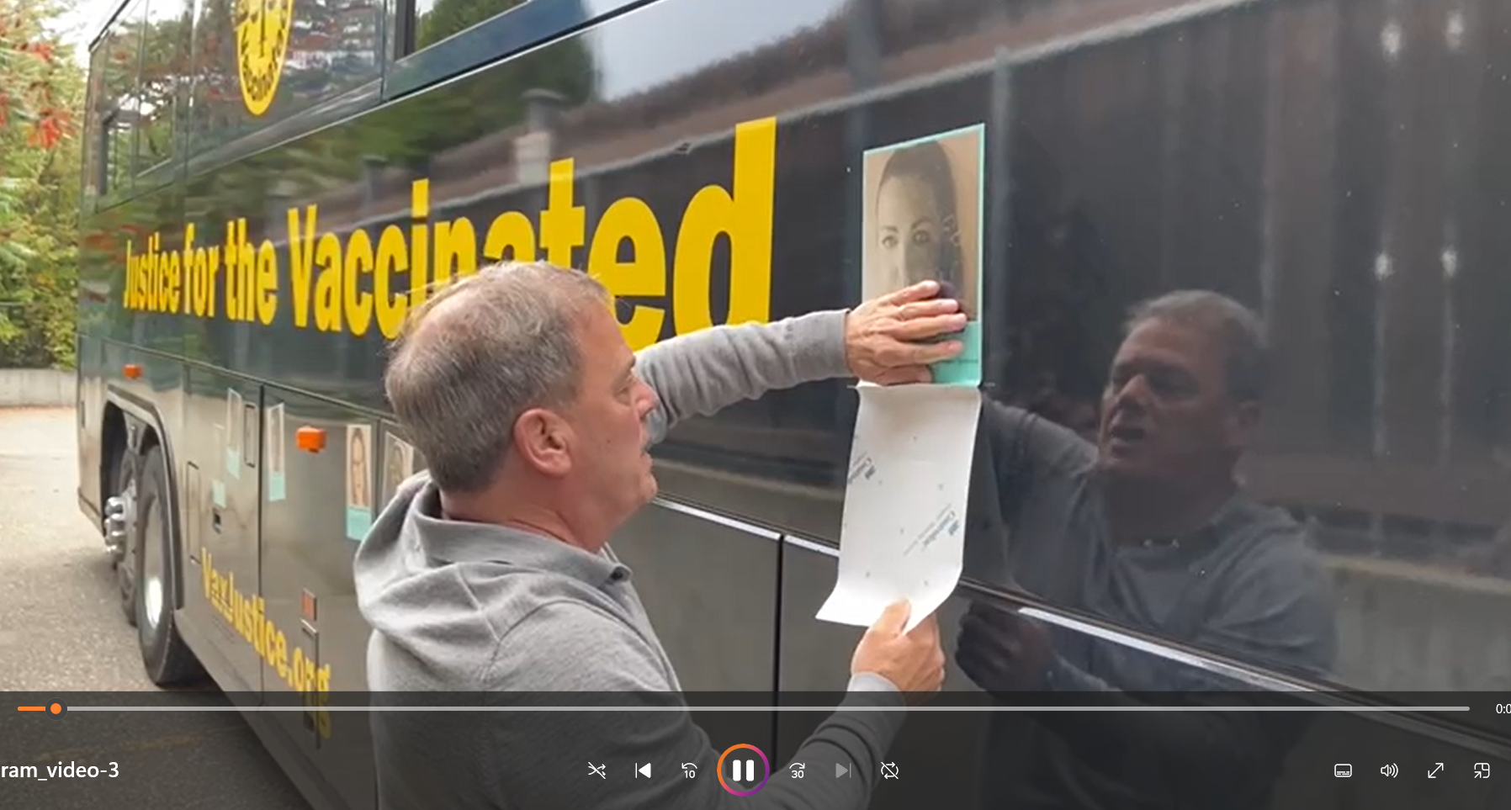

Slide 29
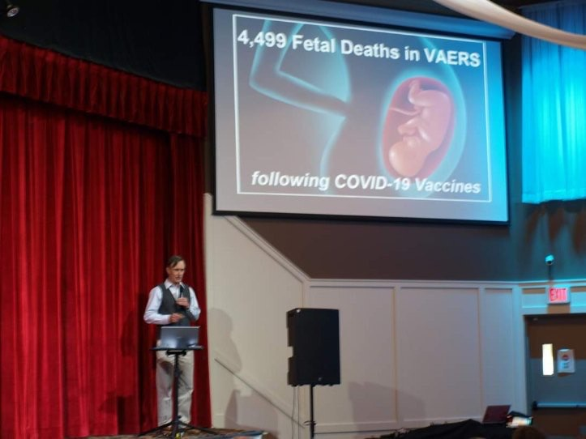
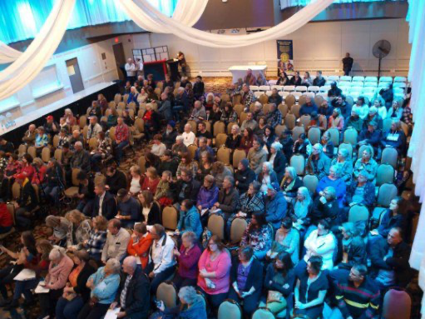
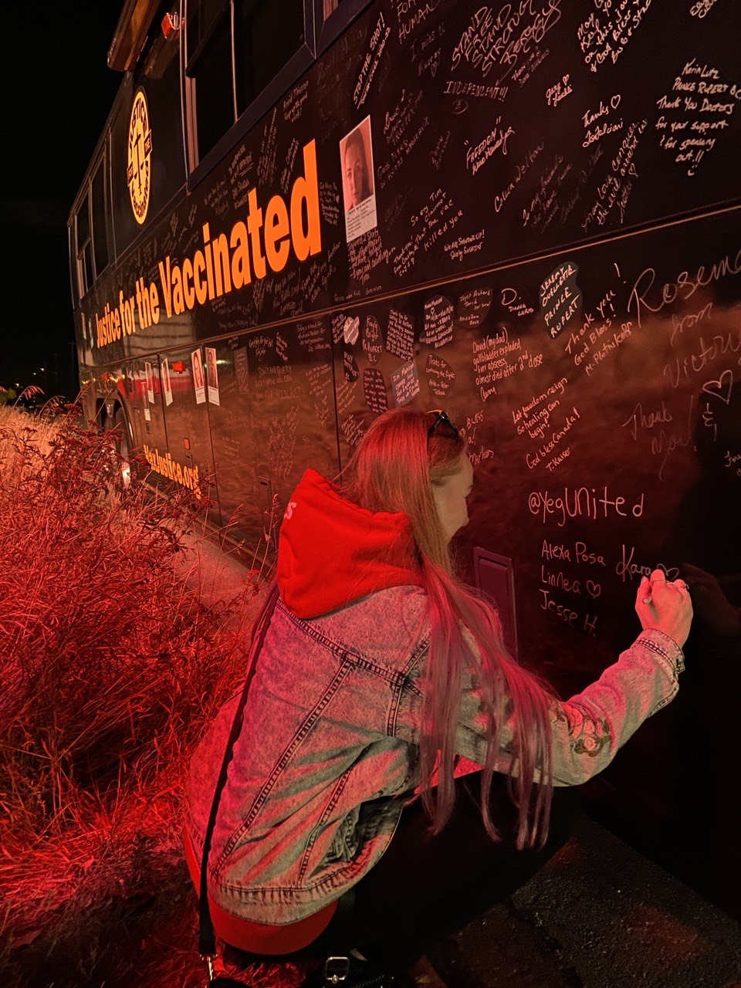

Slide 30
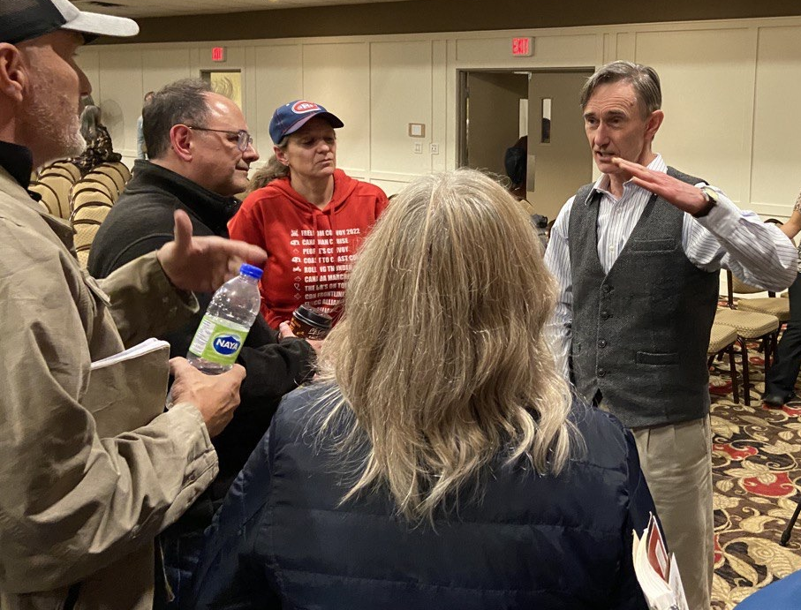

Slide 31
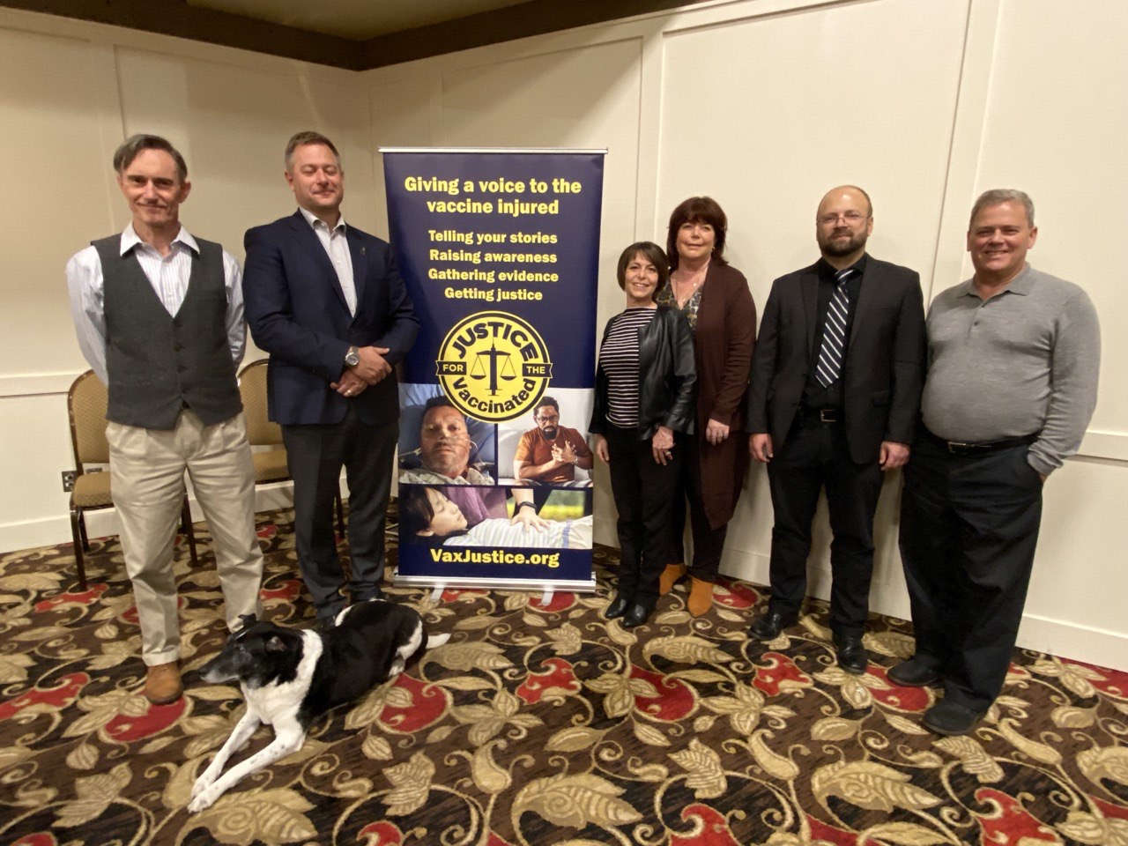

Slide 32
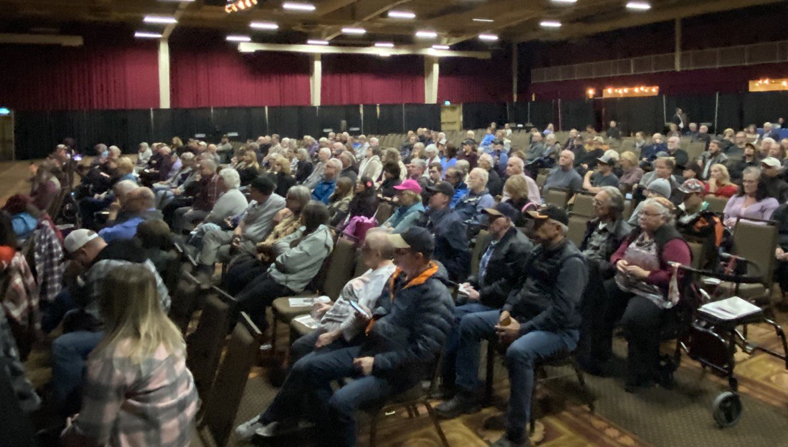

Slide 34
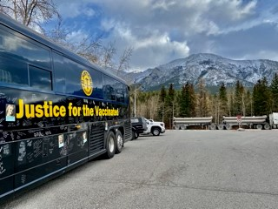

Slide 35
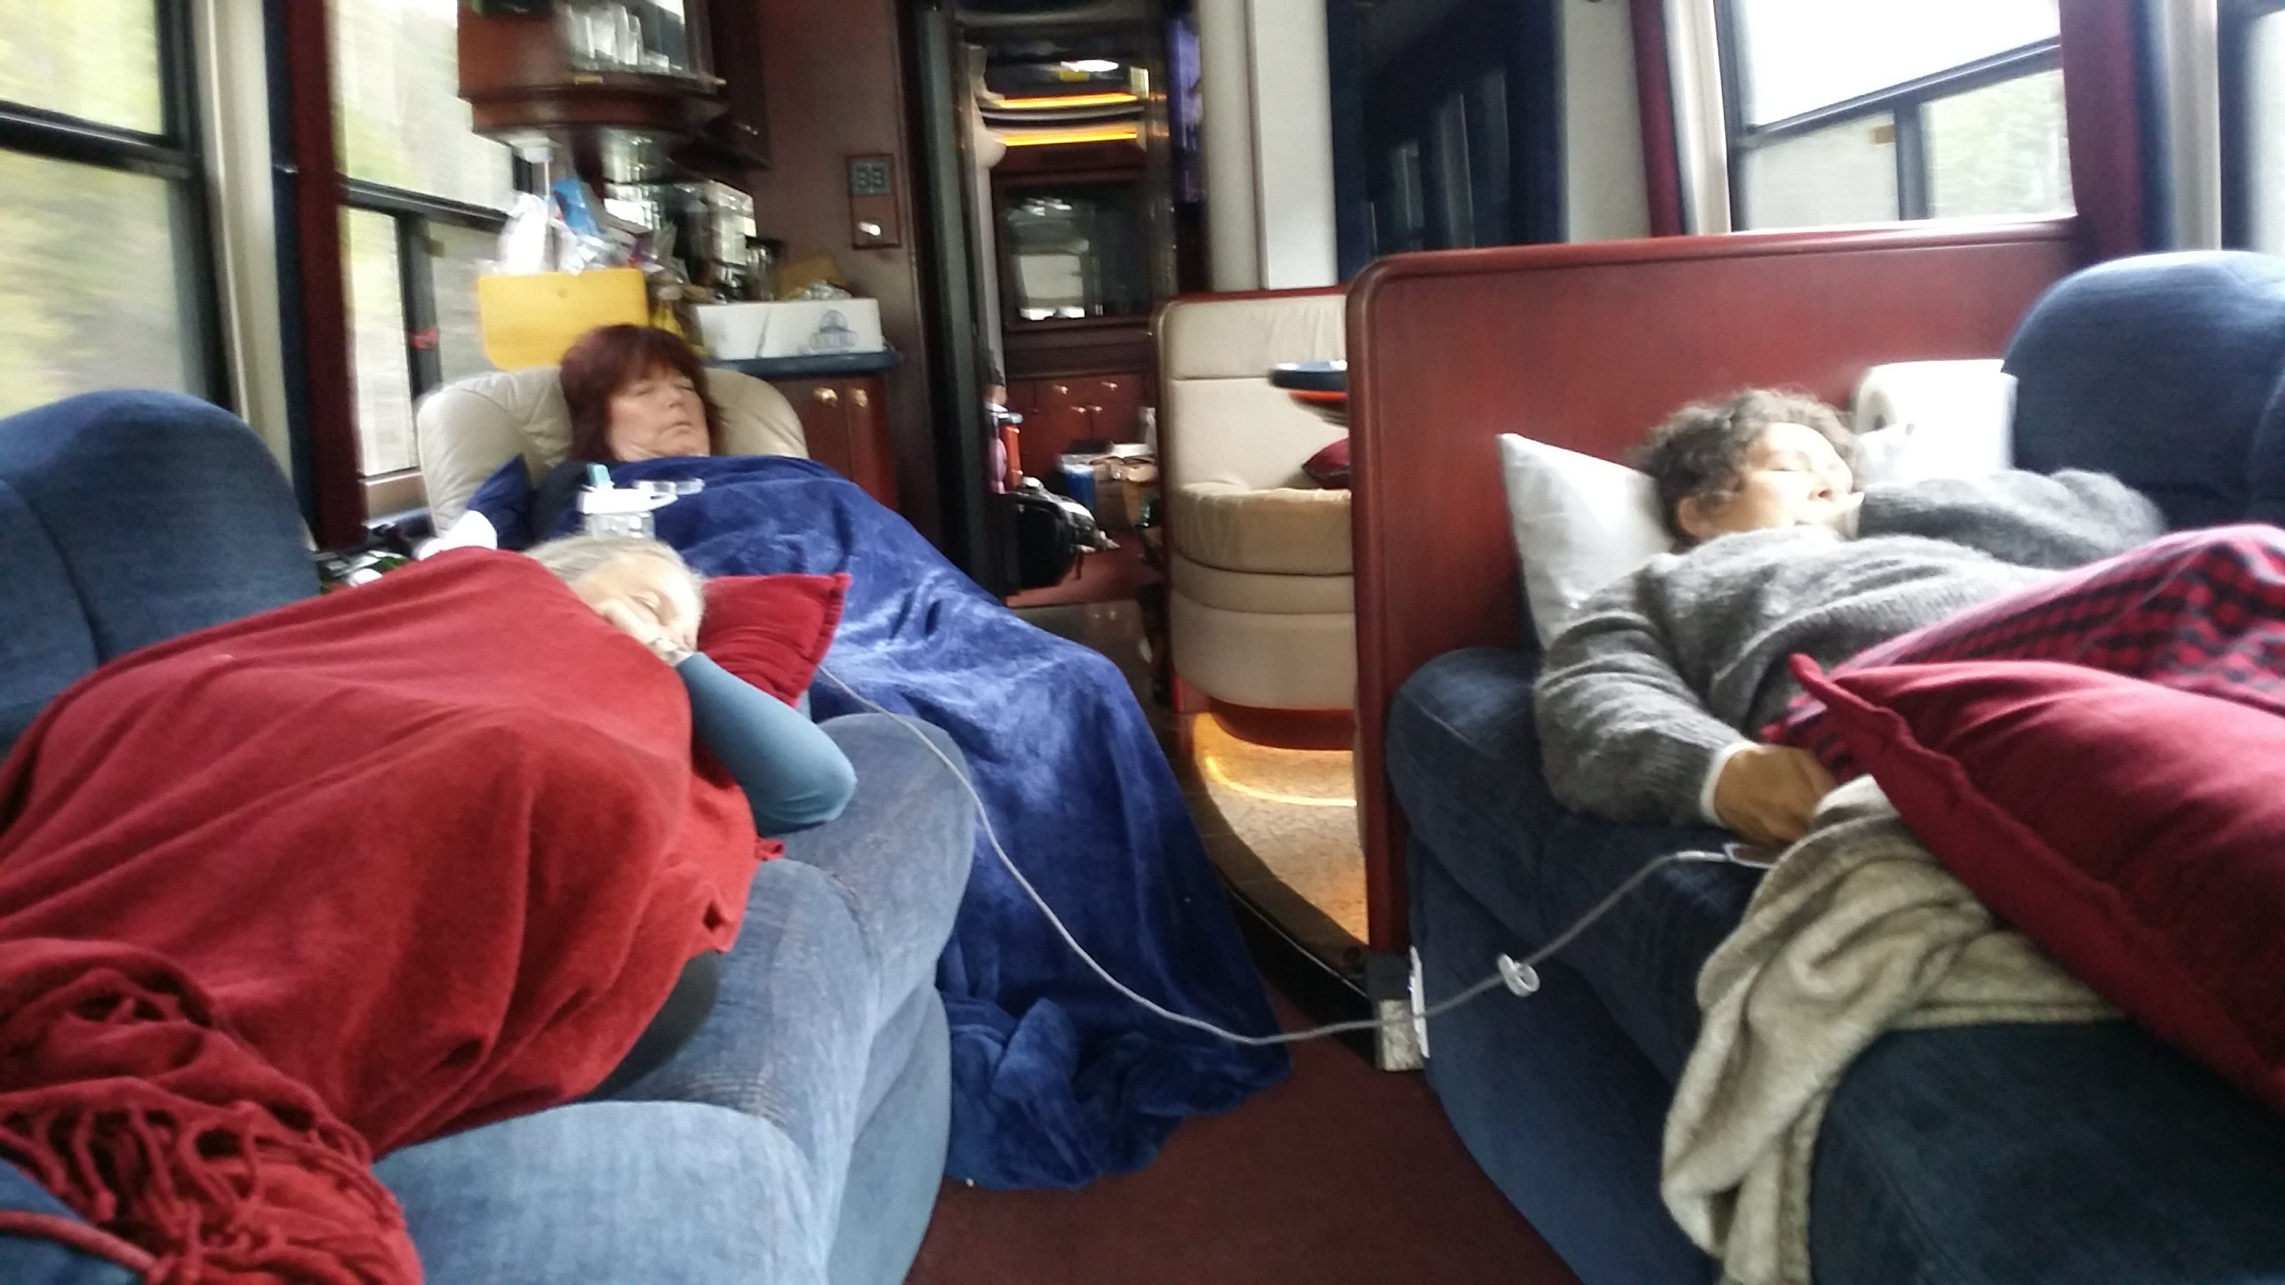

Slide 36
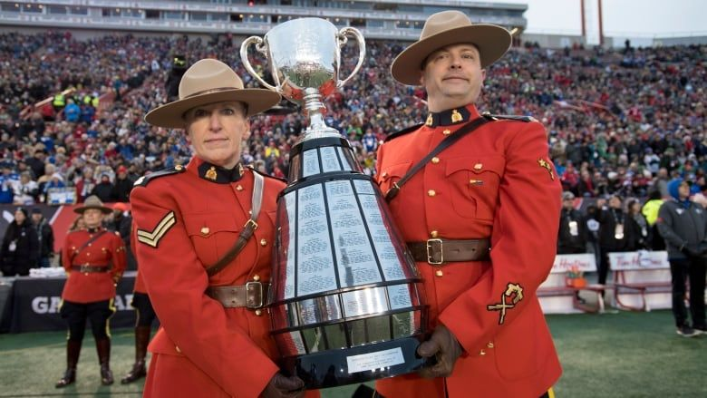

Slide 37
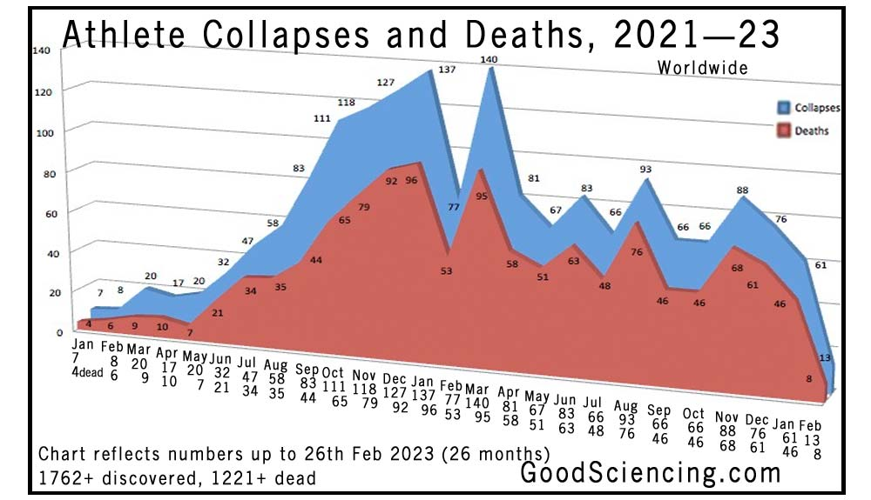

Slide 38
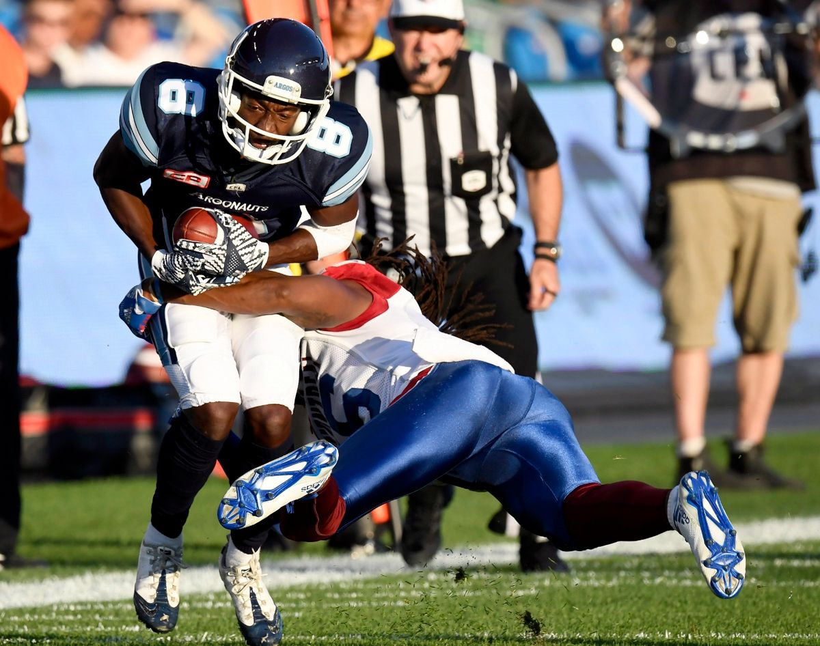

Slide 39
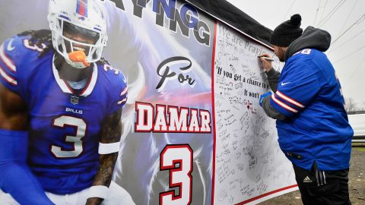

Slide 42
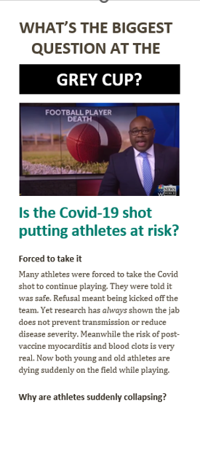

Slide 43
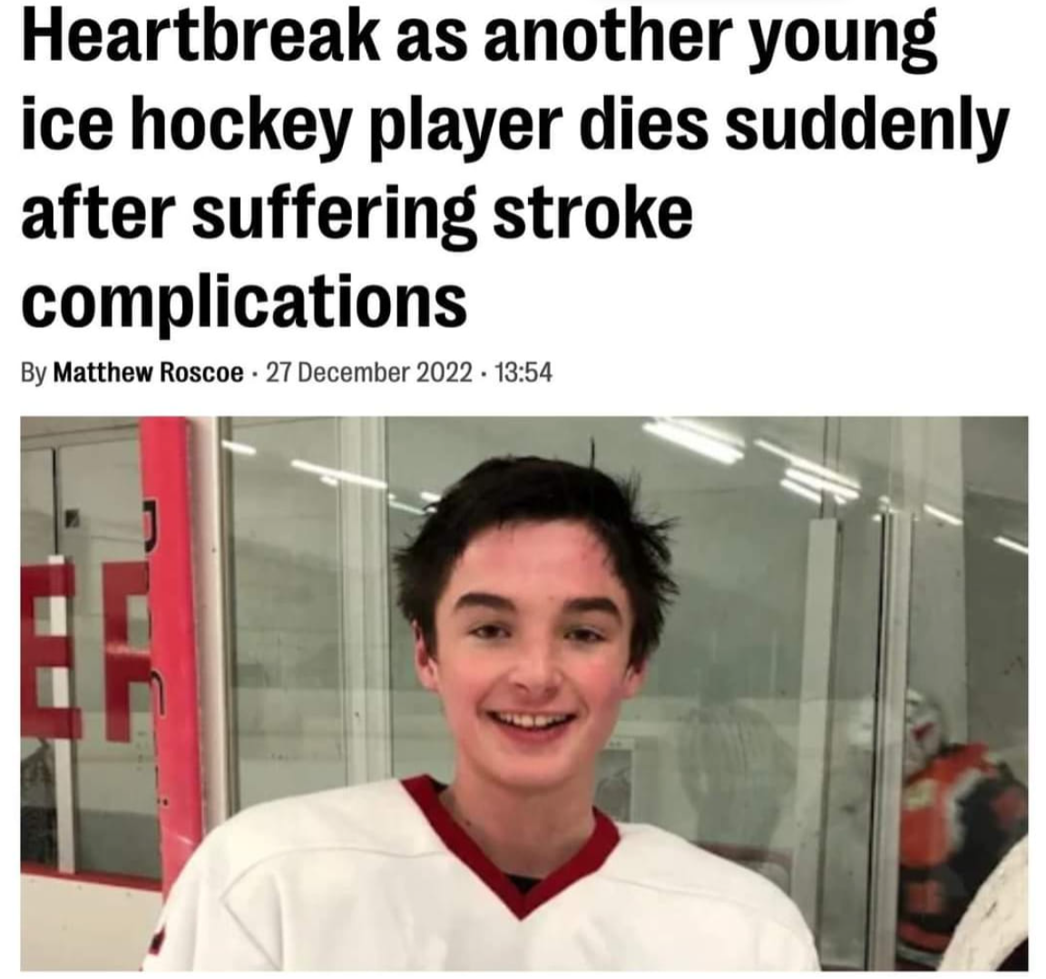

Slide 44
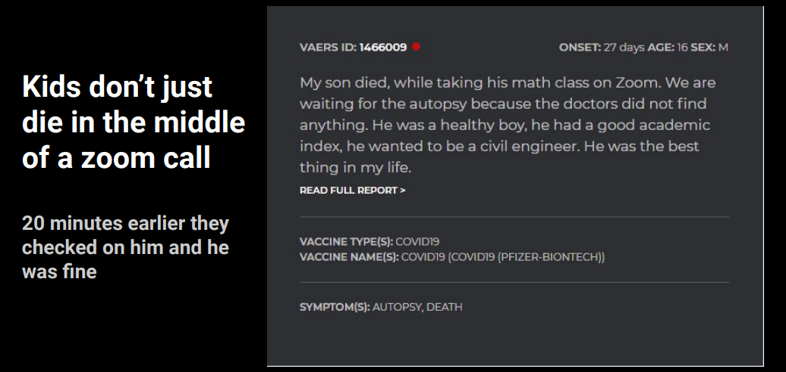
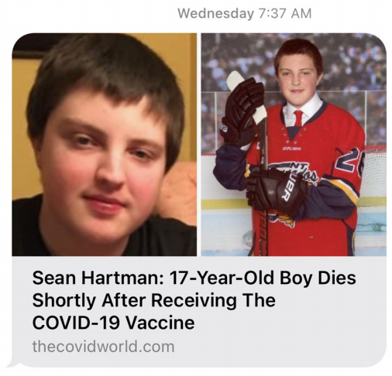

Slide 45
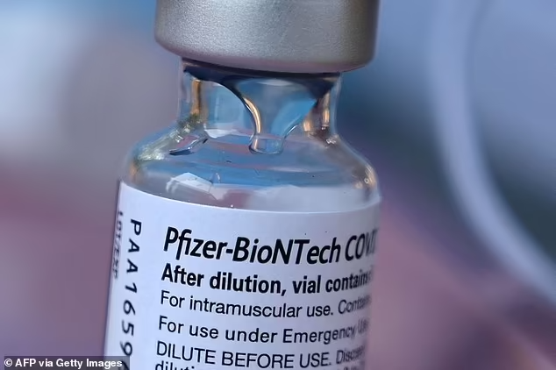
What’s in the Covid-19 “vaccine”?

Slide 46
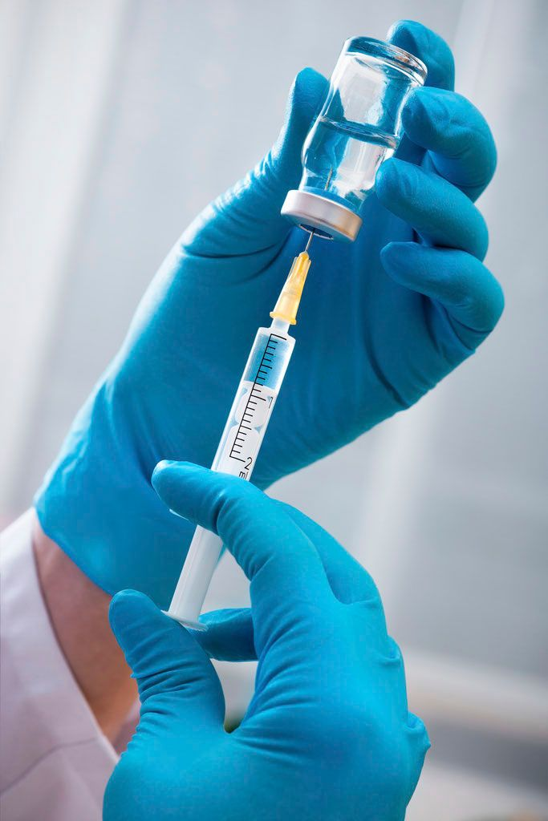
The Four Big Questions
1. Am I COVID vaccine injured?
2. Could I have an asymptomatic vaxx injury?
3. Am I experiencing “shedding” (injury from
exposure to vaxxed people)?
4. What can I do about it?

Slide 47
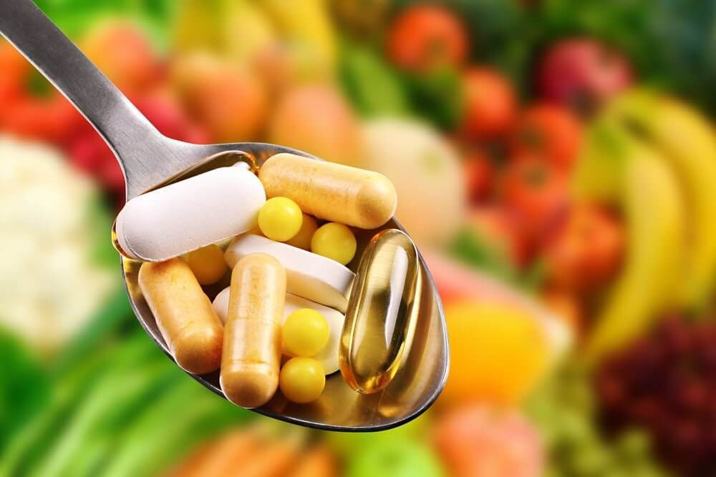
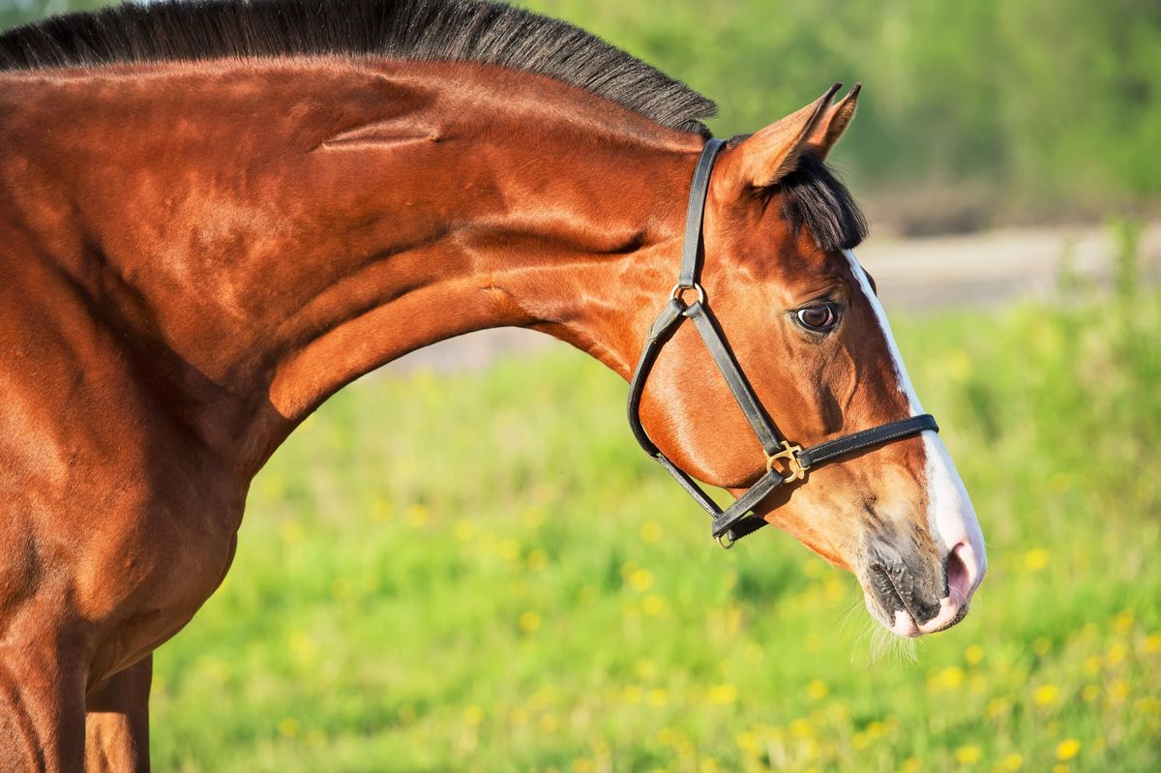
A Basic Approach
Good multivitamin (includes molybdenum)
Vitamin D 5000 iu – 50,000 iu with vit K2 100 mcg daily
Magnesium
Vitamin C 1000 mg three times daily (sustained release) or IV if possible
Zinc 20 mg daily (often in multivit)
Ivermectin 0.3 mg/kg daily to start
Quercetin or hydroxychloroquine
Nattokinase
Melatonin
Black seed oil (capsule) 200-500 mg twice daily
N-acetyl cysteine (NAC)

Slide 48
For medical treatment, consult these websites:
https://covid19criticalcare.com – I-Recover Post-Vax Protocol
www.TruthForHealth.org – Vaccine Injury Treatment Guide
www.worldcouncilforhealth.org – Spike Protein Detox Guide

Slide 49
Consult telehealth

Slide 50
Tour Doctors
Dr. Stephen Malthouse
Dr. Charles Hoffe
Dr. Daniel Nagase
Dr. Anna Kindy
Dr. Rachel Maurice
Dr. Sofia Bayfield
Dr. Kevin Sclater
Dr. Biz Bastian
Dr. Eric Payne
Dr. William Makis
Tour organizers
Kari Simpson
Shelly Semmler
Dennice Pearce
Elizabeth Chapman
Cris Vleck
The community hosts and organizers
The pastors
Those that gave testimony

