Slide 1
Denis rancourt, phd
NATIONAL CITIZENS INQUIRY
Ottawa
17 May 2023

Slide 2
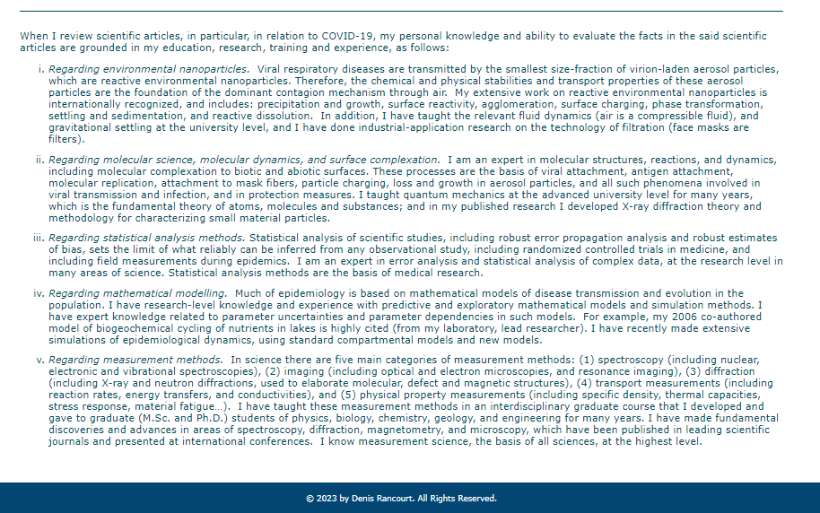
Nanoparticles / molecular science / statistical analysis / modelling / measurement

Slide 3
Collaborators:
Denis Rancourt, PhD
Marine Baudin, PhD
Joseph Hickey, PhD
Jérémie Mercier, PhD
John Johnson, PhD
Christian Linard, PhD
Denis Rancourt, PhD – NCI - CeNC

Slide 4
Denis Rancourt et al.
→ More than 30 articles
and reports related to
COVID circumstances
https://denisrancourt.ca/
Denis Rancourt, PhD – NCI - CeNC

Slide 5
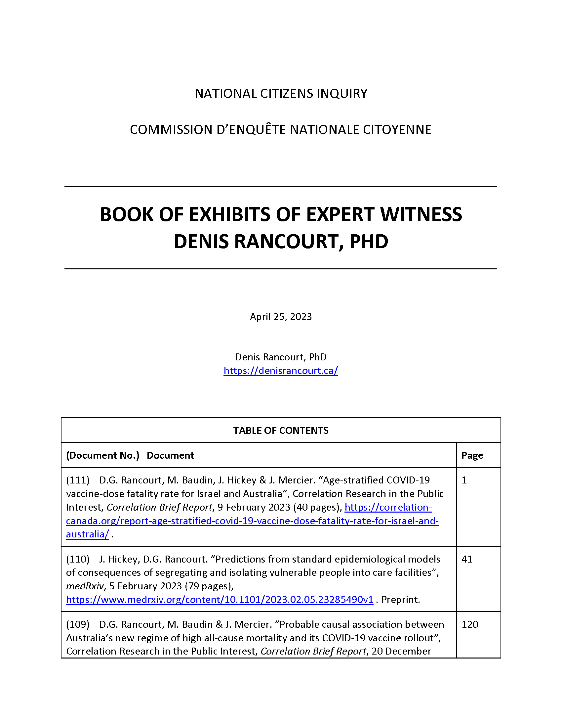
Notes:
Figure 1 – Australia, 75-84

Slide 6
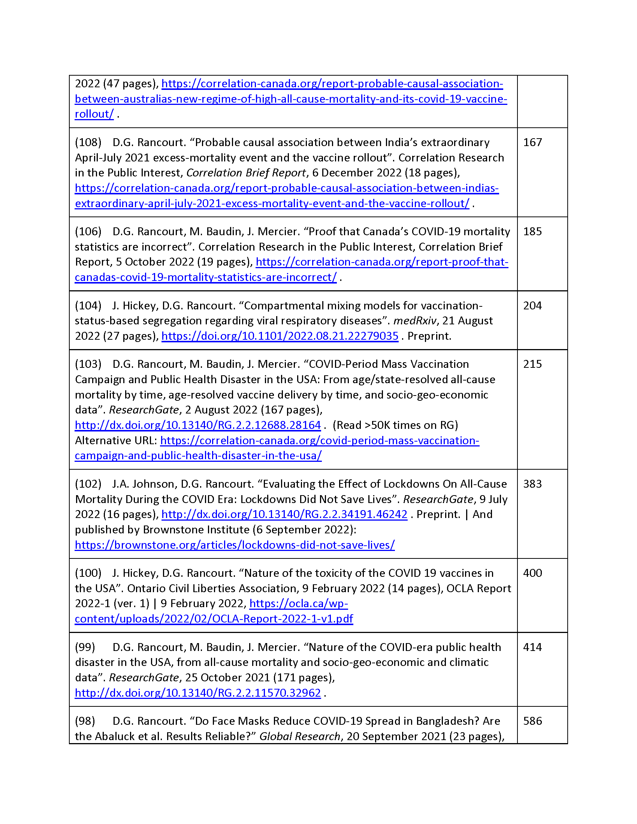
Notes:
Figure 1 – Australia, 75-84

Slide 7
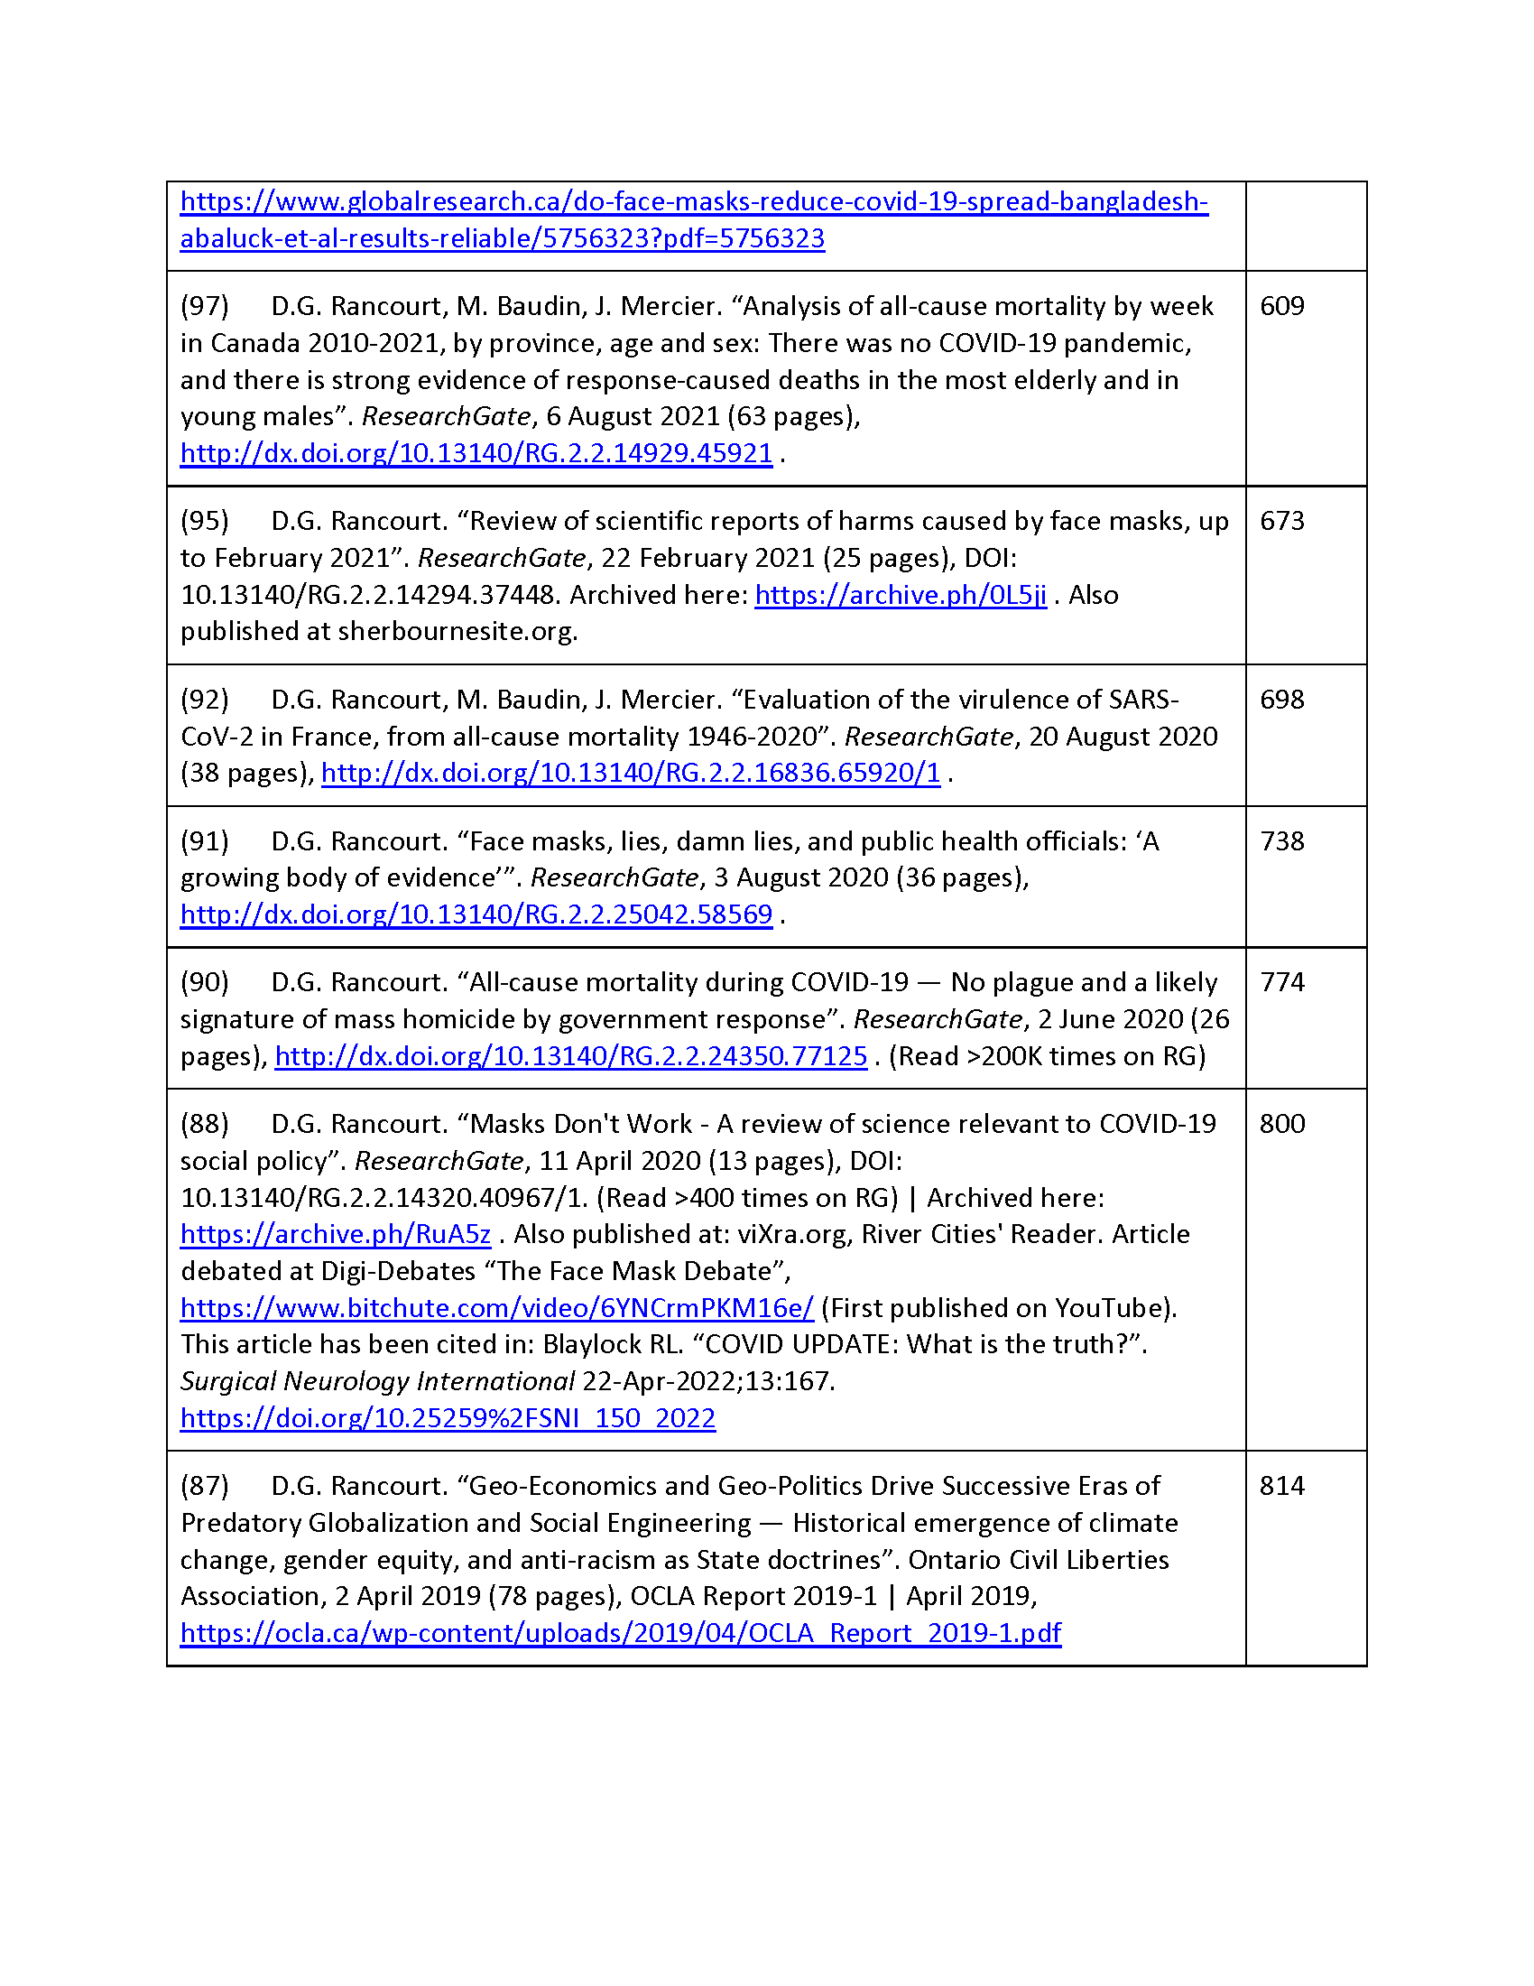
Notes:
Figure 1 – Australia, 75-84

Slide 8
Study of all-cause mortality shows that:
there was no pandemic causing excess mortality
measures caused excess mortality
COVID-19 vaccination caused excess mortality
Denis Rancourt, PhD – NCI - CeNC

Slide 9
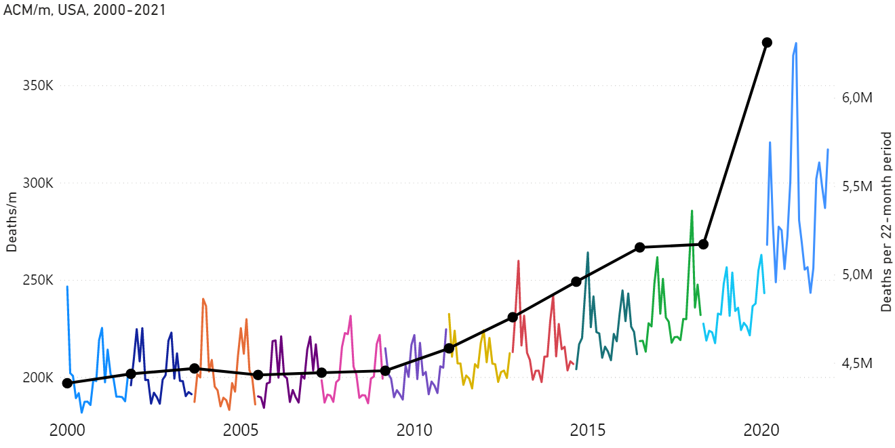
All-cause mortality by month
2000-2021
USA
(with 22-month totals)
(WHO declaration: 11 March 2020)
Denis Rancourt, PhD – NCI - CeNC
Notes:
Figure 3

Slide 10
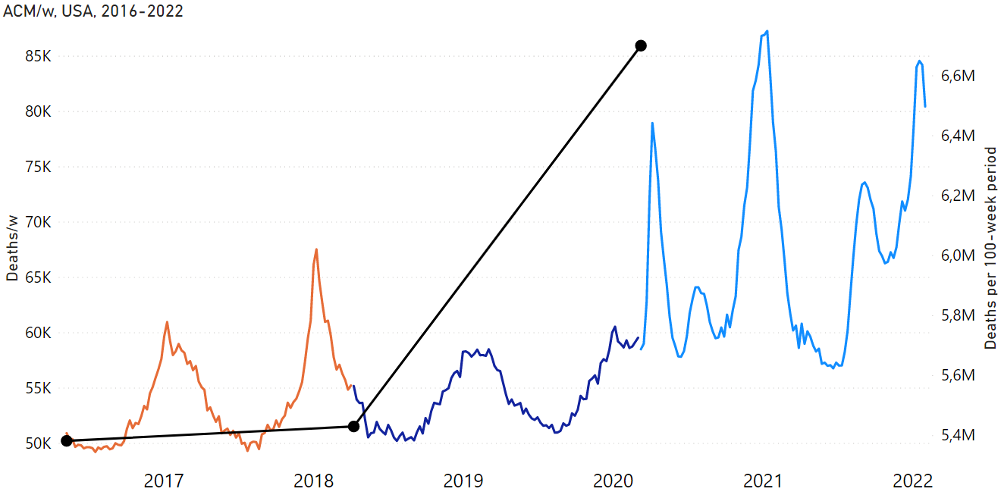
All-cause mortality by week
2016-2022
USA
(with 100-week totals)
(WHO declaration: 11 March 2020)
Denis Rancourt, PhD – NCI - CeNC
Notes:
Figure 6

Slide 11
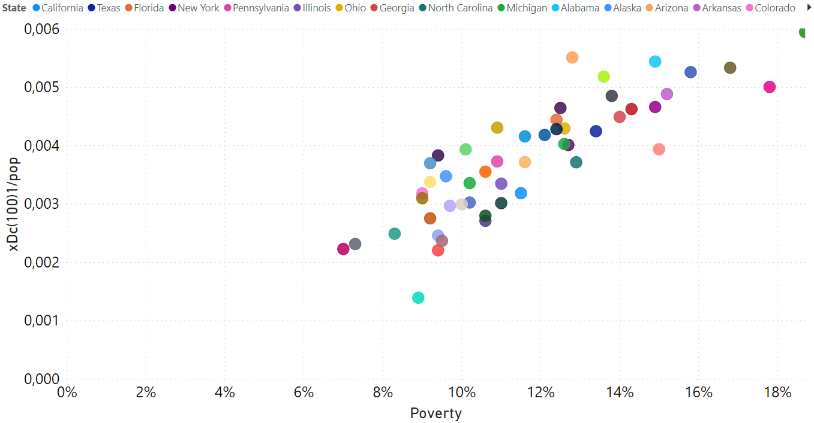
Excess all-cause mortality
by state, USA
(100-week COVID period)
vs
Poverty
Denis Rancourt, PhD – NCI - CeNC
Notes:
Figure 20B

Slide 12
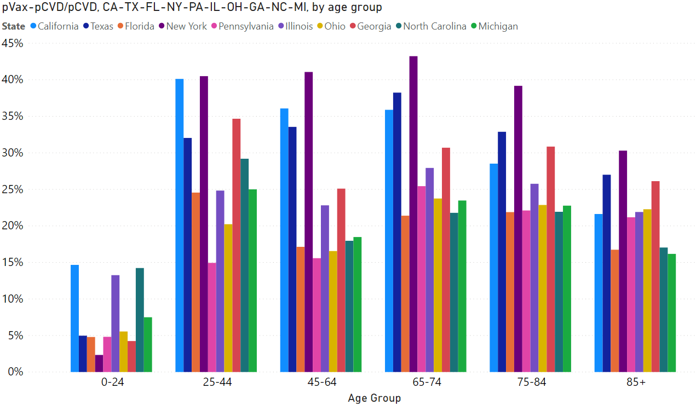
Excess mortality (% increase) by age group / 10 largest states, USA
pre-Vax
Denis Rancourt, PhD – NCI - CeNC
Notes:
Figure 17B

Slide 13
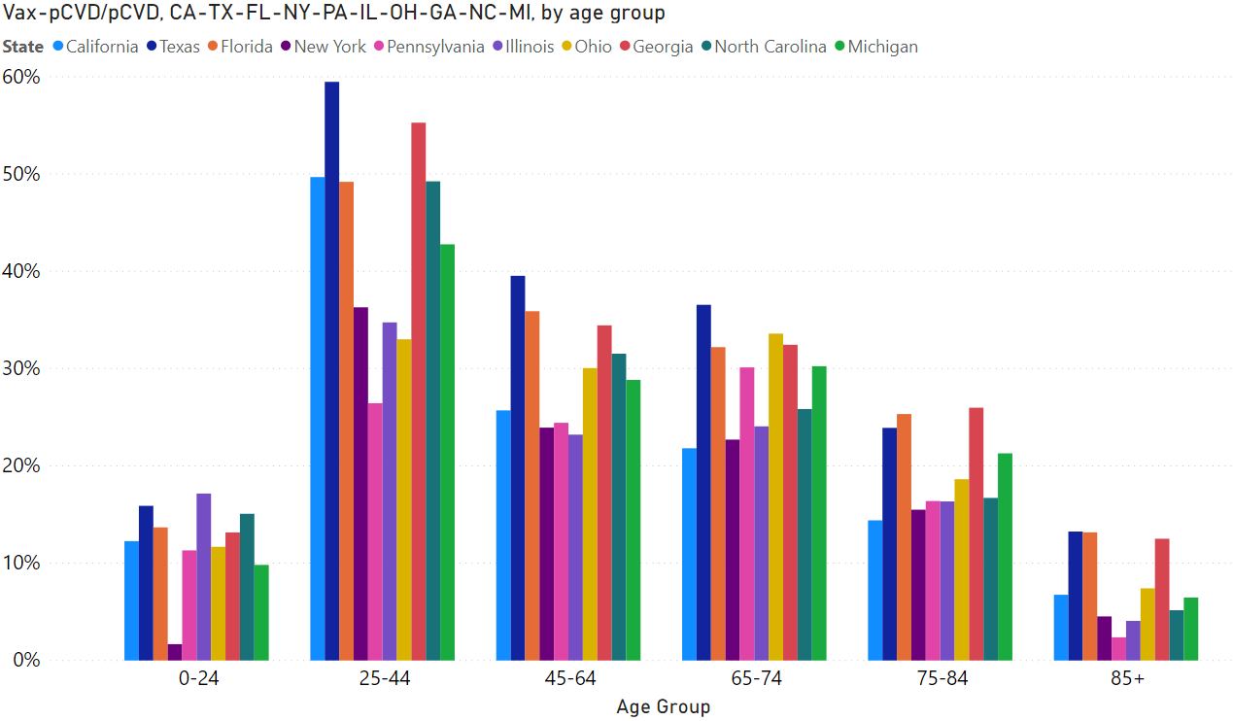
Excess mortality (% increase) by age group / 10 largest states, USA
post-Vax
Denis Rancourt, PhD – NCI - CeNC
Notes:
Figure 17C

Slide 14
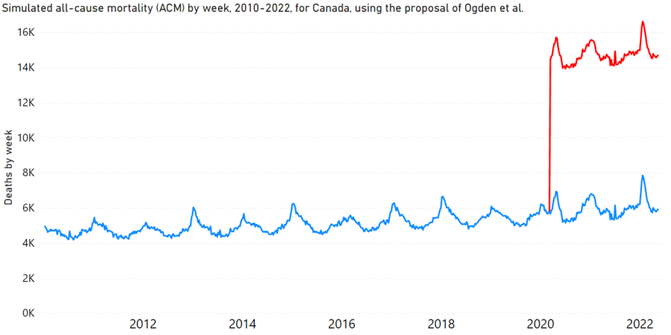
Theresa Tam and co.: 1M extra deaths scenario
vs
reality in Canada ...
(= actual all-cause mortality by week, 2010-2022)
(→ impossible coincidence)
Denis Rancourt, PhD – NCI - CeNC
Notes:
Figure 1 – Australia, 65-74

Slide 15
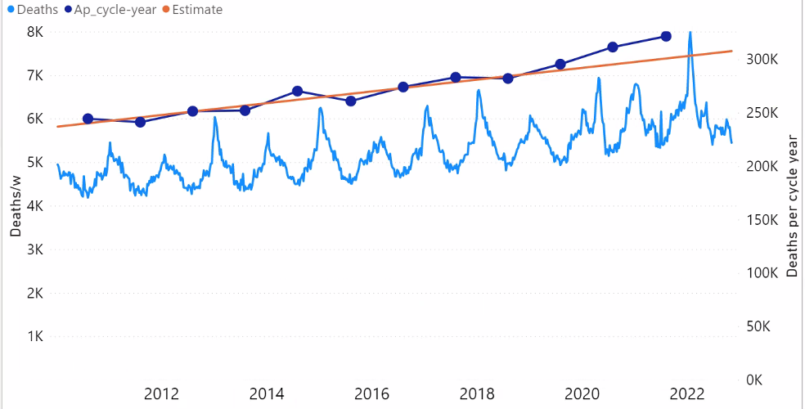
Canada
2010-2023
All-cause mortality by week
(with cycle-year totals
and <2019-2020 trend line of totals)
(full Y-scales)
Denis Rancourt, PhD – NCI - CeNC

Slide 16
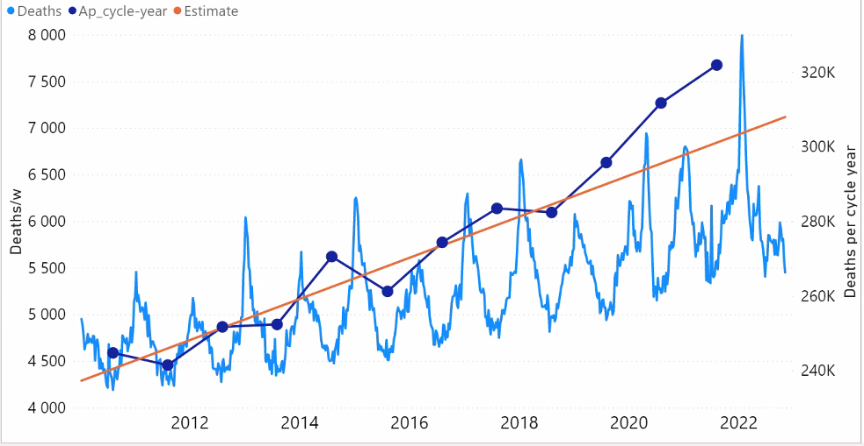
Canada
2010-2022
All-cause mortality by week
(with cycle-year totals
and <2019-2020 trend line of totals)
(expanded Y-scales)
Denis Rancourt, PhD – NCI - CeNC

Slide 17
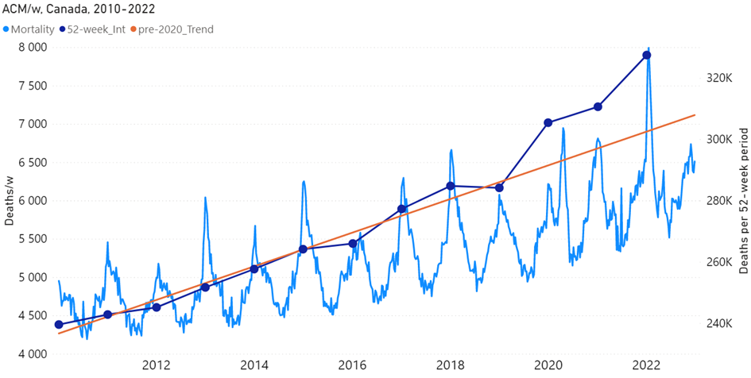
Canada
2010-2022
All-cause mortality by week
(with calendar-year totals
and <2020 trend line of totals)
(expanded Y-scales)

Slide 18
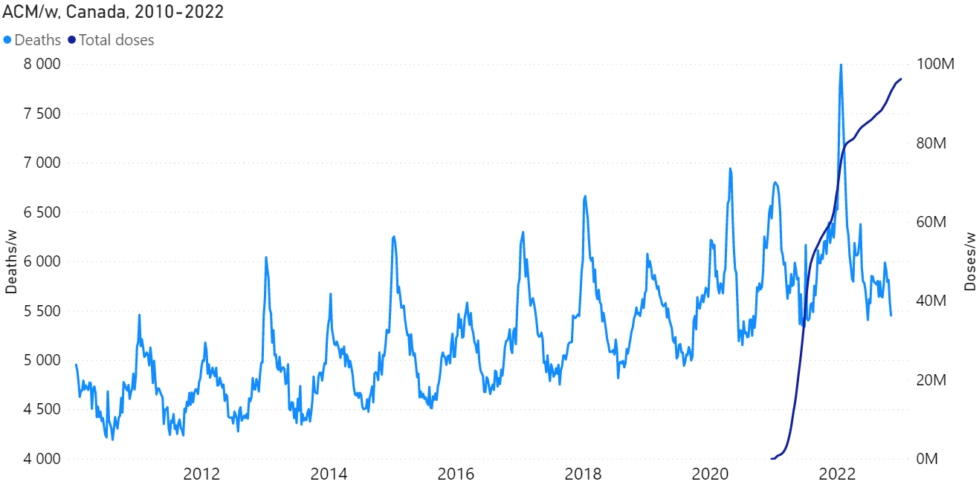
All-cause mortality by week 2010-2022 Canada
& weekly cumulative vaccine-dose administration
Denis Rancourt, PhD – NCI - CeNC

Slide 19
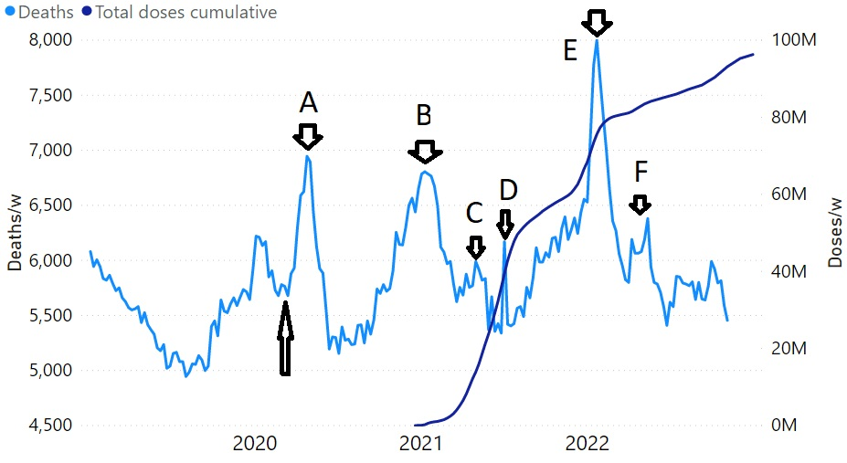
All-cause mortality by week 2019-2023 Canada
& weekly cumulative vaccine-dose administration
Denis Rancourt, PhD – NCI - CeNC

Slide 20
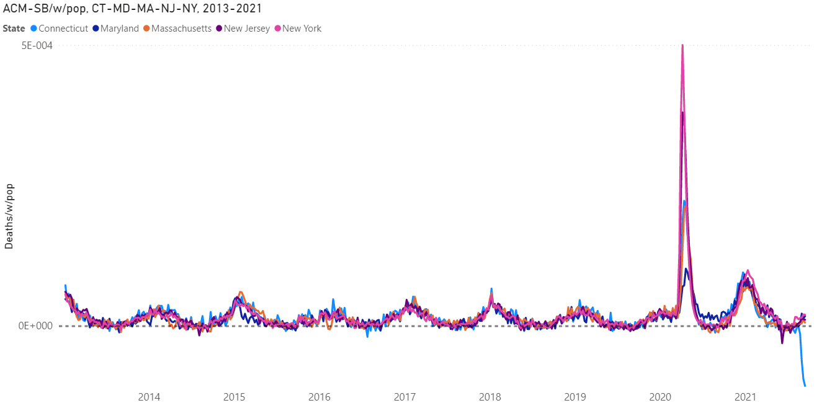
USA states
CT, MD, MA, NJ, NY
2013-2021
All-cause mortality by week by population
→ hot spots: post-11 March 2020 deaths anomaly
Denis Rancourt, PhD – NCI - CeNC
Notes:
Figure 9a

Slide 21
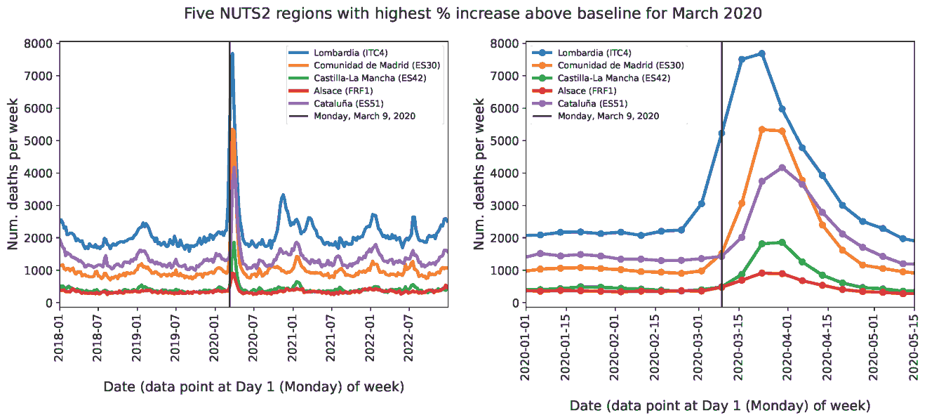
All-cause mortality by week in European regions
Lombardi (IT), Madrid (ES), Alsace (FR)...
→ hot spots: post-11 March 2020 deaths anomaly
Denis Rancourt, PhD – NCI - CeNC

Slide 22
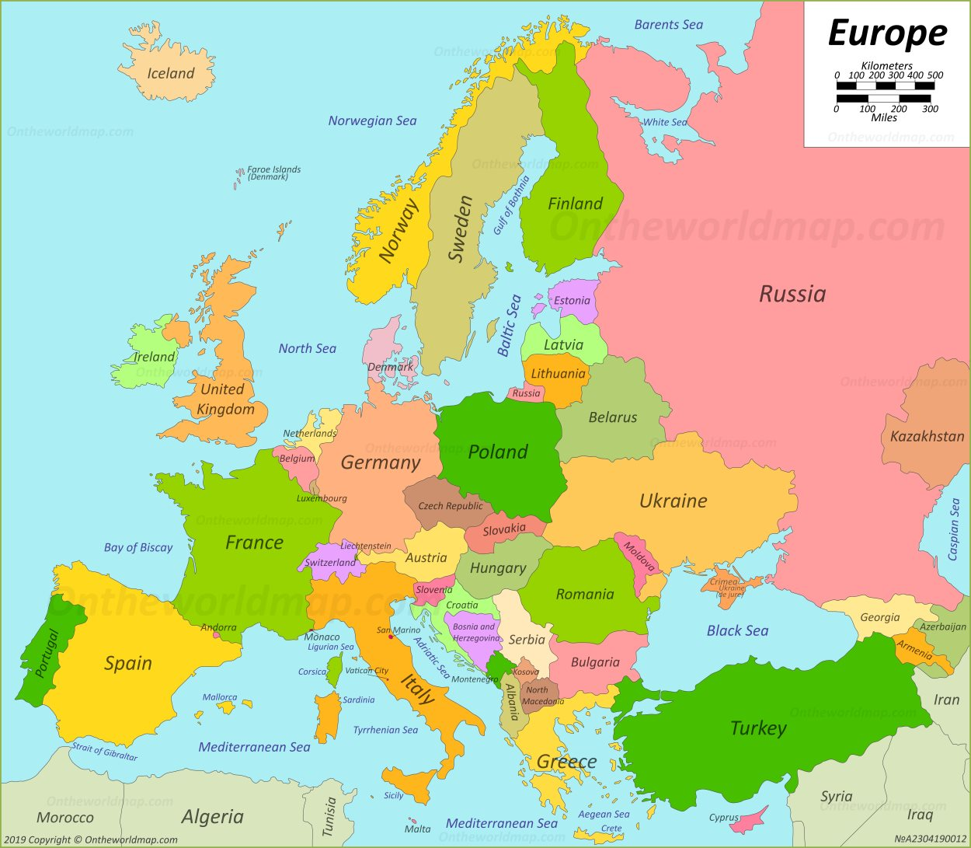

Slide 23
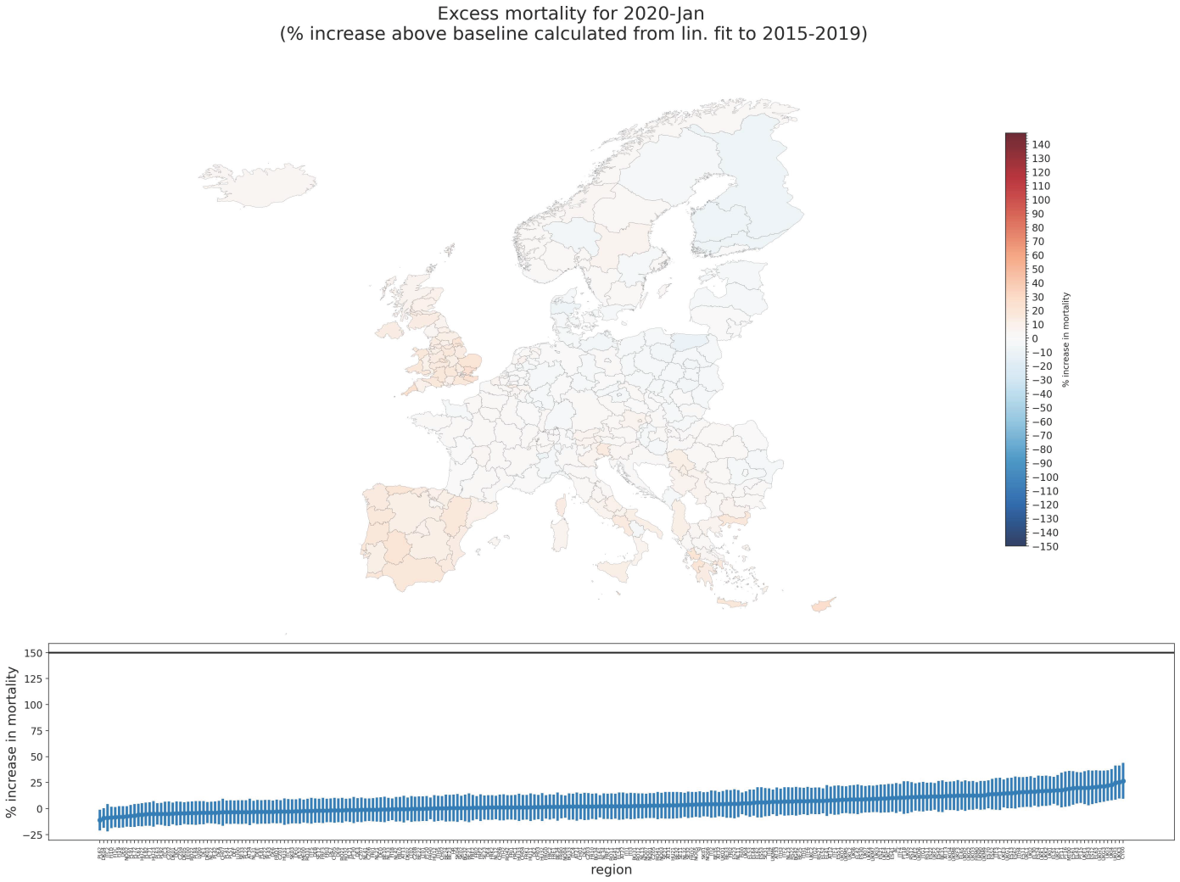
2020 - January

Slide 24
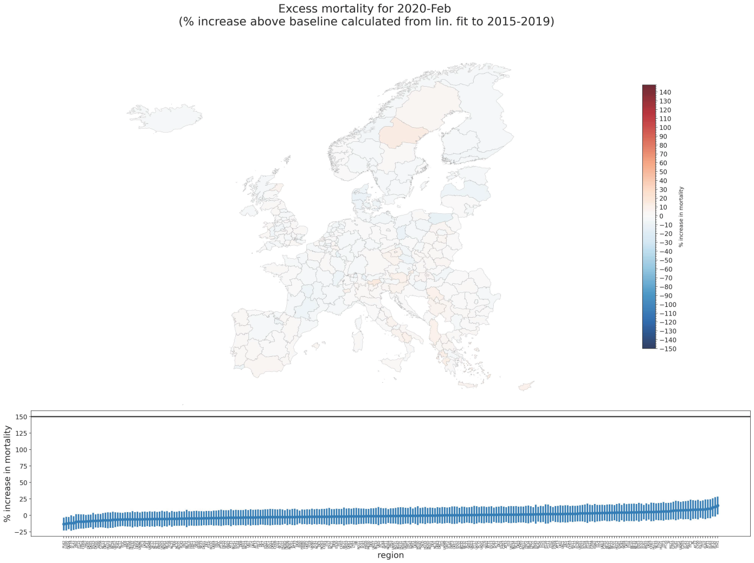
2020 - February

Slide 25
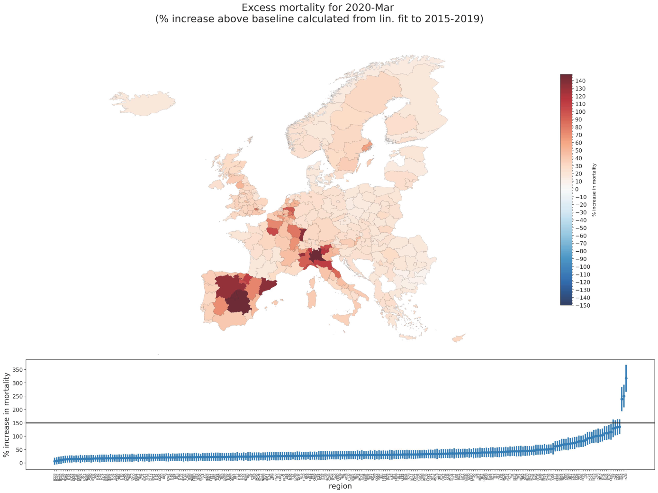
2020 - March

Slide 26
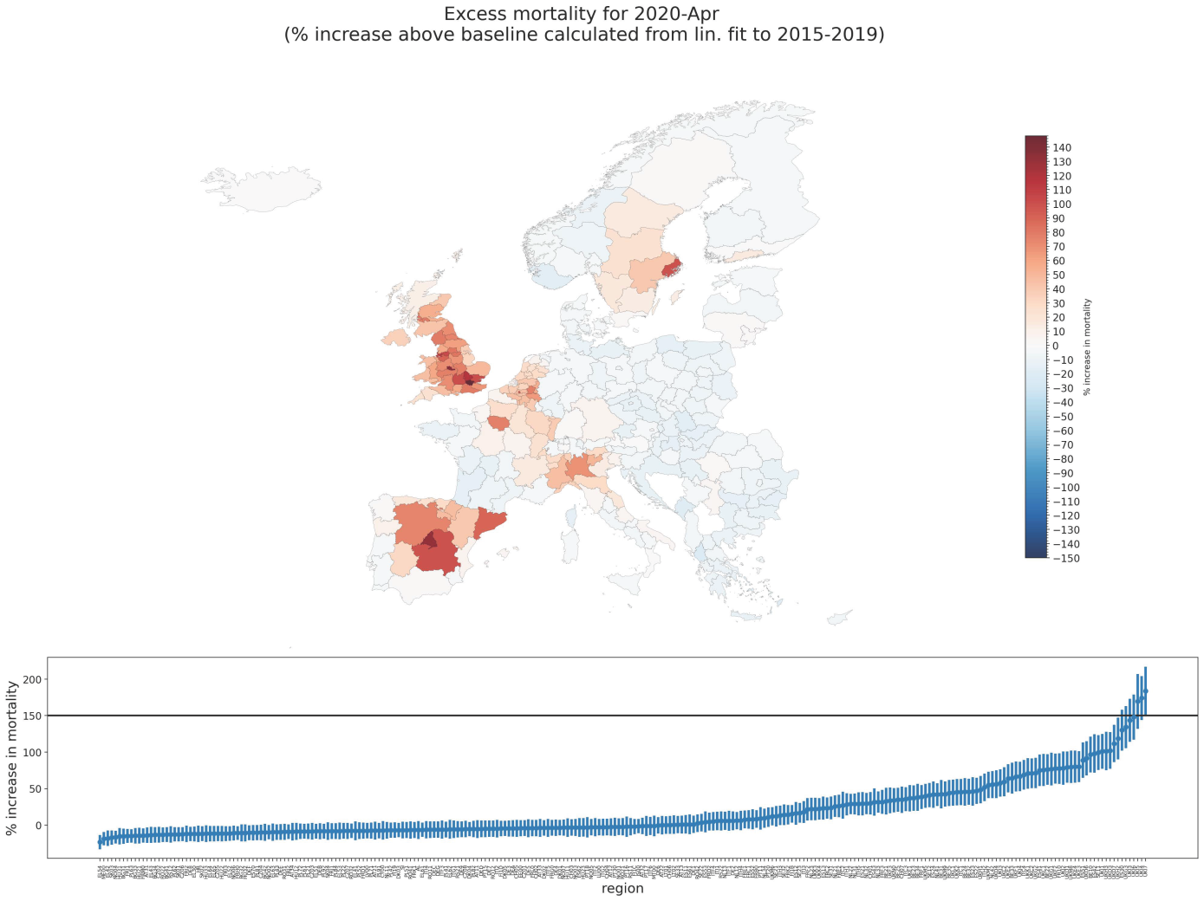
2020 - April

Slide 27
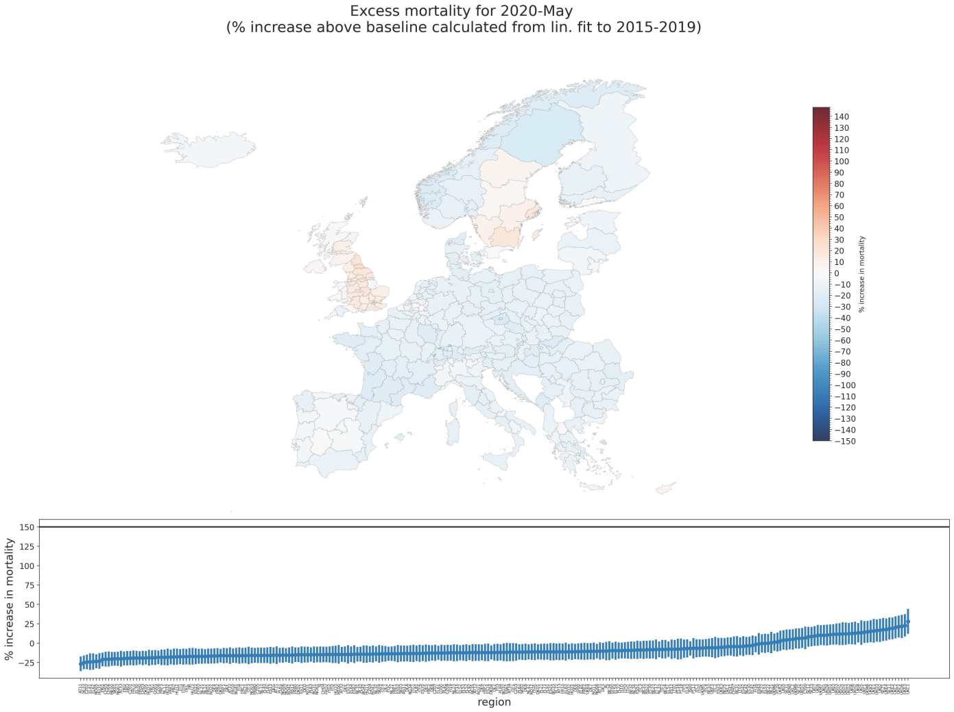
2020 - May

Slide 28
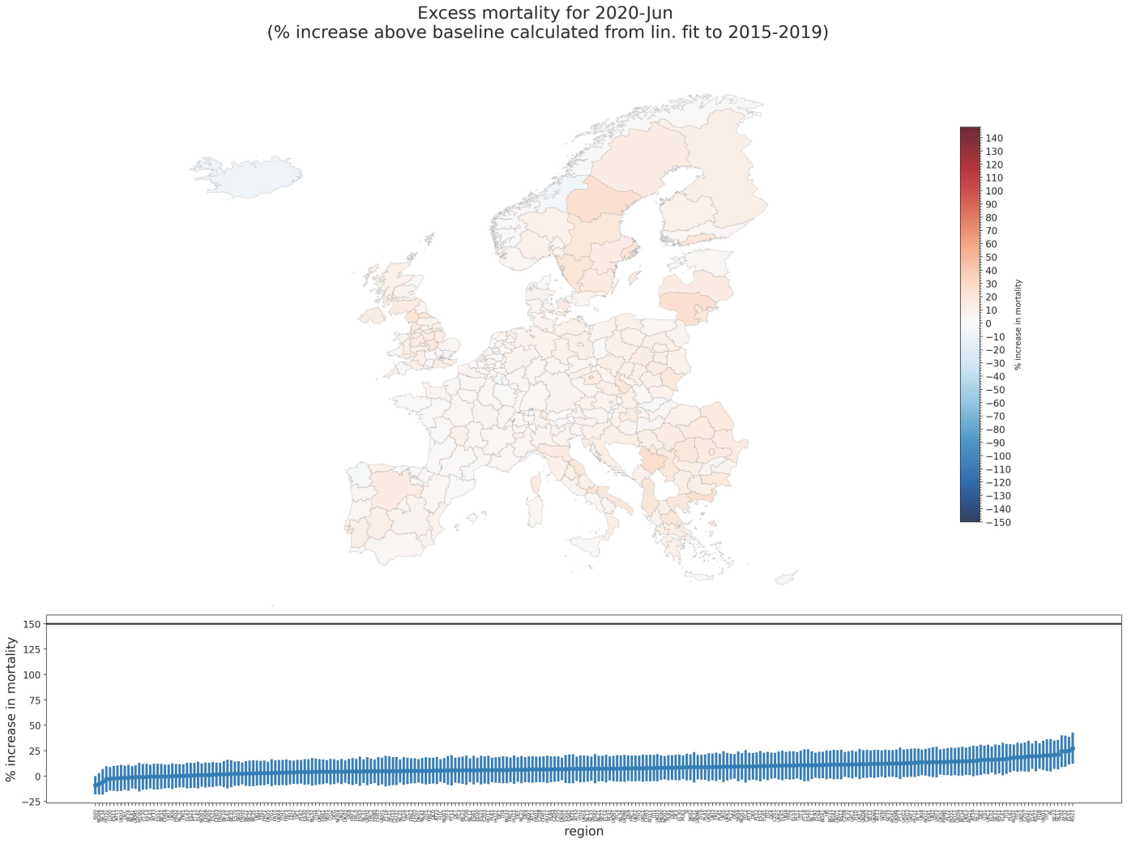
2020 - June

Slide 29
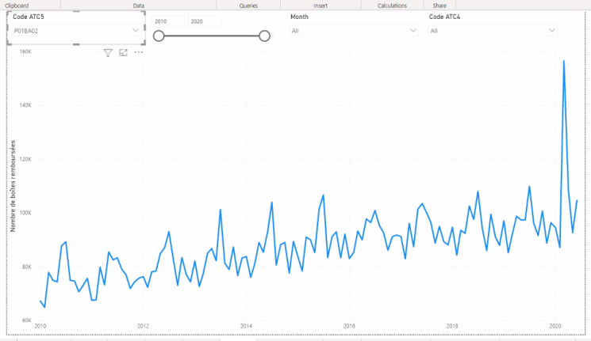
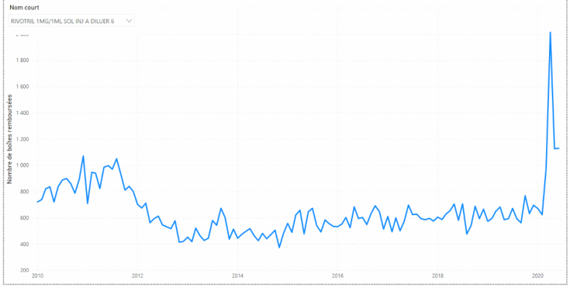
France:
hydroxychloroquine - HCQ
Toxic treatment protocols
caused the hot-spot excess
deaths in March-April 2020
(H/T Dr. Claus Köhnlein ...)
France:
“Rivotril” - clonazepam

Slide 30
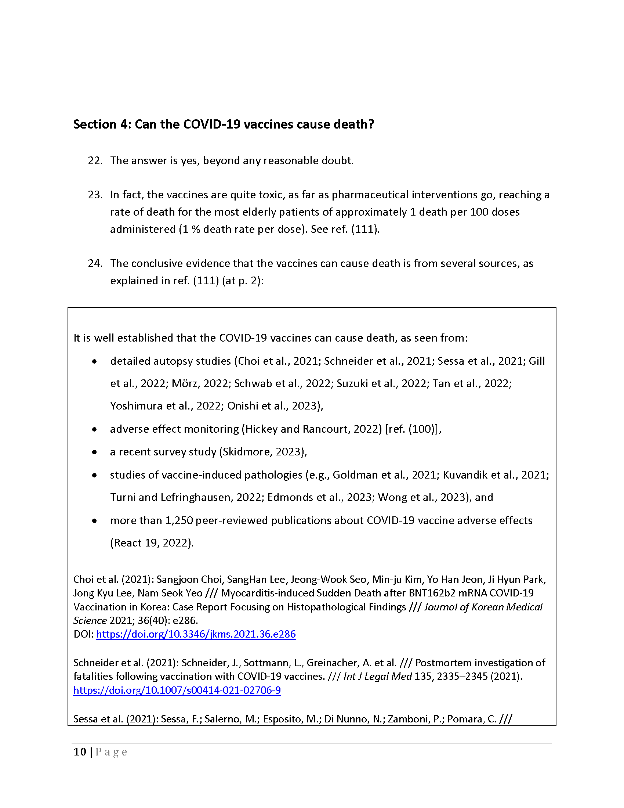
The COVID-19 vaccines
can cause death:
autopsy studies
adverse effect
monitoring
survey study
induced pathologies
>1,250 peer-reviewed
studies of vaccine harm
vaccine-dose fatality
rate (vDFR) quantification
Denis Rancourt, PhD – NCI - CeNC

Slide 31
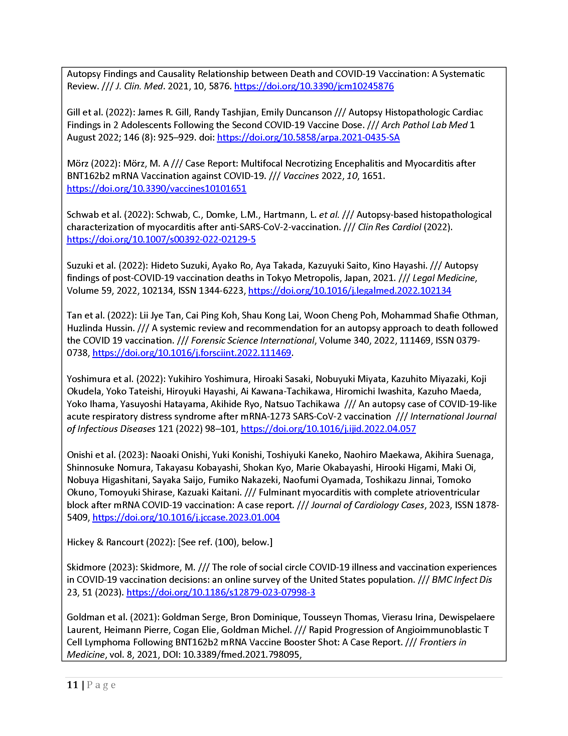
Autopsy studies...

Slide 32
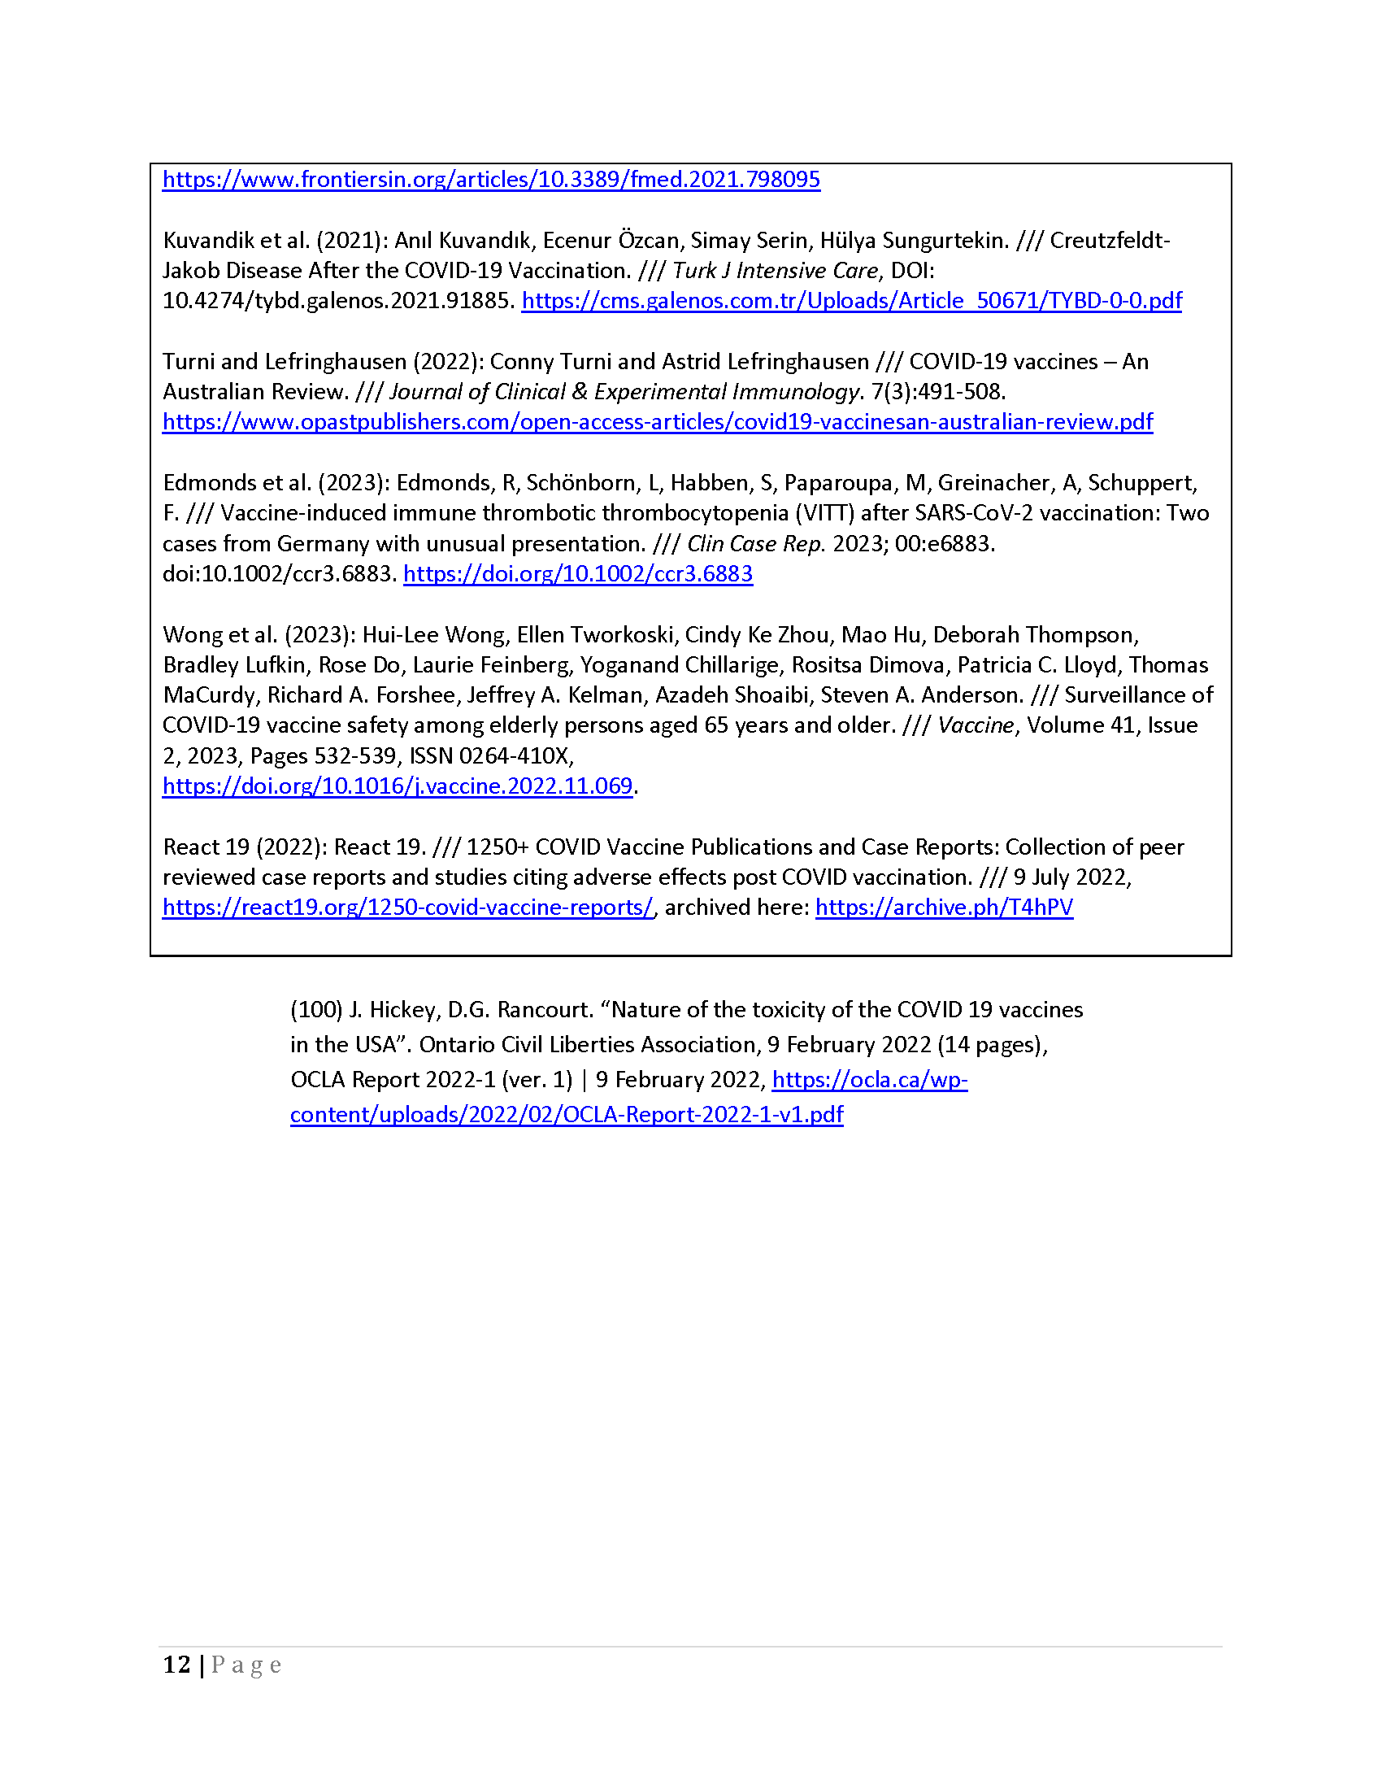
Autopsy studies...
VAERS

Slide 33
Australia
1980-2022
All-cause mortality by month
(with 16-month totals)
(WHO declaration: 11 March 2020)
Denis Rancourt, PhD – NCI - CeNC
Notes:
Appendix 2

Slide 34
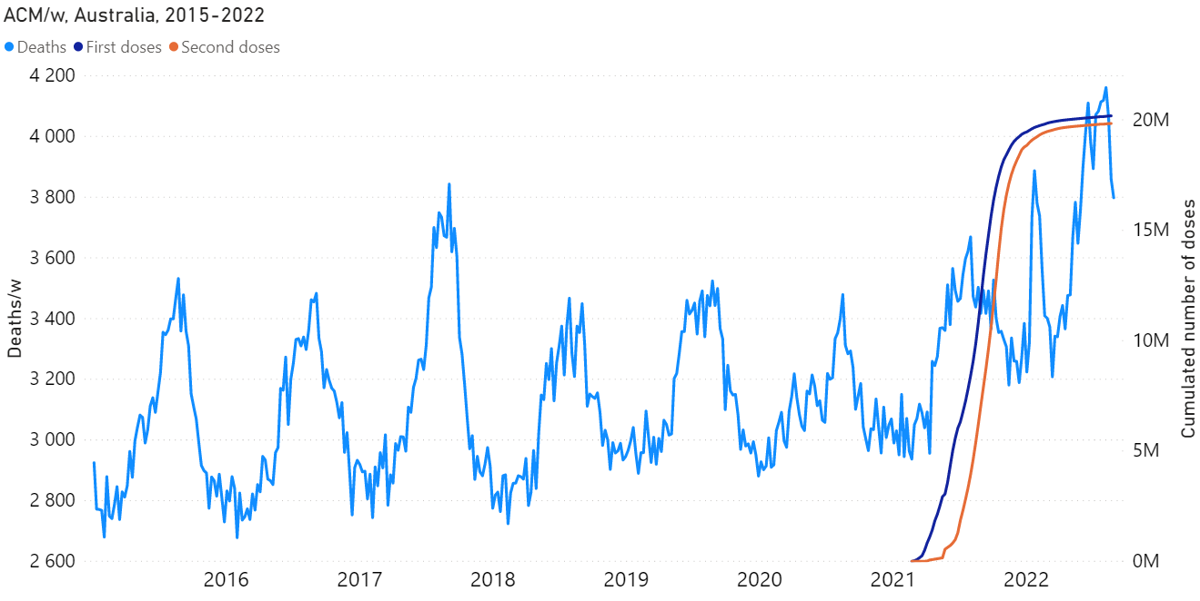
All-cause mortality by week 2015-2022 Australia
& weekly cumulative vaccine-dose administration
(doses 1 & 2)
Denis Rancourt, PhD – NCI - CeNC
Notes:
Figure 2

Slide 35
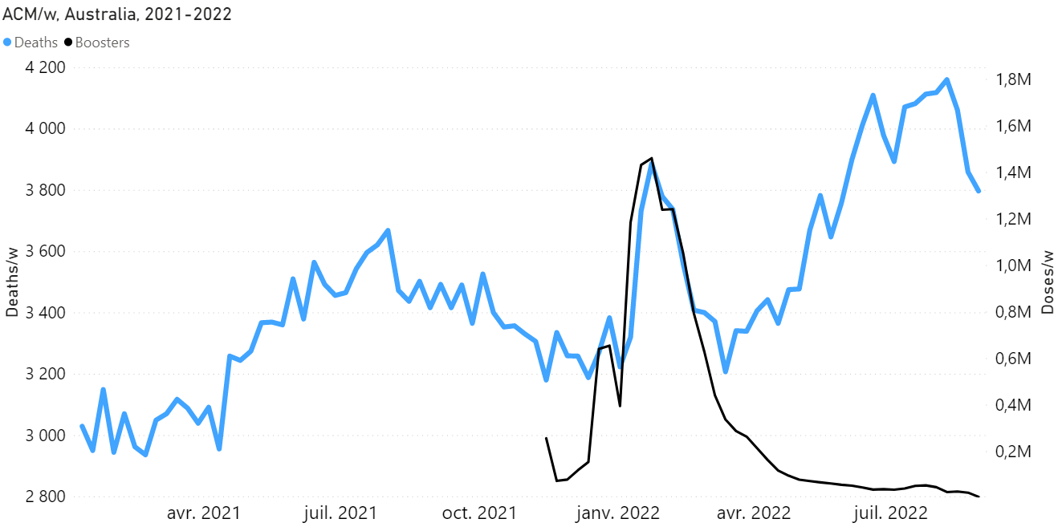
All-cause mortality by week
2021-2022 Australia
& weekly vaccine-dose administration
(3rd dose)
Denis Rancourt, PhD – NCI - CeNC
Notes:
Figure 6A

Slide 36
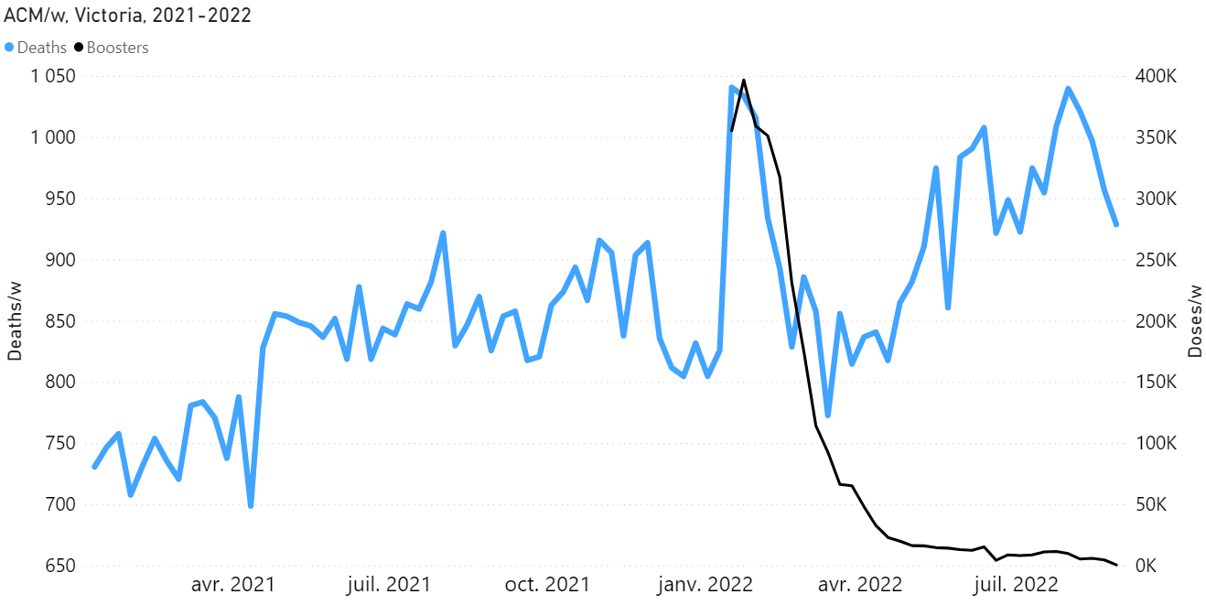
All-cause mortality by week
2021-2022 Victoria (Australia)
& weekly vaccine-dose administration
(3rd dose)
Denis Rancourt, PhD – NCI - CeNC
Notes:
Figure 6B

Slide 37
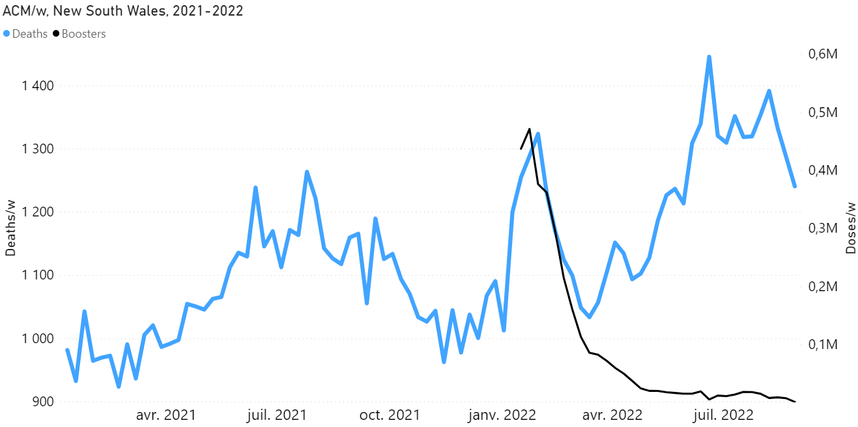
All-cause mortality by week
2021-2022 New South Wales (Australia)
& weekly vaccine-dose administration
(3rd dose)
Denis Rancourt, PhD – NCI - CeNC
Notes:
Figure 6C

Slide 38
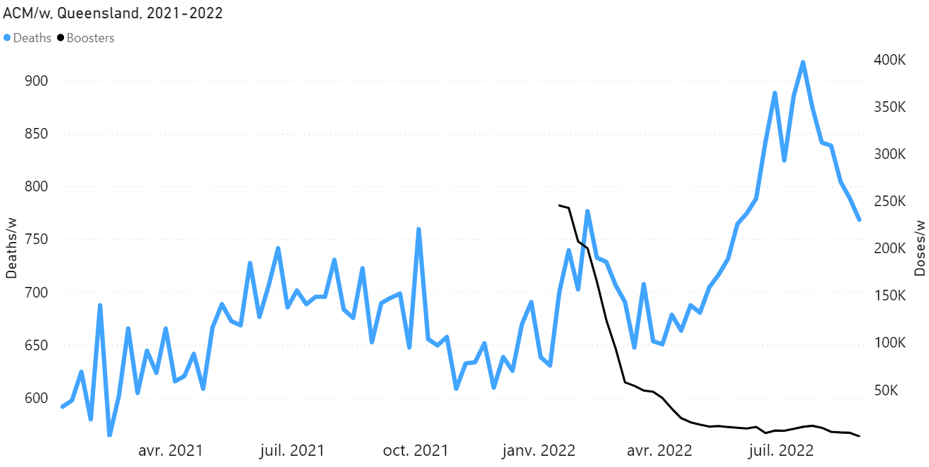
All-cause mortality by week
2021-2022 Queensland (Australia)
& weekly vaccine-dose administration
(3rd dose)
Denis Rancourt, PhD – NCI - CeNC
Notes:
Figure 6D

Slide 39
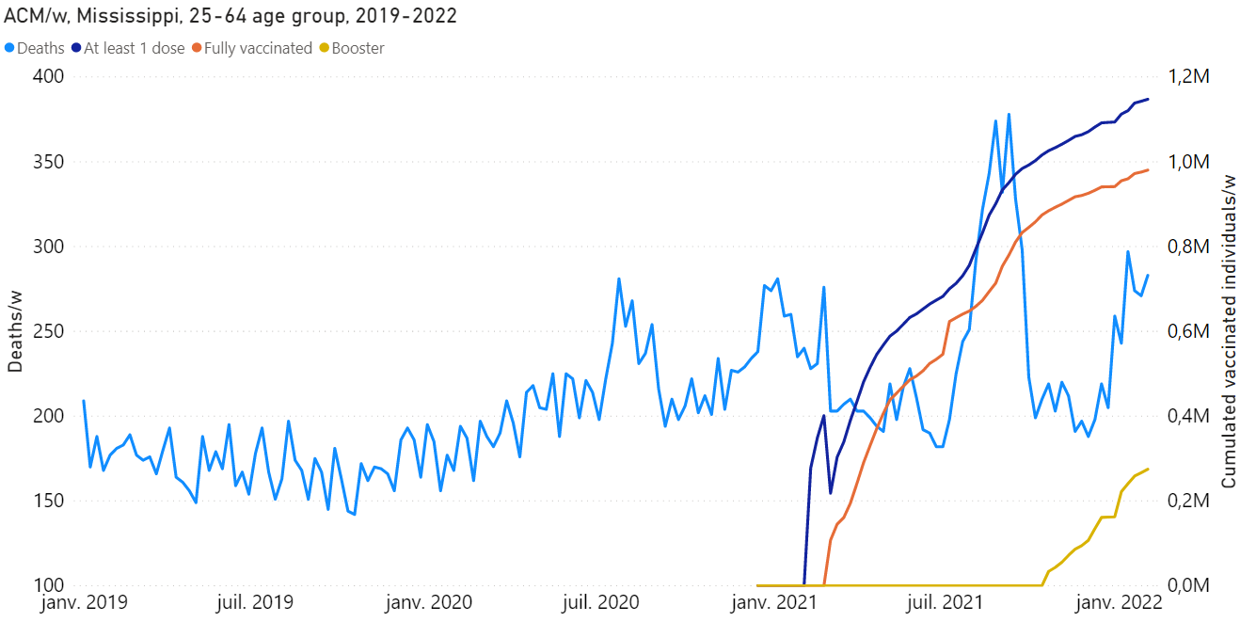
All-cause mortality by week
2019-2022 Mississippi (USA)
25-64 years age group
& vaccine roll-outs
Denis Rancourt, PhD – NCI - CeNC
Notes:
Figure 7

Slide 40
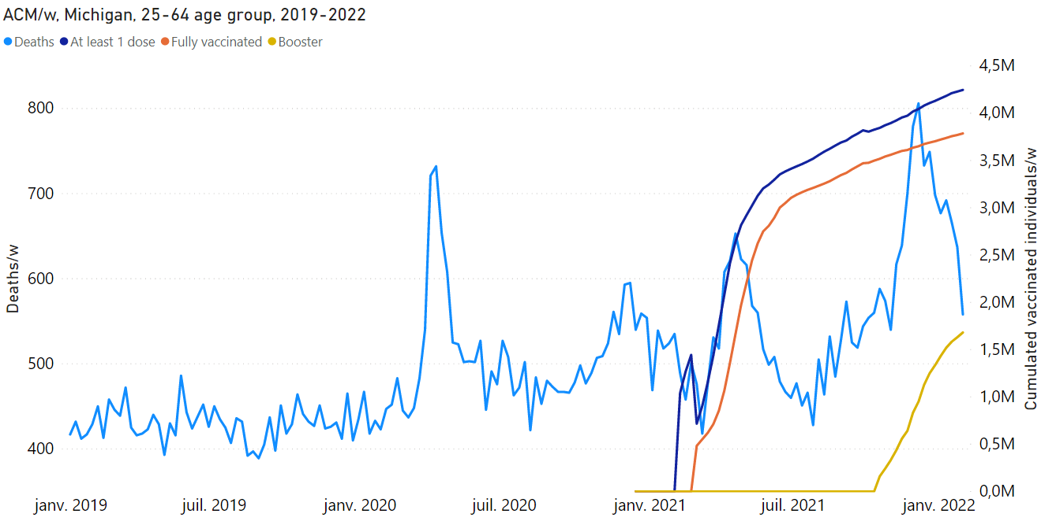
All-cause mortality by week
2019-2022 Michigan (USA)
25-64 years age group
& vaccine roll-outs
Denis Rancourt, PhD – NCI - CeNC
Notes:
Figure 8A

Slide 41
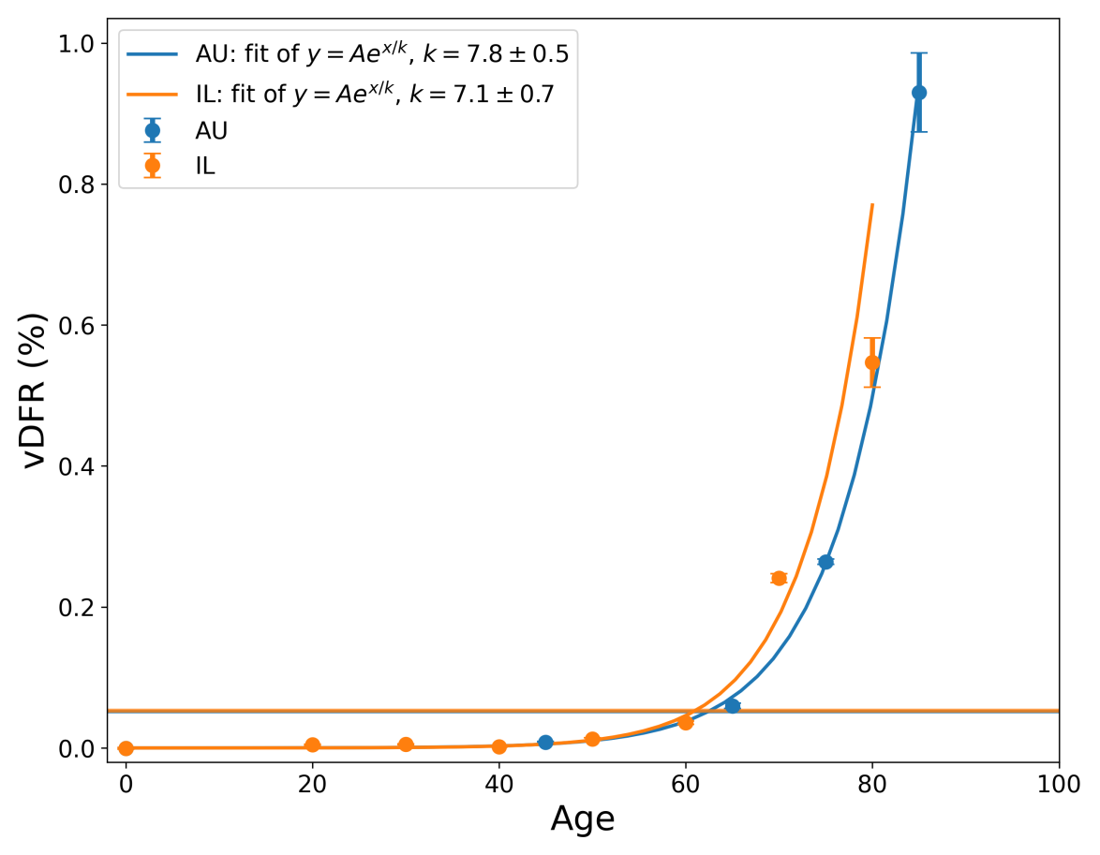
Vaccine dose fatality rate (vDFR)
by age group
Australia, Israel
(5 year age doubling of risk of death
per injection)
Denis Rancourt, PhD – NCI - CeNC
Notes:
Figure 3 – vDFR (upper)

Slide 42
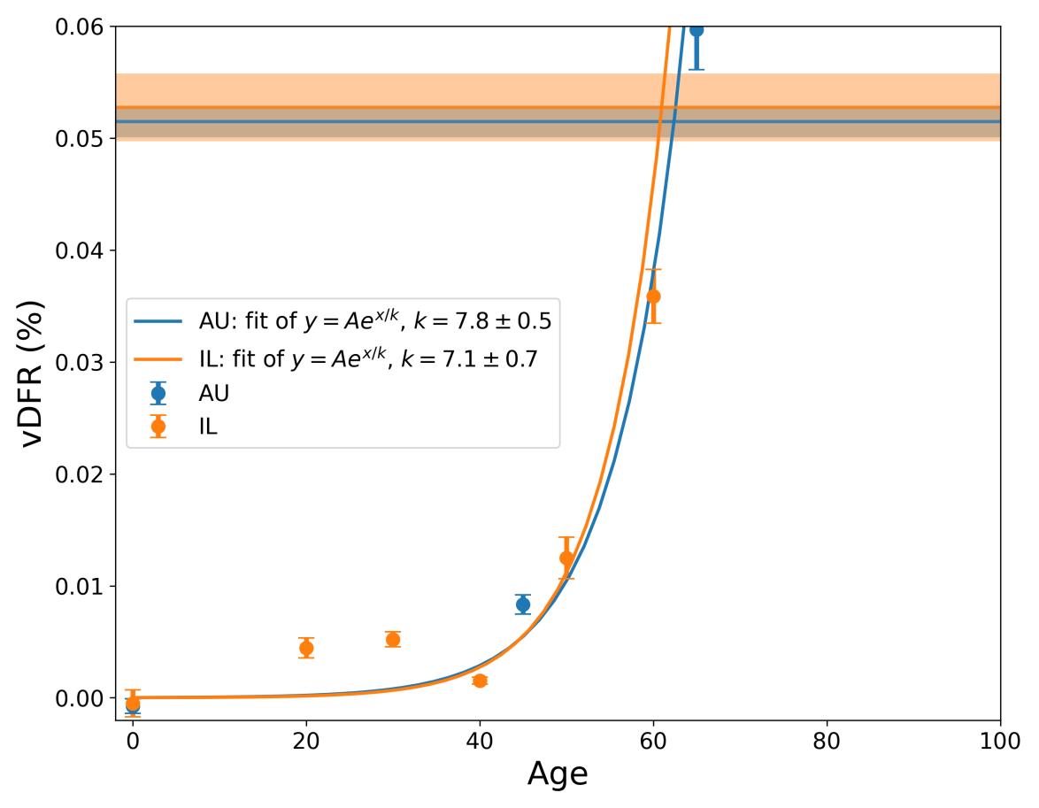
Vaccine dose
fatality
rate (vDFR)
by age group
Australia, Israel
Denis Rancourt, PhD – NCI - CeNC
Notes:
Figure 3 – vDFR (middle)

Slide 43
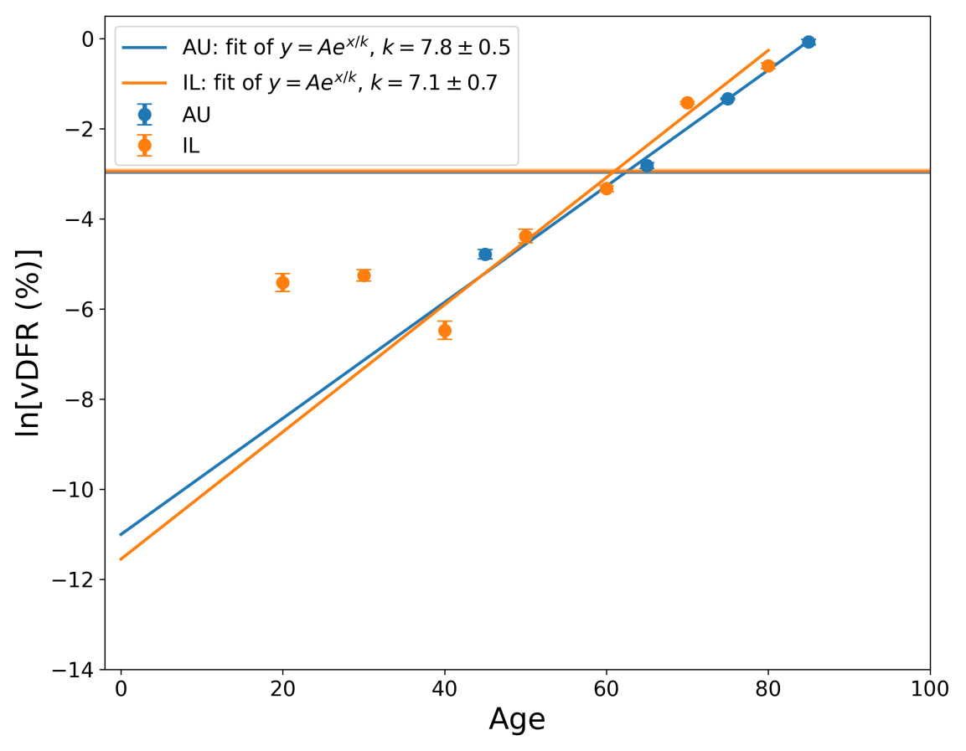
Vaccine dose fatality
rate (vDFR)
by age group
Australia, Israel
(semi-log scale)
Denis Rancourt, PhD – NCI - CeNC
Notes:
Figure 3 – vDFR (lower)

Slide 44
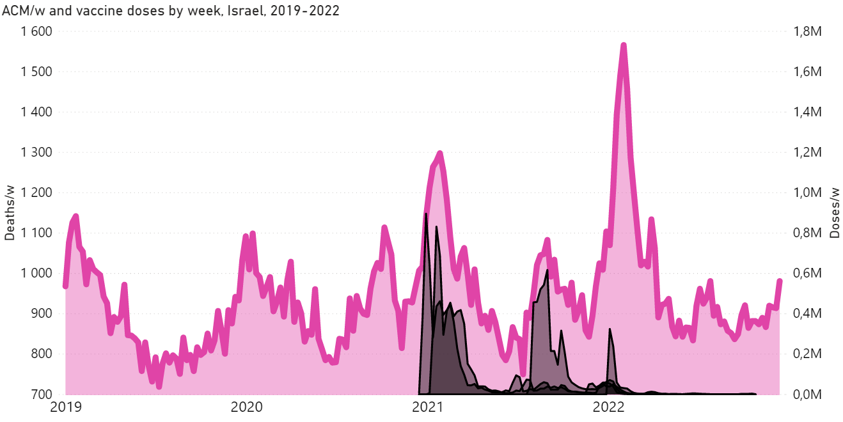
Israel
2019-2022
All-cause mortality by week
& vaccine administration by week
(all ages)
Denis Rancourt, PhD – NCI - CeNC
Notes:
Appendix 2 – Israel, all ages

Slide 45
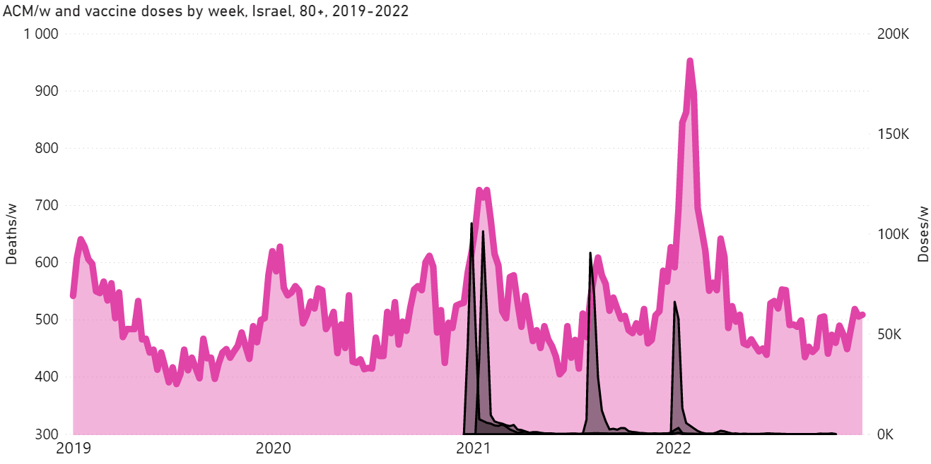
Israel
2019-2022
All-cause mortality by week
& vaccine administration by week
80+ years age group
Denis Rancourt, PhD – NCI - CeNC
Notes:
Appendix 2 – Israel, 80+

Slide 46
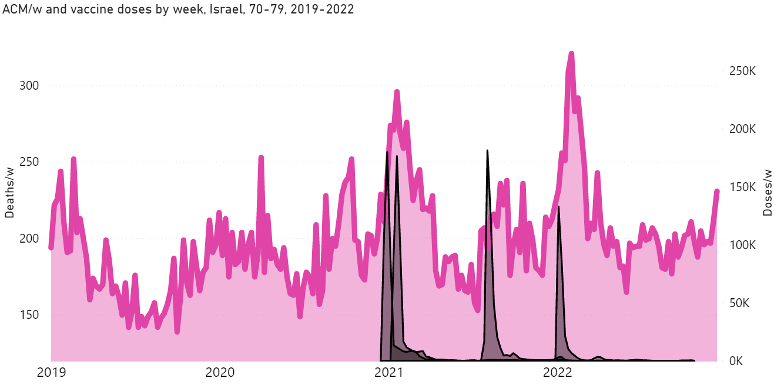
Israel
2019-2022
All-cause mortality by week
& vaccine administration by week
70-79 years age group
Denis Rancourt, PhD – NCI - CeNC
Notes:
Appendix 2 – Israel, 70-79

Slide 47
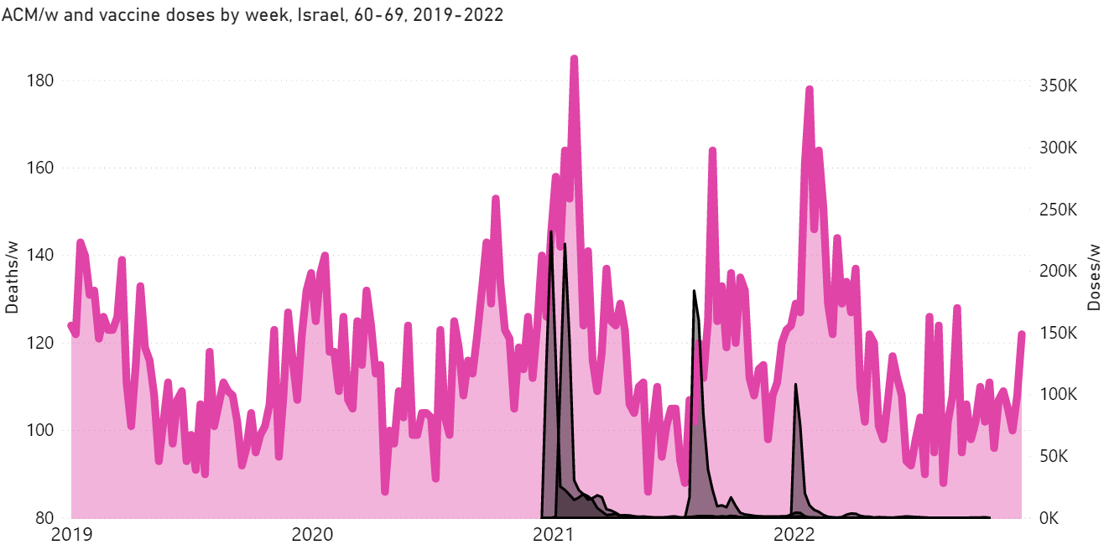
Israel
2019-2022
All-cause mortality by week
& vaccine administration by week
60-69 years age group
Denis Rancourt, PhD – NCI - CeNC
Notes:
Appendix 2 – Israel, 60-69

Slide 48
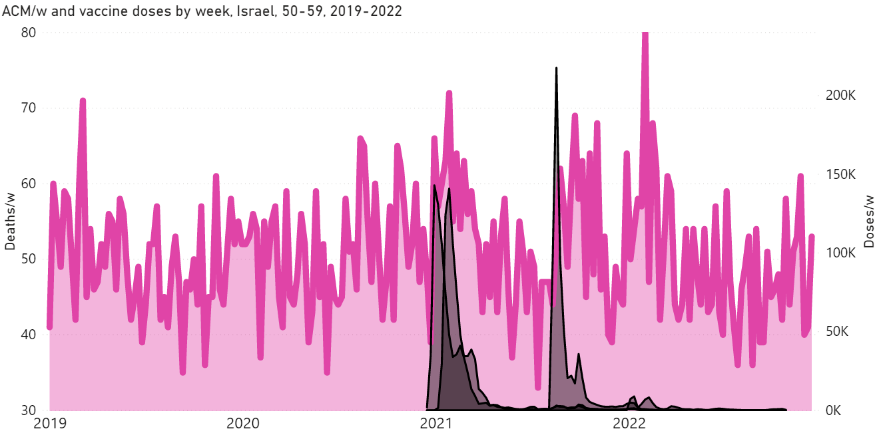
Israel
2019-2022
All-cause mortality by week
& vaccine administration by week
50-59 years age group
Denis Rancourt, PhD – NCI - CeNC
Notes:
Appendix 2 – Israel, 50-59

Slide 49
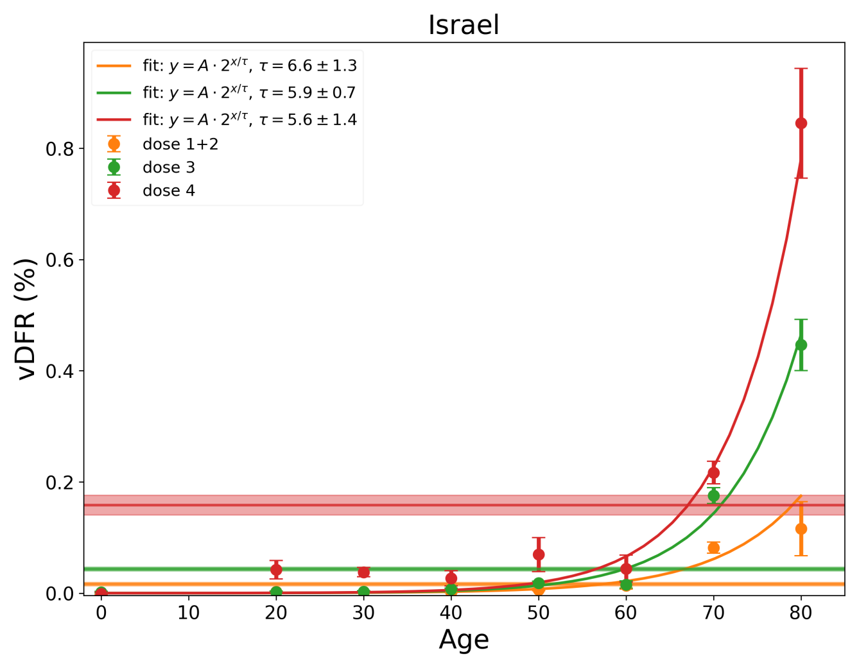
Vaccine dose fatality rate (vDFR)
by age group
& by dose number
& all-age by dose number
Denis Rancourt, PhD – NCI - CeNC

Slide 50
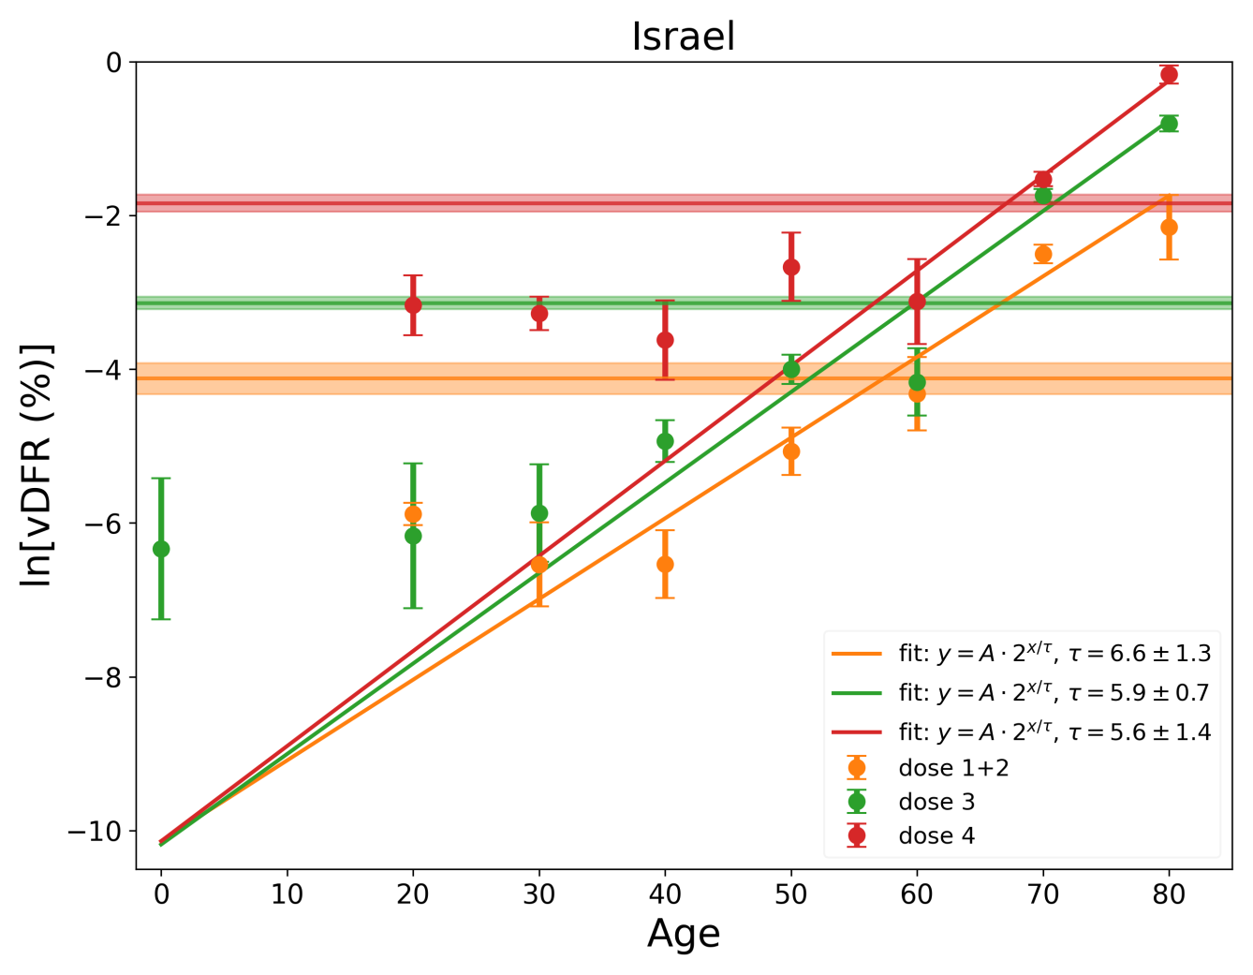
(same, semi-log scale)
Denis Rancourt, PhD – NCI - CeNC

Slide 51
Total vaccine deaths to date
India, Australia, Canada, Chile, Germany, Israel, New Zealand,
USA ...
vDFR: 0.05% - 0.1% - 1% - <3%
13 M – World
3.7 M – India
330 K – USA (vs 1.3 M)
~ 30 K – Canada
Denis Rancourt, PhD – NCI - CeNC

