Slide 1
Denis rancourt, phd
NATIONAL CITIZENS INQUIRY
TESTIMONY UPDATE
Ottawa
28 June 2023

Slide 2
Interdisciplinary scientist...
theoretical condensed-matter physics of magnetism
Invar and non-magnetic steel
meteoritics and planetary science
synthetic chemistry of intercalation compounds
measurement theory and technology ...
statistical analysis, factor analysis, error propagation
radiation balance physics (planetary warming)
molecular science, molecular dynamics, reactions
environmental biogeochemistry (bacteria & nanoparticles)
geopolitics, social and political theory
health and psychological stress
mortality and disease
theoretic epidemiology (2 articles peer-reviewed, with first author Dr. Joseph Hickey)
Denis Rancourt, PhD – NCI

Slide 3
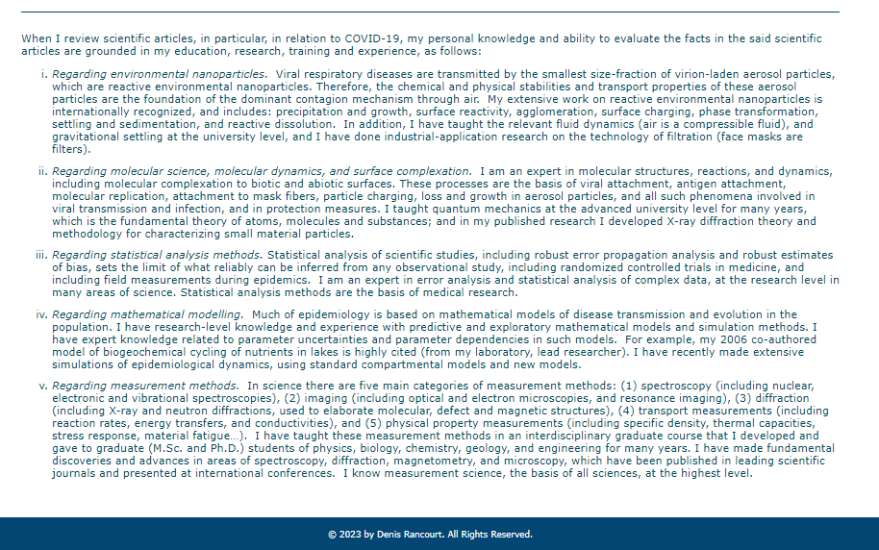
Nanoparticles / molecular science / statistical analysis / modelling / measurement

Slide 4
Collaborators:
Denis Rancourt, PhD
Marine Baudin, PhD (latest Canada analysis)
Joseph Hickey, PhD (latest World analysis)
Jérémie Mercier, PhD
John Johnson, PhD
Christian Linard, PhD
Denis Rancourt, PhD – NCI

Slide 5
THE BILINGUAL FIRST INSTALMENT OF THIS TESTIMONY WAS:
Quebec City : 11 May 2023 (en français)
Ottawa : 17 May 2023 (in English)
NCI EXHIBITS:
nationalcitizensinquiry.ca → Hearings → Exhibits → Ottawa
Denis Rancourt, PhD – NCI

Slide 6
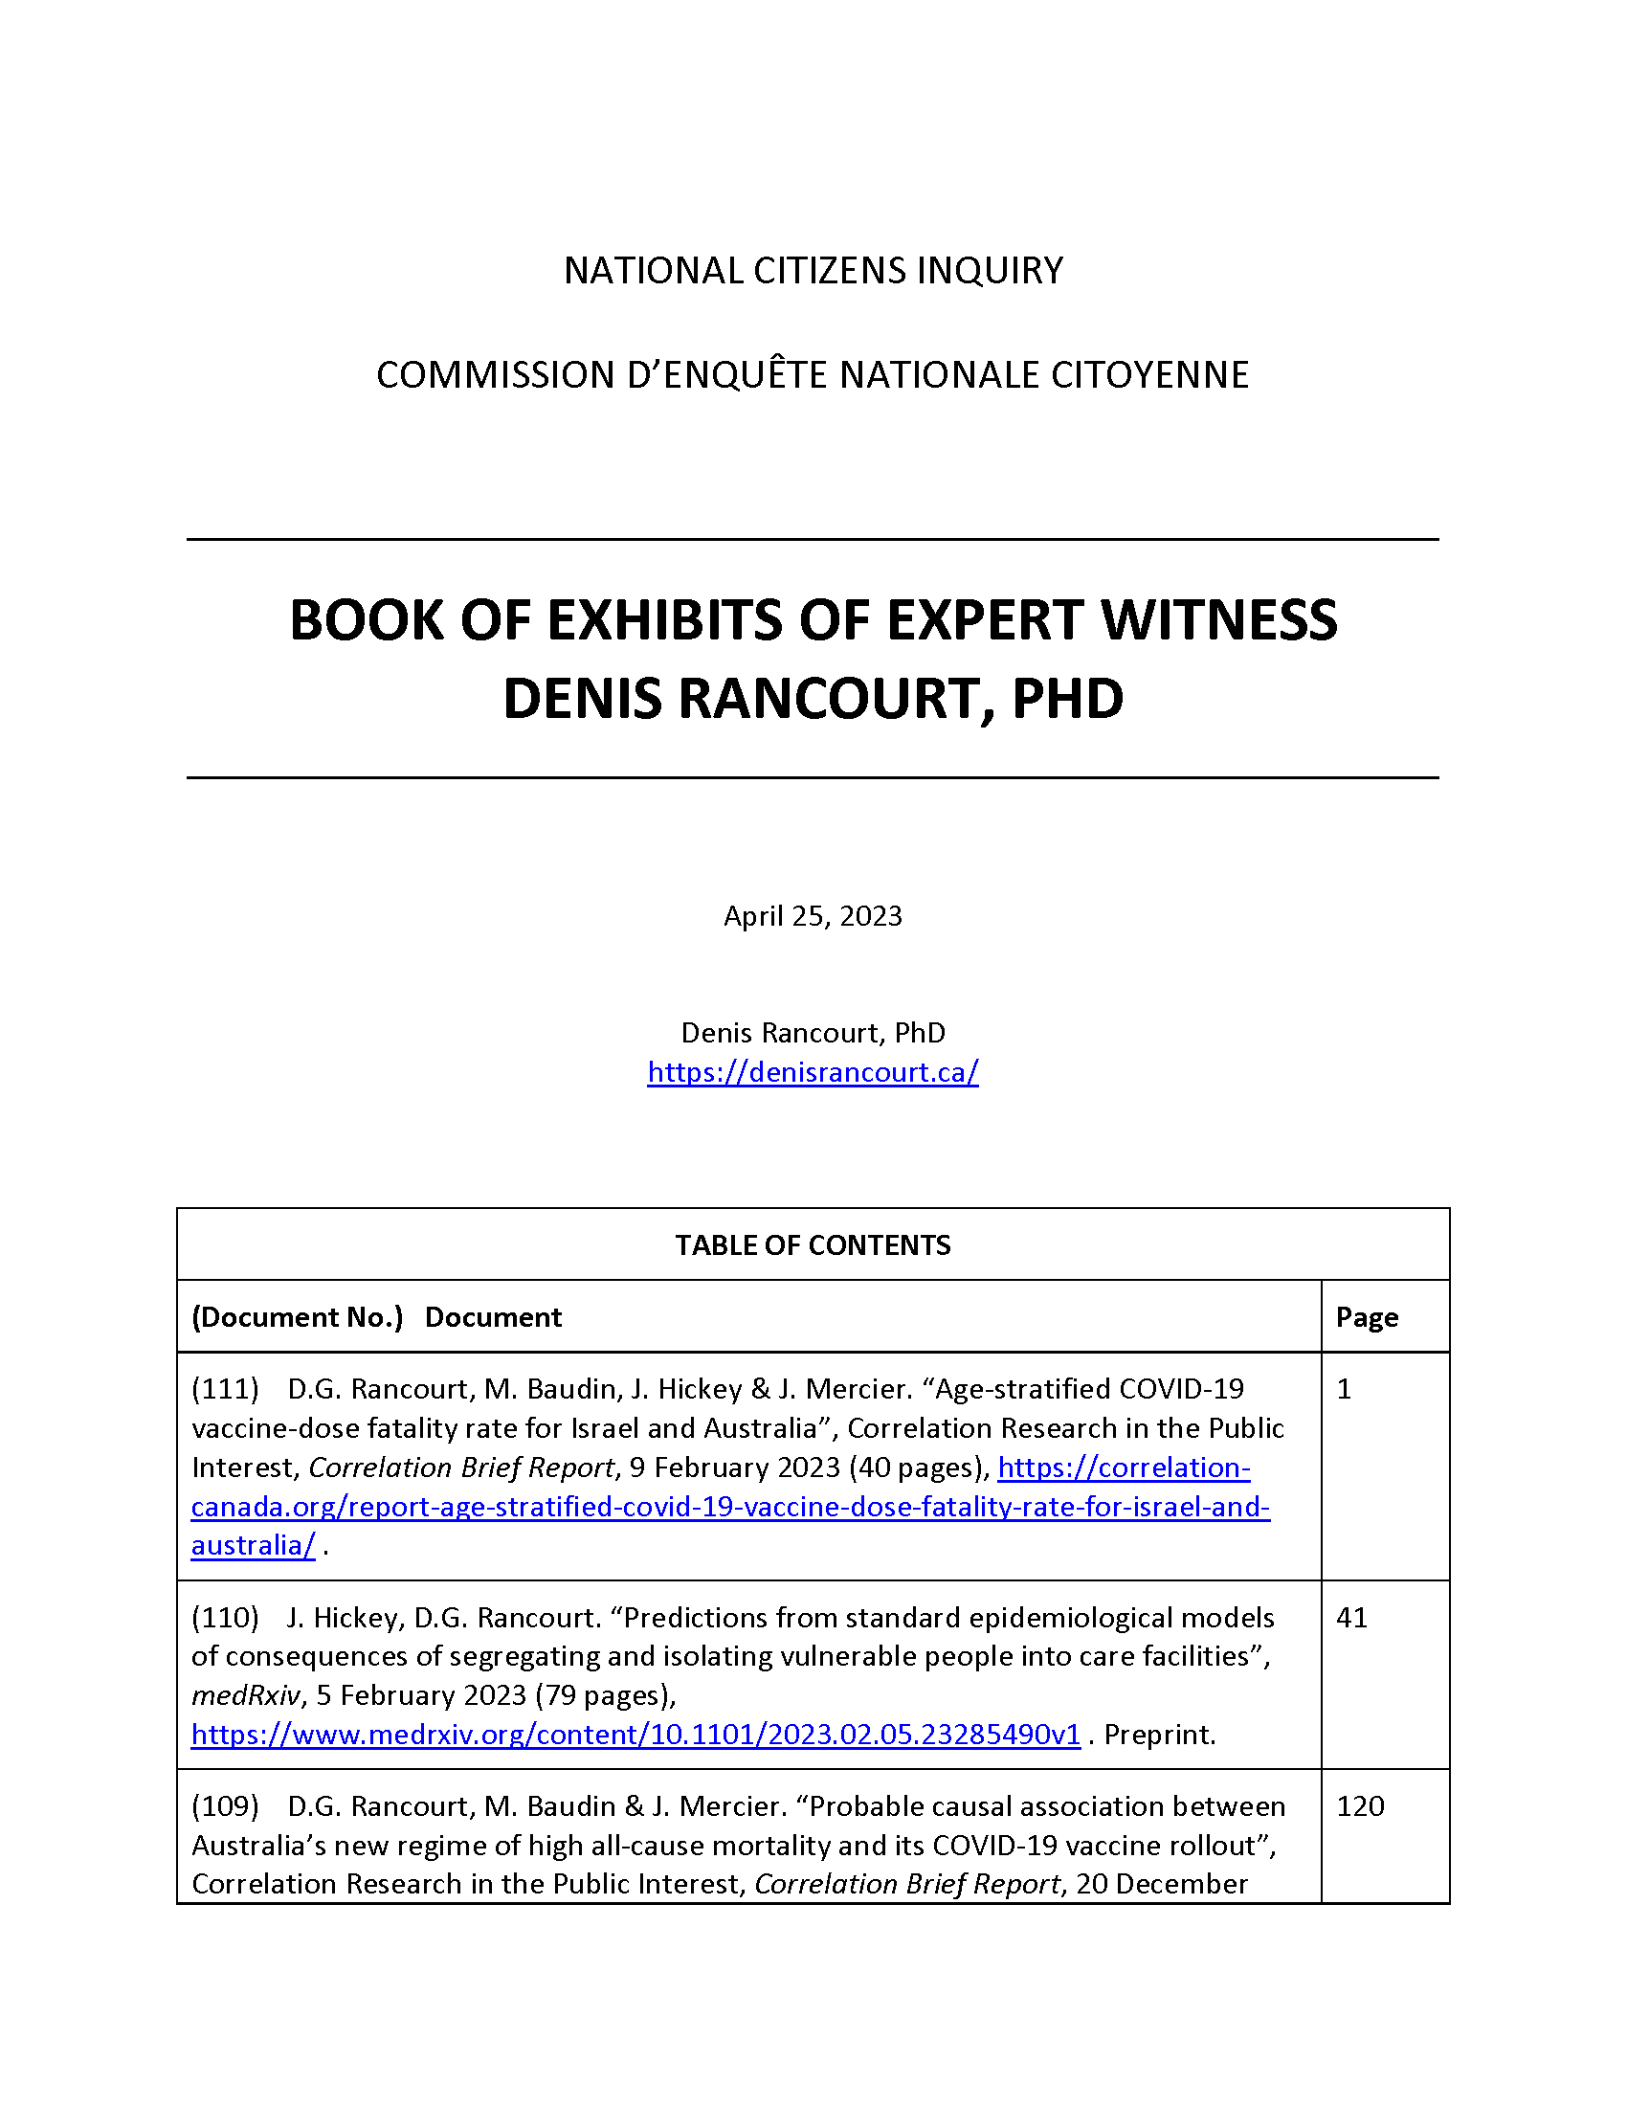
BoE
Notes:
Figure 1 – Australia, 75-84

Slide 7
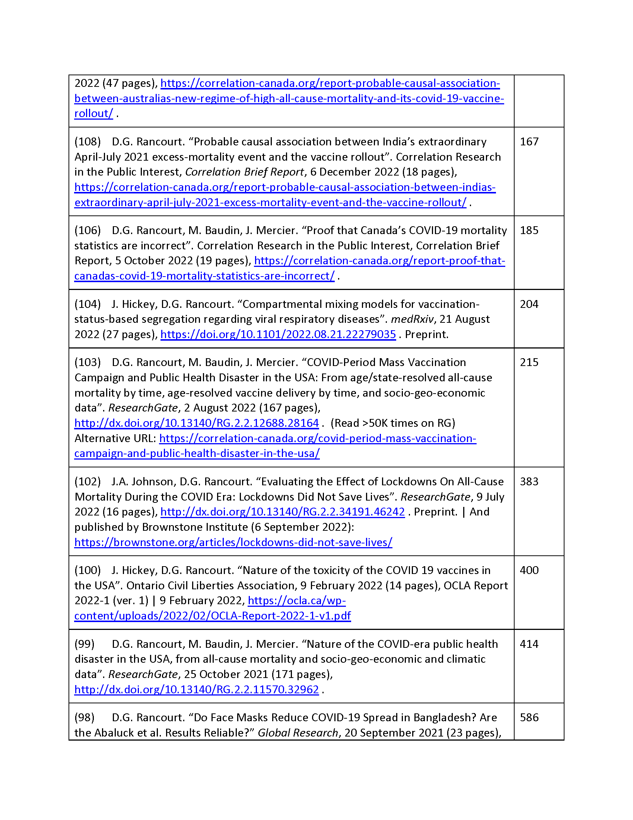
BoE
Notes:
Figure 1 – Australia, 75-84

Slide 8
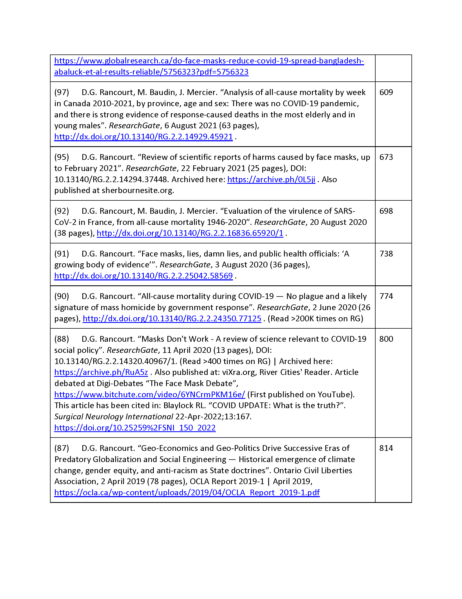
BoE
Notes:
Figure 1 – Australia, 75-84

Slide 9
Also, my website, COVID section:
https://denisrancourt.ca/
→ More than 30 articles and reports related to COVID
Denis Rancourt, PhD – NCI

Slide 10
FIRST-INSTALMENT ― CONCLUSION WAS:
there was no pandemic causing excess mortality
measures caused excess mortality
COVID-19 vaccination caused excess mortality
without the pandemic propaganda, “response” and coercion ...BAU... there would not have been any excess mortality
New 2000-word essay 22 June 2023:
“There Was No Pandemic”
Denis Rancourt, PhD – NCI

Slide 11
FIRST-INSTALMENT ― MADE THESE POINTS:
none of the post-second-world-war CDC‑promoted viral respiratory disease pandemics
●1957-58 “H2N2” ●1968 “H3N2” ●2009 “H1N1 again”
can be detected in the all‑cause mortality of any country
1918 mortality event, recruited to be a textbook viral respiratory disease pandemic (“H1N1”), occurred prior to the inventions of antibiotics and the electron microscope, under horrific post-war public-sanitation and economic-stress conditions
● proven by histopathology of preserved lung tissue,
deaths caused by bacterial pneumonia
● did not kill 50+ year olds (!)
“pandemic response industry”
Denis Rancourt, PhD – NCI

Slide 12
FIRST-INSTALMENT:
excess mortality often refuses to cross national borders and inter-state lines ― the invisible virus targets the poor and disabled and carries a passport
it never kills until governments impose socio-economic and care-structure transformations on vulnerable groups within the domestic population
vicious new “treatment” protocols killed patients in hotspots that applied those protocols in the first months of the declared pandemic
this was followed by coercive measures, which were squarely contrary to individual health ― fear, panic, paranoia, induced psychological stress, social isolation, self-victimization, loss of work and volunteer activity, loss of social status, loss of employment, business bankruptcy, loss of usefulness, loss of caretakers, loss of venues and mobility, suppression of freedom of expression, etc.
Denis Rancourt, PhD – NCI

Slide 13
TODAY: TESTIMONY UPDATE (28 June 2023)
PART I: Latest all-cause mortality data on Canada
age-groups
vaccines
provinces
worldwide
PART II: Critique of a few recently published articles
What we did and did not learn!
Denis Rancourt, PhD – NCI

Slide 14
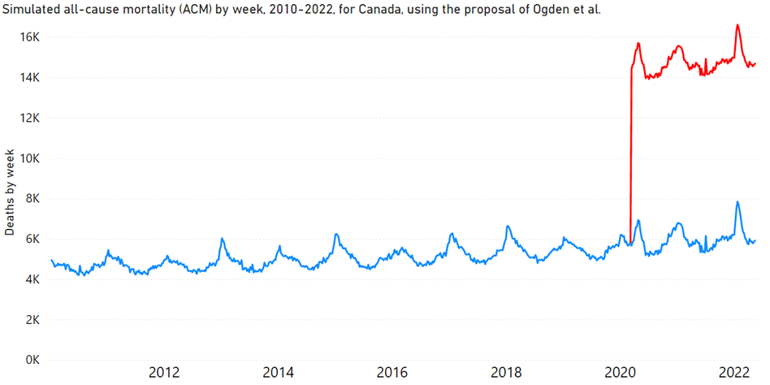
Theresa Tam and co.: 1M extra deaths scenario
vs
reality in Canada ...
(= actual all-cause mortality by week, 2010-2022)
(→ impossible coincidence)
Denis Rancourt, PhD – NCI - CeNC
Notes:
Figure 1 – Australia, 65-74

Slide 15
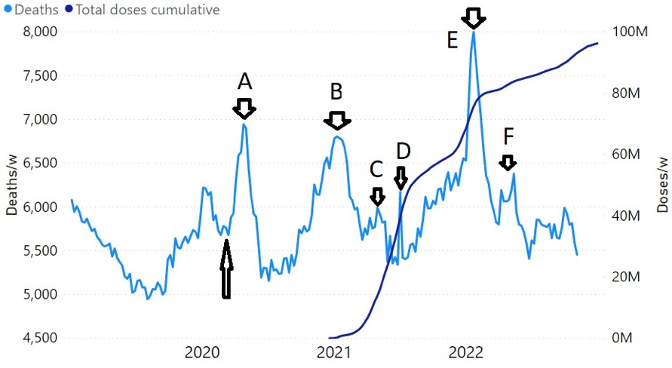
All-cause mortality by week ― Canada 2019-2023
& weekly cumulative vaccine-dose administration
Denis Rancourt, PhD – NCI - CeNC

Slide 16
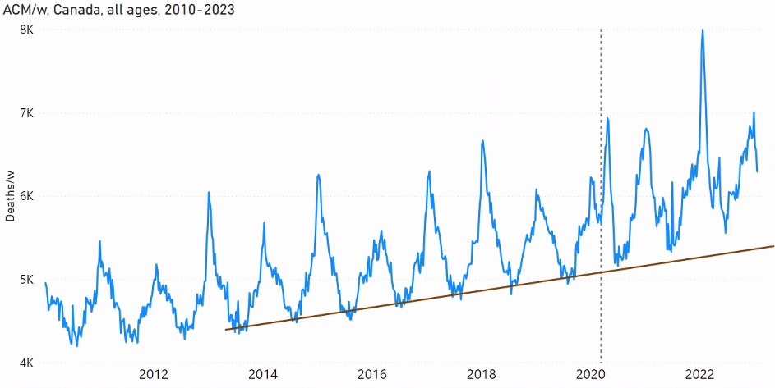
All-cause mortality by week
Canada ― all-ages
2010-2023
(Summer-trough baseline)
(WHO declaration: 11 March 2020)
CAN
Denis Rancourt, PhD – NCI

Slide 17
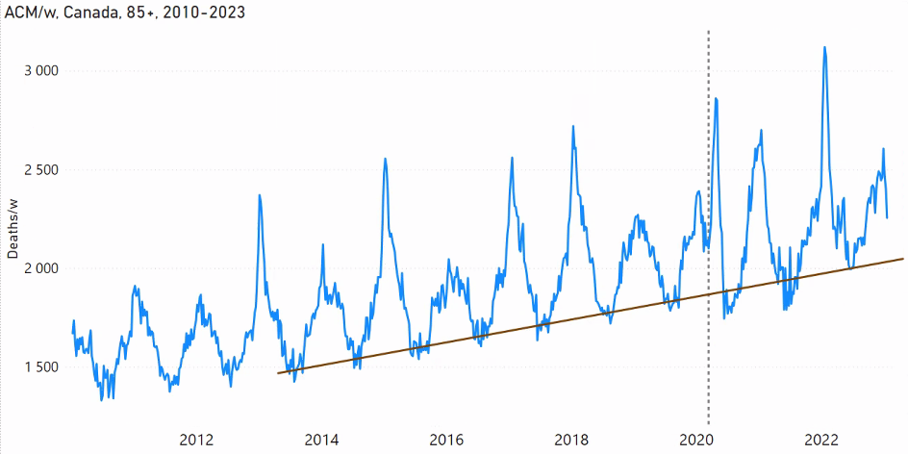
All-cause mortality by week
Canada ― 85+ years
2010-2023
(Summer-trough baseline)
(WHO declaration: 11 March 2020)
CAN
Denis Rancourt, PhD – NCI

Slide 18
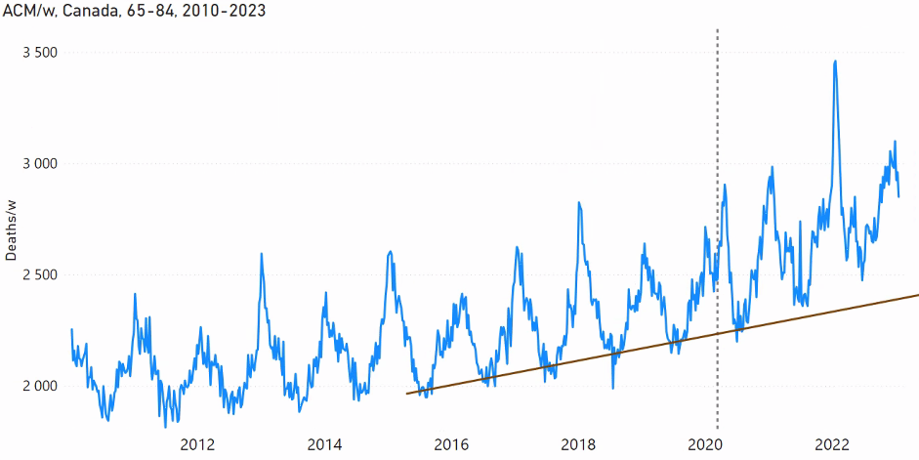
All-cause mortality by week
Canada ― 65-84 years
2010-2023
(Summer-trough baseline)
(WHO declaration: 11 March 2020)
CAN
Denis Rancourt, PhD – NCI

Slide 19
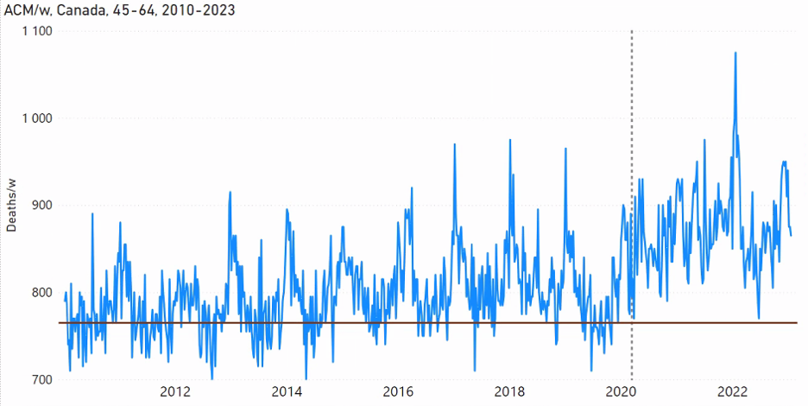
All-cause mortality by week
Canada ― 45-64 years
2010-2023
(Summer-trough baseline)
(WHO declaration: 11 March 2020)
CAN
Denis Rancourt, PhD – NCI

Slide 20
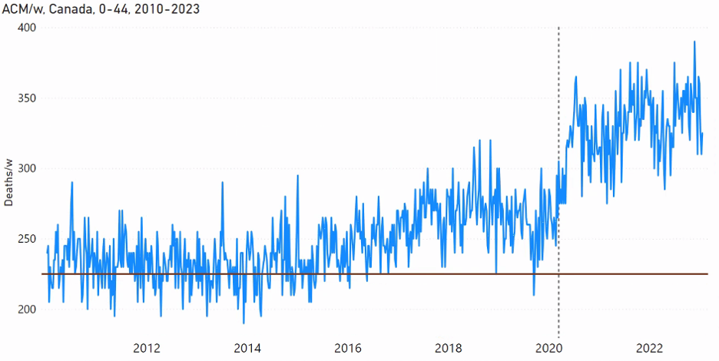
All-cause mortality by week
Canada ― 0-44 years
2010-2023
(Summer-trough baseline)
(WHO declaration: 11 March 2020)
CAN
Denis Rancourt, PhD – NCI

Slide 21
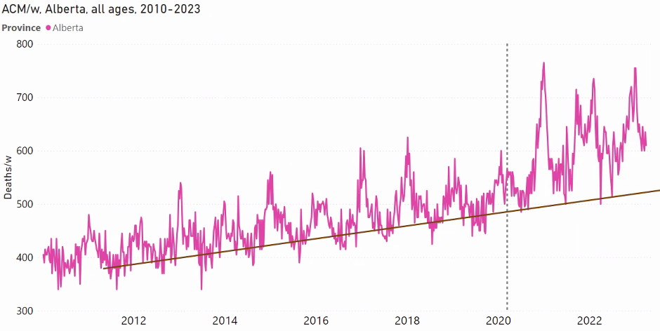
All-cause mortality by week
Alberta (Canada) ― all-ages
2010-2023
(Summer-trough baseline)
(WHO declaration: 11 March 2020)
AB
Denis Rancourt, PhD – NCI

Slide 22
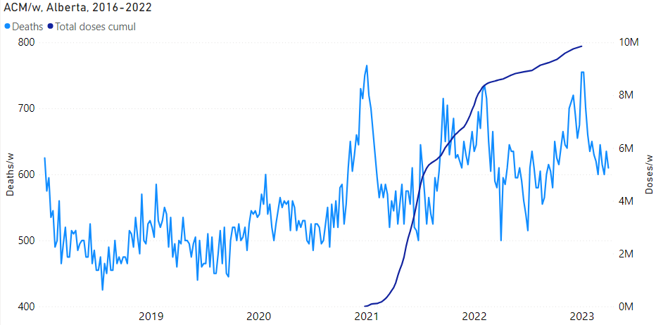
All-cause mortality by week
Vaccine doses rollouts
Alberta (Canada) ― all-ages
2018-2023
AB
Denis Rancourt, PhD – NCI

Slide 23
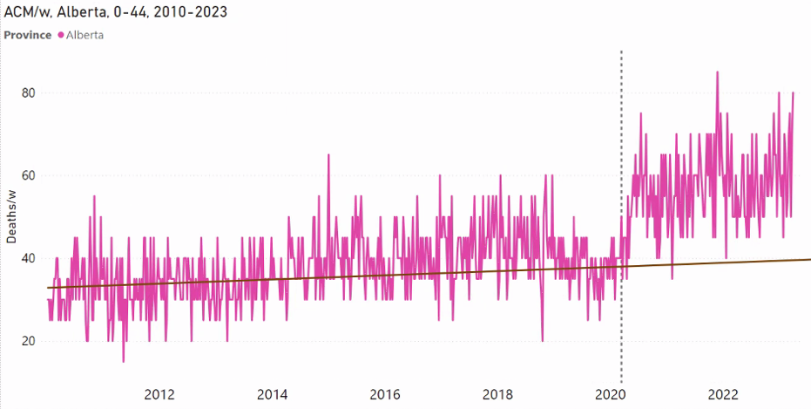
All-cause mortality by week
Alberta (Canada) ― 0-44 years
2010-2023
(Summer-trough baseline)
(WHO declaration: 11 March 2020)
AB
Denis Rancourt, PhD – NCI

Slide 24
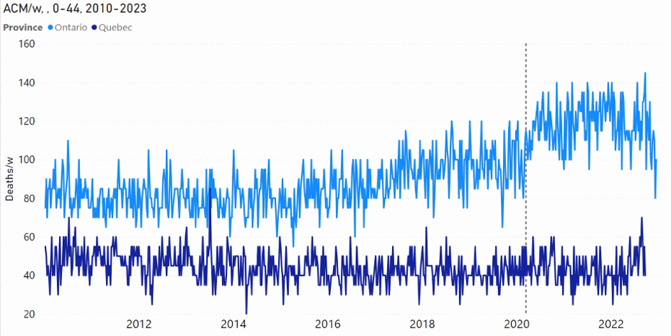
All-cause mortality by week
Ontario & Quebec (Canada) ― 0-44 years
2010-2023
(WHO declaration: 11 March 2020)
ON
QC
Denis Rancourt, PhD – NCI

Slide 25
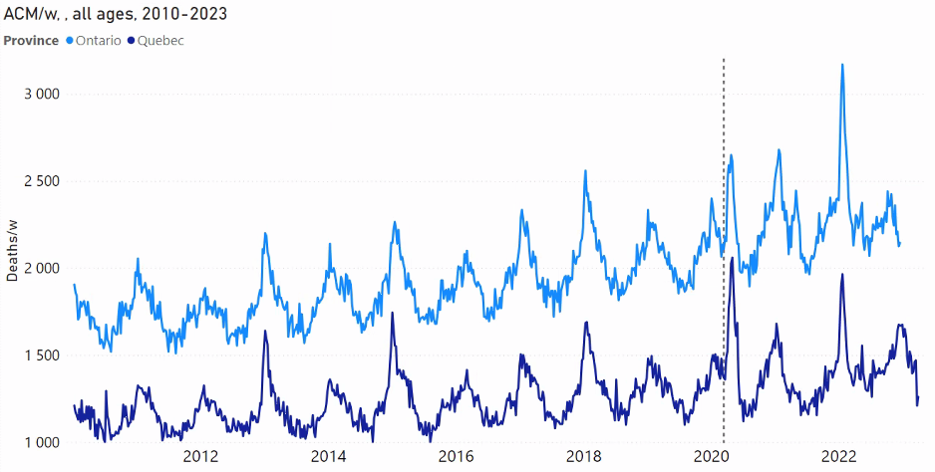
All-cause mortality by week
Ontario & Quebec (Canada) ― all-ages
2010-2023
(WHO declaration: 11 March 2020)
ON
QC
Denis Rancourt, PhD – NCI

Slide 26
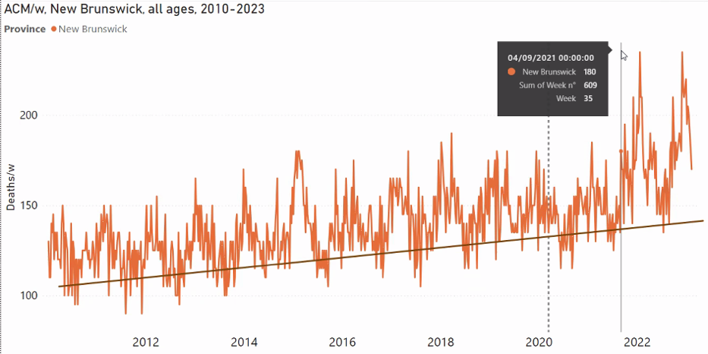
All-cause mortality by week
New Brunswick (Canada) ― all-ages
2010-2023
(WHO declaration: 11 March 2020)
(Post-vaccine upsurge date)
NB
Denis Rancourt, PhD – NCI

Slide 27
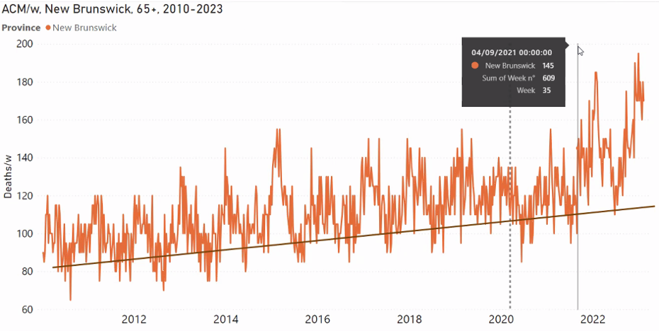
All-cause mortality by week
New Brunswick (Canada) ― 65+ years
2010-2023
(WHO declaration: 11 March 2020)
(Post-vaccine upsurge date)
NB
Denis Rancourt, PhD – NCI

Slide 28
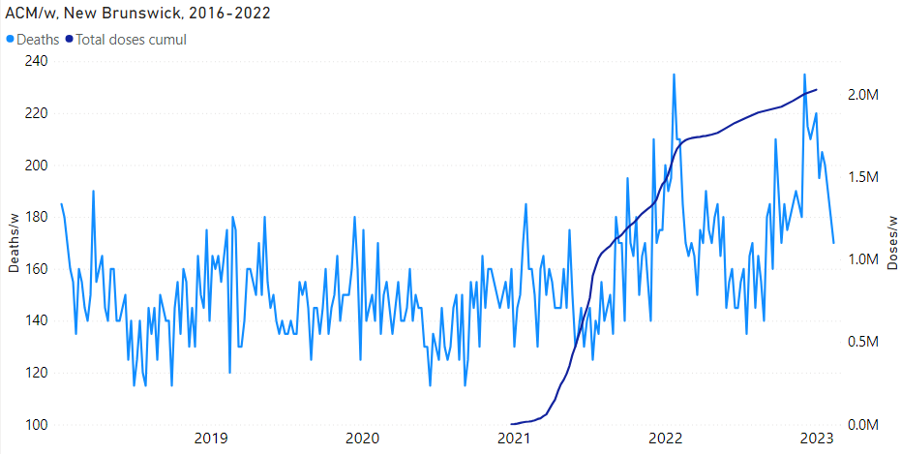
All-cause mortality by week
Vaccine doses rollouts
New Brunswick (Canada) ― all-ages
2018-2023
NB
Denis Rancourt, PhD – NCI

Slide 29
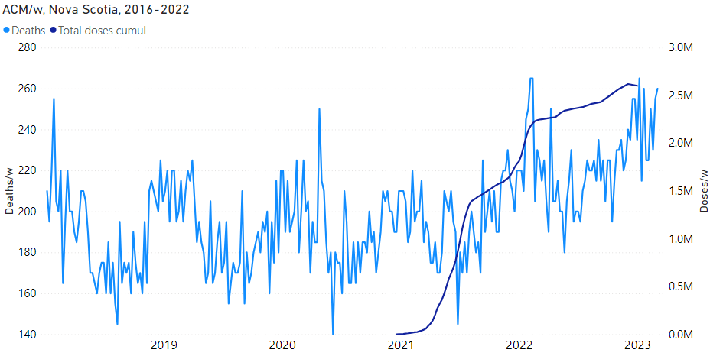
All-cause mortality by week
Vaccine doses rollouts
Nova Scotia (Canada) ― all-ages
2018-2023
NS
Denis Rancourt, PhD – NCI

Slide 30
Next: quantify vaccine-associated mortality
“vaccine-dose fatality rate” ― vDFR
Canada, whole population
Denis Rancourt, PhD – NCI

Slide 31
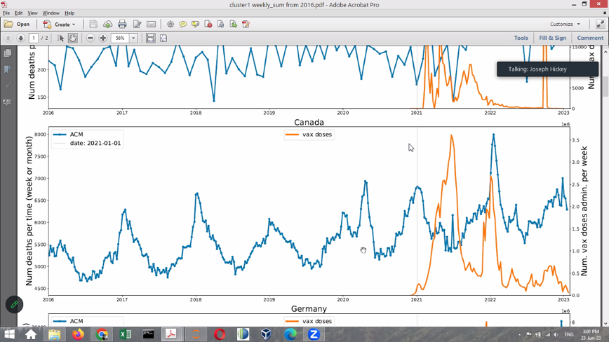
All-cause mortality by week ― Canada 2016-2023
& weekly vaccine-dose administration
Canada
Denis Rancourt, PhD – NCI

Slide 32
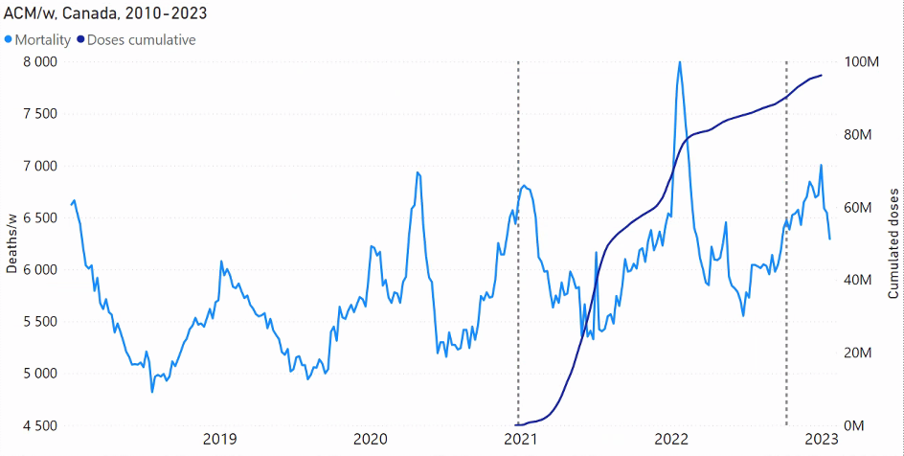
All-cause mortality by week, Canada, all-ages, 2018-2023
Vaccination period for calculation:
Week-52, 2020 (21 Dec 2020) through week-40, 2022 (3 Oct 2022)
90,338,953 doses administered
CAN
Denis Rancourt, PhD – NCI

Slide 33
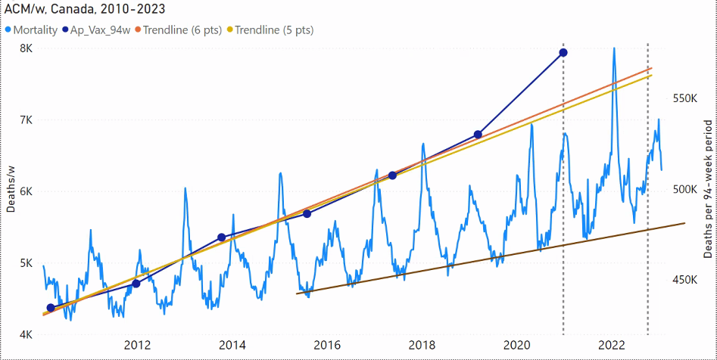
All-cause mortality by week
Canada ― all-ages
2010-2023
(Vaccination-period integration)
CAN
Greater mortality than during Covid prior to vaccination
Denis Rancourt, PhD – NCI

Slide 34
VACCINE DEATHS IN CANADA
Week-52, 2020 (21 Dec 2020)
through week-40, 2022 (3 Oct 2022)
90,338,953 doses administered
6-pts trend: 28,000 deaths
5-pts trend: 31,000 deaths
Vaccine-dose fatality rate (vDFR) = 0.03 %
(~ 1 death per 3000 injections, all-population average)
Denis Rancourt, PhD – NCI

Slide 35
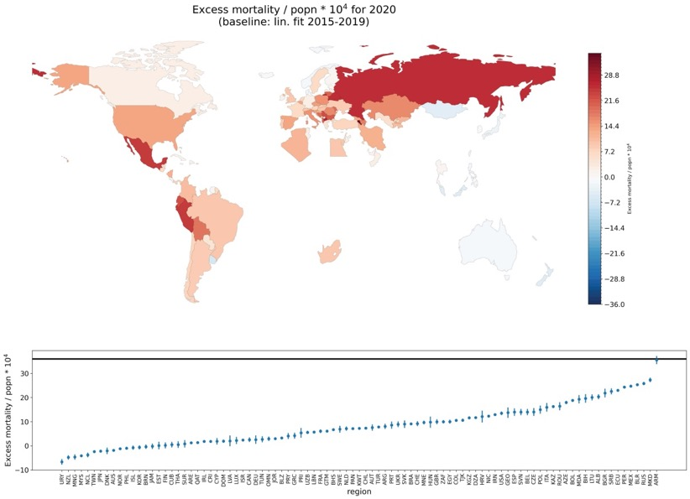
Excess all-cause mortality 2020 ― World map
2020
Denis Rancourt, PhD – NCI

Slide 36
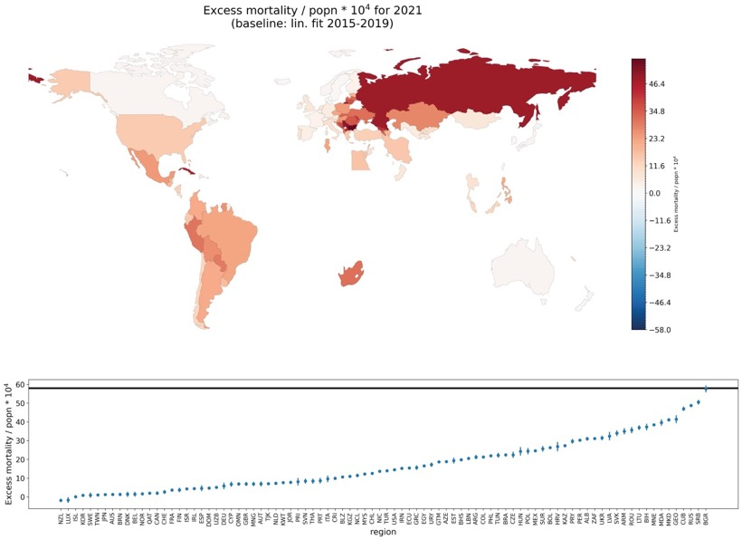
Excess all-cause mortality 2021 ― World map
2021
Denis Rancourt, PhD – NCI

Slide 37
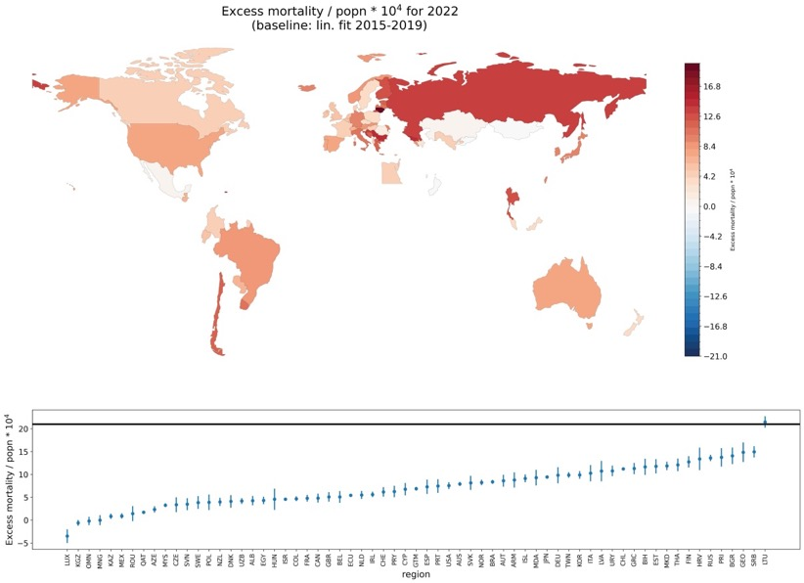
Excess all-cause mortality 2022 ― World map
2022
Denis Rancourt, PhD – NCI

Slide 38
CONCLUSION ― VACCINE DEATHS
World: 13M vDFR = 0.1%
India: 3.7M vDFR = 1%
USA: >330K (1.3M all excess) vDFR > 0.05%
Canada: 28K-31K vDFR = 0.03%
vDFR exponential with age, doubling every 5 years of age
Denis Rancourt, PhD – NCI

Slide 39
PART II
Denis Rancourt, PhD – NCI

Slide 40
TESTIMONY UPDATE
PART II: Critical review of a few recently published articles
What we did and did not learn!
DID LOCKDOWNS WORK? The verdict on Covid restrictions
Institute of Economic Affairs - IEA Perspectives 1
By Jonas Herby, Lars Jonung, and Steve H. Hanke
June 2023 (222 pages)
How did the Covid pandemic response harm society?
A global evaluation and state of knowledge review (2020-21)
By Kevin Bardosh
Pre-print version: May 14, 2023 (119 pages)
Denis Rancourt, PhD – NCI

Slide 41
What did we learn?
Short answer:
Nothing that governments and scientists should have learned was learned, or even questioned.
The disproved paradigm of spreading pandemic-causing viral respiratory diseases is completely intact
There is no admission of even the possibility that excess mortality was exclusively due to measures and vaccines
The dominant factors determining public health are hidden from view ― individual and societal susceptibility to disease versus spectrum of pervasive potential pathogens (ISS vs PPP)
Denis Rancourt, PhD – NCI

Slide 42
DID LOCKDOWNS WORK? The verdict on Covid restrictions
Institute of Economic Affairs - IEA Perspectives 1
By Jonas Herby, Lars Jonung, and Steve H. Hanke
June 2023 (222 pages)
Meta-analysis of 22 studies
Using a “lockdown stringency index”
No time-series analyses
No field (or forensic) studies whatsoever
Denis Rancourt, PhD – NCI

Slide 43
How did the Covid pandemic response harm society?
A global evaluation and state of knowledge review (2020-21)
By Kevin Bardosh
Pre-print version: May 14, 2023 (119 pages)
... analysis synthesizes 600 publications with a focus on meta-analyses, systematic reviews, global reports and multi-country studies.
This cumulative academic research shows that the collateral damage of the pandemic response was substantial, wide-ranging and will leave behind a legacy of harm for hundreds of millions of people in the years ahead.
Denis Rancourt, PhD – NCI

Slide 44
Many original predictions are broadly supported by the research data including: a rise in non-Covid excess mortality, mental health deterioration, child abuse and domestic violence, widening global inequality, food insecurity, lost educational opportunities, unhealthy lifestyle behaviours, social polarization, soaring debt, democratic backsliding and declining human rights.
Societal harms should challenge the dominant mental model of the pandemic response: it is likely that many Covid policies caused more harm than benefit, although further research is needed to address knowledge gaps and explore policy trade-offs, especially at a country-level.
Planning and response for future global health emergencies must integrate a wider range of expertise to account for and mitigate societal harms associated with government intervention.
Denis Rancourt, PhD – NCI

Slide 45
CONCLUSION (PARTS I & II)
In addition to natural events (heat waves, earthquakes, extended large-scale droughts), events that cause excess mortality are large assaults against domestic populations, affecting vulnerable residents, such as:
sudden devastating economic deterioration (the Great Depression, the dust bowl, the dissolution of the Soviet Union)
war (including social-class restructuring)
imperial or economic occupation and exploitation (including large-scale exploitative land use)
the now well-documented measures and destruction applied during the COVID period
There is no empirical evidence that excess mortality can be caused by sudden appearances of new pathogens.
Denis Rancourt, PhD – NCI

