Slide 1
The Canadian federal employer’s response to SARS-CoV-2, in contrast to existing federal occupational health and safety regulation and code:
An analysis and testimony presented by Ryan Orydzuk

Slide 2
Note: This is just a brief overview of Occupational Health and Safety legislation in Canada, and will not cover ALL relevant aspects. I also wanted to thank the National Citizens Inquiry for allowing me to testify here today.

Slide 3
A question for folks to consider during my testimony today:
As a federal employer, if a safety professional was bringing forward the following health and safety concerns regarding your vaccination policy, would you still choose to wilfully ignore the concerns, despite your own life, and the lives of your employees being at risk?

Slide 4
Who am I?
I am a former federal safety officer, with over a decade of experience and education as a safety professional.
I began my employment with Canada Post first as a letter carrier, then gradually pursued various interests of advancement within the corporation until I attained the position of an Occupational Health and Safety Officer. In this role I was a liaison between management representatives and approximately 750 employees, across 3 bargaining agencies in the Edmonton Mail Processing Plant.
After 4 years at the EMPP I transitioned into the newly created role of Human Resources Business Partner. This role expanded my area of responsibility, and subsequently increased to: 5 Collective Agreements, 1300 employees, 1 regional director, 4 area managers, 25-30 area superintendents/supervisors and 11 Local Joint Health and Safety Committees. This did not reduce the workload that I previously had regarding occupational health and safety management, instead, aspects of labour relations, grievance management, as well as other human resource functions were added to my scope of responsibility.
Based on a decade of internal and external education and experience attained as a Safety Professional, my main responsibility was to advise management representatives on the “Employer Duties”, and how they were to be interpreted when applying the existing Labour Code and Regulatory legislation. In essence, my job was to ensure that employees were safe and the employer fulfilled their due diligence.
I was an active leader for many of Canada Post’s new workplace safety process implementations, and responsible for creating, and maintaining many safety protocols for the Senior Officers within my region.
As part of my day-to-day responsibilities in OHS, I trained and advised Directors, area Managers, unionized Local Joint Health and Safety Committees, various enabling groups, 3rd party contractors and front-line employees.

Slide 5
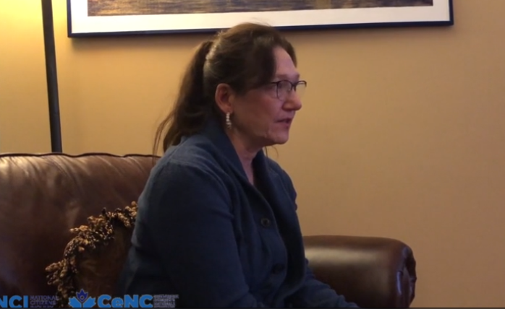
Ann the former pharmacist
Ann made some very good points about “informed consent” in her interview, but more importantly, she asked a key question to the National Citizens Inquiry towards the end of her testimony:
Who is accountable for all of this?
Today I am going to share whom I believe to be fully responsible, and highlight
the well-known laws that can be utilized to possibly hold those individuals accountable.

Slide 6
So who is legally responsible for the Covid-19 fiasco?
Big Pharma?
For creating the injections?
The Public Health Agency?
For approving the use of the injections?
The Government?
For pushing a mandate to begin with?
The Individual?
For making their own choice in the end, right?

Slide 7
Your Employer

Slide 8
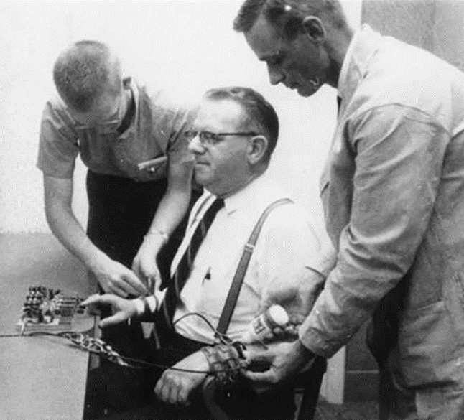
“If your friends all jumped off a bridge, would you jump too?”
The Milgram Experiment –
Obedience to Authority (Peer pressure on steroids)
Notes:
Remember what your mom or dad used to say to you back in the day when you told them you were doing something borderline risky, or even dangerous with your friends?
The difference between friends and authority in this case is terrifying, as peer pressure for the most part was a bit of verbal abuse, where the employer this time around was using the employee’s most basic and necessary of human needs listed in Maslow’s hierarchy of needs. With many employees already living paycheck to paycheck, or in a far worse situation, it would seem very unlikely that the majority of Canadians that needed the most basic resources - food, water, oxygen, shelter – would be willing to sacrifice their employment to protect themselves from the injections.

Slide 9
Employers should have asked themselves three questions
1. Am I actually required to follow this vaccination mandate?
NO
2. Is it even legal for me to implement this kind of a vaccine mandate?
NO
3. If I listen to the Prime Minister’s request regarding a vaccination mandate, have I completed all of my “due diligence” as the employer?
NO

Slide 10
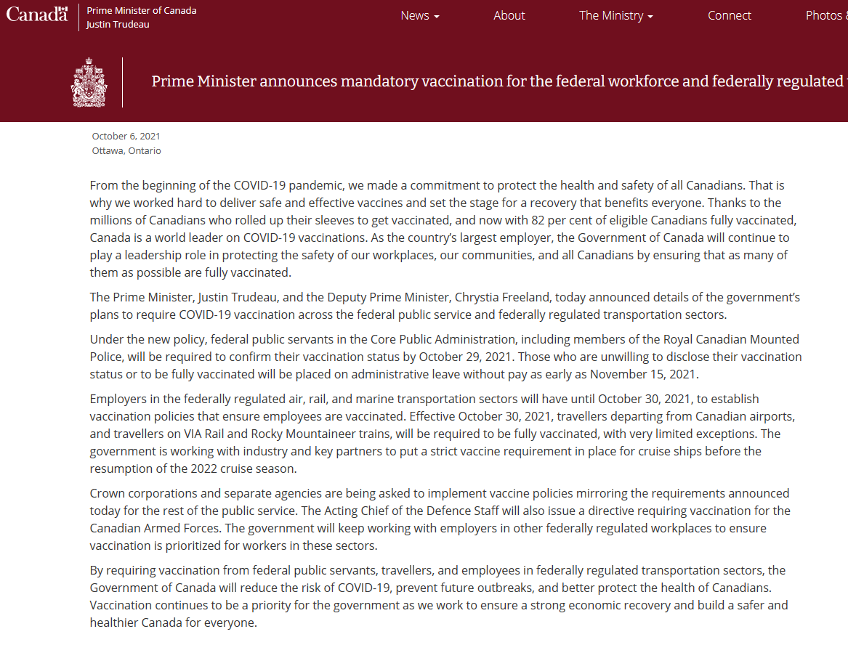
Let’s look directly at the Prime Minister’s own announcement

Slide 11
Before and after....
Prior to Covid 19 – Federal Employers
Covid 19 Era – Federal Employers
Employers typically did not try to mitigate influenza viruses in the workplace.
They did not re-engineer their work environments to try and control viral spread.
They did not provide their employees any sort of personal protection equipment to stop exposure.
They rarely had any seasonal signs posted in their facilities reminding people to be aware of influenza spread in the workplace.
Most employers outside of a few exceptions, NEVER forced their employees to take an influenza vaccine or any medical product as a condition of their employment. (Medical/Military)
Employers would never violate the Genetic Non-Discrimination Act, by forcing employees to undergo genetic test (Definition: Genetic Non-Discrimination Act S.C. 2017) as a condition of: entering into or continuing a contract agreement with that individual.
Members of the public were never questioned on health and safety matters, nor were they asked to wear personal protective equipment when entering federal environments.
Employers decided they needed to try and mitigate SARS-CoV-2 as a workplace hazard.
They began to build barriers and install plexiglass walls in their facilities as a means of protection.
Employers went overboard with unproven personal protective devices that were never designed to prevent the wearer from Covid-19.
Employers decided to put signs EVERYWHERE, constantly reminding people to use chemical hand sanitizer, wear their masks and remain 6 feet apart from one another.
Then finally employers went to the extreme, and decided to create an actual workplace policy that would demand their employees to take an experimental gene therapy injection as a condition of their current employment contract; somehow superseding every single labour law created to protect workers, particularly Occupational Health and Safety.
As part of their “accommodation process”, employers decided to have employees to undergo repeated genetic testing, via PCR or rapid test, to disclose their ongoing medical status.
People were repeatedly questioned and pursued regarding medical status and mask compliance.

Slide 12
Federal Employer Flow Chart for Implementing ANY New Process,
Equipment or Activity – “Due Diligence”…or “Is this even legal?”
NEW PROCESS, PIECE OF EQUIPMENT OR ACTIVITY
EVERYTHING the employer does in the work place, MUST first pass the requirements under
Part 2 of the Canada Labour Code and Canadian Occupational Health and Safety Regulations.
Hazardous Products Act
Genetic Non-Discrimination Act
Assisted Human Reproduction Act
Financial Administration Act
Collective Agreements CUPW, CPAA, APOC, RSMC, PSAC (Canada Post)
Criminal Code of Canada WESTRAY LAW
Duties of Employer’s (s:125)
Informed Consent
Right to Know, Right to Participate, Right to Refuse
Definition of Danger
OHS Interpretive Guidelines
Terms of Reference
National Bargaining Consultation Local and National Joint Health and Safety Committees
Minutes of all these consultations
Various CA articles including employee health and safety
WHMIS
GHS – Global Harmonized System Hazardous and Dangerous Goods Training
Genetic Protection Rights

Slide 13
Legal requirements of the employer to fulfill their “Due Diligence” or
Duties of Employer when implementing a new process, piece of equipment or activity
So after the employer has confirmed the legality of their new process, piece of equipment or activity, the following steps should be taken by the employer with the union (not inclusive of all potential aspects)
A primary initial discussion amongst the employer’s executive stakeholders to determine if the newly proposed idea has any merit as a device or piece of equipment to protect an employee in the workplace - assign the policy holder
Assign a project a facilitator that will create a plan for the new concept that includes: timelines, employee impact, job hazard assessments, health & safety committee review, certification, etc. This person would formally create the change request with the corporation and follow all the designated steps to maximize corporate compliance.
Create a comprehensive presentation on the new concept and present the material to each and every national joint health and safety committee.
Ensure that all discussions about the new safety process are captured on the national safety minutes as per federal legislation. The minutes should reflect the specifics of the discussion; any presentation material; noted guests; positives and negatives of implementation (considering mental health and wellness); potential hazards; any relevant regulatory impacts that have arisen pertaining to other legislated acts, etc, etc…
Provide all relevant information to the bargaining agencies, their safety officers as well as any of the employees that may raise concerns or issues with the newly proposed process – repeat this change management process.
Provide a timeline of piloting, reviewing and implementation of the new safety process, piece of equipment or device.
Demonstrate to respective unions what legislated requirements must specifically be filled in relation to the new process, piece of equipment or device, before it can be finalized as a new policy. These requirements could be collective agreement based, labour code based or even have specific requirements under other acts or regulations.
Pick a small area of the corporation to test pilot the new safety process. This ensures that the new process can be properly controlled, observed, documented, analyzed and reviewed. After all is said and done, and all the legislative requirements are met, possibly finalize the concept should the small test pilot determine proven risk mitigation and safety compliance.
Establish through the workplace hazard prevention program, a process for monitoring the effects and safety concerns as they arise and ensure that this process is communicated to the employees and their respective unions.

Slide 14
How does Occupational Health and Safety Play into all of this?
The truth is that Occupational Health and Safety (OHS), is the very piece of this puzzle that everyone has been missing.
The entire Covid-19 management process, that culminated with federal employers creating their own vaccination policy/practice, was rooted in OHS. However, this was the first of many oversights that Senior Officers had made, as their policies/practices should have immediately ended once OHS legislation was applied. (Definition: Criminal Code of Canada S.C. 1985)
Federal employers handed their legal expectations, all listed under the Duties of Employers in sections 124-125 of the Canada Labour Code (CLC), directly to an unaccountable and unchecked third-party entity: the Public Health Agency of Canada (PHAC).
What federal employers should have done, was USE the “Duties of the Employers” listed under part 2 of the CLC, to refuse any requests coming from the Prime Minister’s Office. This would have served to protect the employers from liability issues, instead of inversely setting themselves up for it. Even at a minimum, it could have provided more time for the employer to evaluate the legality or need to create a new vaccination policy/practice in such a short period of time, and all with a brand-new technology in mind.
These are big claims to make…Trust me, I know. In order for my evidence and the scope of the issue to be understood, I will need to take you through a condensed version of Safety School.

Slide 15
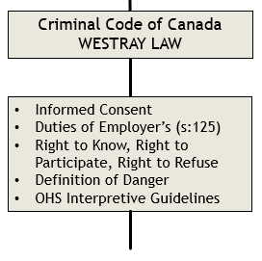
EVERYTHING the employer does in the work place, MUST pass the requirements under Part 2 of the
Canada Labour Code and Canadian Occupational Health and Safety Regulations first.
Since its induction, employers have had to follow their legal obligations listed under Part 2 of the Canada Labour Code.
This is not a new concept in anyway.
In fact, because of the WESTRAY mining disaster in 1992, that led to the deaths of 26 workers in Nova Scotia, it became criminal law in 2004 that employers MUST protect the health and safety of their workers.
Section 217.1 of the Criminal Code creates an occupational health and safety duty requirement for all organizations who undertake or have the authority to direct how others work or perform a task, to take all reasonable steps to prevent bodily harm to the person performing the work or task, and to any other person.
Duties of Employers
124 Every employer shall ensure that the health and safety at work of every person employed by the employer is protected. (CLC)
125 (1) Without restricting the generality of section 124, every employer shall, in respect of every work place controlled by the employer and, in respect of every work activity carried out by an employee in a work place that is not controlled by the employer:
(c) except as provided for in the regulations, investigate, record and report, in accordance with the regulations, all accidents, occurrences of harassment and violence, occupational illnesses and other hazardous occurrences known to the employer;
(s) ensure that each employee is made aware of every known or foreseeable health or safety hazard in the area where the employee works;
(t) ensure that the machinery, equipment and tools used by the employees in the course of their employment meet prescribed health, safety and ergonomic standards and are safe under all conditions of their intended use;
(w) ensure that every person granted access to the work place by the employer is familiar with and uses in the prescribed circumstances and manner all prescribed safety materials, equipment, devices and clothing;

Slide 16
EVERYTHING the employer does in the work place, MUST pass the requirements under Part 2 of the
Canada Labour Code and Canadian Occupational Health and Safety Regulations first. (Continued)
The Right to Know
You have the right to be informed of known or foreseeable hazards in the workplace and to be provided with the information, instructions, training, and supervision necessary to protect your health and safety…
…In addition, you are given the right to have access to government or employer reports related to the health and safety of employees through your policy health and safety committee, workplace health and safety committee or health and safety representative.
The Right to Refuse
You have the right to refuse to work if you have reasonable cause to believe that:
your workplace presents a danger to you
the use or operation of a machine or apparatus presents a danger to you or to another employee, and
the performance of an activity constitutes a danger to you or to another employee
Definition of Danger – Interpretative Guidelines – 905-1-IPG
"Hazard" means a source of harm or risk to an employee.
"Condition" means circumstances, and in particular, those affecting the functioning or existence of something.
"Activity" means the tasks directly related to the employee's duties.(In this case a vaccination policy/practice)
"Reasonably expected" means:
Does not require that the threat materialize every time the hazard, condition or activity occurs;
It is not necessary to establish precisely the time when the threat will materialize nor does the threat need to materialize frequently;
Only requires that a person determines in what circumstances the threat could reasonably be expected to materialize;
There is more than one way to establish that a condition, hazard, or activity can reasonably be expected to be a threat. Evidence of actual injury in exactly the same circumstances is not required.
Other sources of evidence include: expert opinions; opinions of ordinary witnesses having the necessary experience; and inference arising logically or reasonably from known facts.

Slide 17
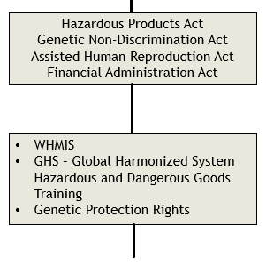
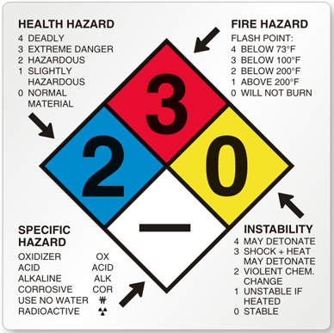
EVERYTHING the employer does in the work place, MUST pass the requirements under Part 2 of the
Canada Labour Code and Canadian Occupational Health and Safety Regulations first. (Continued)
Section 125.1 speaks to the “further specific duties of the employer” and directly to the requirements for employers to use and store hazardous/dangerous products in the work place.
(a) ensure that concentrations of hazardous substances in the work place are controlled in accordance with prescribed standards;
(b) ensure that all hazardous substances in the work place are stored and handled in the manner prescribed;
(c) ensure that all hazardous substances in the work place, other than hazardous products, are identified in the manner prescribed;
(f) where employees may be exposed to hazardous substances, investigate and assess the exposure in the manner prescribed, with the assistance of the work place committee or the health and safety representative; and
(g) ensure that all records of exposure to hazardous substances are kept and maintained in the prescribed manner and that personal records of exposure are made available to the affected employees.
Employer’s “duties” regarding the Global Harmonized System & WHMIS - Used for Identifying known hazardous/dangerous products
Use of Material Safety Data Sheets (MSDSs) – just called Safety Data Sheets now.
Employee Education and Training
Instructions with respect to the product identifier;
Procedures for the safe handling, use, storage and disposal of a controlled product, including information relating to the disposal of a controlled product contained or transported in piping systems and vessels; and
Procedures to be followed in the case of an emergency involving a controlled product.
- Hazard Identification and Ingredient Disclosure. Employers are responsible for evaluating those products produced in a workplace process using the hazard criteria identified in the Controlled Products Regulations.
WHMIS is consistent with the worker’s “right to know” or their “informed consent” regarding what chemical hazards are present in the workplace, and what the employer and employee is to do to control them. Existing occupational health and safety legislation in Canada requires that workers be informed about ALL risks they may encounter on the job.

Slide 18
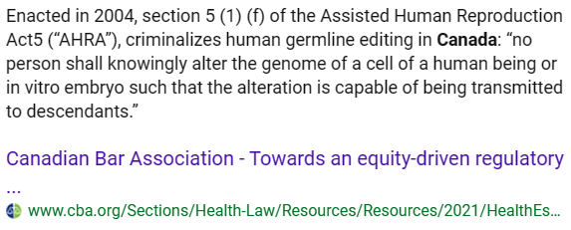
EVERYTHING the employer does in the work place, MUST pass the requirements under Part 2 of the
Canada Labour Code and Canadian Occupational Health and Safety Regulations first. (Continued)
Are there any other Acts or regulations of concern for the employer?
Genetic Non-Discrimination Act:
3 (1) It is prohibited for any person to require an individual to undergo a genetic test as a condition of
(a) providing goods or services to that individual;
(b) entering into or continuing a contract or agreement with that individual; or
(c) offering or continuing specific terms or conditions in a contract or agreement with that individual.
Genetic test: means a test that analyzes DNA, RNA or chromosomes for purposes such as the prediction of disease or vertical transmission risks, or monitoring, diagnosis or prognosis.
Assisted Human Reproduction Act
Principles
The Parliament of Canada recognizes and declares that:
(g) human individuality and diversity, and the integrity of the human genome, must be preserved and protected.
Prohibited procedures
5(1) No person shall knowingly:
(f) alter the genome of a cell of a human being or in vitro embryo such that the alteration is capable of being transmitted to descendants;

Slide 19
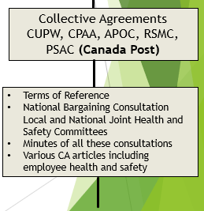
EVERYTHING the employer does in the work place, MUST pass the requirements under Part 2 of the
Canada Labour Code and Canadian Occupational Health and Safety Regulations first. (Continued)
Employee collective bargaining agreements are all formed on the existing labour laws that protect all federal workers. The existing labour laws are the minimum requirements that MUST be adhered to by corporations and unions alike – neither entity can supersede the established labour or occupational health and safety legislation.
Usually if the employer had missed an aspect of the legislation or labour code, the checks and balances provided by the employee’s collective agreement would catch these issues in the end.
However....what happens if the union themselves acts unknowingly or ignorantly regarding their members’ grievance? What if articles within their collective agreement are overlooked, or the union simply sides with the employer’s agenda despite obvious concerns?
Sadly when this occurs, the employee membership ends up being denied every single right that was afforded to them under both their collective agreement and the labour code because there is no executive member choosing to fight on behalf of the employees.

Slide 20
Are there potential consequences for the employer when safety laws are completely ignored?
YES!

Slide 21
The potential consequences of willful and immoral conduct by the employer
How this all ties back into the WESTRAY mining incident of 1992 and the amendments and additions made to the criminal code of Canada.
Section 217.1 Criminal Code of Canada:
Every one who undertakes, or has the authority, to direct how another person does work or performs a task is under a legal duty to take reasonable steps to prevent bodily harm to that person, or any other person, arising from that work or task.
Section 219 (1) Criminal negligence
219 (1) Every one is criminally negligent who:
(a) in doing anything, or
(b) in omitting to do anything that it is his duty to do, shows wanton or reckless disregard for the lives or safety of other persons.
Definition of duty
(2) For the purposes of this section, duty means a duty imposed by law.
The duties are listed in part 2 of the Canada Labour Code and accompanying Canadian Occupational Health and Safety Regulations
Causing death by criminal negligence
220 Every person who by criminal negligence causes death to another person is guilty of an indictable offence and liable
(a) where a firearm is used in the commission of the offence, to imprisonment for life and to a minimum punishment of imprisonment for a term of four years; and
(b) in any other case, to imprisonment for life.
Causing bodily harm by criminal negligence
221 Every person who by criminal negligence causes bodily harm to another person is guilty of
(a) an indictable offence and liable to imprisonment for a term of not more than 10 years; or
(b) an offence punishable on summary conviction.

Slide 22
But Ryan... Are these vaccines not the property of the Big Pharma or even the Government of Canada?
Could the employer claim that these vaccines are owned by the pharmacies administering them to people?
How can one claim that these are the employer’s
device or piece of equipment?

Slide 23
How are these vaccines legally tied to the employer as their liability?
1. Because the mandatory vaccination policies/practices had been announced as a safety protocol to protect employees while at work, the senior officers within said individual federal entities immediately adopted all liability under part 2 of the Canada Labour Code for their mandatory vaccination policies.
2. The employer cannot hand their legal liabilities over to an unaccountable third party (PHAC) when it comes to a new workplace activity or piece of equipment that THEY are choosing to implement. The employer is also required to render the equipment 100% safe to use.
Employers can listen to the suggestions that come from a third party or outside agency, but they cannot defer their duties entirely. If the employer chooses to do this, without maintaining their “due diligence”, then the employer can suffer the legal consequences of relying solely on one external source of information to approve their new piece of equipment or workplace process.
3. The definitions for the Employer and Employee in the Canada Labour Code as well as the Canada Revenue agency, make it very clear that the employer is the one that employs one or more employees and provides you with your paycheck. The employer CANNOT defer this responsibility to an unaccountable third party...Someone has to be liable right?
4. Section 125(1)(l) in the CLC states that the employer must: provide every person granted access to the workplace by the employer with prescribed safety materials, equipment, devices and clothing. Simple: The employer’s policy, the employer’s workplace, the employer’s activity, hence the employer’s equipment or device.
5. As the provincial Workers Compensation Boards (WCB) have already stated, employers that implement mandatory vaccination policies are subject to and responsible for managing the injury claim and responsible for covering the employee’s injury pay as a work-related illness or injury. The employer will also subsequently suffer the raised WCB premium costs should their injury and claim rate increase due to the employer’s vaccination policy.

Slide 24
Some very big regulatory complications for the federal employer....
Federal employers implemented their vaccination policy/practice as a workplace safety activity, more specifically, assigning selected vaccines as piece of personal protective equipment (PPE) to protect against SARS-CoV-2 (Covid-19: variant specific). Because of this action, the following regulatory clause under section 12.04 of the Canadian Occupational Health and Safety Regulations (Protection Equipment and Other Preventative Measures) must be applied directly to their vaccination policy/practice and everything included thereunder.
12.04 Any protection equipment that is provided or used in a workplace must be designed to protect the person from the hazard in question and must not in itself create a hazard.
Employers should have IMMEDIATELY recognized the obvious complications in implementing vaccines as a piece of personal protective equipment for a couple of different reasons:
Personal protective equipment HAS to be 100% safe, because mathematically it MUST reduce risk, not increase or multiply it. For example: When an employee puts on a hard hat, the hard hat does not give the employee a stroke; just like wearing a safety vest doesn’t cause a heart attack.
Because a known side effect of taking the vaccines, IS getting Covid-19 itself, it seems quite ridiculous to tell employees that you are protecting them against a hazard, when the PPE you are providing them, creates the hazard the employer is claiming they are trying to protect the employee against.
Using simple mathematical probability, the employer will injure or kill their employees with their SAFETY policy.

Slide 25
An example in mathematic probability and how it proves danger
Canada Post has:
60,000 – 65,000 employees nationally
Adverse event rate for Covid-19 vaccines in CAEFISS March 24th, 2023: 0.056% (I hypothesize this is a much higher number than what is being recorded)
60,000 x 0.00056% = 34 employees injured with potential fatalities from 1 round of vaccines.
65,000 x 0.00056% = 36 employees injured with potential fatalities from 1 round of vaccines.
One only has to consider, that if these vaccination practices had been left active and not suspended, then employers would have likely made it mandatory that employees continue to take booster shots to remain compliant.
The Prime Minister had already purchased 10 vaccines for each Canadian, and since the employer’s policies/practices did not have any clause preventing them from adding booster shots as a requirement to maintain employment status, we may have already been at vaccine injection 4 or 5 for federal employees.
So if we take those 34 Canada Post employees that would be injured with potential fatalities, and multiply it by 4 vaccine doses:
34 x 4 = 136 employees harmed since mid-November 2021. This is just at Canada Post and due to a “safety” policy.

Slide 26
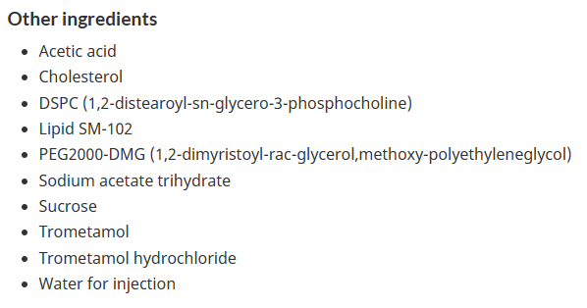
Another very big regulatory complication for the federal employer....
Aside from testimony from Dr. McCullough regarding the dangers of the spike protein itself, there is a very obvious and disturbing connection between some of the vaccines provided by the employer and known hazardous/dangerous chemicals.
As mentioned earlier, anyone that has had a job before with any employer, likely has taken WHMIS training to understand the how chemical exposure is legislated and how the employer or employee is to individually deal with and use chemical products.
The problem for the employer this time around, is that the regulated hazardous/dangerous products in question, appear to be ingredients in the two most commonly used vaccines in Canada: Pfizer and Moderna. These comprise roughly 97% of ALL the vaccines doses administered in Canada. It is also important to note that these ingredients are only found in the vaccine
The ingredients in question are proprietary to the vaccine companies themselves and are found in the vaccines being provided to Canadians as options. These ingredients are called: ALC-0159 & ALC-0315, which are found in the Pfizer Comirnaty vaccines; and,
SM-102, which is found in the Moderna Spikevax vaccine.(To the right are screenshots, directly from the Government of Canada’s authorized vaccines webpage)
SM-102: Moderna Spikevax
ALC-0159 & ALC-0315: Pfizer Comirnaty

Slide 27
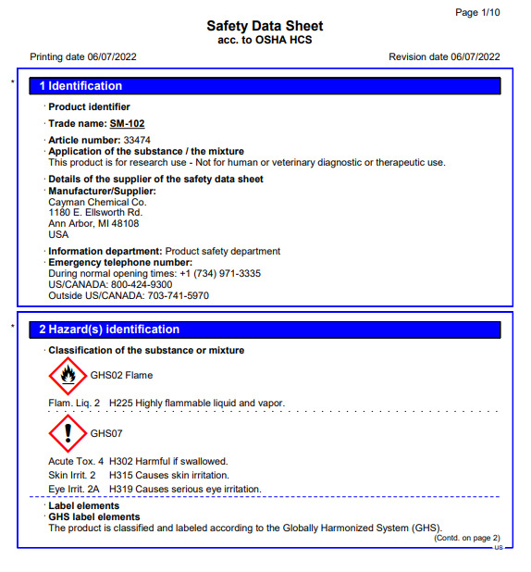
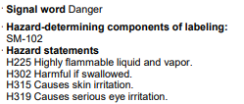
Another very big regulatory complication for the federal employer....
Even with a modicum of research into the ingredients of the vaccines, federal employers would have learned immediately, that the ingredients themselves are registered as hazardous/dangerous products.
If researched, the employers would have found that not only do these vaccines meet the definition of danger, as the ingredients were registered with the signal word “Danger”, but they also would have noticed the disclaimers from the manufacturers that informed anyone using the product: This product is for research use – NOT for human or veterinary diagnostic or therapeutic use.
SM-102: Moderna Spikevax
Pfizer’s proprietary ingredients also have the same health concerns and danger warnings attached to their Safety Data Sheets for ALC-0159 & ALC-0315.

Slide 28
Another very big regulatory complication for the federal employer....
One of my employer’s aspects to Covid-19 management was to supply hand sanitizer for employees that wanted to try to reduce their chances of contracting Covid-19 through tactile contact.
Because of the chemical products within the hand sanitizer, federal employers were required to immediately disclose to their employees and unions, the chemical composition and ingredients contained within the sanitizers, as well as provide them the accompanying Safety Data Sheets – this was certainly the case with my employer.
AN IMPORTANT QUESTION?....
If the employees and their unions were concerned about the chemical components of a product that many people were aware of and were using regularly, and the employer was in a panic to get their “due diligence” completed when queried about the chemical composition and effects, then why on earth would the employer avoid all discussions and concerns in relation to the ingredients of the vaccines, when they were brand new and experimental by definition?
WHY and HOW was this obvious question missed?

Slide 29
Very big regulatory complications for the federal employer....continued
If you look at what SM-102 is, it is the lipid nanoparticle that delivers the synthetic mRNA genetic coding to the inside of your cells to create the “spike protein itself”. ALC-0159 & ALC-0315 for Pfizer’s Comirnaty, and SM-102 for Moderna’s Spikevax, function similarly by facilitating the creation of the spike protein. But as the SALK Institute determined in April of 2021, before the vaccines were made mandatory by the federal employers, the spike protein itself WAS the very source of danger and damage to the vascular system.
The team then replicated this process in the lab, exposing healthy endothelial cells (which line arteries) to the spike protein. They showed that the spike protein damaged the cells by binding ACE2. This binding disrupted ACE2’s molecular signaling to mitochondria (organelles that generate energy for cells), causing the mitochondria to become damaged and fragmented.
Previous studies have shown a similar effect when cells were exposed to the SARS-CoV-2 virus, but this is the first study to show that the damage occurs when cells are exposed to the spike protein on its own.
The novel coronavirus’ spike protein plays additional key role in illness - Salk Institute for Biological Studies
If the spike protein is the hazard/danger that the employer is trying to mitigate in the workplace, then why are they injecting their employees with a product that will create large concentrations of these spike protein within the vascular system. Also, we have to remember that roughly 5% of the vaccine adverse events from Pfizer’s own trial data, is an individual contracting covid.
The injections are also made much more serious and dangerous than natural infection, because the mRNA in the vaccines, is encapsulated by the lipid nanoparticle. This feature of the mRNA coded vaccines allows the spike protein to pass the blood brain barrier (endothelium) and enter other crucial organs in the body.
We also need to remember that the vaccines that the employer was using as personal protective equipment, were not designed to protect against any Covid-19 variant other than the Alpha strain.

Slide 30
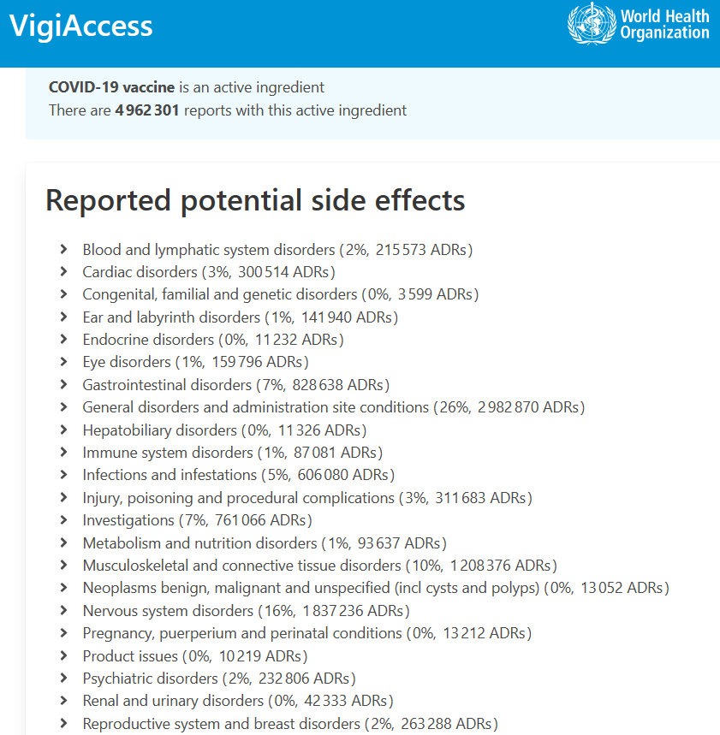
Very big regulatory complications for the federal employer....continued
Because vaccines injuries are being recorded in multiple global databases all at once, all known adverse events that were previously considered “natural cause” health events, would now HAVE TO BE FORMALLY INVESTIGATED by the employer by law – this is direct result of the employer’s choice to implement a medical product as a safety device in the work place.
This means that if any employee dies of a heart attack or stroke away from the workplace, that death would now have to be considered as a possible vaccine adverse event due to the employer’s medical device and vaccination policy they chose to implement. This is simple to understand as the employer had forced their employees to take a chemical agent that may have accelerated these health complications or death.
This is also why WCB is holding employers accountable for vaccine injuries.
Employers would also have had to build this injury reporting aspect directly into their vaccination policy, as employees would have had to have been notified of the potential for injury, and to immediately report the injury to the employer for investigation....JUST LIKE ANY OTHER WORK PLACE INURY OR EVENT. The only difference this time is that the employer is directly causing the injury because of their vaccination policy.
Federal employers would also need to track and monitor any of these injuries as part of their work place hazard prevention programs.

Slide 31
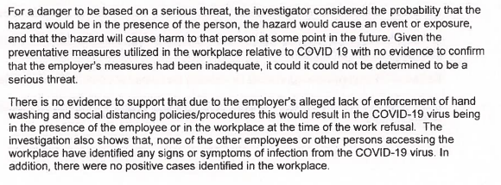
Very big regulatory complications for the federal employer....continued
One overlooked factor by many federal employees and employers, is that multiple employee work refusals were actually submitted to the labour board regarding the safety of federal facilities and their environments in 2020 – certainly at Canada Post.
Employees were concerned for the most part, that they themselves would suffer fatal consequences by possibly contracting Covid-19 while working in their employer’s facility.
These employees raised a very good question to the employer and Labour Board in 2020: If Covid-19 was the lethal virus that the employer, PHAC and the government was making it out to be, then why would employers continuously subject their workers to a deadly, invisible, microscopic asymptomatic virus, that was considered a level three human pathogen and compared to anthrax by the federal health agency?
Regarding precedent: federal employers in the past would shut their facilities down and evacuate their employees when an unknown substance had been spilled or possible concerns of a released biohazard had taken place – remember Anthrax in the mail in 2001? So if Covid-19 had a higher risk rating and injury outcome than exposure to an unknown substance, employers would have to shut down their facilities to maintain the same level of safety precedent and risk management that they originally had created as part of their emergency response management system.
But you see, there never was a big concern about Covid-19 from the federal employer or the Labour Board (ESDC). This is because all through 2020, the board ruled (at CPC) that the mitigation methods used by the employer were absolutely acceptable and that the facilities should remain open.

Slide 32
Very big regulatory complications for the federal employer....continued
Every single employee that was suspended or fired from their job as a result of the employer’s vaccination mandate, was denied their Right to Refuse under the Canada Labour Code as well as their Collective Agreement.
When an employee voices their refusal to participate in a work place activity or process, the supervisor or management representative as well as their bargaining unit Shop Steward, MUST enquire as to WHY the employee is refusing the work to begin with, and what grounds – the CLC or CA – they are refusing the work under.
This is usually summed up in the question: Are you refusing this work under your Collective Agreement or the Canada Labour Code? This is very clearly outlined in multiple sections in the Labour Code beginning at 127.1.
Refusal to work if danger
128 (1) Subject to this section, an employee may refuse to use or operate a machine or thing, to work in a place or to perform an activity, if the employee while at work has reasonable cause to believe that:
(a) the use or operation of the machine or thing constitutes a danger to the employee or to another employee;
(b) a condition exists in the place that constitutes a danger to the employee; or
(c) the performance of the activity constitutes a danger to the employee or to another employee.
Select a remedy
128(7) Where an employee makes a report under subsection (6), the employee, if there is a collective agreement in place that provides for a redress mechanism in circumstances described in this section, shall inform the employer, in the prescribed manner and time if any is prescribed, whether the employee intends to exercise recourse under the agreement or this section. The selection of recourse is irrevocable unless the employer and employee agree otherwise.
When employees refused to attest to, or comply with the employer’s vaccination mandate, the employer by law would have HAD to immediately investigate the matter as a work refusal according to section 128(7.1) of the CLC.
Instead of following the CLC, the employers tried to avoid this part of the legislation by coding their employees as “Non-Compliant”.

Slide 33
Very big regulatory complications for the federal employer....continued
Ignorance is NOT bliss when responsibility exists...
Senior Officers acting as Managers, Directors, etc, all receive very comprehensive safety training regarding their legal duties all highlighted under section 125 of the CLC.
Aside from the specialized internal and external training that is provided to these senior officers by the corporation that they are working for, the Treasury Board Secretariat also provides the federal Manager’s Handbook, which highlights very clearly each and every one of the legal expectations that we are reviewing today.
Manager's Handbook Canada Labour Code - Part II - Canada.ca
Some of the basic aspects that are covered in this manager document are as follows:
Definition of Danger
Definition of Employee / Employer
The Canadian Occupational Health and Safety Regulations
Employer’s Duties
Training Requirements
Offenses and Punishments
Hazardous / Dangerous Products
Hazard Identification
Risk Assessments
Safety Committees
Work Place Hazard Prevention Program
I.C.R.P.
Right to Refuse

Slide 34
To sum up these basic safety concepts and facts

Slide 35
To sum up...10 basic points
- This was the first time in Canadian history that many employers adopted a medical procedure as a workplace activity. - The new workplace activity included a brand new piece of equipment and technology, never used in human beings prior to Covid-19 and was rushed out for use despite any long term carcinogenic or mutagenicity properties being evaluated. - This was the first time that federal employers ever tried to mitigate any flu virus as a workplace hazard using the hierarchy of control measures – in the past it was just sick days and left up to the employees discretion. - Despite having just cause and legal recourse to deny the request coming from the Prime Minister’s office, corporations and federal entities listed on schedules 2 and 3 of the FAA decided to push this forward with vaccines as the only solution available. - The employers avoided Occupational Health and Safety discussions entirely, and as a result many employees were denied their three basic rights afforded to them under occupational health and safety legislation in Canada. (Right to Know, Right to Participate and Right to Refuse) - Employers decided to hand their legal liabilities over to an unchecked third party - the PHAC. - Employees that chose to refuse the attestation process or to take a vaccine offered by their employer, in many cases, were automatically considered non-compliant despite having legitimate religious, medical or safety reasons for refusing the employer’s vaccine. The employee complaints regarding the employer’s vaccination process, should have all been investigated immediately as official work refusals. - Employers from the very beginning were always legally liable for the safety of the vaccines as a workplace activity – this is highlighted by every provincial WCB board. - There are obvious clauses and definitions in both the labour code and safety regulations that should have IMMEDIATELY halted the employer’s vaccination policy/practice. (Danger, section 12 PPE, section 10 hazardous/dangerous products, etc.) - The Labour Board (ESDC) told my federal employer that their original measures for managing Covid-19 – unapproved facemasks, social distancing and hand sanitizer - were all acceptable mitigation measures for Covid-19 as long as employees were not showing symptoms of Covid-19.

Slide 36
Now on to my testimony regarding Canada Post...

Slide 37
Now the very basics of safety have been touched on...why is my testimony unique?
Apparently I was the only employee out of 60,000 - 65,000 employees at Canada Post that submitted a work refusal regarding the employer’s vaccination practice - I am unaware of any other federal employees submitting a work refusal regarding their employer’s vaccine policy/practice under these grounds. Further to this fact, I was the only safety professional raising these concerns in any capacity.
My concerns and information as a long standing safety professional, should have carried more weight with the employer, the Local Joint Health and Safety Committee as well as the Labour Board (ESDC).
The OHS legislation and regulations that govern the federal employer’s entire process in this case, have been completely overlooked by federal employees, unions and many senior officers. My testimony will highlight all of these examples with my employer, while explaining what should have happened in normal circumstances.
I highlighted to my employer and the Labour Board, the level of deceit from the employer as well as the coercion that had taken place when employers made it seem that they were mandated by the federal government to implement a vaccination practice.
Despite all of the evidence and proof that I submitted to Canada Post, the Local Joint Health and Safety Committee and the federal Labour Board, each party that held a legal “duty” in relation to my work refusal, chose to sweep my investigation and evidence under the rug while denying me an opportunity to present my material.
The evidence that I had submitted in my “Letter of Informed Consent”, demonstrated to the corporation blatant violations of OHS legislation. The concept of “duty” and “criminal negligence” as defined in section 217.1 & 219 of the Criminal Code of Canada were reviewed with the employer, and they were advised of their potential legal liability.

Slide 38
Now that danger has been defined, let’s make one thing absolutely clear: The vaccines provided by the federal employer meet the legal definition of “danger” as written in Canadian occupational health and safety law.
The remainder of my testimony is based on the fact that the vaccines constitute a danger as defined in the code, and that the Canada Post Corporation and the Labour Board were made fully aware of their legal obligations and potential criminal liability prior to and then on the official record in November 2021.

Slide 39
A reminder…for many federal employers there NEVER was a mandate
If we look at the Prime Minister’s announcement, the mandate he was announcing was only ever for the Core Public Administration and the RCMP.
This made it very clear that crown corporations like Canada Post and other agencies were only being asked to mirror his policy.
The federal employers listed on schedules 2 & 3 of the Financial Administration Act (FAA), were never forced to implement a vaccine policy, let alone rush one into existence in such a compressed time period.
They had chosen to implement these vaccination policies and practices on their own, and when doing so, adopted ALL of the risk and liability when it came to the safety of the vaccines.
A few federal agencies NOT under the
Core Public Administration (A few examples below)
Canada Border Services Agency
Canada Employment Insurance Commission
Canada Revenue Agency
Canada School of Public Service
Canadian Centre for Occupational Health and Safety
Canadian Energy Regulator
Canadian Food Inspection Agency
Canadian High Arctic Research Station
Canadian Institutes of Health Research
Canadian Nuclear Safety Commission
Canada Mortgage and Housing Corporation
Canada Post Corporation

Slide 40
The Greatest “Sleight of Mouth” ever pulled on employees.
Dr. Mark Trozzi highlighted during his testimony how medical definitions were changed constantly during the “pandemic”, but so were all of the safety definitions as well.
Safety Mandate = Dangerous and Unknown Process Following the Guidance of the PHAC = Failing With “Due Diligence”
Personal Protective Equipment = Untested and Dangerous Equipment
Safe and Effective = Recognized as a Legal Danger
Options = Or Else
Employer = Public Health Agency of Canada
Non-Compliant = Work Refusal
It is important to recognize that the option for an employee to file a work refusal was completely removed from the employer’s entire vaccination mandate process. Not only did the employer avoid this employee option like the plague, labelling employees as “non-compliant”, union officials seemed to develop amnesia when it came to reminding employees about the option to file a work refusal as well.

Slide 41
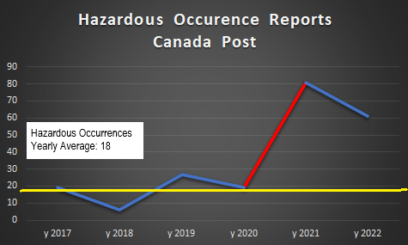
Canada Post’s safety measures on a timeline
Masks were provided and social distancing began at Canada Post
Vaccination practice implemented. CP went from 45 covid cases to 2844 right after the vaccines were implemented.
This is a 6220% increase in 2 months, and a 590% increase over the average number of cases captured during this time period.
Vaccines were made available in Canada and CP started to recommend them to employees.
Mandatory Mask Policy
Canada Post also apparently saw a 326% increase in the hazardous occurrence reporting from 2020 to 2021 according to reports that were given provided to our community of postal workers via an information request.
Hazardous occurrence events can include: Death of an employee (even if it appears to be from natural causes), permanent disabling injury of an employee, permanent impairment of a body function of an employee, an explosion, damage to a boiler or pressure vessel that results in fire or rupture of the boiler or pressure vessel or damage to an elevating device that renders it unusable, or a free fall of an elevating device.

Slide 42
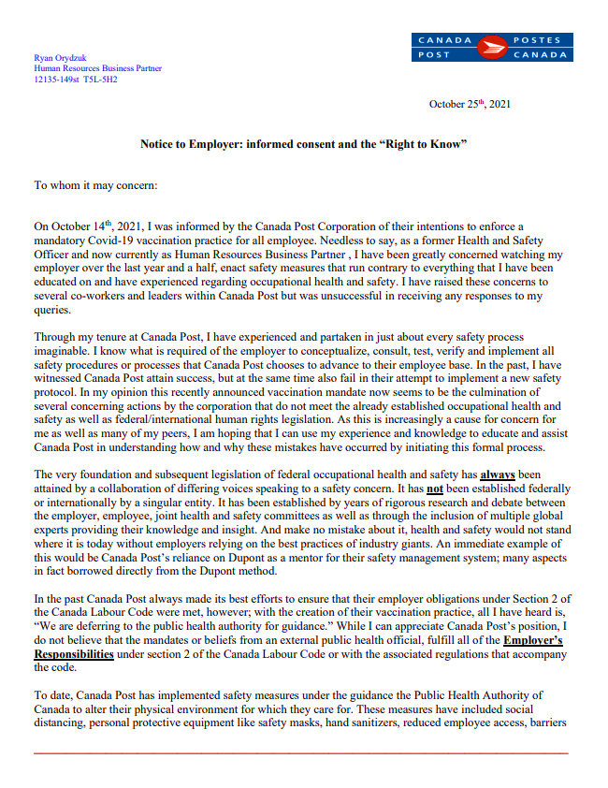
My letter of informed consent and official work refusal...an overview
A large piece of my work refusal at Canada Post was a document that I referred to as my Letter of Informed Consent.
This letter to the employer was 31 pages long, had 90 questions and included over 50 scientific studies and sources of legitimate scientific, medical and OHS information.
It highlighted the employees’ 3 basic rights.
The letter informed the employer of the definition of danger and accompanying interpretive guidelines.
Pointed out and warned the employer of their legal liabilities that management was undertaking under the CLC, COHS regulations, the Criminal Code of Canada, the Genetic Non-Discrimination Act and the Assisted Human Reproduction Act.
It asked basic and complicated questions to measure the corporation’s understanding of mRNA technology and its effects on the employee.
It spoke to the clear connection of the spike protein and the dangers that it posed to the cardiovascular system.
It covered aspects of genetic manipulation and reverse transcriptase.
Raised concerns about the employer taking on the informed consent process of the physician.
It spoke to the lack of efficacy of the vaccines.
The letter spoke to the corporation using the vaccines as personal protective equipment.
The letter informed the employer that they were NOT to hand their legal responsibilities under part 2 of the Canada Labour Code over to an unaccountable third party like the Public Health Agency of Canada.

Slide 43
Work refusals have four basic stages...
Stage 1 – The employee submits the work refusal under their collective agreement or Canada labour code. An investigation and discussion with between the employee and their immediate supervisor would take place regarding the employer’s workplace process, equipment or activity.
After a full investigation, then supervisor would then rule as to whether or not they believed the employee’s concerns constitute a danger or do not constitute a danger.
Stage 2 – If your immediate supervisor does not believe there is a danger based on your evidence and information, then they can make a ruling of “no danger” and the investigation and all of the accompanying material and information would be escalated to the Local Joint Health and Safety Committee for further investigation.
The Local joint would then meet with the employee that submitted the work refusal and go through all of their concerns in a fair and impartial investigation. The time to investigate can vary based on the complaint, the amount of information provided, the type of information provided, the level of expertise and safety knowledge from the complainant and committee members, etc... The committee would then make a ruling of danger or no danger and provide their response to both the employer and employee that submitted the refusal.
Stage 3 – If the employee is dissatisfied with the employer’s and committees investigation and do not agree with their findings, the matter can be escalated to the Labour Board (ESDC Health and Safety Officer or HSO) for investigation. The ESDC Officer would then meet with the parties involved and investigate the matter in the presence of the employee.
Stage 4 - If the HSO decides the employer’s actions are legitimate and do not constitute a danger, then the employee can contest the HSO’s ruling and take their case to the Canadian Industrial Relations Board for an appeal.
When it comes to federal work refusals, it is mandatory within the first 3 stages for the refusing employee to be afforded an investigation into their concerns by their supervisor, the LJHSC and the ESDC HSO.
I can tell you flat out, that when it came to investigating or reviewing any of the information provided to Canada Post as part of my letter of informed consent, absolutely nothing was reviewed with me at any stage of the work refusal process. In fact, each party claimed to have reviewed ALL of my material without me present, and then on record, lied about what I had said at each level of the investigation in their submitted responses to me.

Slide 44
Stage 1 - The investigation with my immediate team leader...
Prior to my work refusal, I first had to file a hazard report , which included my letter of informed consent and 90 questions. It was responded to within just 24 hours by Canada Post with the following answer:
Response by Team Leader Sheri Medynski to a hazard report received Nov 23 @ 6:56 pm CST from Ryan Orydzuk HRBP Canada Post Corporation specifically stating in hazard report the following “The listed hazards of concern are the vaccinations that the Canada Post Corporation has chosen as a means to enforce their vaccination practice. The vaccinations may constitute a potential danger given the federal government’s definition of danger for all Canada Post employees that are forced to take the vaccine as per the Canada Post mandate.” Ryan, thank you for your concerns outlined in the hazard report. These are unprecedented times for all Canadians and Canada Post, and I acknowledge the perspective you conveyed as we implement this new practice. As you may be aware, the Government of Canada announced a Covid-19 vaccine requirement for the federal workforce and asked Crown corporations, like Canada Post, to implement policies mirroring these requirements. As such, after consultations with all bargaining groups and our Policy Committees, Canada Post developed a vaccination practice in line with the federal government’s approach with consideration of the Privacy Act and the Canadian Human Rights Act.
Our practice came into effect October 29, 2021 and requires all employees actively at work to be fully compliant by November 26, 2021. With respect to some of your specific questions, I can confirm information about the vaccines authorized for use in Canada is publicly available on the Government of Canada website. I would also encourage you to view information on vaccination efficacy available through Health Canada, if you have not done so already, as you take all things into consideration. CPC is committed to creating and maintaining a healthy and safe environment for all employees, visitors, contractors, and customers. Vaccination has shown to be effective in reducing the transmission of Covid-19 and protecting individuals from severe consequences of the virus. CPC continues to encourage any employee who is not fully vaccinated to begin or complete the vaccination process and thus ensure employees follow the corporation’s mandatory Vaccination Practice
What does their response imply when looked at closely?
That the federal government clearly asked Canada Post to implement their OWN vaccination practice; again, they CHOSE to adopt the liability.
The practice itself is a health and safety practice for “employees, visitors, contractors, and customers” while working in a Canada Post facility.
The practice is a condition of employment.
No investigation took place.

Slide 45
Stage 1 - The investigation with my immediate team leader...continued
After not receiving an adequate response or investigation into my safety concerns I responded to my employer with the following email on November 26, 2021.
Good afternoon, thank you for your response to my query.
I unfortunately do not think that you have adequately answered any of the questions that I have provided to you as per my “Right to Know” and “Right to Participate”. I would have thought that the three of you would have been able to at least review some of my questions and at minimum, engage me in a conversation regarding my concerns. This is usually standard practice when an employee raises a safety concern and again seems to be quite a departure from the standard operating protocols when a hazard is raised, especially one documented so well by a safety representative within the organization.
I only want to help by illustrating the potential gaps that may have been missed by whomever has created this safety practice, as there appears to be many that have not been considered.
As you have not taken my safety concerns seriously, and have not provided me any informed consent under my right to know as highlighted in section 2 of the Canada Labour Code, I am issuing you the attached work refusal as a means to try and re-engage all of you as my “employer” with my safety concern. I would also remind you that by not addressing my safety concerns or by providing any response to me as to whether you consider my highlighted safety issues to be a hazard, a danger, or neither, I am attaching the very same informed consent document as before to this work refusal, while reminding you that you are required by law to provide me your answer as to whether my work refusal has merit based on the definition of danger and the corresponding Interpretative Guidelines that elaborate on the definition.
Rather than making this decision on your own, it would be best to spend the necessary time with me to hear what I have to say and to review all of the information that I have so that you can best ascertain if there is a risk to any Canada Post employee. There is much to go through and this will be time consuming.
I would also ask the employer if it is possible that during my discussions with them regarding my work refusal that I be afforded witness representation for the conversations. As I understand I do not have a bargaining agency to represent me, I am asking if this is possible and whom the corporation would deem acceptable for this request?
I will also remind the employer that as I am exercising my Right to Refuse their vaccination practice, I am not to suffer any loss of wage while the work refusal is taking place.
I look forward to discussing this matter with you further, have a nice weekend.

Slide 46
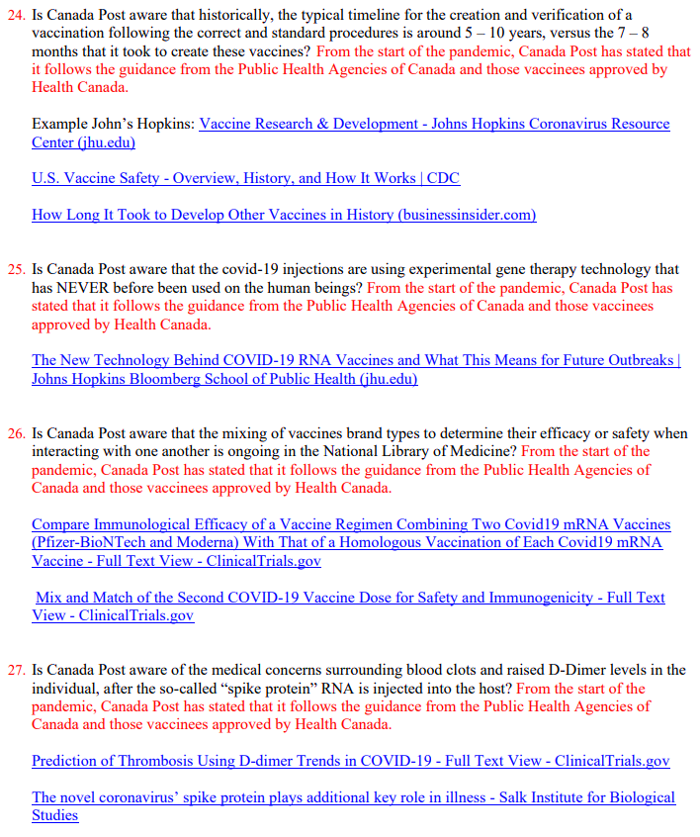
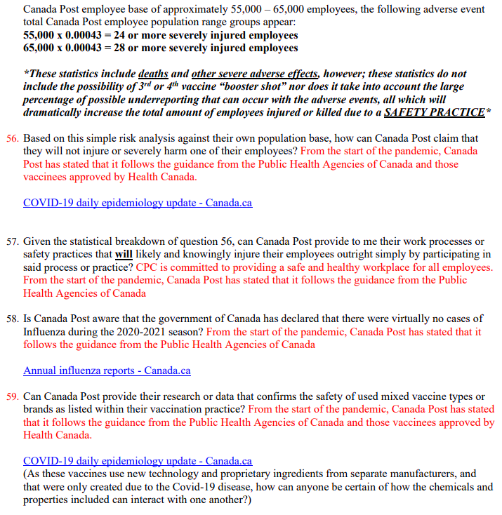
Stage 1 - The investigation with my immediate team leader...continued
After being denied that initial investigation regarding my hazard report, I then formalized my concern into an official work refusal that included the Director of Occupational Health and Safety, the Director of Human Resources and my immediate team leader.
At no time was an investigation completed in my presence and the employer provided the same pathetic response to 78% of the questions I posed to them.
From the start of the pandemic, Canada Post has stated that it follows the guidance from the Public Health Agencies of Canada and those vaccines approved by Health Canada.
This response was given for 78% of the questions submitted.
Once again, employer’s cannot defer their legal responsibilities over to an unaccountable third party, which is why the employers are liable for the WCB claim and any subsequent compensation – NOT THE PHAC. The employer’s repeated response and refusal to investigate the material I had provided them in my letter of informed consent, demonstrates a willful intent to ignore their legal obligations, despite being advised by a safety professional of their legal duties.

Slide 47
All I can say to every single Canada Post employee that may see this testimony, is that the information I gave to Senior Officers at Canada Post regarding their vaccination mandate, should have immediately halted their vaccination practice, and had them greatly concerned for health and well-being of their employees as well as themselves.
The Senior Officers should have also been terrified of the potential legal complications they could face for creating and then implementing a vaccination practice that broke several OHS Laws.

Slide 48
Stage 2 – Investigation by the Local Joint Health and Safety Committee
The investigation shifting to the LJHSC first gave me hope, as I had assisted and advised the two co-chairs that were investigating my claim for years as their Safety Officer at the Edmonton Mail Processing Plant.
This also meant that the union co-chair would now receive ALL of the documentation that I provided Canada Post.
I thought that this would have been to my advantage, because I was certain that when this information had reached the union and committee, that they would immediately want the employer to shut down their vaccination practice as well.
At this point in the proceedings, I now had another expert Canada Post Safety Officer acting as a witness to the events themselves.
However, the LJHSC only met with me for a total of 35 minutes, and only to ask me about the wording of my refusal. Despite mentioning to them several times in our discussion the need to set up multiple meetings to review ALL of the information that I had submitted, the LJHSC was able to come to a conclusion without my presence or input and within a couple of hours of receiving the information. Not only that, but management was provided the committee’s conclusion without my presence despite this being MY WORK REFUSAL.
The LJHSC denied me my proper investigation, and did not follow the legislation that governs their “duties” as a committee. They did not review a single piece of evidence or information that was provided to them in my presence, and subsequently lied about what I had said during my time with them in their final investigation report.
Key points from the LJHSC report
The Edmonton Mail Processing Plant’s formal response to me was nothing more than a couple of paragraphs and DID NOT address any of the attached studies or concerns listed in my Letter of Informed Consent. I also informed the co-chairs that the employer was breaking the law, but there was no concern reported or even mentioned in their “final” report.
One ridiculous thing the LJHSC did say is this:
Canada Post provided options to their Employees to be fully vaccinated, work towards becoming fully vaccinated, or request an accommodation based on Human Rights, Religious or Medical grounds.
LJHSC concludes that there is no danger and that the COVID 19 mandatory vaccination practice has been put into effect with good intentions for the health and safety of their Employees.

Slide 49
Stage 2 – Investigation by the Local Joint Health and Safety Committee (continued)
This was the response from the Director of Health and Safety. From my perspective, he is doing everything he can to prevent this matter from going to the Labour Board for review.
He tried to conclude, that if I do not provide a response to escalate to the Labour Board within an hour, that the corporation would automatically conclude that my safety concerns would be somehow be resolved, and that the work refusal would be closed from their perspective.
Hi Ryan, and I have received and reviewed the investigation report from the LJHSC. Further to your meeting with them on November 29, 2021, the LJHSC determined they had enough information to finalize their investigation and report to the employer. The LJHSC’s report is attached along with the full refusal investigation report to date. You will also see an updated hazard/refusal form.
You will see the LJHSC agrees with your supervisor’ ( ) initial investigation and finds that there is “No Danger” to your refusal. I ask you review the LJHSC investigation report and let and I know if you are satisfied or not with the result of their investigation and the decision of no danger.
We will give you one hour to respond to us from time of this email. If we do not hear back from you within the one hour, we will conclude you agree with the LJHSC and the refusal process has concluded. If we do hear back from you within the required time and you are not satisfied with the LJHSC decision of no danger, we will escalate the investigation to ESDC for a decision today. If you have any questions please reach out.
Thanks Ryan, on behalf of and I,

Slide 50
Stage 2 – Investigation by the Local Joint Health and Safety Committee (continued)
My first email response to the corporation regarding the LJHSC investigation
Good morning , I would ask how the LJHSC was able to come to this conclusion without being able to review any of the information that I have provided within my work refusal with me?
I was only able to speak with the LJHSC for 30 minutes, and was not able to review any of my information or material with the LJHSC, and clearly there is something very strange happening when a employee’s work refusal somehow has an hour deadline for response via email. Since when has this ever been the process with work refusals and since when does the LJHSC make a determination on the material without reviewing it with the employee that submitted the work refusal present?
I am demanding more time to review all of the information that was submitted to the LJHSC as they did not respond to any of the information to material provided in my work refusal, and Canada Post still has not fulfilled their Employer’s Responsibilities under section 2 of the Canada Labour Code. I also told the LJHSC with present that I would need much more time to go through all of the relevant information. I do not feel any of the minutes provided by the LJHSC in this report convey anything of importance that was talked about, nor does it mention the key discussion regarding the Financial Act, the Core Public Administration or the corresponding schedules that apply to the Government’s policy for which Canada Post had told its employees was obligated to implement and enforce a vaccine mandate. To be blunt there is no policy for Canada Post to follow, and they are choosing to implement a vaccination practice of their own without following the necessary steps that the employer must follow under section 2 of the Labour Code.
I have had not further follow up questions from the LJHSC regarding any of the information I provided which to me would be an impossibility if reviewed, and I would also remind you that I still have not received any responses to the 88 questions that were submitted to the LJHSC committee as part of my work refusal.
As my entire discussion around the financial act and its applicability to Canada Post has not been mentioned in the LJHSC minutes that you provided me, I will explain what I was saying to the LJHSC and ask that this be made part of the official record; this can be confirmed by witness .
I will not be denied my rights under the Canada Labour Code, not will I be denied my opportunity to properly meet with the LJHSC regarding this work refusal.

Slide 51
Stage 2 – Investigation by the Local Joint Health and Safety Committee (continued)
After receiving no response, this was my second email response to the corporation regarding the LJHSC investigation
Good afternoon , unfortunately the LJHSC and the corporation has not followed the correct rules of engagement and still has not provided any answers to the questions that I have provided regarding the vaccinations that the corporation is mandating their employees to take.
Again, I will reiterate that the process is to be followed, and in case you need some understanding as to what I am referring to, please look no further than the excerpt from the federal government down below as well as Canada Post’s document on Hazard reporting and the work refusal process. Further to the information that you provided to me from the LJHSC, the employee that has put in the work refusal, needs to be present for the review of the material and the investigation. As I was unable to go through any of the questions on my work refusal with the LJHSC, and I was not afforded an opportunity by the LJHSC to go through my entire work refusal, this process will not move forward until this takes place.
At no point should the LJHSC be investigating or reviewing this matter without my presence. At no point has the LJHSC reviewed any of the material that I have submitted as per my original work refusal, nor was my immediate supervisor present during the limited 30 minute discussion that took place.
I find it strange that the rules seem to keep bending for my particular work refusal, and I am still wondering why there has been no review of the provided material with me present to provide insight and understanding around my concerns about vaccination safety. You also have not addressed any of the concerns nor have you provided me any minutes that reflect my actual 30 minute discussion with the LJHSC about the Core Public Administration or Canada Post’s absence from the schedules that the federal vaccination mandate was for.
This is unacceptable, and does not follow the legislation that has already been created in section 2 of the Canada Labour Code. I will also add that it is not appropriate to claim that the Public Health Authority of Canada is my employer. By the legal definition, they are not my employer and cannot mandate anything at Canada Post. I again point you to the Employer’s Responsibilities under section 2 of the Canada Labour Code and will add that there have already been several errors made by the corporation as it pertains to the work refusal process; both the Labour Code and with our own internal policies. Further to these issues, you still have not provided me any answers under my Right to Know, or my Right To Participate, which would facilitate in my informed consent regarding the corporation’s vaccination mandate.
I will also add that Canada Post has already conceded in their first response to me, that the corporation was “asked” by the federal government to implement these policies. See below. This issue is at the very heart of the concern that I have brought forward to you all for review: that Canada Post created a workplace safety practice that was never a mandate for the corporation to undertake. As such, since the corporation has taken this direction they need to fulfill their obligations under the employer’s responsibilities.

Slide 52
Stage 3 – Investigation by Canadian Labour Board - ESDC
After the corporation ignored my emails, my concerns were forwarded to the Labour Board. Again, I had some temporary hope, as the Labour Board HSO was someone that I had worked with on several prior work refusals.
But this was short lived, the HSO ended up trying to talk me out of my work refusal to begin with.
During an intense 45 minute phone call, I was able to convince the HSO and his supervisor that they were required by law to investigate all of my concerns.
The HSO advised me that he received all of my documentation, including my Letter of Informed Consent, and that I would be able to present ALL of my material as part of my work refusal to him and his HSO colleague that would be investigating the matter.
This gave me some hope, as I finally would be able to show the board my evidence, and how many egregious violations the employer had committed.
However my elation was short lived... After the HSO read my letter of informed consent, he no longer wanted me to present my material, and told me flat out that this was “his investigation” and that he would be running it and asking the questions.
Good morning , I have spoken to and due to his very busy schedule, the earliest opportunity for us to meet would be Friday at 9:00 am.
I would recommend booking off your whole day, as there will be much to discuss. I do not know if we will conclude with all of my information on that day, so please consider being ready to have another meeting to finish anything that was not covered in the first meeting – we can cross that bridge when we get there if necessary of course.
I would also like written confirmation or by means of email, that the employer was okay with me working from home over the duration of the work refusal as per our conversation on Friday, December 8th, 2021 at approximately 6:00 pm.
I would also like written confirmation or by means of email, that the employer has not fulfilled their obligations under the Internal Complaint Resolution Process within the Canada Labour Code to provide me the answers to the questions I submitted to them regarding my Right to Know about vaccine safety.
Thank you and I look forward to speaking with you on Friday at 9:00 am.

Slide 53
Stage 3 – Investigation by Canadian Labour Board - ESDC
This was the response from the Senior Health and Safety Officer from the Labour Board AFTER he told me that I would be able to present all of this material on the telephone.
Good afternoon Ryan;
Myself and will not be booking off the whole day as there is no need to take part in a full presentation on the information you have about your personal objections to the vaccine. All the hard work you have done is so you may make an informed decision (personally) as to if you want to follow Canada Posts Mandatory vaccination practice. We as investigators need to investigate the task that is being refused (being vaccinated) and the facts behind that refusal. Please keep in mind I am not dismissing you as to your concerns however I do have to keep to the task (vaccination) you are refusing. I have all the information you provided to the employer including the letter which has all the links to information, all of which have been reviewed as well as information form Health Canada and their approvals on the vaccines.
As to your ICRP complaint if I as the investigating officer identifies contraventions of the Code, I may take appropriate enforcement action however, I must consider this option for contraventions closely related to the reasons for the refusal and look at if a more appropriate legislation to which those contraventions should be dealt with such as the Internal Complaint Resolution Process.
Please provide us with a reasonable time to conduct an interview where you may present any new facts outside of what we are already in possession of, this does not mean third party information as I am not an expert on the vaccinations and must follow Health Canada Guidance as they are the qualified organization.
This investigation is done in accordance with my operational guidelines and I am the lead on this investigation, I will maintain control of the investigation, and allow each party to provide their information as long as it pertains to the task (vaccination) being refused.

Slide 54
Stage 3 – Investigation by Canadian Labour Board - ESDC
Of course I immediately responded to the ESDC Officer that it was ABSOLUTELY his investigation, as he would have to make a decision as to whether or not the vaccines constituted a danger based on my complaint. I also advised him that I thought it strange that he changed his mind so abruptly, and that it was strange that he did not want any additional information for such an important decision.
Thank you for your response Robert, I am confused by your response that you will not allow me to present any material to you regarding my complaint as per our conversation on Friday, December 8th, 2021. You clearly said that I would be able to present my case with you, and you confirmed this by stating that a powerpoint presentation would be fine provided in pertained to the information that I provided as per my original work refusal?
If the vaccine the refusal is based on several violations of the code, you are the perfect person to relay all of this information to because ESDC is responsible for interpreting and ruling on several aspects of the employer’s responsibilities. I also will add that it only makes sense to include any additional pertinent information regarding the work refusal, as it prevents the need for an employee to have to restart the whole process just to add what could be pivotal information that could determine the Employer’s non-compliance from the Employee’s perspective.
Further to my previous point, it is only in the best interests of all parties involved that all information that I have is reviewed, as the implications to all Canada Post employees should this not be investigated to its full capacity could be life changing or ending based on the Canadian Government’s own vaccination adverse event site, however; as you are the HSO that is in charge of this investigation and you have to personally commit to a ruling of danger or no danger, then I will defer to your decision to not review all of my pertinent information if that is what you believe is correct.
The best opportunity for my representative and I to meet with you, as stated below, would be Friday December 10th at 9:00 am.

Slide 55
Stage 3 – Investigation by Canadian Labour Board - ESDC
I finally met with the two Labour Board HSOs on December 10th, 2021.
To say the least this meeting was a joke, and a complete insult to myself and all of the workers at Canada Post that had concerns with the employer’s vaccinations.
The following items came out of my brief discussion with the HSOs:
Some of the details of the call...
The Labour Board came completely unprepared for the investigation itself.
The only questions that they concerned themselves with, were regarding the specific wording that I had used in my work refusal, rather than any of the information I had provided.
The Senior HSO agreed with me repeatedly on the call regarding the few concerns I was able to mention in the short time I was with them.
The Senior HSO said that he could not look at the ingredients of the vaccines even though they had registered hazardous dangerous products contained within the ingredients.
Had to explain to the HSO that ALL of Canada’s information was derived from a third party – the WHO. After about 10 minutes, the Labour Board seemed like they were out of questions, and were looking to wrap up the investigation with me.
Explained to the HSO, that mathematically, the Canada Post mandate would harm or kill employees outright based on probability.
Informed ESDC Officer of the dangers of DNA corruption.
The HSO was informed of the dangers of the spike protein.
The Senior HSO said that it was the worst week of his life considering my information and work refusal.
The Labour Board did not address any of the dangers demonstrated by my Letter of Informed Consent.
The Labour Board admitted outright that the corporation committed several violations in the way that they handled their process.
Apparently the Labour Board not being able to record my conversation greatly affected their ability to ask questions?
The Labour Board tried to claim that the PHAC had authority over Canada Post employees and whether or not they had to take a vaccination.
The board came out and asked me what information I wanted to add to my work refusal, right after they said I could not present anything from a third party or what ingredients were in the vaccine.
The HSO was given notice that the employer’s mandate met the IPG of Danger.
Informed ESDC that Canada Post was never part of the Core Public Administration schedules under the financial act.

Slide 56
Stage 4 – Investigation by Canadian Industrial Relations Board
Once again, just like it was with my Team Leaders and then the LJHSC, I was not afforded any opportunity to review any of the information that I had provided to ESDC regarding my concerns. I knew after I was informed by the Labour Board that I was not going to be presenting any material or information, that the entire refusal process was corrupted, and that I would not be receiving of my legal recourse with the HSO under the Labour Code and Criminal Code of Canada.
I received a ruling of “no danger” from the Labour Board, and was told I could now appeal my concerns with the Canadian Industrial Relations Board for further investigation.
However, given everything I had just gone through....
The lies and deceit from my supervisors and colleagues that I had worked with my years,
The LJHSC’s refusal to care about my information,
The complete farce that was my investigation with the Labour Board,
The sheer illegality of what the employer was doing, and,
The fact that every aspect of my life, was being completely destroyed by everything that the employer had been doing over the course of covid (marriage, losing rights to see my kids, losing my house, losing my savings, being served divorce papers, being placed on perpetual suspension, losing my job, etc.), I had no fight left in me to continue.
I sunk into depression as I watched my life get destroyed, and am still dealing with the emotional and financial fallout from the corporation’s illegal mandate.

Slide 57
Why Senior Officers at Canada Post may be facing legal issues...
Once Canada Post Senior Officers chose to undertake the Prime Minister’s vaccination mandate, despite having full legal recourse to deny his request under part 2 of the Canada Labour Code, they immediately adopted ALL legal liability for the so-called “safety” practice they were implementing.
Some of the very key takeaways for current and former Canada Post employees to know of regarding their employer’s actions are as follows:
The corporation was NEVER mandated to implement any vaccination practice, they chose to adopt the liability.
Canada Post cannot defer their legal responsibilities over to an unaccountable third party (PHAC).
They denied all of their workers their informed consent and their right to refuse.
The ingredients in the vaccines they were mandating contained known dangerous/hazardous products.
They did not inform any of their employees of these products.
Canada Post currently knows about these products as the products have been captured in their chemical database; this fact has not been disclosed to the employees.
The corporation does not have anything captured within their national safety minutes regarding how mRNA technology works, any of the concerns or whether or not the mRNA vaccines have any side effects or known dangers. This fact applies to each bargaining unit.
The mRNA was coded for only the first strain of virus.
At no point did Canada Post take the information I provided them on mRNA vaccines seriously, nor did they demonstrate an ounce of due diligence when it came to the Duties of the Employer in section 125 of the Canada Labour Code.
Canada Post has not informed their employees that Covid-19 vaccine injuries are covered through WCB and that the employer is liable for those injuries.
Canada Post was informed of all potential side effects and dangers the vaccines posed for their employees, including: blood-clotting, immune disorders, heart attacks and changes to the genetic code.
Canada Post already had been given precedent by the Labour Board in 2020, that masks and social distancing were more than acceptable for mitigating Covid-19.
Canada Post already had emergency procedures in place to shut their facilities down for potential airborne risks that were considered far less deadly than Covid-19.
Despite being informed, Canada Post’s vaccination practice also violated provisions within the Genetic Non-Discrimination Act and Assisted Human Reproduction Act.

Slide 58
So back to the question at the beginning of my presentation...
As a federal employer, if a safety professional was bringing forward the following health and safety concerns regarding your vaccination policy, would you still choose to wilfully ignore the concerns, despite your own life, and the lives of your employees being at risk?

Slide 59
So where does this information leave federal employees, as of today?

Slide 60
The Canadian Industrial Relations Board
The Police
Your local member of parliament (Commission and Investigation)
Your union?

Slide 61
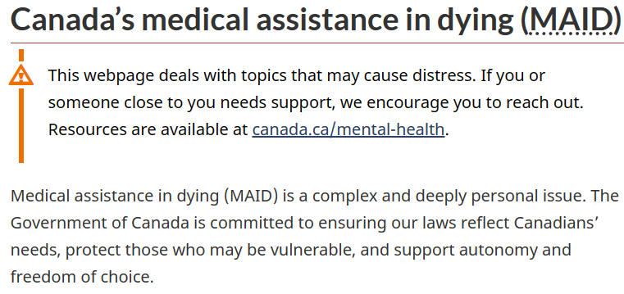
Where are our morals and ethics today in modern Canada?
One could make the argument regarding body autonomy, that being able to end your own existence, is the highest degree of autonomy that one could be given; at least according to the government’s own website.
How does MAID relate to Covid-19 vaccines?
Pertain to body autonomy and freedom of choice.
Delivered via injection.
Can cause direct harm to the individual and death in some cases with the vaccines.
Can accelerate a person’s death.
Both are recommended by the government.
Strange hypocrisies...
In Canada, it is illegal to aide or counsel someone into committing suicide according to section 241(1) of the Criminal Code, but at the same time, legal to commit the same action according to the MAID provisions in section 241(2)?
In Canada, we have reached the point where we can literally take an injectable substance to end our lives prematurely, but the second we refuse to take an injectable substance, to protect ourselves from harm and maintain control over our own body, we are fired from our jobs, ostracized by the media and society, and cancelled from existence?

Slide 62
For the record, I believe the safety opinions I have shared today to be true according to all my knowledge and expertise in OHS.
If necessary, I can produce several digital recordings of my conversations with the parties mentioned in my testimony, as well as any legal documentation to support every claim brought forward here today.
This information is not a secret, and has been available to every federal employee in Canada from the very first day employers attempted to mitigate Covid-19 as a workplace hazard.

Slide 63
Some of the potential criminal offences that federal “Senior Officers” may have committed because of their vaccination mandate
Duty of persons directing work
217.1 Every one who undertakes, or has the authority, to direct how another person does work or performs a task is under a legal duty to take reasonable steps to prevent bodily harm to that person, or any other person, arising from that work or task.
Criminal negligence
219 (1) Every one is criminally negligent who
(a) in doing anything, or
(b) in omitting to do anything that it is his duty to do,
shows wanton or reckless disregard for the lives or safety of other persons.
Definition of duty
(2) For the purposes of this section, duty means a duty imposed by law.
Causing death by criminal negligence
220 Every person who by criminal negligence causes death to another person is guilty of an indictable offence and liable
(b) in any other case, to imprisonment for life.
Causing bodily harm by criminal negligence
221 Every person who by criminal negligence causes bodily harm to another person is guilty of
(a) an indictable offence and liable to imprisonment for a term of not more than 10 years; or
(b) an offence punishable on summary conviction.
Homicide
222 (1) A person commits homicide when, directly or indirectly, by any means, he causes the death of a human being.
(5) A person commits culpable homicide when he causes the death of a human being,
(a) by means of an unlawful act;
(b) by criminal negligence;

Slide 64
Some of the potential criminal offences that federal “Senior Officers” may have committed because of their vaccination mandate (continued)
Death that might have been prevented
224 Where a person, by an act or omission, does any thing that results in the death of a human being, he causes the death of that human being notwithstanding that death from that cause might have been prevented by resorting to proper means.
Acceleration of death
226 Where a person causes to a human being a bodily injury that results in death, he causes the death of that human being notwithstanding that the effect of the bodily injury is only to accelerate his death from a disease or disorder arising from some other cause.
229 Culpable homicide is murder
(a) where the person who causes the death of a human being
(i) means to cause his death, or
(ii) means to cause him bodily harm that he knows is likely to cause his death, and is reckless whether death ensues or not;
(b) where a person, meaning to cause death to a human being or meaning to cause him bodily harm that he knows is likely to cause his death, and being reckless whether death ensues or not, by accident or mistake causes death to another human being, notwithstanding that he does not mean to cause death or bodily harm to that human being; or
(c) if a person, for an unlawful object, does anything that they know is likely to cause death, and by doing so causes the death of a human being, even if they desire to effect their object without causing death or bodily harm to any human being.
Manslaughter
234 Culpable homicide that is not murder or infanticide is manslaughter.
Administering noxious thing
245 (1) Every person who administers or causes to be administered to any other person or causes any other person to take poison or any other destructive or noxious thing is guilty
(a) of an indictable offence and liable to imprisonment for a term of not more than 14 years, if they did so with intent to endanger the life of or to cause bodily harm to that person; or
(b) of an indictable offence and liable to imprisonment for a term of not more than two years or of an offence punishable on summary conviction, if they did so with intent to aggrieve or annoy that person.

Slide 65
Some of the potential criminal offences that federal “Senior Officers” may have committed because of their vaccination mandate (continued)
Death that might have been prevented
224 Where a person, by an act or omission, does any thing that results in the death of a human being, he causes the death of that human being notwithstanding that death from that cause might have been prevented by resorting to proper means.13
Acceleration of death
226 Where a person causes to a human being a bodily injury that results in death, he causes the death of that human being notwithstanding that the effect of the bodily injury is only to accelerate his death from a disease or disorder arising from some other cause.
The Genetic Non-Discrimination Act
Genetic Non-Discrimination Act:
3 (1) It is prohibited for any person to require an individual to undergo a genetic test as a condition of: (b) Entering into or continuing a contract or agreement with that individual. (Accommodation process was illegal)
Assisted Human Reproduction Act
Principles
The Parliament of Canada recognizes and declares that:
(g) human individuality and diversity, and the integrity of the human genome, must be preserved and protected.
Prohibited procedures
5(1) No person shall knowingly:
(f) alter the genome of a cell of a human being or in vitro embryo such that the alteration is capable of being transmitted to descendants;

Slide 66
Appendix A – Timeline of events

Slide 67
Timeline of initial discussions and work refusal with Canada Post
June – October 2021: Began verbal discussions regarding my safety concerns and research into mRNA vaccines with various peers within the Human Resources Department (Human Resources Business Partners), other enabling groups like Occupational Health and Safety, my immediate Manager and also on regional covid management calls that included various parties from across the country. These calls included the senior officers responsible for managing covid at Canada Post.
I was beyond shocked and extremely concerned in how little anyone seemed to care about the information that I was sharing, despite being one of Canada Post’s most reliable and educated health and safety professionals for 10 years. After I had started to bring these concerns up to my peers on my team, my immediate manager and her colleague decided to cancel all of our regular weekly discussions around covid.
November 15th, 2021: It was on this date that we had a regional call about covid management that I brought up the concerns about potential employee work refusals in relation to the corporation’s vaccine practice that was going to go live on November 26th, 2021. Several health and safety officials on that call said that they would need to reach out to the unaccountable governing body – Employment and Social Development Canada (ESDC) - ahead of time, to create a “one page” response that would squash employee work refusals before they could occur.
November 15th - 22nd, 2021: After I attended and heard the response from OHS as to what their intentions were regarding employees’ work refusals, I finished my Letter of Informed Consent that I had began several weeks earlier as a back-up for the discussion I knew that I was going to have to formalize with the employer. This letter was created to try and assist my immediate boss as well as the occupational health and safety department with understanding the illegality of every action they were taking but also to inform them that they would be held liable for any vaccine injuries. I knew at this point that this entire fiasco was never about employee health and safety, and that there were other intentions in mind with the creation of the covid vaccine practice.
Beginning of November 2021: Began speaking to my immediate clients on our morning safety calls that they should not be endorsing or advising any employees to take the covid vaccine given that they were unproven and experimental. I also let the supervisory group know that they could be responsible for the liability of the vaccines should an employee take the shot and suffer an adverse effect.

Slide 68
Timeline of initial discussions and work refusal with Canada Post (Continued)
November 22nd, 2021: I submitted my Letter of Informed Consent, which contained 90 questions and over 30 scientific studies and other various sources to warn my employer of the dangers associated with the vaccines they were forcing their employees to take. This letter was given to my immediate manager as I wanted to understand how the corporation had gone about making their assessment and how they somehow by-passed just about every safety law that was ever created. Laws that were already in place in part 2 of the Canada Labour Code as a means to prevent the employer from ever being able to mandate a vaccine. My boss had responded to me the following day, and coincidentally, it was a one page response that did not address ANY of the questions I asked as part of my Right to Know.
(Continued)...when a letter such as mine, written by an experienced, educated and tenured safety professional, was completely disregarded, just like my Right To Know. It was at this time that I informed them that my rights were denied and that the vaccines met the definition of “Danger” as written in the Labour Code and further supported by the Interpretive Guidelines (IPG) that describe how danger is measured in occupational health and safety.
November 29th, 2021: I was invited to a call with my manager, the director of safety and the director of human resources to discuss the outcome of their decision. I thought that we would be discussing the material that I had submitted, but apparently this call was to just inform me that they were making a ruling that the vaccines did not constitute a danger for employees. They provided me their answers to my 90 questions, but the massive problem was that they answered each question with the same cut and paste response: “We are following the guidance of the Public Health Authority of Canada.” During this call, I was disgusted with their responses and refusal to engage me in any reasonable discourse regarding my legitimate safety concerns. I called them each out and made them respond to me officially that they each did not believe the vaccines were a danger...
November 26th, 2021: I officially formalized my concerns into an official work refusal with Canada Post. I submitted the standard work refusal reporting form as well as attached my Letter of Informed Consent once again. I sent this email directly to my boss who was required to investigate the matter with me, as well as the Director of Health and Safety and the Director of Human Resources. I let each party know that their actions were a complete departure from standard operating procedures...

Slide 69
Timeline of initial discussions and work refusal with Canada Post (Continued)
(Continued)... I was ordered to respond as quickly as possible to their desire to move the investigation onto the next stage of the process. This next stage in the work refusal process included involving the Local Joint Health and Safety Committee (LJHSC) at the Edmonton Mail Processing Plant. They expected me to attend the investigation that very day within a few hours and without representation. I had to demand a witness to these discussions at this point, as these criminals were doing everything they could to deny any appropriate or legal response, and to hurry the investigation through the system as fast as possible. I was able to contact a safety colleague that had close to 40 years of expertise under his belt to act as my witness for further discussions with the Local Joint Health and Safety Committee.
Later that afternoon I met with the Local Joint Health and Safety Committee for what I thought would have been just the first discussion to go over some of the very basic elements of my work refusal. During the discussion I touched a few of the elements of why the employer was in “deep trouble” for what they were attempting to do and that they would be held criminally liable for what they have done. I also spoke to the LJHSC committee about how Canada Post WAS NEVER MANDATED by the government to implement any vaccine....
(Continued)...I showed them that Canada Post never was under the same Financial Act schedules that the government had any authority over, and that Canada Post was choosing to force their employees to take the vaccine without performing ANY of their DUE DILIGENCE under their Employer Duties in part 2 of the Canada Labour Code.
The discussion lasted maybe about 35-40 minutes, and I had informed both co-chairs and my witness that we would need several days to review all of the information that I had provided to Canada Post as part of my Letter of Informed Consent – the info that my directors refused to investigate. The meeting closed and I was expecting an invite from them for our next discussion.
December 1st, 2021: After not hearing from the LJHSC for a day, which I did think was strange given the so-called “urgency” to hurry me into an investigation with them, I knew that there was not going to be ay further investigation into my claim or my 90 questions on my letter of informed consent.
Oddly enough, I did receive an email, and it was NOT from the LJHSC responding to me in any way. In fact, the director of occupational health and safety contacted me and told me that HE RECEIVED the final results of their investigation, and provided them to me in an email, claiming that the committee had investigated the matter on THEIR OWN and decided that the vaccines did not constitute a....

Slide 70
Timeline of initial discussions and work refusal with Canada Post (Continued)
(Continued)...danger to employees. So at this point I was just disgusted by the level of corruption that was taking place around me, and how each supposed “safety advocate” or leader in the corporation decided to by-pass the standard processes for evaluating and investigating concerns as part of a work refusal. Not one single right that was afforded to me under the code was provided to me, as I was NOT PRESENT for any investigation that took place. And given that I was the SAFETY PROFESSIONAL that trained these LJHSC co-chairs years earlier, I found the situation clad with dark irony.
I sent an email that day in response to the director of OHS, HR, the two co-chair members of the LJHSC and my witness, demanding that my rights be given to me as written in the code. Even worse is that the LJHSC Committee’s report to me, outright lied about the entire conversation that took place and tried to make me look incompetent. That is okay though, because I recorded the whole discussion, and this will come back and haunt them all at a later date.
I also informed my director and HR director at this point of the schedule discrepancies within the Financial Act that demonstrated that Canada Post WAS responsible for their own...
(Continued)...vaccine practice, and that the government did not order them to implement any vaccine mandate.
The two directors did not seem to care much and said that I had an hour to choose whether or not the matter would be escalated to the labour board (ESDC) for investigation into the matter.
But this did not give me any comfort as I knew that the labour board officers were basically lapdogs for the Canadian government.
On the same day, I wrote another email informing the two directors of the illegalities that were taking place and again demanded my rights be given to me, and explained that I really only had about 30 minutes to speak with the LJHSC and that very little was discussed.
I did not receive a response, and the corporation sent my work refusal onto the labour board.
December 2nd – December 6th, 2021: It was during this period of time that I was contacted by the Labour Board’s senior investigator and work refusal specialist to begin some discussions over the phone as to whether or not my work refusal would be investigated.
During the first discussion with the labour board officer, the officer tried to talk me out of my work refusal by telling me that I did not...

Slide 71
Timeline of initial discussions and work refusal with Canada Post (Continued)
(Continued)...have any grounds to actually file a work refusal! At this point I started to get very angry, as I know what constitutes a work refusal, and exactly how the process works. I argued with the labour officer for well over an hour on the facts and merits of my case, and told him flat out that if he tried to deny me my rights under the code, that I would be pursuing this matter with a lawyer and that I would be seeing every single one of them in court for the corruption. I told the labour officer that he better be damn sure about what he was saying to me, as there would be repercussions down the road. The officer decided after that, that he would speak to his “superiors” to see if he was mistaken.
I received a call back from the officer 45 minutes later saying that he was “absolutely wrong” and that he will be beginning an investigation with me into the matter.
(Continued)... whatever I liked, and that there should be no issue reviewing this matter...boy was this ever a big lie though.
December 8th, 2021: After my discussion on the previous day with the senior officer, I figured that I had better put it on record in my response to their invite, that I wanted enough time to present my material for investigation. In my response to them, I had let them know that they should be booking the whole day off as there was a great deal of information for me to go through and that we may need additional days to review all of the pertinent information....
Apparently, once I put this on record, the labour board changed their tune and did not want to facilitate my request, telling me that they would not be investigating my material, listening to any presentations or booking off any extensive time to speak with me. They also informed me that they would only be looking at specific violations of the code itself, which is NOT the only expectation of them to follow, as the Labour Board HAS to rule on whether or not the vaccines are a danger as per my complaint. The senior officer also seemed to want to try and establish the fact to me that HE was the lead investigator and that his investigation would go in the direction that he saw fit.
This response left me greatly concerned at this point, as I knew that once again, my material and concerns would not be…
December 7th, 2021: I had received an email from the labour board informing me that they were wanting to begin my investigation – this would be with two ESDC officers.
Because of what had taken place at the previous two levels of the investigation, I decided to call the senior official and advise them of my concerns and wanted to know what I would be able to present. He assured me that I would be able to present...

Slide 72
Timeline of initial discussions and work refusal with Canada Post (Continued)
(Continued)...reviewed and that this was all just a show to demonstrate that they went through the process steps at a bare minimum. After I had received this response, I decided to query the senior officer as to why he changed his tune so quickly based on our earlier conversation. I let the investigator know that it would only benefit his investigation to properly hear me out with all of my claims as it would facilitate in his abilities in assessing the matter at hand – I mean what investigator wants less information rather than getting all of the information?
I also reminded the lead investigator that this was indeed HIS investigation and that he would have to make a ruling of either “danger” or “no danger” down the road; in other words, I put HIM on notice too.
(Continued)...and the Interpretative Guidelines that accompany the definition. I asked the board why they were so unprepared for their investigation and why they kept bringing up something like my wording that has already been well established? I asked why they did not have any questions prepared regarding my material or what my specific concerns were, and at times had to ask the officers if they needed to go back to the drawing board to better prepare for their so-called investigation.
Despite it being completely allowable and already written within the labour code as an expectation for ESDC to follow, the board decided to tell me that all of my medical information and scientific evidence held no water during my investigation.
The labour board agreed with me during this conversation that the vaccines were being implemented as a form a personal protective equipment. The labour board agreed with me that the employer was NEVER MANDATED by the government during this conversation. The labour board refused to consider the fact that these vaccines carry known hazardous/dangerous goods within them. Their investigation was a joke, and they already had their answer given to them before our meeting.
December 10th, 2021: I met with the labour board officers as well as my witness for our first and only “investigation” into my concerns.
I almost felt sorry for the labour board officers, as they were completely unprepared and spent a fair bit of time trying to understand what my refusal was all about. I had to go over the wording in my refusal over and over again, like they were trying to get me to slip up on something. I kept saying flat out, the vaccines were dangerous according to the definition of danger...

Slide 73
In closing…
To close this basic timeline off, I will simply say this:
At no point was I ever given my proper and informed consent from my employer. Not one employee at Canada Post was afforded their three basic safety rights regarding the employer’s vaccination practice. It was explained to the corporation and the labour board exactly how and why each vaccine met the legal definition of DANGER as written in the Canada Labour Code and the accompanying Interpretative Guidelines. The employees were lied to when the corporation claimed that they were following the government’s mandate, when in fact they were undertaking the risk and responsibility on their own.
These are the basics…but if you want more information in detail of how this all works, and how all Canadian employees can fight back, then please go to Posties for Freedom to read Disgruntled, as I highlight all of the laws and regulations being broken within that short book.

Slide 74
Fasken Law alludes to the fact, that the employer is liable for the adverse events their employees suffer from their mandatory vaccination policy
Adverse Reaction to COVID-19 Vaccine Could Be Compensable Under Workers’ Compensation | Knowledge | Fasken
Early in 2020, the workers’ compensation boards (WCBs) across Canada set out criteria by which they would consider whether a claim for COVID-19 would entitle an employee to workers’ compensation benefits. Generally, in order for someone to be entitled to benefits, it must be shown that their illness arose out of and in the course of their employment.
As we move toward getting the country vaccinated against COVID-19, another question has arisen: if a worker has an adverse reaction to a COVID-19 vaccine, are they entitled to workers’ compensation benefits?
In all workers’ compensation cases, the circumstances surrounding the claim must be examined in order to confirm whether benefits are payable. For those provinces that have provided direction around the compensability of this issue, their stance is similar. Generally, an adverse reaction to a COVID-19 vaccine may be considered compensable if:
The immunization is required by the employer/compulsory; and
The worker sustains an injury/illness/death as a result of the vaccination.
In British Columbia, the WCB has set out on its website how it would determine whether a vaccination was required by the worker’s employment. Criteria include that:
The vaccination was required as a condition of employment or a condition of continued employment;
The vaccination is not required as a condition of employment, but the worker would not be permitted to work if there was an outbreak at the employer’s premises;
The worker is convinced that it was necessary to receive the vaccination, in spite of objective evidence from the employer that the process was not compulsory.

Slide 75
Appendix B – Medications in the Workplace

Slide 76
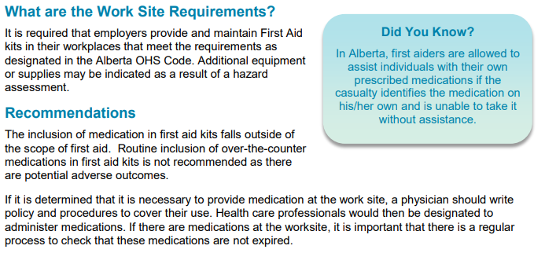
Employers, first-aid, and medications in the workplace
Needless to say, in the traditional form of first-aid, we typically think of a first-aider as someone applying bandages and monitoring an injured employee. But what about when employees suffer a headache or maybe have a chest cough with a bad cough at work?
Is the employer required to provide first aid to the employee and what methods can they use?
The regulations for standard first aid kits in Canada
First aid kits DO NOT carry medications as a standard inventory item, because employers are NOT allowed to provide medication to employees. This is due to legal complications regarding potential for adverse events to the medication itself.
It is also important to recognize that in those emergency situations, that the First Aider responding to the incident is also not held liable by law for assisting the individual in distress; they are protected by the Good Samaritan Act.

Slide 77
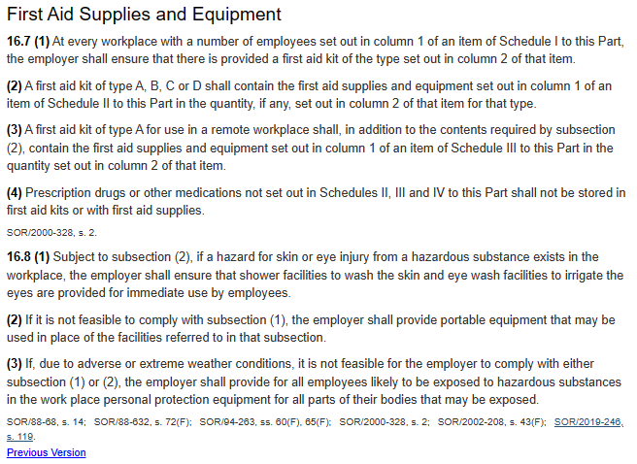
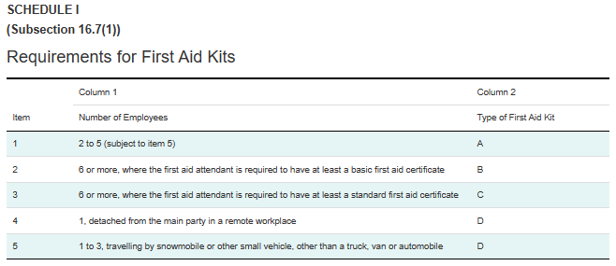
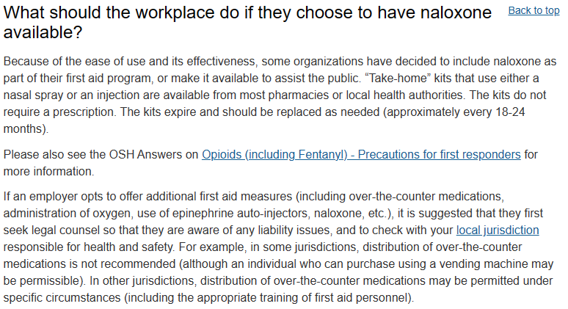
Employers, first-aid, and medications in the workplace
CCOHS: First Aid - Administering Naloxone (naloxone hydrochloride)

Slide 78
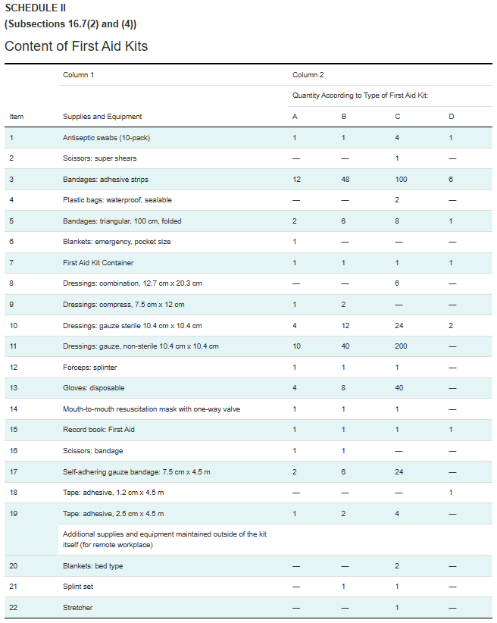
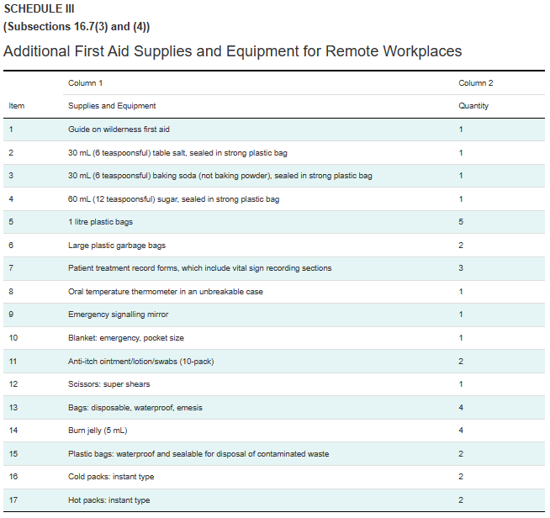
Employers, first-aid, and medications in the workplace

Slide 79
Appendix C – Criminal Case Precedent for Occupational Health and Safety

Slide 80
Criminal Negligence and Safety
Labour Code Definition
Criminal negligence
219 (1) Every one is criminally negligent who
(a) in doing anything, or
(b) in omitting to do anything that it is his duty to do,
shows wanton or reckless disregard for the lives or safety of other persons.
Definition of duty
(2) For the purposes of this section, duty means a duty imposed by law.
The following is derived directly from the Government of Canada’s Justice/Laws webpage:
Criminal liability for workplace deaths and injuries – Criminal Code Offences and their Application by the Courts (justice.gc.ca)
Criminal negligence causing death (section 220)
The offence of criminal negligence causing death in the occupational health and safety context requires proof beyond a reasonable doubt of the following elements:
a breach of the legal duty (i.e., the duty pursuant to section 217.1 of the Criminal Code or any other duty emanating from a provincial/federal statute – including provincial legislation on workplace safety – or the common law)
the breach amounts to a wanton or reckless disregard for the lives and safety of others
a person died as a result
the act or omission constituting the breach of a legal duty caused the person’s death
Penalty: A maximum penalty of life imprisonment for an individual, in the case of an organization, a fine in the discretion of the court.

Slide 81
Criminal Negligence and Safety
What does a wanton or reckless disregard for the lives and safety of others mean?
The requirement that an accused’s behaviour (including omissions) showed wanton or reckless disregard for the lives or safety of others has been interpreted by the Supreme Court of Canada in R v J(F), [2008] 3 SCR 215 to mean a “marked and substantial departure” from what a reasonably prudent person would have done in the same circumstances.
Some examples of criminal negligence case law in Canada
In R v Metron Construction Corporation, a swing stage carrying a construction site supervisor and five workers collapsed, falling 14 floors to the ground. The site supervisor and three workers died. One worker survived the fall but suffered serious injuries. The sixth worker on the swing stage was properly attached to a life line that prevented him from falling - he was uninjured.
In this case, Metron Construction pled guilty to criminal negligence causing death. It was conceded that the facts outlined in the agreed statement of fact supported a finding of criminal negligence. The plea was based on the site supervisor’s failure to take reasonable steps to prevent bodily harm and death by:
Directing and/or permitting six workers (including himself) to work on a swing stage, when he knew or should have known that it was unsafe to do so (i.e., the swing stage did not have any markings, serial numbers, identifiers, or labels identifying its maximum capacity (as required by health and safety legislation and industry practice))
Directing and/or permitting six workers (including himself) to board a swing stage knowing that only two lifelines were available (i.e., industry standards and health and safety legislation require all employees working at great heights on scaffolds to be attached to a lifeline)
Permitting persons under the influence of drugs to work on the project

Slide 82
Criminal Negligence and Safety
In R v Scrocca, a worker died during a dirt unloading operation with a backhoe. During one of the unloading trips, the brakes of the backhoe failed and it continued to roll down a slope striking a worker and pinning him against a wall. The worker died of his injuries. The facts demonstrated that the cause of the accident was a major defect in the braking system. The court based its finding that Mr. Scrocca exhibited a “marked and substantial departure” from what a reasonably prudent person would have done in the same circumstances on the following facts:
Expert evidence demonstrated that Mr. Scrocca had not checked or had the brakes checked for at least five years and probably much longer
Evidence that the backhoe had been in use for 30 years and, apart from minimal maintenance, the backhoe never received a full mechanical inspection

Slide 83
Criminal Negligence and Safety
Manslaughter by Unlawful Act (paragraph 222(5)(a))
The offence of manslaughter by unlawful act requires proof beyond a reasonable doubt of the following elements:
the commission of an unlawful act, which can be either a criminal offence or a regulatory/provincial offence
the unlawful act must be objectively dangerous and must cause death
the conduct of the accused constitutes a marked departure from the conduct of a reasonable person placed in the same circumstances
having regard to all the circumstances, a reasonable person would have foreseen the risks of bodily harm
Penalty: A maximum penalty of life imprisonment or, in the case of an organization, a fine in the discretion of the court.
For the purposes of manslaughter by unlawful act, what constitutes a marked departure?
In R v Fournier, the employer was working with an employee at a construction project, replacing underground sewer and water mainlines. The walls of the excavation were not shored properly as required by the Quebec Safety Code because excavated earth was placed too close to the excavation site.
The excavated walls collapsed and the worker was crushed by a slab of concrete that fell into the excavated hole. The defendant was ultimately found guilty of manslaughter by unlawful act (para 222(5)(a) of the Criminal Code). The court noted that a reasonable person in the same circumstances would have foreseen the risks of bodily harm and allowing the work to continue under those circumstances constituted a marked departure from the standard of care a reasonable person placed in the same circumstances would have allowed to occur.
The Fournier decision stands for the proposition that the unlawful act does not have to be a criminal offence but it must be an act that is both unlawful and objectively dangerous.

Slide 84
Criminal Negligence and Safety
Unlawfully Causing Bodily Harm (section 269)
The offence of unlawfully causing bodily harm requires proof beyond a reasonable doubt of the following elements:
An unlawful act that is criminal or regulatory in nature (federal or provincial legislation) and that is objectively dangerous
Objective foresight of bodily harm that is concurrent with the underlying offence
Bodily harm that is more than merely trivial or transitory
Penalty: For an individual, a maximum penalty of ten years imprisonment on indictment or 18 months on summary conviction. In the case of an organization, a fine, the amount in the discretion of the court.
For the purpose of unlawfully causing bodily harm what constitutes objective foresight of bodily harm that is concurrent with the underlying offence?
In R v Hritchuk, the defendant service manager pled guilty to unlawfully causing bodily harm after employees used an unsafe method to drain gasoline from a vehicle and a fire resulted that permanently injured an employee. The dealership had the appropriate tool to perform the task safely but it was inoperative.
The service manager knew that the device was inoperative but did not know that the employee victim was using an unsafe method to empty the gas. The service manager was responsible for ensuring that the correct device was available and used in accomplishing the task, thereby ensuring a safe work environment.
These facts were sufficient to support objective foresight of bodily harm.

