Slide 1
National Citizen Inquiry
Saskatoon, CA
Daily ClOUT VOLUNTEERS
DR CHRIS FLOWERS MD
April 22, 2023

Slide 2
Qualifications and Experience
Medical Degree MBBS, University of London, UK
Fellow of the Royal College of Radiology, UK
Fellow of the Society of Breast Imaging, USA
Led the Breast Cancer Screening Programme in South West Wales, UK and Breast Cancer lead for the South West Wales Cancer Network
Associate Professor of Radiology and Biomedical Imaging, University of California, San Francisco
Radiology lead of the University of California Breast Cancer Research Program (ATHENA)
Associate Professor, University of South Florida and Moffitt Cancer Center, Tampa, Florida
Medical researcher, Jonnson Cancer Center, UCLA
Medical Lead, WarRoom/DailyClout Pfizer Document Investigations (3,500 volunteers - crowd sourced citizen investigations)

Slide 3
EXPERIENCE
I have been a clinical researcher for almost 40 years
Involved in many clinical trials
Mainly in the field of Breast Cancer Screening
where the balance of BENEFITS vs HARMS is paramount
I have authored many peer reviewed papers and also chapters in medical textbooks
Received awards from prestigious medical journals for distinction in reviewing

Slide 4
EVIDENCE from WARROOM/DAILY CLOUT PFIZER DOCUMENT INVESTIGaTIONS

Slide 5
Who ARE WE?
Approximately 3,250 volunteers reviewed the Pfizer documents released as part of the North Texas FOIA to the FDA
Mixture of Medical professionals, from academia, primary care, research backgrounds
Nurses, clinical trials specialists, actuaries and many others
FINANCIAL CONFLICTS: None.
All members are UNPAID VOLUNTEERS who also do not hold any stock interest with Pfizer

Slide 6
Background on the Pfizer DATA
These are the regulatory documents the FDA required Pfizer to produce as part of their
application for an Emergency Use Authorization (EUA)
How were they obtained?
FOIA request to the FDA for the documents by Attorney Aaron Siri
and a judge in a North Texas Court granted the request (Jan 2022)
Timescale?
The FDA complained that they would not be able to release the documents
(that it would ‘take 75 years’)
The judge ordered them released over the next 12 months and gave a
schedule of numbers of pages to be released per month
When would it have become available to regulators?
These documents were shared with the European Medicines Agency
as well as other regulators at the time 2020/2021

Slide 7
Have all the documents been released?
Many thousand documents have been released
However
The way they were released proved to obfuscate the findings
After 3 months of releasing redacted documents, they grouped files into .XPT files
(SAS data file), which was used to hide PDF files which were JPEG Images
You cannot search an image containing words
There are many outstanding documents needed to complete the picture of the clinical trials and their outcomes

Slide 8
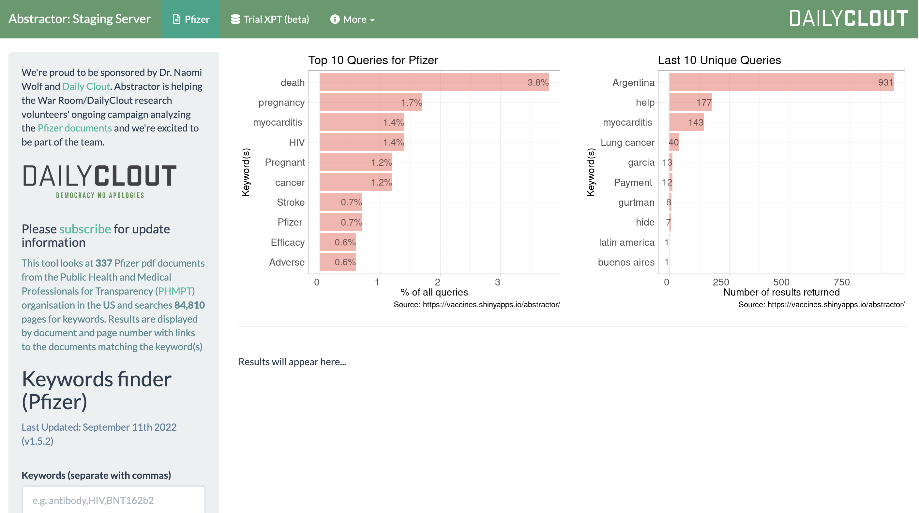
Have all the documents been released?
Our data teams worked round the clock every month on the new XPT files and extracted the data into Excel data files (which were separately validated by another team), before we could search the files
Our data team also developed a tool for searching the Pfizer documents called ABSTRACTOR
https://vaccines.shinyapps.io/abstractor/

Slide 9
What remains to be released?
Many documents refer to yet another document which in many cases has yet to be released
In other words, Pfizer have made it extremely difficult to get to the truth
A large number of Subject Case Report Files (CRF) have NOT been released.
e.g. Female Subjects account for 49%, (21,616)
Based on the Pfizer protocol, all females must undergo urinalysis testing (HCG) to screen for pregnancy before receiving Dose 1 and Dose 2; a minimum of 43,232 HCG tests would have been administered.
However, only 9 CRF documents have been identified to date

Slide 10
PFIZER DOCUMENTS
Pre-clinical trial data
Wistar (humanized) RATS
CLINICAL TRIAL DATA
Post TRIAL (90 day) DATA

Slide 11
RAT DATA
DISTRIBUTION
Throughout the body to all organs, including reproductive organs
21 male rats and 21 female rats

Slide 12
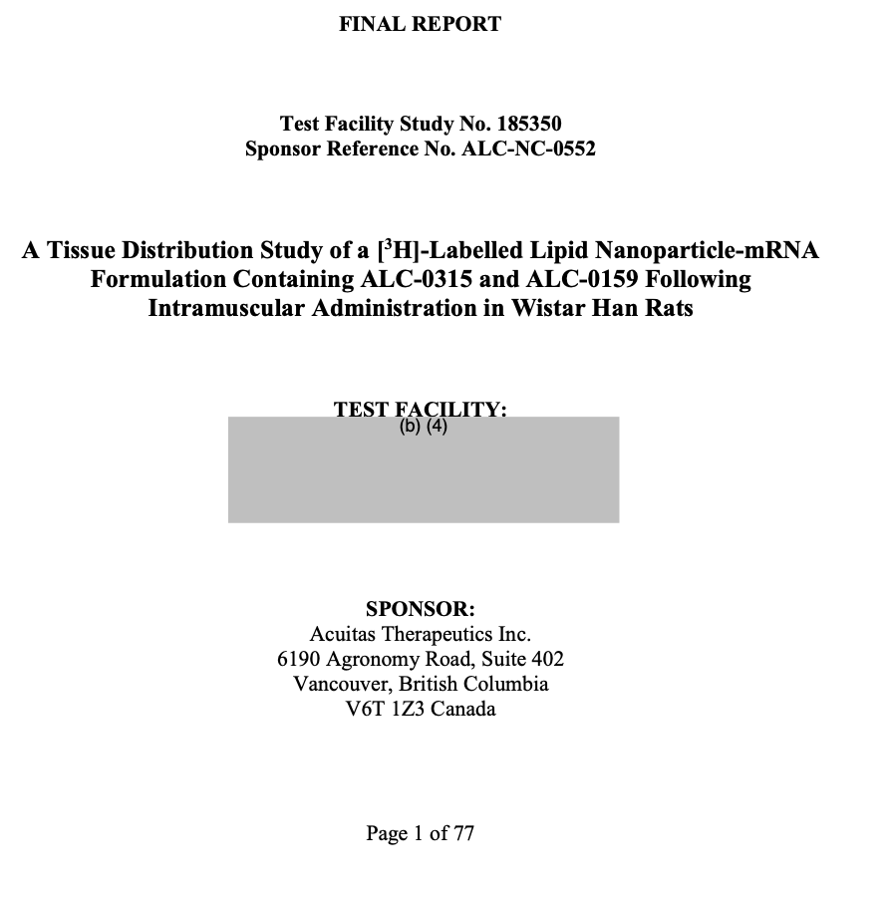
SPONSOR:
ACUITAS THERAPEUTICS INC, CANADA
Testing the LNP they would be using to
contain the BNT162b2 mRNA component
NOTE: The rapid onset of symptoms from the LNP delivery system

Slide 13
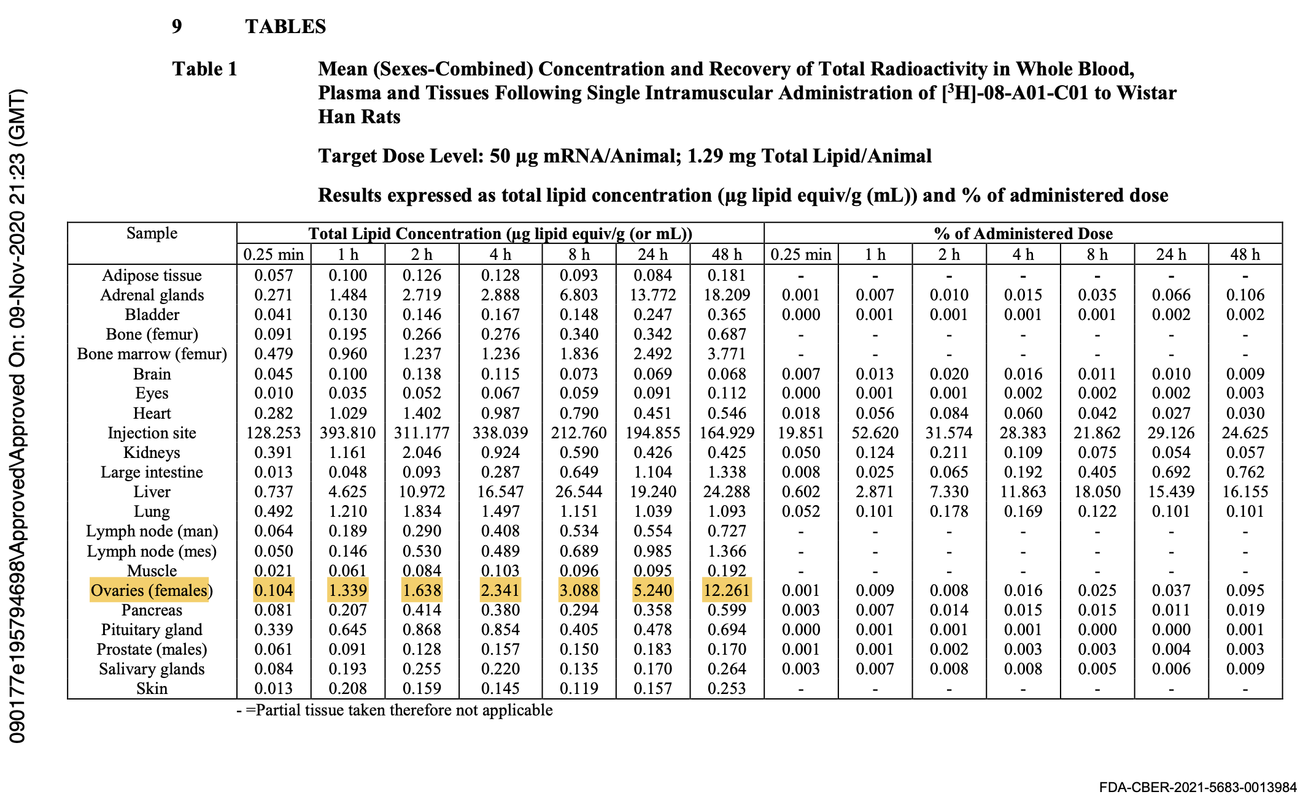
Note: Increasing concentration of LNP in Ovaries over 48 hours. No further follow up

Slide 14
PHASE 1 Clinical Trial
BioNTech
Safety studies (normally take at least 5 years)
4 May - 19 June 2020 Out of 195 subjects,
45 subjects were randomized, (many more were discarded)
3 separate groups in ratio of 4 vaccine v 1 placebo
10, 30 and 100 mcg BNT162b1 groups

Slide 15
Safety Trial
The trial was too short and had too few subjects to reach any conclusion regarding “Safety”.
Since pregnant women were excluded, they had not evidence to declare that the vaccine was safe for pregnant woman, the fetus, or breast feeding of infants.
There were far too few children below the age of 16 to draw any conclusions regarding the health risk to this population

Slide 16
CLINICAL TRIAL DOCuments
The Protocols changed during the trial
Total of 14 Amendments
9 of which came AFTER the start of the Phase 3 trial
5 were after the conclusion of the study
Dates Amendment 10: 12/1/20 - Amendment 14: 3/2/21
Phase 3 trial dates : July 27 - Nov 14, 2020

Slide 17
Protocol amendments
1 | 5/13/20
2 | 5/27/20
3 | 6/10/20
4 | 6/30/20
5 | 7/24/20
6 | 9/8/20
7 | 10/6/20
8 | 10/15/20
9 | 10/29/20
10 | 12/1/20
11 | 1/4/21
12 | 1/14/21
13 | 2/12/21
14 | 3/2/21
Protocol Amendments submitted to the FDA by Pfizer
PHASE 3
CLINICAL TRIAL

Slide 18
Note the date at the bottom of the protocol page
The World Health Organization declared the COVID-19 outbreak a
Public Health Emergency of International Concern on 30 January 2020,
and a pandemic on 11 March 2020

Slide 19
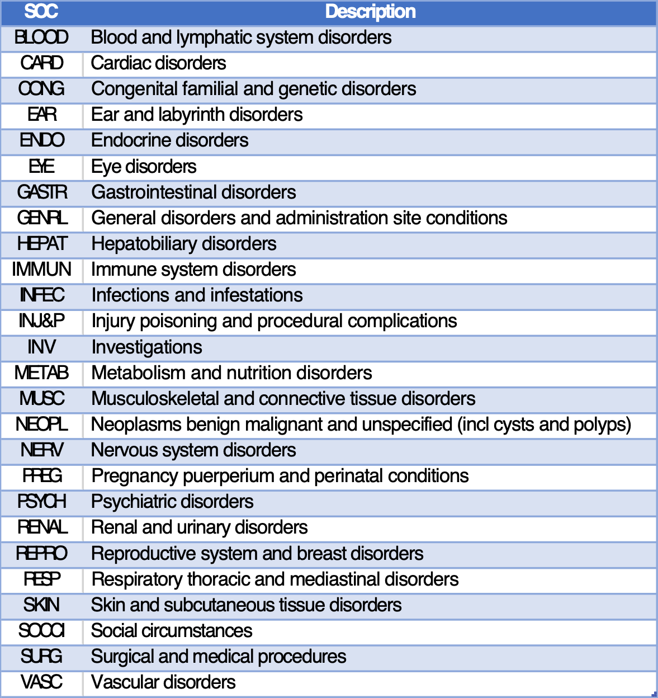
DANGER SIGNALS in the first 90 days
These are covered by the Post Marketing Experience 5.3.6 document
Broken down by System Organ Class (SOC)
275 patients had stroke
25,957 Nervous System disorders
17,283 Gastrointestinal disorders
8848 Respiratory, Thoracic and other Chest and Heart disorders

Slide 20
SAFETY SIGNALS regarding deaths DURING THE TRIAL
Nov 14 Efficacy subset data cut-off
On November 14, only 50% of the Subjects had been exposed for 2 months post Dose 2
There were 11 Deaths by November 14, NOT the 6 reported by Pfizer, (5 in the placebo group and 6 in the Vaxed)
Of these 11 Deaths, the number of Deaths due to “heart attacks” was 2 in the Placebo and 3 in the Vaxed
The difference in the Deaths between the two arms did not become obvious until March 13, 2021 (21 versus 17)
Of the 21 Deaths in Vaxed individuals, 9 died of “heart attacks” but of the 17 deaths in the placebo group, 4 died of “heart attacks”
Conclusions: November 14 was too early to make any decisions regarding “Safety”
The Adverse Event signals became clearer by March 13, 2021
This data and the data from post-marketing should have been used to determine Risk versus Benefit for all age groups

Slide 21
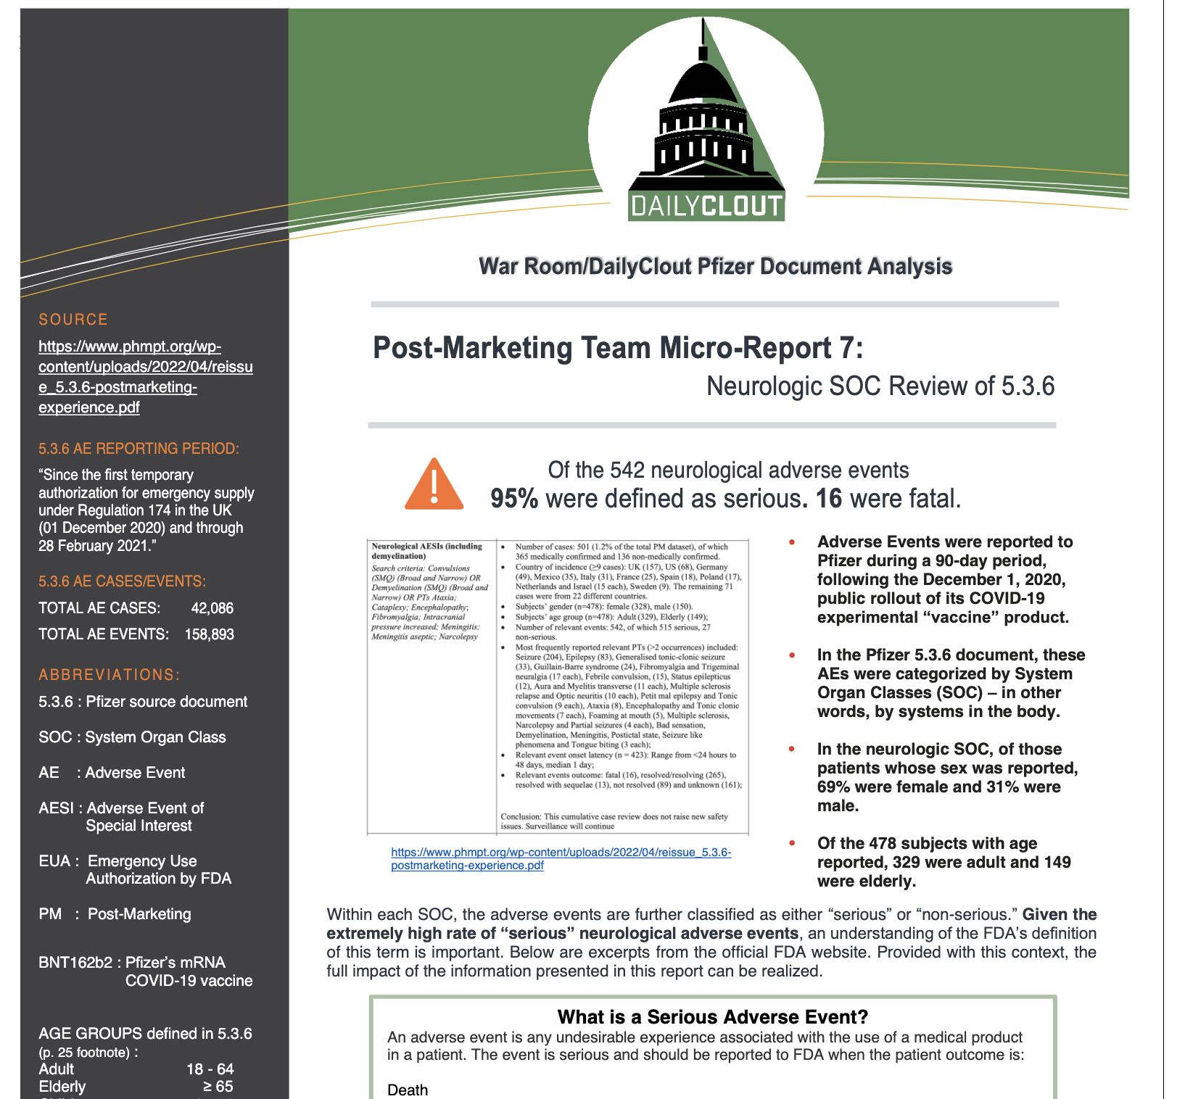
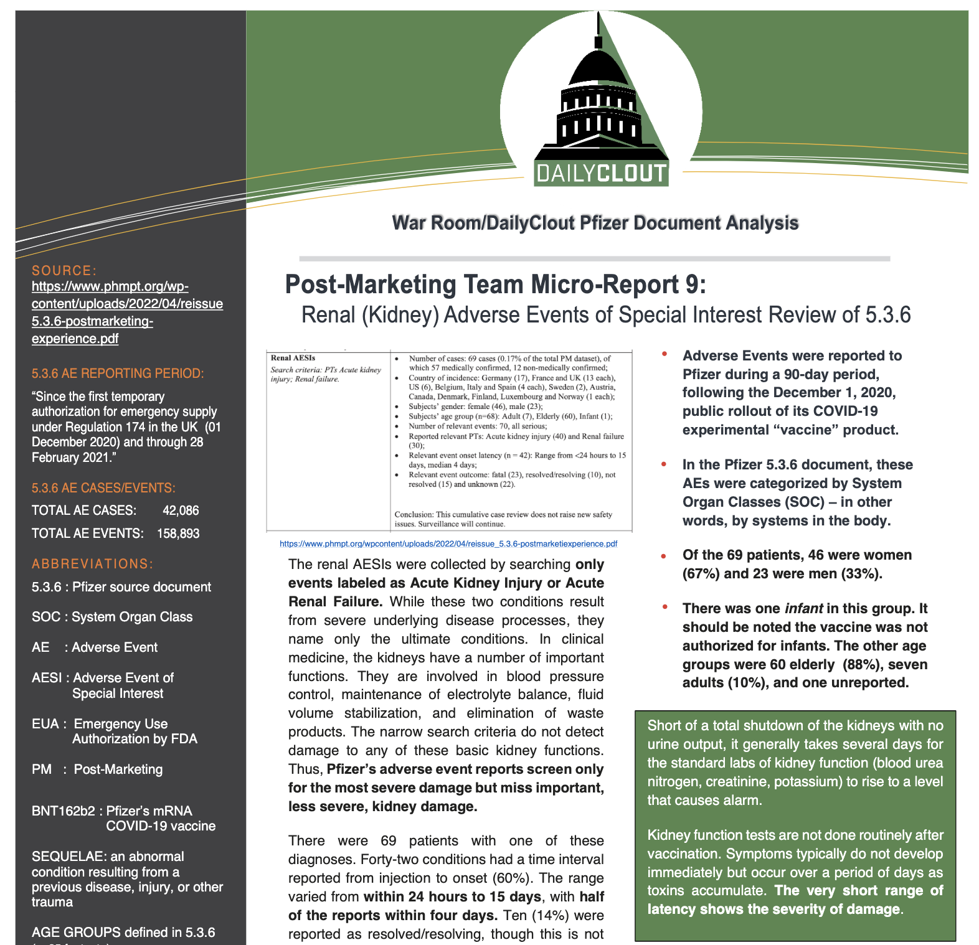
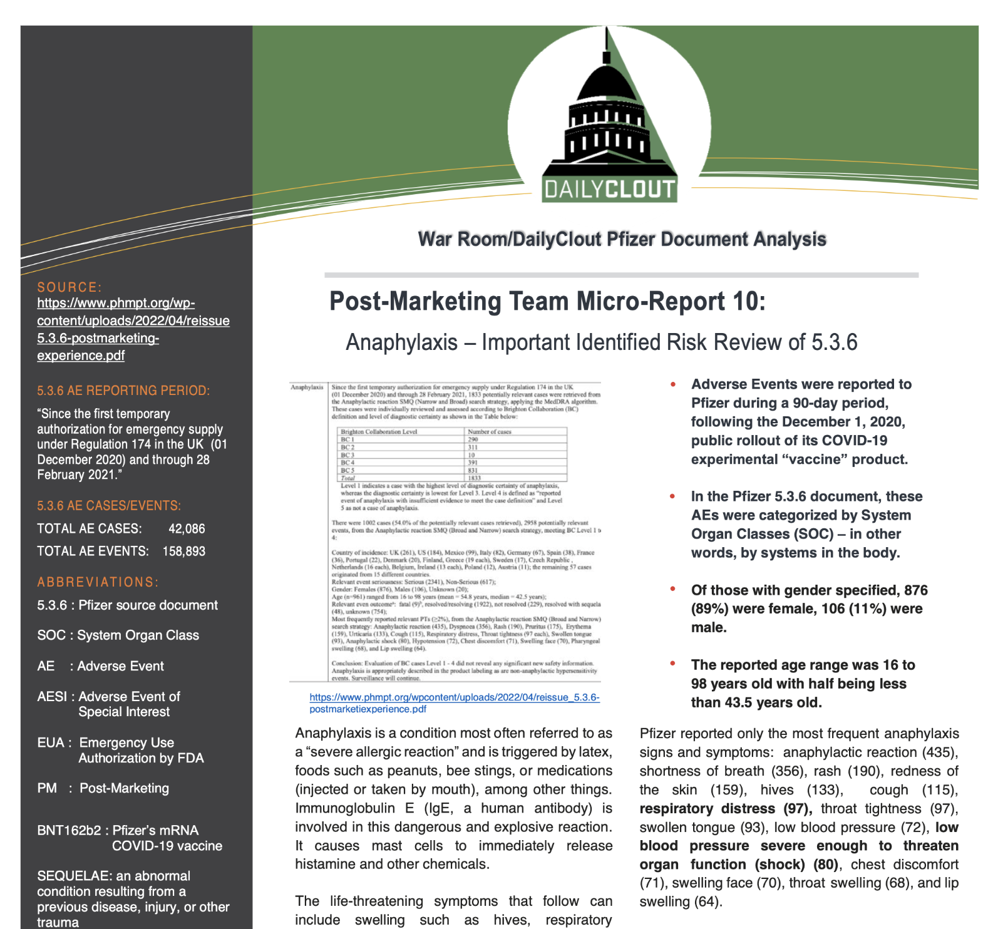
SERIOUS Adverse EVENTS by SOC
To make the findings easier to understand, our teams published micro-reports based on individual system organ classes

Slide 22
SERIOUS Adverse EVENTS by SOC
Headline findings (after 90 days post roll-out of the vaccine)
Death (1223)
Most SAEs occurred within the first 4 days post vaccination,
and within 24-48 hours in
29914 (71%) women, 9182 (29%) men
54% were under 50 years
The highest number of cases were in the age bracket of 31-50 yrs
WORKING AGE Women > Men

Slide 23
SERIOUS Adverse EVENTS by SOC
Headline findings (after 90 days post roll-out of the vaccine)
175 cases were under 17 years of age
Harms include -
Bell’s palsy in a one year old;
stroke in a seven year old
renal failure in an infant less than 23 months of age
NO INFORMED CONSENT was provided
Pfizer reported that surveillance would continue, yet no information on subsequent surveillance has been publicly released to date

Slide 24
Example of Bells palsy
Bells palsy occurred in 4 patients receiving the vaccine and none in the placebo arm
The subjects who were placebos were then unblinded and received the vaccine similar numbers developed B.P.
Pfizer’s explanation was that the numbers were small but made no explanation as to why they considered it to be insignificant
More examples occur regularly of news anchors or weathermen developing a rapid onset palsy ‘on-air’
🇨🇦 Justin Beiber 🇨🇦

Slide 25
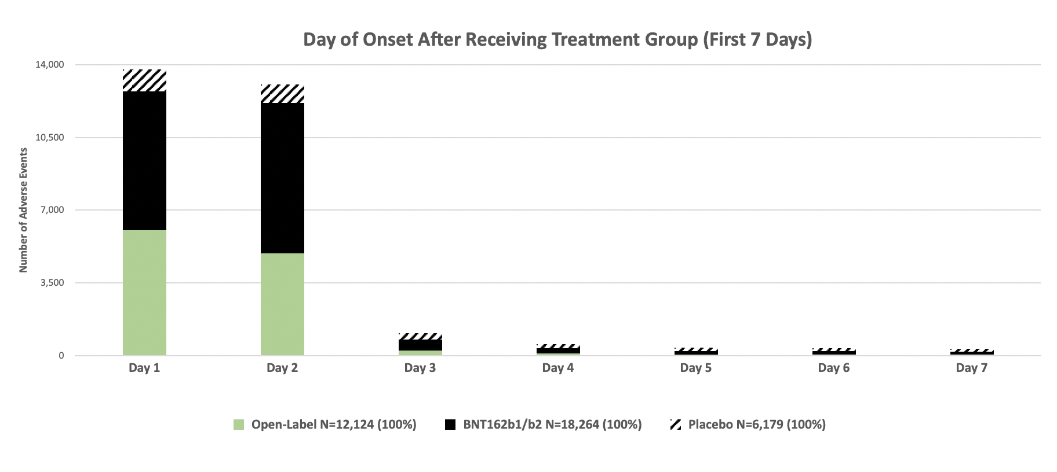
Visualization of latency

Slide 26
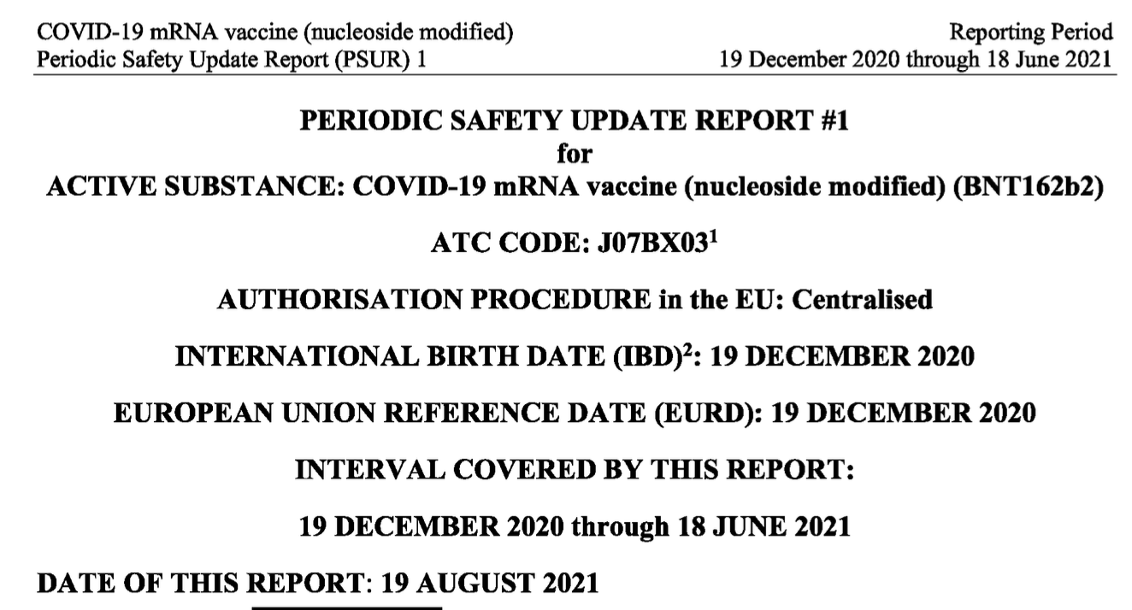
SERIOUS Adverse EVENTS by SOC
These data are replicated by the European Medicines Agency report
EU PERIODIC SAFETY UPDATE REPORT #1
Total doses:
238,029,171
Number of countries: 30

Slide 27
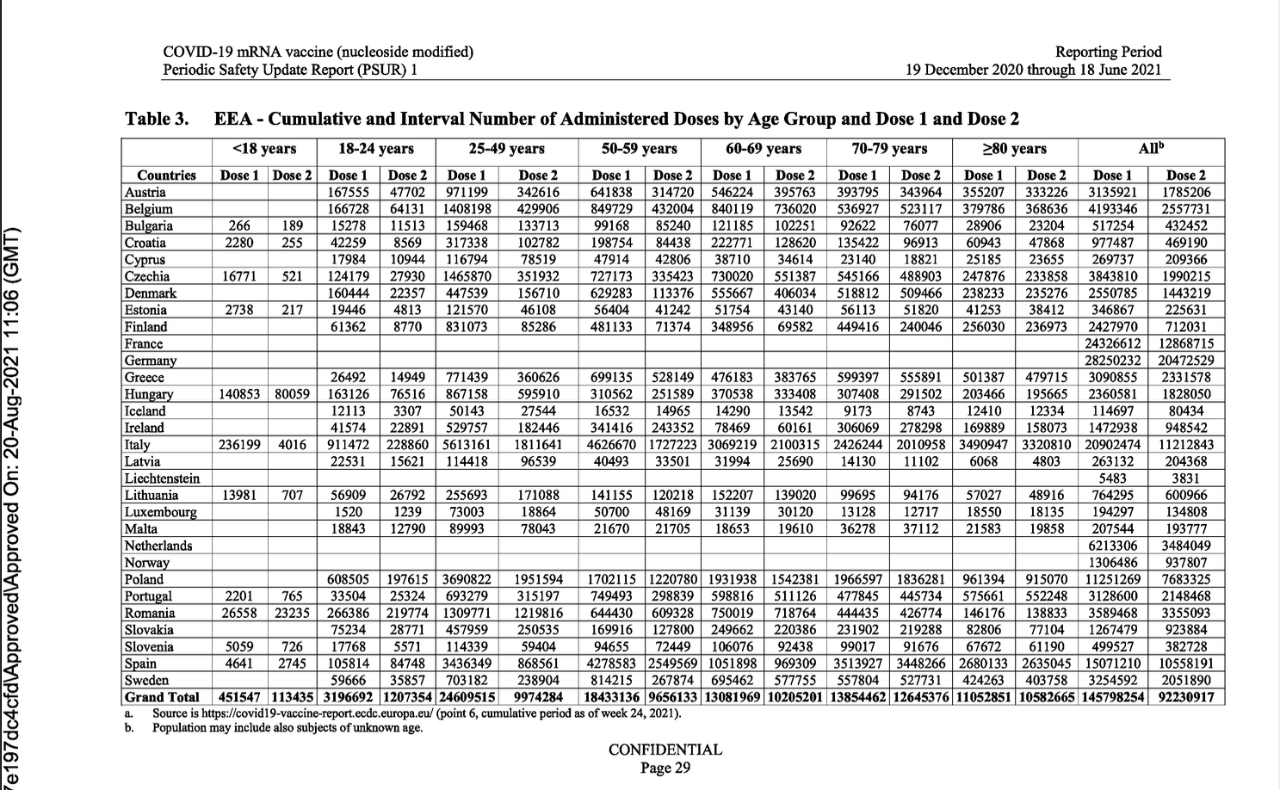
EU PERIODIC SAFETY UPDATE REPORT #1
First 6 months after roll out in Europe

Slide 28
1.17 million adverse events with 5,115 deaths
⅓ of all Adverse Events (AEs) were serious
The commonest age range for these was for working-age adults (31-50 years)
Nearly half of all deaths plus 86% of AEs were amongst healthy people, in other words, those with NO CO-MORBIDITIES
Nearly half of the outcomes remained ‘unresolved’
23% did not recover
Women suffered AEs at a rate of 3:1 over men

Slide 29
Was there manipulation of data?
The data was manipulated in a number of ways -
e.g. the anaphylaxis reports were subjected to the Brighton Collaborative Criteria, (a rigorous research-oriented set of definitions)
This allowed Pfizer to eliminate 831 of the 1833 reports of anaphylaxis
Collection of cases for Brighton classification were evaluated not by a complete chart review or actual patient interaction but based on limited VAERS reports or similar sources.
Thus a lack of information should not be construed as data negating the diagnosis of anaphylaxis

Slide 30
importance of revealing raw clinical trial data for assessment of medical products
Access to raw trial data [human clinical data collected at the site level, before transmission to sponsor in preparation for submission to regulator] was important enough to prove the vaccine ‘prototype’ was not 95% effective at preventing SAR-CoV-2 as reported, and unsafe based on the ‘raw data’.
The people analyzing the ‘raw’ trial data should include those people who are qualified, who have no conflicts of interest (COI)
i.e. those not incentivized in the result, as was the case in the Pfizer pivotal phase 1, 2/3 clinical trial.

Slide 31
need for ongoing analysis of the data
even after a product has emergency authorization or has been administered to the public
It is clear from the Post Marketing Experience data that there were
1. An unexpected number of serious adverse events
2. These were classified by the ‘sponsor’ (Pfizer) and they consistently called as
‘NO NEW SAFETY SIGNALS’
3. This function should have been performed by a ‘trusted’ public body with no C.O.I.
4. If that was done it is likely that the trial would have been stopped immediately

Slide 32
Definitions of AE
Definitions of what is an adverse event and the time limit imposed
Pfizer had
14,565 unique Subjects expressed 36,567 Adverse Events
AEs grouped according to 1,518 Preferred Terms (PTs), organized under 26 Organ Class Systems (SOCs)
The onset was anything from 1 day to 213 days, BUT the vast majority were within a few days of the vaccine, giving little doubt that it was associated with the vaccine

Slide 33
Adverse events and Biologics
Biologics are very different than standard drugs. They have differences regarding metabolism and clearance, as well as the possibility of immune suppression
We believe a longer period of observation is very important, particularly in looking at development of cancers and infertility/birth defect potential
Unlike most small molecule drugs where routes of elimination are known and well studied, the metabolism of mRNA and LNP components is still being elucidated

Slide 34
What about a NOVEL PLATFORM?
Dr Fauci told residents of Washington that this had been researched for 20 years
Dr Peter McCullough in his testimony in Truro, stated that this platform was being researched in 1986
The involvement of the US Military in the development of manipulation of viruses by ‘Gain of Function’, with the vaccine being produced as a ‘prototype’ under an OTA with the D.O.D.
All the above should give everyone pause to consider using this technology until we know more about the safety profile

Slide 35
competence of regulators to assess a novel vaccine platform
1. Government regulators are bureaucrats, not experts, generalists in their field of occupation
2. Regulators rely on outside experts, like the Data Safety Monitoring Board (DSMB), Institutional Review Boards (IRBs)
However, FDA oversight of clinical trials is lax, slow moving, and secretive
Moreover, due to the pandemic, the use of on-site no-notice inspections was paused.
We are still looking to see “official action indicated” (OAI) reports for the C4591001 study

Slide 36
competence of regulators to assess a novel vaccine platform
Three disqualifications and closures that leave trial participants and others in the dark include
The closure of Site 1161 (Benchmark Research, San Angelo, TX), Dr Darrell Herrington (PI), missing in action;
Site 1068 Bozeman Health Clinical Research, Bozeman, MT, Dr. Andrew Gentry (PI) responsible for 84 of 119 subjects (71%) who had ‘Important Protocol Deviations’ and 44 Exclusions, removed from the study (March 2021);
FOIA report of violations of protocol by Site 1231 Hospital Militar Central, Buenos Aires – iTrials Clinical Research, Dr. Fernando Polack (PI) that failed to be reported, caused the Argentine Institutional Clinical Trial Review Committee (CIREC) to lose its accreditation (May 2021)

Slide 37
Ideas on Mechanisms of harm
Evidence from histological studies including Post-Mortem examinations
Suggest - extensive SPIKE PROTEIN DISEASE
Spike protein has been found in every part of the human body
What should have given the researchers pause when developing this novel vaccine platform?
Use of Lipid Nanoparticles which can cross NORMAL DEFENSIVE MEMBRANES
mRNA which can be incorporated into human DNA by reverse transcription
We have effectively turned our cells into mini spike protein factories
No “off switch” was incorporated

Slide 38
QUESTIONS?

