Slide 1
Quality Decisions In High-Stakes Situations
Dean Beaudry BSc, MSc, PEng
Notes:
My Introduction

Slide 2
Root Cause
Analysis
(Why or How)
Canadians suffered severe social, emotional, educational, mental & physical heath, & economic consequences as a result of (federal & medical) governance covid actions
Priority was higher for covid over equally important health and national issues
High levels of social isolation, division, & fear
covid treatments that doctors felt had promise were dismissed
Procedures that balanced priorities were dismissed
International experts and Canadian stakeholders calling for balancing of priorities were dismissed
covid mitigations caused isolation
Fear was used to drive compliance
+
Unvaccinated, unmasked, & dissenting opinions were vilified
Procedures were LTA
Procedures were valid & appropriate
+
The Vision & Values that once defined us as Canadians has waned
Lack of knowledge or skill
Unchecked and inadequate governance action
+
Scientific process not followed
Conviction to do right, peace, patience, kindness, self-control
True - right
Improper motivation
Page 2
Broken consequence model

Slide 3
Root Cause Analysis
Unchecked & inadequate governance action
Undue Authority
Public Trust
Suspension of charter rights
Malfunctioning BS detectors
Inadequate facts or understanding supports trust
Provided authority for a general lowering of ethical & privacy standards, coercive vaccination requirements, vaccine passports, travel restrictions, lockdown, & assembly restrictions
Eliminated the requirement for critical thinking & difficult decisions
MSM limited or avoided coverage that conflicted with government messaging
Gov’t has significant media influence

Slide 4
Guideposts
Priority
Information
Alternatives
Deliberation
Decision
Detachment
Cognitive Dissonance
1. Emotion
High-stakes decisions always have TENSION
Knowledge & Sound Judgment
Positional
2. Authority
Authority
Stakeholders
Ethics, Accountability
3. Character
Tension
Priority
Information
Alternatives
4. Competence
Notes:
Decision 1
Emotion has no place in high-stakes decisions
Character and logic can easily be corrupted in autocracy
There are two types of authority – one is the real deal
Social Media and media - provide you with information you want to hear, two intelligent reasonable people can be pitted against each other because of this – having an agreed dataset is a better starting point
Emotion – Lots of emotion is not trustworthy – wall climbing example
Emotion is used an influence tool – Ivermectin is horse medication – but so is penicillin but you don’t hear of people being discouraged from using penicillin because of it. Its an emotional trick
Authority – positional versus authority that comes from accountability & competency
Accountable people DO relay the facts and information freely (truth and transparency), DO NOT hide information by redaction, evasive answers or privilege. Competent – DO support views with fact base explanations, DO engage in debate calmly, DO maintain good ethics & character, DO communicate well with lay people, DON’T cancel others, DON’T flippantly accuse others of being some kind of “ist”.

Slide 5
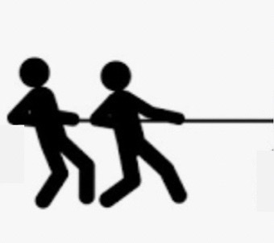
Strategy for Minimizing Failure Points
All Stakeholders Represented
Situation
Guiding Principles (Values) +
Process +
Situation Appraisal
Risk Assessment & Management
Group Facilitator
Curiosity
Creativity
Innovation
Discovery
All Experts Represented
I don’t like it but I understand & I find it acceptable
Consensus – not necessarily agreement, but, stakeholders / experts / process participants can live with and support priority, information, alternatives, & decision - they are bound to publicly support
Applied Science is a Process
The only reason to not do this is when control is prioritized over doing what is right - a values failure
Notes:
3 points
- Define the group character by guiding principles – values and priorities we can all agree with
Bring in experts and stakeholders with differing views and priorities so that bias can be balanced
Use a process and a facilitator to maintain principle and process compliance, then all pull togther
Bias can be balanced by ensuring differing viewpoints are represented
Competency can be increased by the addition of different skills – expert in statistics
Usually there is quick and reasonable agreement on priorities, information, and alternatives when the group knows a process will be applied
A good tool for ensuring proper weighting on information is to label the information as fact, opinion, and assumption – at times the group may have to stop and do homework when there are few facts available
Guiding principles represent the groups ground rules or agreed character
There are many processes or what industry refers to as Instruments, this presentation will be weighted toward RAM

Slide 6
Guiding Principles Example
Priority
Stakeholder Engagement
We are Safe, Reliable, and Profitable:
We each contribute to business success by working safely, reliably and cost effectively, and decisions consider our impact on local communities and the environments.
We Have the Courage and Conviction to Do What is Right:
We achieve our results with courage, wisdom and integrity – being ethical in all our endeavors, principled in our decisions and accountable for our actions.
We Interact with Care, Honesty and Respect:
We uphold the dignity and worth of our colleagues and everyone we interact within our communities.
We Value Competence and Contribution:
We value and recognize sound judgment, initiative and commitment as key components of performance and development.
We are a Participative Organization:
We are involved in the design of our work, actively seeking input and collaboration from others while understanding the decisions that affect us.
We Value Diversity in Our Workforce and Communities:
We are an inclusive organization which respects and values diverse backgrounds, characteristics, experience and perspectives.
We Create Our Own Future:
We learn from the past, anticipate future needs, and implement strategies that are sustainable over the long-term
Character
Authority
Notes:
Guiding Principles
Good guiding principles provide an excellent framework for team self-governance
Culture is only ensured when leadership requests / encourages their direct reports to hold them to account – without this the principles are just a piece of paper and hypocrisy will prevail

Slide 7
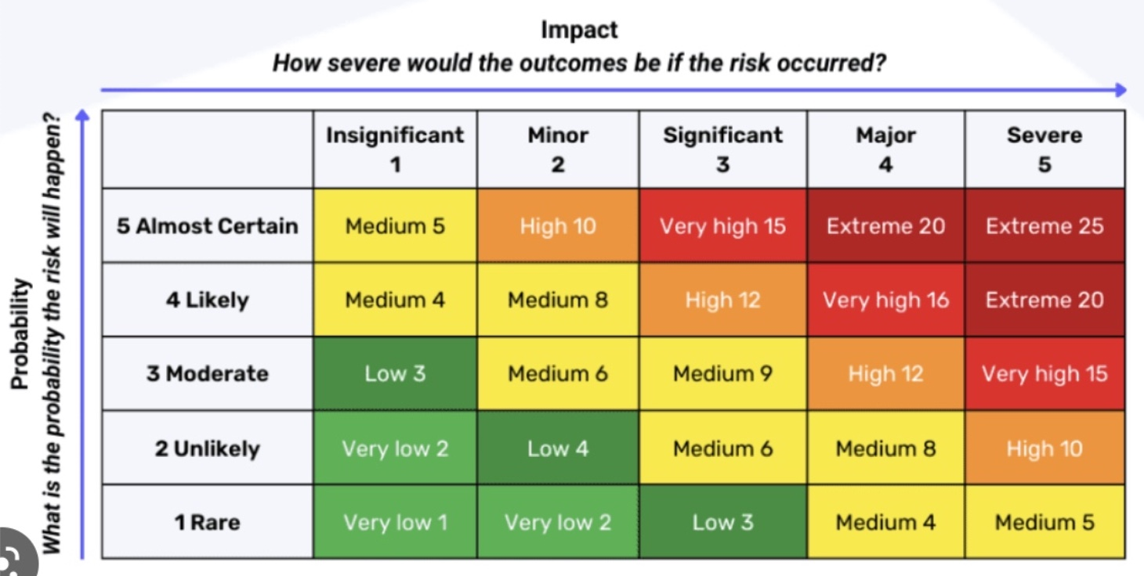
What is RISK Assessment?
Risk = Probability x Consequence
PROBABILITY
Matrix Position | Probability Description | Mathematical Representation
5 | Almost Certain | 0.33 - 1
4 | Likely | 0.033 - 0.33
3 | Moderate (Possible) | 0.0033 - 0.033
2 | Unlikely | 0.00033 - 0.0033
1 | Rare | 0.0000333 - 0.000333
P2
CONSEQUENCE
Matrix Position | Consequence Description | People | Financial
5 | Severe | Multiple Fatalities | >$100B
4 | Major | Fatality | $50-100B
3 | Significant | Lost Time Injury | $10-$50B
2 | Minor | Medical Aid Injury | $500M-$10B
1 | Insignificant | Band Aid Injury | < $500M
*
C4
In 2020 there were 15,508 accidents that were fatal in Canada
Generalized risk – Probability is =15,508 / 38,500,000 = 0.0004 – P2
- Consequence is fatal – Major – C4
Accidental death in Canada is a generalized Medium Risk (8). It is a useful reference. Its an everyday risk we have peace with; we all tolerate (apply diligence but not stressed out)
Notes:
Risk Matrix
Use of a risk matrix is common industry practice
Emotions can be checked using a risk matrix – just facts and mathematics

Slide 8
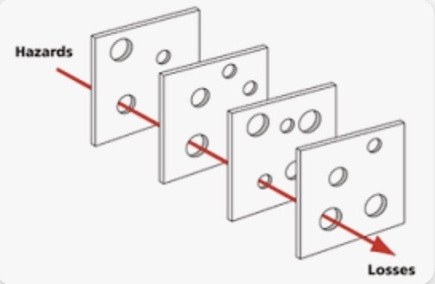
What is RISK Mitigation?
Identification & implementation of mitigations that address
Consequence mitigations
Seatbelts
Airbags
Fall arrest
Personal Protective Equipment (PPE)
Probability mitigations
Attentive driving / work
Driving lights on / back up alarms
Rule compliance – speed limit
Condition appropriate & well maintained equipment
Avoiding / mitigating unsafe conditions
Barriers
Mitigation Effectiveness Assessment
Does it cause a change to the risks position on the risk matrix?
Does it introduce new risks?
Is the cost/benefit or risk/reward favorable?
If new risks are introduced are they risk assessed & mitigated?
Notes:
2 points
An effective mitigation moves the risk to a lower position in the matrix – it is tested for cost / benefit and discarded if ineffective
We don’t judge the risk management by the outcome, we judge it by due diligence
Due diligence requires
Appropriate stakeholder involvement
A BIC process
Quality and comprehensive information
Qualified experts

Slide 9
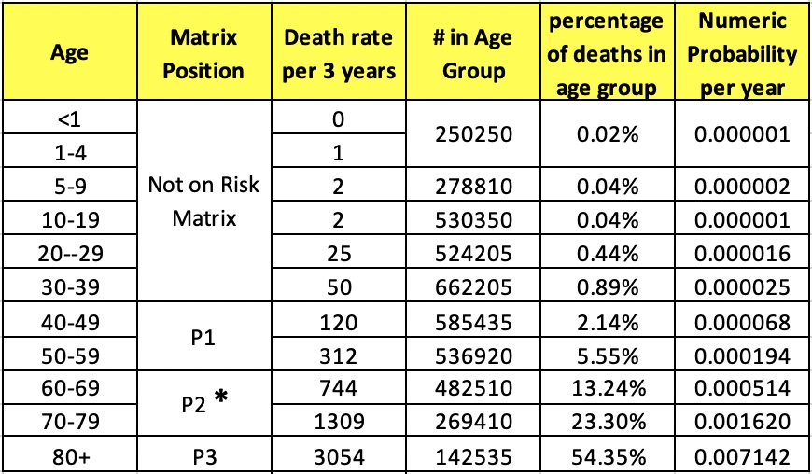
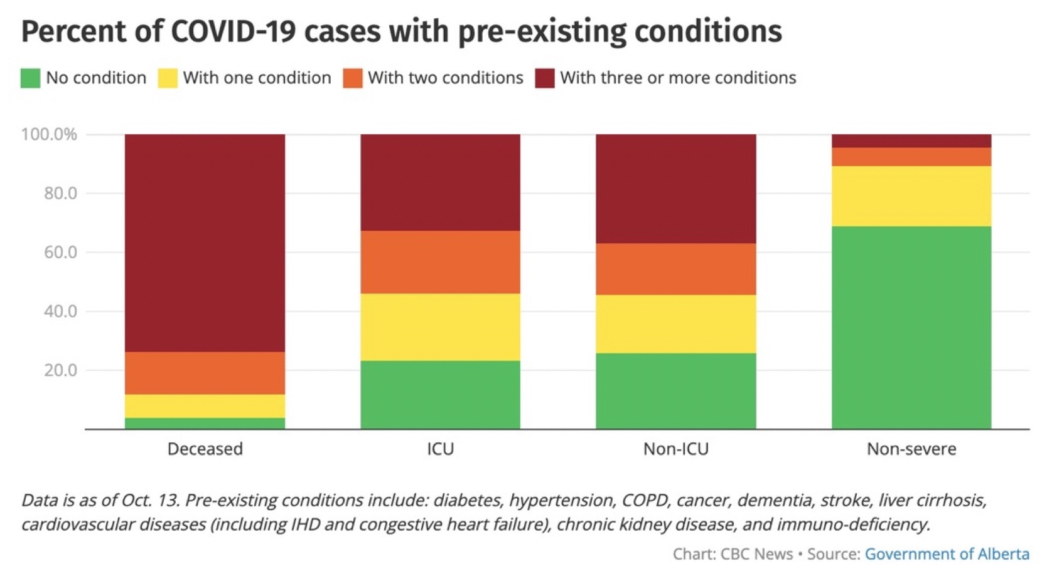
Covid Risk Factors – Data from Alberta Health
INDIVIDUAL RISK
ALBERTA Age Data – March 2023
Pre-Existing Conditions (PEC) - Alberta
73.6%
3 or more
14.6% - 2
4% - 0
7.8% - 1
Diabetes, hypertension, COPD, cancer, dementia, stroke, liver cirrhosis, kidney & heart disease, immuno-deficiency
Average # pre-existing conditions – 2.6 (or more)
96% had at least 1 pre-existing conditions
4% of the covid deaths had no pre-existing condition
Average Age of covid related death – 79
99% of deaths were over 40
0.09% of people in the under 20 group died (9/100th of 1%)
SNAPSHOT – 120 days leading to Jun 7, 2022 there were 868 covid deaths - 79% of these deaths were vaccinated / 21% were not vaccinated – at this time the Albertan vax / unvax ratio was 77% / 23%
Vaccination did not stop infection, transmission, or death
Notes:
All of this data is courtesy of Alberta Health
This data can be presented in a way that is more informative using the risk matrix

Slide 10
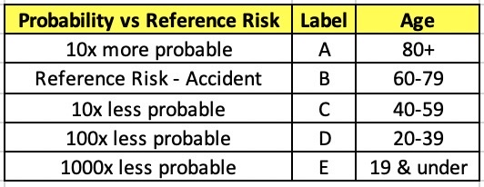
Plotting Available Government Data on a Standard Risk Matrix
INDIVIDUAL RISK
Datasets from Alberta Government (https://www.alberta.ca/stats/covid-19-alberta-statistics.htm#severe-outcomes) & Canada Health (https://health-infobase.canada.ca/covid-1)
A
*
*
B
This analysis is more like an autopsy – it’s based on what has already happened
Health Canada statement “The benefits of all COVID-19 vaccines continue to outweigh the risks of the disease.” (April 8, 2023) – What about the risk of vaccine injury?
For the under 20 age group – 669,000 people would have to be vaccinated to probably save 1 life – that would probably result in a vaccine injury to 221 people (inc 9 deaths) HARM >>> Benefit
C
D
Vaccinated Canadians 32,458,765
Serious Adverse Events (SAE) 10,685 (C3)
10,685 / 32,458,765 = 0.00033 (P2) or 1/3000
E
Generalized covid & Mitigated Accident Risk (Reference)
Examples - 427 deaths reported, 1426 cardiac related , 1504 clotting, 87 spontaneous abortion, 468 paralysis/stroke
SAFE 427/32,458,765 = 0.0000132 or 1/75,000
Notes:
How is it possible for the vaccine to lower risks in positions C,D, or E?

Slide 11
Not new information
All this was known October 2020 via the Great Barrington Declaration which states “We know that vulnerability to death from COVID-19 is more than a thousand-fold higher in the old and infirm than the young. Indeed, for children, COVID-19 is less dangerous than many other harms, including influenza. ”
In Alberta in 2023 there have been 3 influenza deaths in the 0-19 age category, that is a higher annual rate than covid

Slide 12
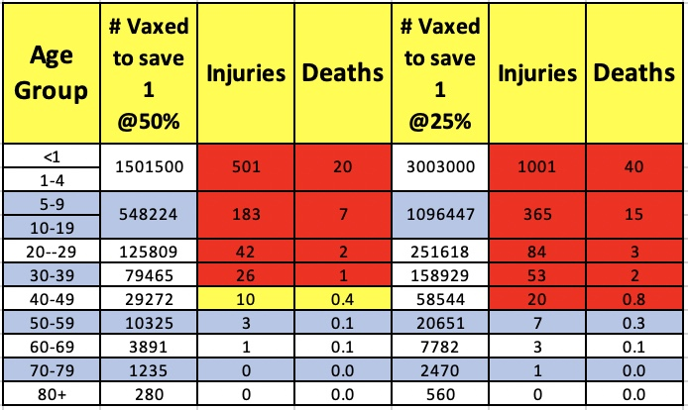
Vaccine Risk / Benefit
INDIVIDUAL RISK
Health Canada implies that vaccines are safe at 1 death per 75,000 fully vaccinated (2 jab). Using the same criteria you are safe from covid above in the red shaded area without mitigation.
Perhaps a health care practitioner could use tables like these to provide vaccination guidance to individuals or groups based on age, pre-existing conditions, risk tolerance, and vaccine efficacy. All data required to support this sort of individualized or group healthcare was available prior to 2020 end
73.6%
3 or more
14.6% - 2
4% - 0
7.8% - 1

Slide 13
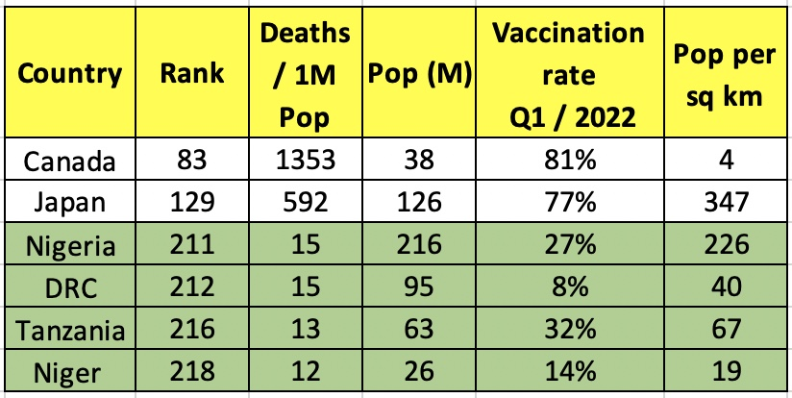
10 Countries DID NOT HAVE A PANDEMIC
INDIVIDUAL & NATIONAL RISK
This is an example of 4 of 10 countries with a combined population of 438M – compared to G7 average (168x better results) avoided over 1M deaths
For CANADA these results would have meant about a 98% reduction or 50,000 fewer deaths
Wouldn’t “science” or just due diligence want to know why 10 countries did not have a pandemic? Didn’t we have money to assess this? $566B

Slide 14
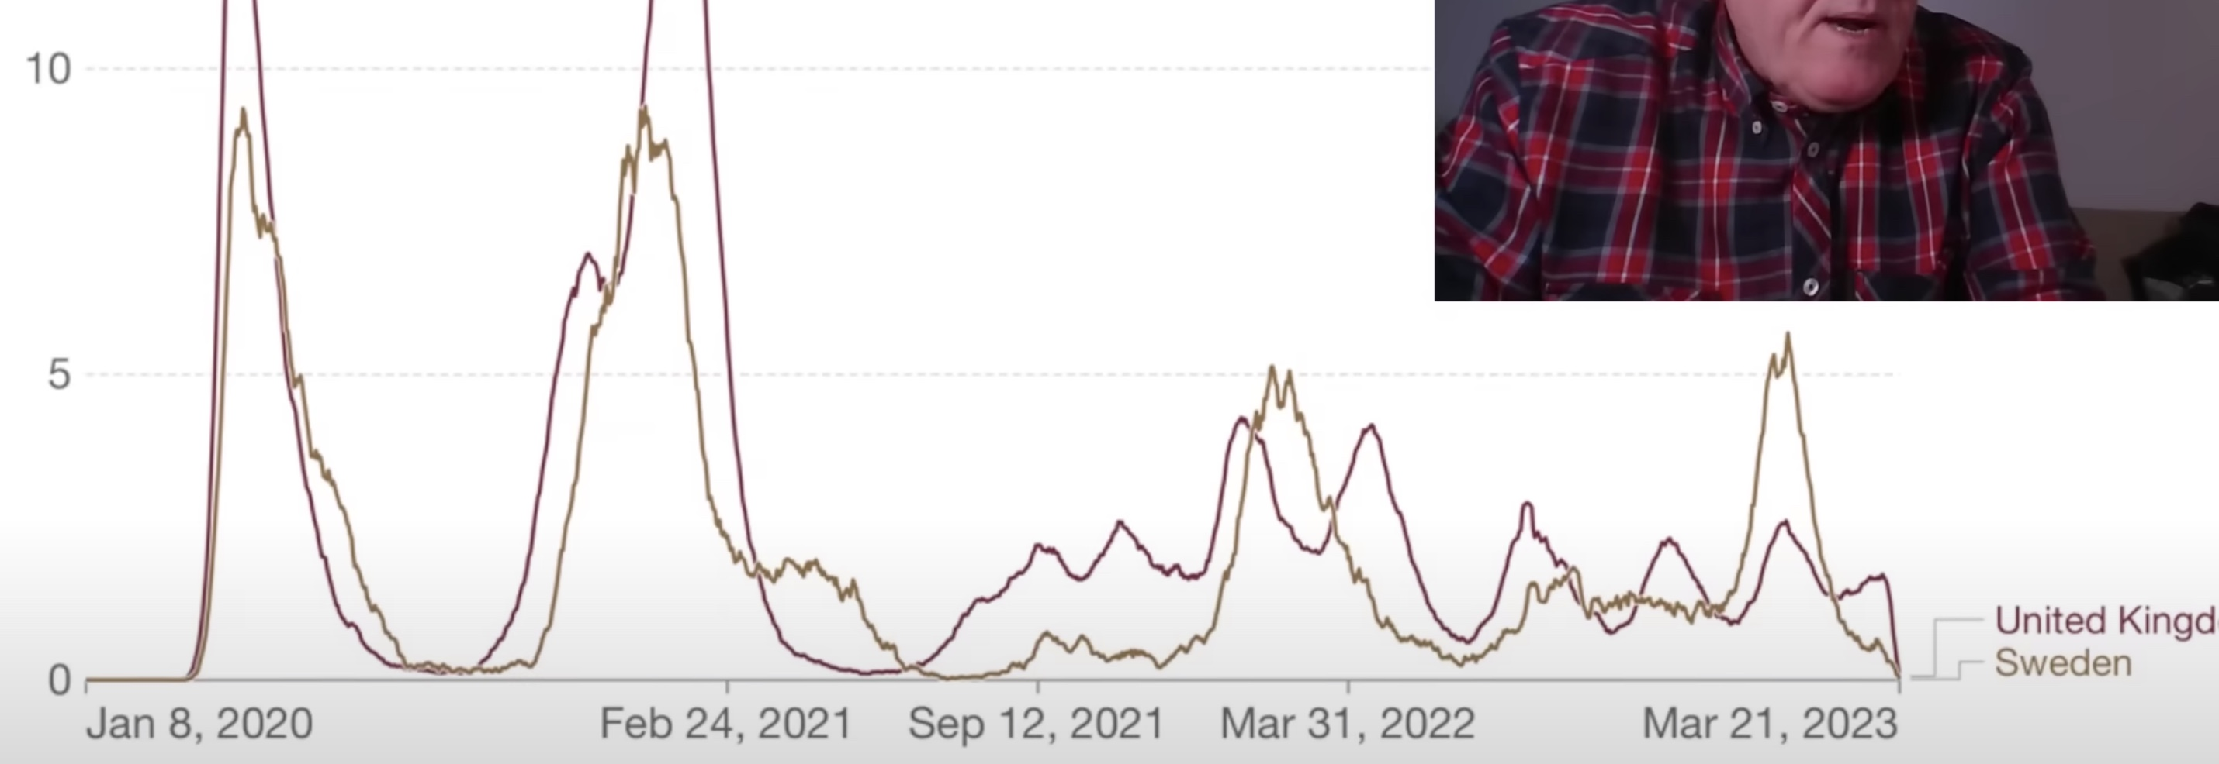
Mitigation Effectiveness - Lockdown
Dr. Anders Tegnell – Swedish State Epidemiologist “The cost of locking down would be horrifyingly high”
Swedish population advised to work from home,
Schools not closed - online teaching for over 16 only
Advised safest outdoors
Ban on gatherings over 50,
A few rules for restaurants,
Other covid measures entirely voluntary
South Dakota was the only state in the USA that had ZERO lockdowns – 21 lockdown states had a higher covid death rate
Covid deaths per million pop
UK & Sweden
Chart from a screenshot of Dr. John Campbell – YouTube talk entitled “Sweden, never locked down”
End of 2020
+
-
+
-
+
-
+
-
Sweden, without locking down, achieved better covid results than other G7 countries such as USA, Italy, UK, & France which had some of the most stringent lockdowns
Doesn’t science have curiosity? Don’t we want to understand how an alternate approach was working? Didn’t we have money to research this? $566B
Notes:
6 other Countries in the 10 – Burkina Faso, Sierra Leone, Benin, Tajikistan, Chad, South Sudan all had malaria

Slide 15
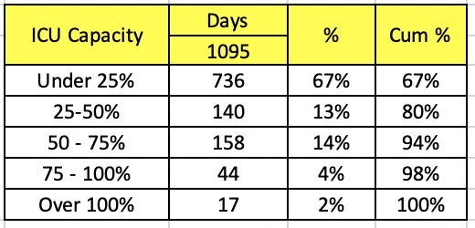
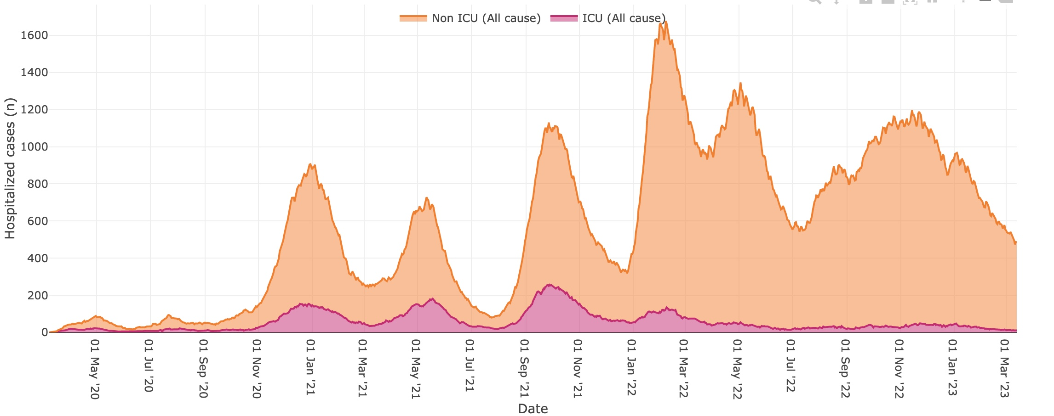
Alberta ICU Capacity / Restrictions
July 9, 2021 - All age 40+ (99% of the “vulnerable”) have been provided vaccination opportunity
Restriction Direction
Added $566B in Federal Gov’t debt but with that money built zero ICU capacity
ICU Capacity (225)
ON
OFF
ON
OFF
ON
OFF
PROOF OF VAX

Slide 16
Mitigation Effectiveness - Masks
The Cochrane meta-analyses adhere to a standardized methodology and undergo close review by the Collaboration, above and beyond the usual scientific peer review process. Cochrane reviews had been considered the gold standard for resolving controversies in medicine, especially when individual studies may have reported inconsistent or inconclusive results. As Dr. Robert Wachter, former chair of the American Board of Internal Medicine, told the New York Times in 2014, “When clinicians are debating the right thing to do, all someone needs to say is, ‘There’s a Cochrane review about that,’ and the argument ends.”
As the Cochrane review’s Oxford University lead investigator Tom Jefferson (also first author of a highly influential Cochrane review of the controversial influenza medication Tamiflu) explained in a recent interview, “There is just no evidence that [masks] make any difference. Full stop. Our job as a review team was to look at the evidence, we have done that.”

Slide 17
The Legal Priority of the government is to
Uphold the CONSTITUTION
The Canadian Constitution
Charter of Rights
The Constitution of Canada
In order to suspend these rights Section 1 requires that there must be evidence that either the state is in peril or the existence of the state is in peril
Canada
Province
Province
Province
Territory
The onus of proof under section 1 is on the person seeking to justify the limit, which is generally the government (Oakes, supra). The standard of proof is the civil standard or balance of probabilities (Oakes, supra).
The Charter of Rights under sections 2,6,7,15 protect freedom of association, expression, religion, conscience, assembly, mobility, and equality.
Notes:
The Canadian Constitution contains the fundamental principles upon which the country is founded. The Charter of Rights is within the constitution. This is the highest law of the land. Only God is higher.
No law or action or emergency orders can contravene these rights unless the state or the existence of the state is in peril

Slide 18
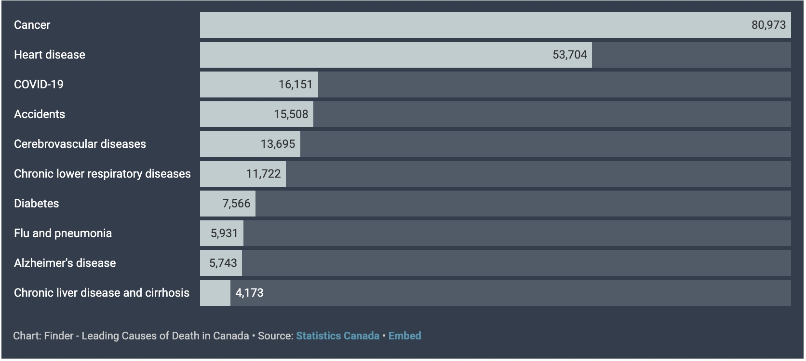
2020 Top 10 leading causes of death (C4 consequence)
NATIONAL RISK
P2 - 0.0021
P2 - 0.0014
P2 - 0.0004
P2 - 0.0004
P2 - 0.0004
P1 - 0.0003
P1 - 0.0002
P1 - 0.0001
P1 - 0.0001
P1 - 0.0001
3 year average 16,400
National accident HARM = death of 4/100th of 1% of the Canadian population each year.
An emergency is an urgent, sudden, and serious event or an unforeseen change in circumstances that necessitates immediate action to remedy HARM or avert imminent danger to life, health, or property; an exigency.
Sudden – occurring or done quickly and unexpectedly or without warning
Immediate – occurring or done at once; instant.
Imminent – ready to take place, happening soon
Notes:
Now that you are all unemotional RAM experts, what level of risk is covid relative to accidents in Canada
Which of these is a threat to the state or the existence of the state?
Are accidents a provincial or nation wide emergency?
Do we need to close the highways from non-essential travel?
From this chart we can quickly envision relative generalized risk.
We can draw some preliminary conclusions from generalized risk but individual or group risk is more useful. For example, people who drive long hours regularly are more exposed to the risk of traffic accident and ought to provide more focus to risk mitigations. They also pay more for insurance. If you want to know your risk look at the price of insurance. Older people pay substantially more for travel medical insurance.
More data is required to assess your individual or group risk.

Slide 19
Which is more Peril? Covid-19 & Accidents both cause loss and suffering in Canada
They are the same
Emotion was the reason we believed these risks were different
Accidents
Pick on everyone
Normalized
15,500 deaths (every year)
225,000 injuries
Mitigations are
harmless to individuals
harmless to society
are subject to proper legislative process
Easily characterized
Impact 4/100th of 1%
Impact 4/100th of 1%
Covid-19
Picks on the aged & infirm
Fear producing
16,398 deaths (3 year average)
Long covid or other injuries #?
Mitigations
caused loss and suffering to individuals
caused loss and suffering to the nation
were subject to coercion through unjustified emergency powers and medical ethical violations
Compete with 2.6+ other potential causes / pre-existing conditions
Fear
There is equal justification to suspend human rights to mitigate accidental deaths as covid deaths. A mitigation that would be effective on accidents is to close highways to all but essential traffic. Absurd??

Slide 20
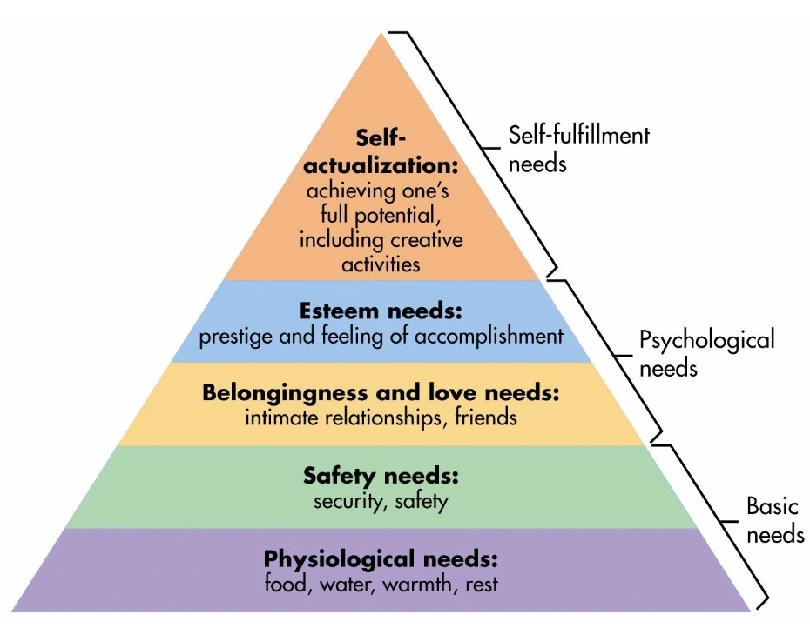
For a nation the Logical Priority is to protect what underpins our needs
Maslow's hierarchy of needs
Business is the goose that lays the golden eggs that pays for all basic needs of all individuals and is the source of all government revenue / social security
Thriving Business
Leads to affordable food, energy, & housing – reliable / adequate employment, tax base
Notes:
Maslow’s hierarchy of needs is commonly accepted. Each layer of needs requires satisfaction to fully support the need above
The harm or destruction of the lowest layer (foundation) puts everything else in jeopardy. The default position for any society ought to be protect the base

Slide 21
NATIONAL RISK
Mitigation Results
Vaccines did not stop infection, transmission, or death – may have had a net positive impact for 50+ age group
Vaccine adverse events – 43,884 adverse events, 10,685 serious, 427 deaths reported
There is evidence that lockdowns & masks had a net negative impact on social, emotional, educational, mental & physical heath
Mitigations moved a MEDIUM RISK to EXTREME
Financial Consequences of Mitigations
+ $3,270 per taxpayer debt servicing only - $566B (23.4%) increase Federal & Provincial Debt
+ $8,300 Interest per homeowner ($300K Mortgage)
+ $2,000 Rent
+$4,000 Food – family of 4 (Dalhousie U)
+$2,000 Fuel & Heat
Single person - $7.5K +
Family - $15K +
Average household - $11K
x 15.3 Million households
+$170B /year to Canadian families (not including paying down debt)
*
*

Slide 22
More on Decision Failure Points - Accountability
Without consequences there is no accountability
Future and uncertain consequences are weak
Immediate and certain consequences are strong
Owners or Shareholders
External Stakeholders
Communities
NPOs
Board of Directors
C-Suite
Managers
Area Leaders
Front Line Leaders
Front Line Workers
Legal & Personal
Accountability
Decision Making
& Accountability
Pushed down
External Stakeholders
Regulators
Business Alliances
Affiliates
Competitors
Notes:
Business
Accountability cannot exist without the potential of certain consequences
Best-in-Class organizations push decisions down but ensure appropriate support and oversight
Typical publicly traded and many private corporations have this structure. The C-suite has personal accountability by law, they are also legally bound to fiduciary responsibility. This means they are accountable to not waste or treat themselves to excess.
The most effective organizations delegate decision making as low as possible into the organization
Before and after experience
Covid decisions would typically have decision oversight from a manager and the work of decision making would be delegated down from the manager

Slide 23
Broken Consequence Model
Pfizer & Moderna had unprecedented revenue increases - Pfizer up $70B & Moderna up $19B
The federal government contractually transferred liability for vaccine injury from the Pfizer & Moderna products to the Canadian taxpayer’s – contracts are unavailable for taxpayer review
The federal government bureaucrats received $191M in bonuses and raises throughout the pandemic, the MPs received their automatic raises each year – the Canadian public received minimum $170B worth of cost of living increases and total deferred taxes went up $566B (past $50K per Canadian)
The vaccine injured received pain, suffering, stigma and long waits and claim scrutiny – vaccine approvals and safety claims have not been publicly scrutinized
MSM news generally aligned with government narratives, CBC receives $1.2B / year taxpayer funding and received $85M in raises & $99M in leader bonuses over 3 years, other MSM received $600M in taxpayer funded corporate welfare while MSM shareholders received dividends
Individual lawsuits aimed at holding the government to account have to secure independent legal financing – the government choses the arbiters of these suits and uses taxpayer funding to defend its actions
There are laws to ensure accountability of officers of private & publicly traded businesses – there are laws that indemnify elected officials

Slide 24
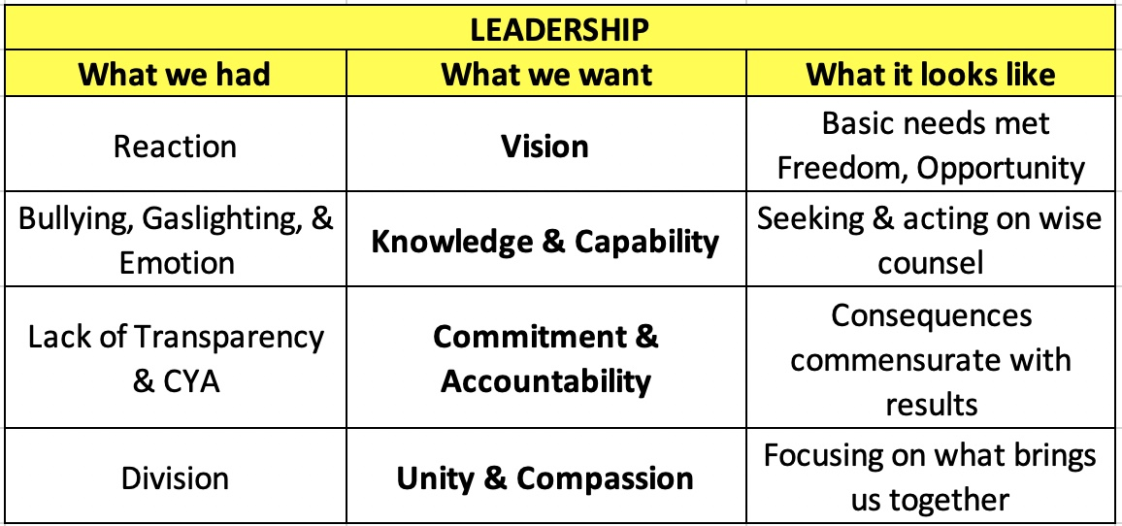

Slide 25
God keep our land, Glorious and Free 2 Chronicles 7:14
🎵
🎶
End

