Slide 1
Canada’s Deadly Response to COVID-19
Independent Inquiry into Government Management of the COVID-19 Crisis
David Redman
Lieutenant Colonel (Retired)
Former Head of Emergency Management Alberta
Notes:
Intro self very brief if not introduced.
Army Officer – Battle Procedure, Estimate of the Situation, Operation Planning Process
EMA – Learned the detail of:
P/T governments
Municipal Governments
Federal/provincial relationships
The private sector linages to government in daily operations and emergencies
Critical infrastructure continuity
Actual management of emergrncies
Fires/floods/tornadoes
Terrorism
Pandemic Planning
Office of the Auditor General of Canada – link Policy to Programs

Slide 2
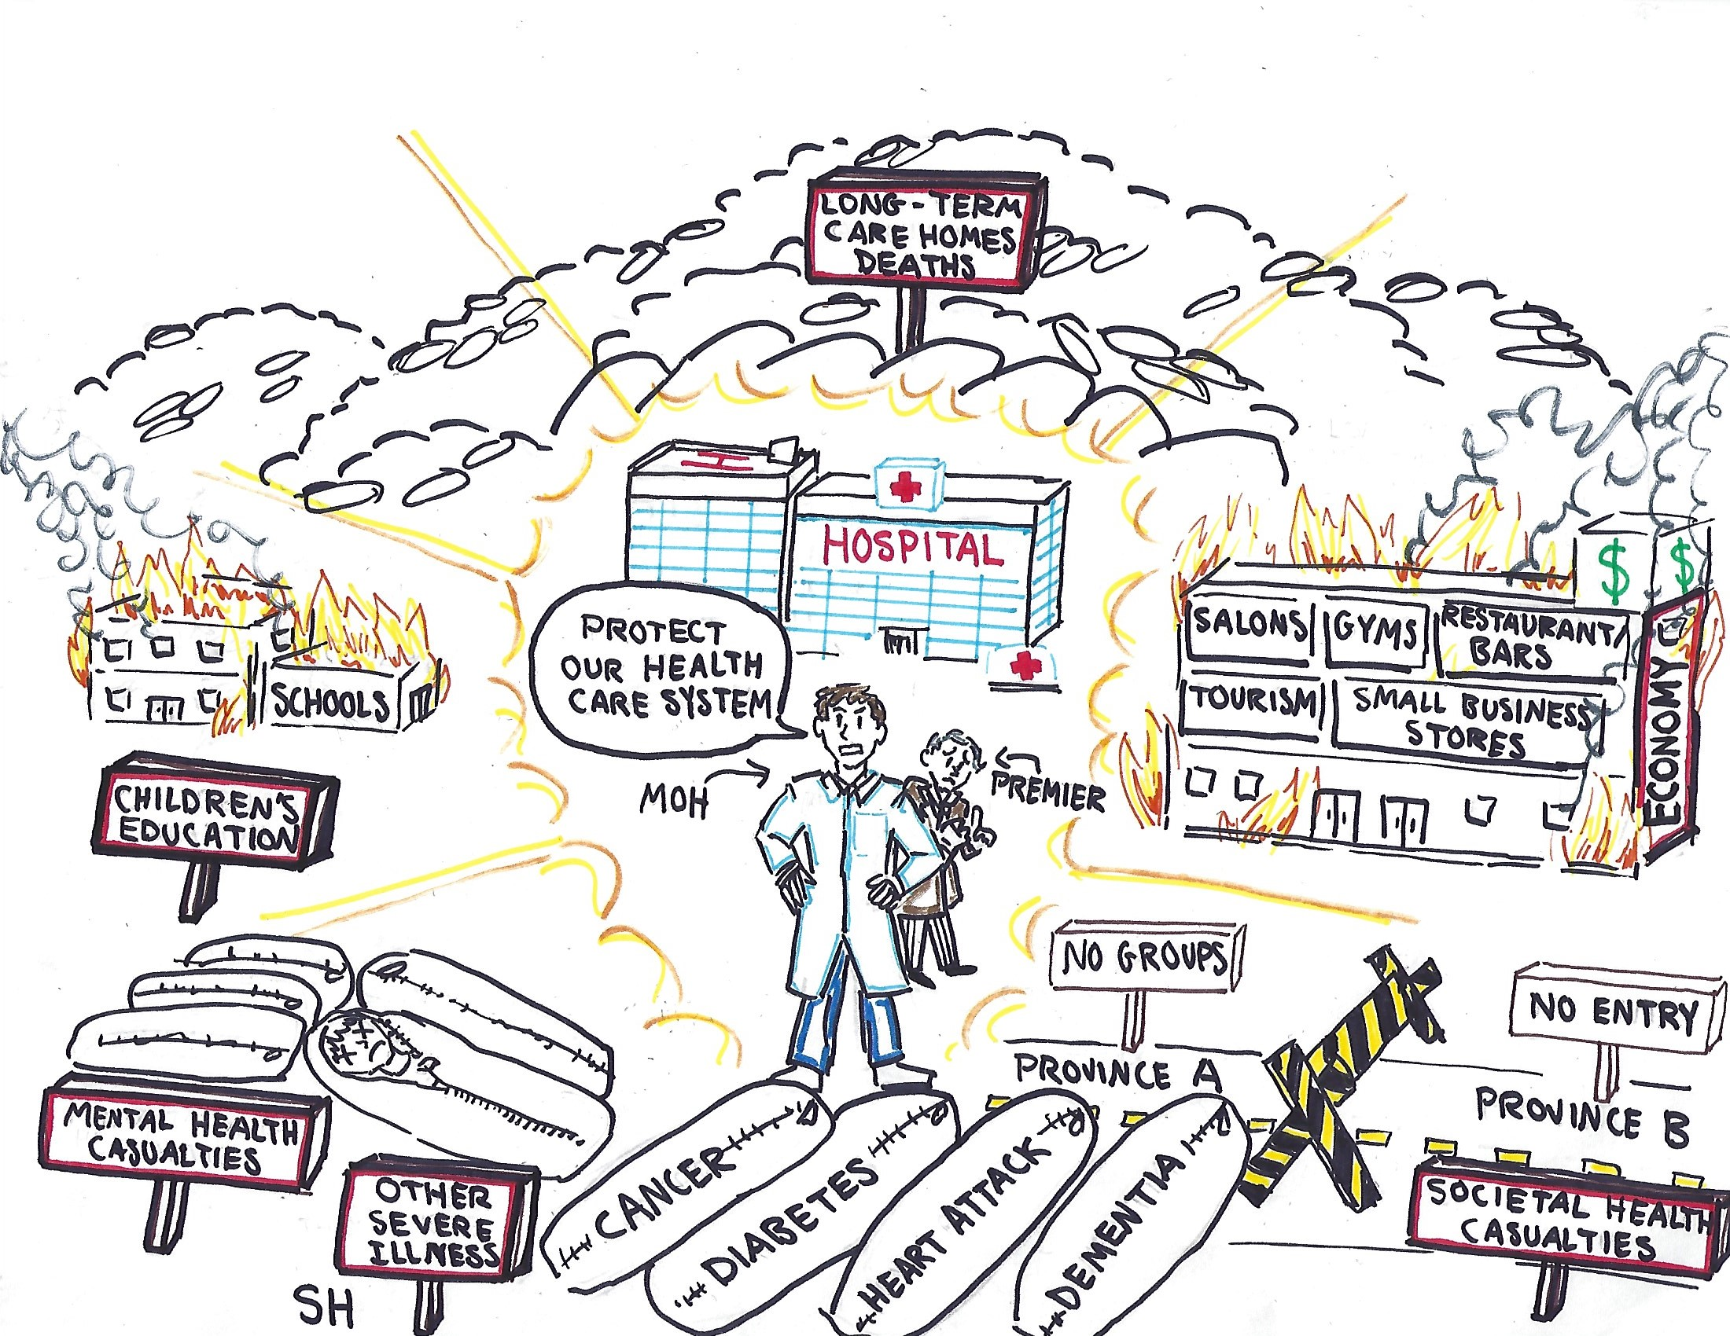
Our Canadian Covid-19 Response
David Redman LCol (Retired)
Former Head of Emergency Management Alberta
Notes:
A 15-year-olds view of the response in Winter 2020/2021

Slide 3
Presentation Overview
An Emergency Management Doctrinal Framework
Pandemic Emergency Management Process
Concluding Remarks
David Redman LCol (Retired)
Former Head of Emergency Management Alberta
Notes:
Emergency Management in Canada
Every P/T and Federal government has an EM organization
The EMO is a disciplined group with both knowledge and skill in the PROCESS to manage emergency events
The process the EMOs coordinate is designed to ensure that:
all required agencies have input to resolving emergencies,
that elected government leads,
There is a full development of options,
The options are weighted with costs verses benefits.
That a written plan is produced and shared
The process includes:
the implementation, adjustment and completion
of all functions of EM (mitigation, preparedness, response and recovery)
for all hazards
Second part an example for what we did vs what EM would have done

Slide 4
Emergency Management Framework
Hazards
Natural
Human Induced
Groupings/Organizations
Types of Agencies
Groupings
Functions
Coordinating Activities
Essential Resources
David Redman LCol (Retired)
Former Head of Emergency Management Alberta
Notes:
Every day we balance risks
We do it through EM at the P/T order of government daily
Five dimensions and each dimension is
a discipline in itself,
linked together with defined process
We pay experts in each area in our P/T governments who have years of experience
We ignored them

Slide 5
The “All Hazards” Approach
I. Natural Hazards
II. Human Induced Hazards
Biological
Human
Animal
Plant
Meteorological/ Elemental
Drought
Flood/Storm Surge/Tsunami
Ice/Snow
Fire
Wind-Tornado/Hurricane
Geological
Earthquake
Landslide
Avalanche
Non-intentional
Human Error
System Failure
Economic Instability
Sectors
Energy
Finance
Information/ Communication
Agriculture
Health
Environment
Transport
Public safety/ security
Government operations
Intentional
Civil unrest
Activism
Criminal Acts
Terrorism
International Tension
War
Sectors
Energy
Finance
Information/ Communication
Agriculture
Health
Environment
Transport
Public safety/ security
Government operations
SAFETY
SECURITY
David Redman LCol (Retired)
Former Head of Emergency Management Alberta
Notes:
EM follows an “all Hazards” approach
Each hazard can impact other hazards
Each hazard has monitoring and evaluation to balance risks
Each hazard has a Subject Matter Agency, normally defined in legislation
But
all hazards are responded to when they become a P/T level emergency in an identically coordinated manner

Slide 6
Emergency Management Agencies
Subject Matter Agency | The organization assigned by legislation, regulation, policy or a plan to lead the daily management of a specific hazard. In the event of an emergency or disaster caused by this hazard, manage this hazard under the cross-government direction by the Coordinating Agency.
Coordinating Agency {Only One per Order of government} | The organization assigned by legislation, regulation, policy or a plan to coordinate the emergency management efforts of different orders of government, supporting agencies and other emergency management partners to coordinate requests from the subject matter agency to deal with the direct affects of the specific hazard, while dealing with the full indirect results of the specific hazard;
Supporting/ Logistics Agency | Organization(s) assigned by legislation, regulation, policy or a plan to assist in the emergency management of a specific hazard under the direction of the coordinating agency.
David Redman LCol (Retired)
Former Head of Emergency Management Alberta
Notes:
Define three terms
It is both inefficient and dangerous to respond to each hazard in a non-integrated and uniform manner
The Coordinating agency are experts in the Operational Planning Process and teaches this process to others to a level to work together in an emergency
While a department or group may be the Subject Matter Agency for one hazard, they will likely be a Supporting Agency for a different hazard

Slide 7
Partners in Emergency Management
SUBJECT MATTER AND
SUPPORTING/LOGISTICS AGENCIES
Energy
Agriculture
Health
Transportation
Education
Infrastructure
Information Communications
Finance
Small Business
Tourism
INTERNATIONAL
Government
Leadership
&
Coordination
Emergency
Management
Organizations
Industry
Facilities,
Corporate HQ,
Associations
Non-
Government
Organizations
(NGOs)
FEDERAL
PROVINCIAL
COUNTY/REGION/DISTRICT
MUNICIPAL/FIRST NATIONS
FIRST RESPONDERS
CITIZENS/OCCUPATION EMPLOYEES
David Redman LCol (Retired)
Former Head of Emergency Management Alberta
Notes:
Every day each tube or system is full of our citizens doing their jobs
Each tube likely has a mix of public sector and private sector employees
Each tube works fine, independently, until impacted by a major emergency or disaster
First Responders assist those directly impacted by the hazard
Municipal order of government coordinates the response to all others while supporting the First Responders
P/T EMOs then bring support to the municipalities and coordinate between the tubes for private and public sector support while ensuring the continuity of both critical infrastructure and government operations
Federal government coordinates requests from P/Ts, aid between P/Ts if requested, and coordinates National Emergencies
Private sector, who is dealt with daily by EMOs and S/M agencies, is coordinated into the mitigation, planning, response and recovery routinely by the EMO

Slide 8
Functions of Emergency Management
Mitigation/ Prevention | Attempting to maintain a normal state of life by removing/minimizing the items at risk from the effects of hazard(s), or by reducing the effects of the hazard(s) on the items at risk, with an aim to prevent or reduce a disaster impact when it occurs; e.g. building fireguards, river dikes, security measures, legislating building codes, quarantines.
Preparedness | Recognizing that perfect mitigation is impossible, building capability to effectively and rapidly respond when items at risk are about to be or are affected by hazards. It includes the planning, stockpiling, training, exercising and education necessary to achieve a state of readiness for incidents, disasters and major emergencies; e.g plans, aide memoirs, simulation exercises, equipment stockpiles, review/implementation of lessons learned.
Response | Executing the capability to minimize the losses to items at risk (with an emphasis to prevention of injury/loss of life) when they are affected by hazards.
Recovery | Returning the effected organization/group to a state of normal life, after it has been affected by a hazard. Commences ASAP during Response and runs concurrently.
Independent Inquiry into Government Management of the COVID-19 Crisis
David Redman LCol (Retired)
Former Head of Emergency Management Alberta
Notes:
These are NOT phases; they are four functions that can be happening concurrently
Each area is a discipline, with specific training
Mitigation – who or what is most at risk (Hazard specific, Critical Infrastructure) and is mitigation safety or security related or both
Preparedness includes taking Lessons Learned (an actual process) and incorporates them into Written Plans
These Plans save time and lives when an emergency occurs
Describe the Alberta Model – 314 Municipalities, 46 First Nations, 8 Metis Settlements and AEMA
Response – One single cross order of government operational response coordinating agency
Recovery – One single cross order of government operational agency who starts to prepare or lead recovery as soon as possible after the response begins.

Slide 9
Emergency Management Activities
Governance Program Management
Governance/ Program Management
Operations
Training/Education
Intelligence
Finance
Plans
Administration
Logistics
Communications
Public/Private Sector Coordination
Support of Government
Support of Public
Liaison Officers
Technical Support
Incident Command System (ICS) Activities
David Redman LCol (Retired)
Former Head of Emergency Management Alberta
Notes:
Ten activities that make up every project or program
Each can become a full discipline in itself as the size of the emergency grows
Describe ICS (Incident Command System) for first responders
Governance is Key! It is never the S/M agency unless the event is minor but even then, elected officials lead
The EMO is trained in each of these activities and coordinates training and actions in each activities during major emergencies

Slide 10
Integration of the Framework of Emergency Management
Function Grouping | Mitigation | Preparedness | Response | Recovery
International
National
State/Provincial
Local/Municipal
Citizen
Human Induced - Intentional
Human Induced - Non-Intentional
Governance
Operations
Intelligence
Plans
Logistics
Public/Private Coordination
Communications
Finance
Administration
Training
Personnel
Equipment
Supplies
Infrastructure
Information Communications Technology
Finances
Publications/Records/ Documents
Natural - Meteorological
Natural - Biological
Natural - Geological
David Redman LCol (Retired)
Former Head of Emergency Management Alberta
Notes:
Discuss the linking of the five dimensions
Process is the key
Describe the final fifth dimension, 7 resources

Slide 11
Integration of the Framework of Emergency Management
Function Grouping | Mitigation | Preparedness | Response | Recovery
International
National
State/Provincial
Local/Municipal
Citizen
Human Induced - Intentional
Govt & Industry DOCTRINE
Govt & Industry LEGISLATION
Human Induced - Non-Intentional
Governance
Operations
Intelligence
Plans
Logistics
Public/Private Coordination
Communications
Finance
Administration
Training
Govt & Industry REGULATIONS, OC, MC
Govt & Industry STANDARDS
Natural - Meteorological
Govt & Industry GUIDELINES, RECOMMENDED PRACTICES
Natural - Biological
Govt & Industry PLANS
Natural - Geological
Govt & Industry PROCEDURES
Notes:
There is a continuous link between the Emergency Management discipline and the public and private sectors through laws and practices

Slide 12
Emergency Management Process
Aim
Governance
Hazard Assessment
Mission Analysis
Feedback on Results
Situational
Awareness
Monitoring
HAZARD(S)
Options
Feedback on Implementation
Cost Benefit Analysis
Supervision
Decision
With all Partners, by Phases
Implementation
Written Plan Publicly Issued
David Redman LCol (Retired)
Former Head of Emergency Management Alberta
Notes:
Each box and bullet is a documented action
The elected officials are the decision makers
Each step is required
Missing steps can have deadly consequences
EM staff are trained in the entire process and each step in the process
The steps can sometimes be done very rapidly early in the process and reviewed in detail later, depending on the emergency
In major emergencies the hazard always evolves
The OPP process allows decisions to be revisited and other options selected if required

Slide 13
Presentation Overview
An Emergency Management Doctrinal Framework
Pandemic Emergency Management Process
Concluding Remarks
David Redman LCol (Retired)
Former Head of Emergency Management Alberta

Slide 14
Emergency Management Process
Aim
Governance
Hazard Assessment
Mission Analysis
Feedback on Results
Situational
Awareness
Monitoring
HAZARD(S)
Options
Feedback on Implementation
Cost Benefit Analysis
Supervision
Decision
With all Partners, by Phases
Implementation
Written Plan Publicly Issued
David Redman LCol (Retired)
Former Head of Emergency Management Alberta

Slide 15
Emergency Management Process
The Aim in pandemics is:
“to minimize the impact of the virus/disease on all of Society”
NOT “to minimize the impact on the medical system”
David Redman LCol (Retired)
Former Head of Emergency Management Alberta

Slide 16
Overarching Principles in a Pandemic
Pandemics happen continuously
Emergency Management is foundation of Response to all Emergencies
Control Fear - never use Fear
Confidence in Government
Surge Capacity
Mutual Assistance
Constant Feedback and evaluation of evidence
Pandemics are public emergencies, NOT Public Health Emergencies – requiring an all of society response
David Redman LCol (Retired)
Former Head of Emergency Management Alberta

Slide 17
Emergency Management Process
Aim
Governance
Hazard Assessment
Mission Analysis
Feedback on Results
Situational
Awareness
Monitoring
HAZARD(S)
Options
Feedback on Implementation
Cost Benefit Analysis
Supervision
Decision
With all Partners, by Phases
Implementation
Written Plan Publicly Issued
David Redman LCol (Retired)
Former Head of Emergency Management Alberta

Slide 18
Governance in a Pandemic
The Premier leads - constantly and visibly – not the Subject Matter Agency
The Prime Minister is in support of Premiers for Mutual Assistance and the limited areas of Federal Jurisdiction
A Task Force for the Pandemic is formed by each order of government
The Task Force includes senior leadership from:
Major public sectors Ministries (Lead, Coordinating, Supporting)
Major private sector Industries
Appropriate Not-for Profits
Other groups/agencies as felt appropriate by the Premier
The Coordinating Agency (i.e. the EMO) supports the daily operation of the Task Force
The Coordinating Agency conducts the emergency management process in support of directions of the Task Force
David Redman LCol (Retired)
Former Head of Emergency Management Alberta

Slide 19
Emergency Management Process
Aim
Governance
Hazard Assessment
Mission Analysis
Feedback on Results
Situational
Awareness
Monitoring
HAZARD(S)
Options
Feedback on Implementation
Cost Benefit Analysis
Supervision
Decision
With all Partners, by Phases
Implementation
Written Plan Publicly Issued
David Redman LCol (Retired)
Former Head of Emergency Management Alberta

Slide 20
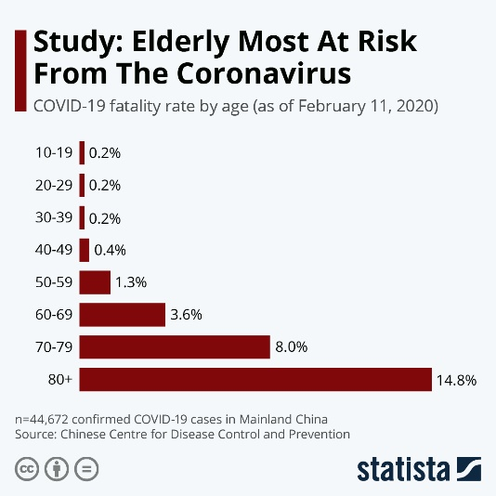
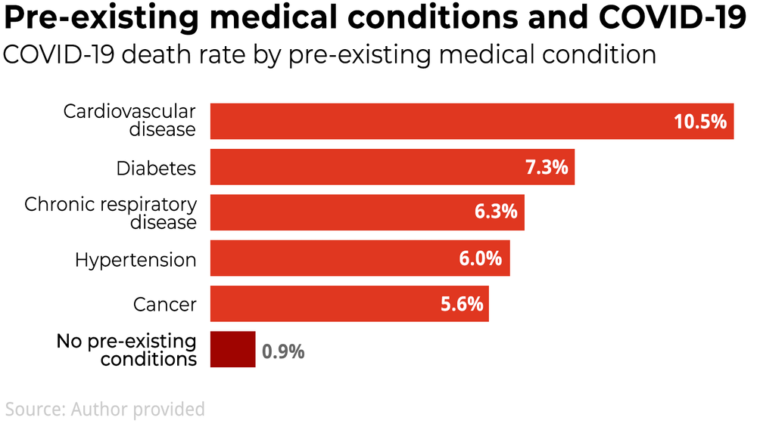
The Emergency Management Process Hazard Assessment – Covid 19
In February 2020, we knew that over 95% of the deaths in China and Europe were in seniors, over the age of 60, with multiple co-morbidities.
https://www.statista.com/chart/20860/coronavirus-fatality-rate-by-age/
https://theconversation.com/why-are-older-people-more-at-risk-of-coronavirus-133770
David Redman LCol (Retired)
Former Head of Emergency Management Alberta

Slide 21
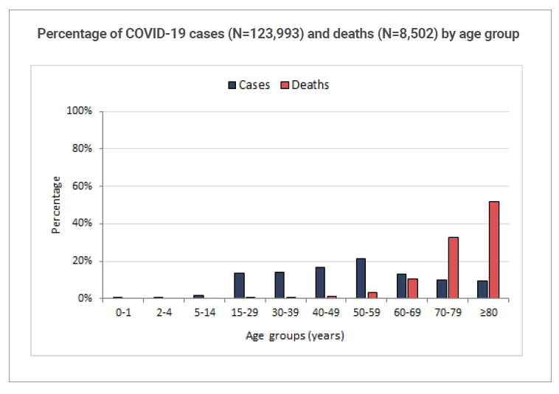
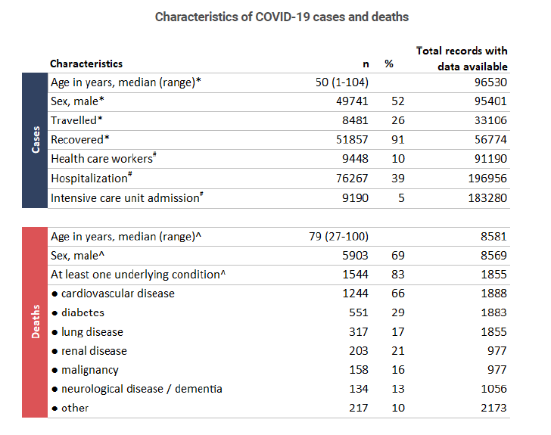
WHO Data March 2020
> 95%
David Redman LCol (Retired)
Former Head of Emergency Management Alberta

Slide 22
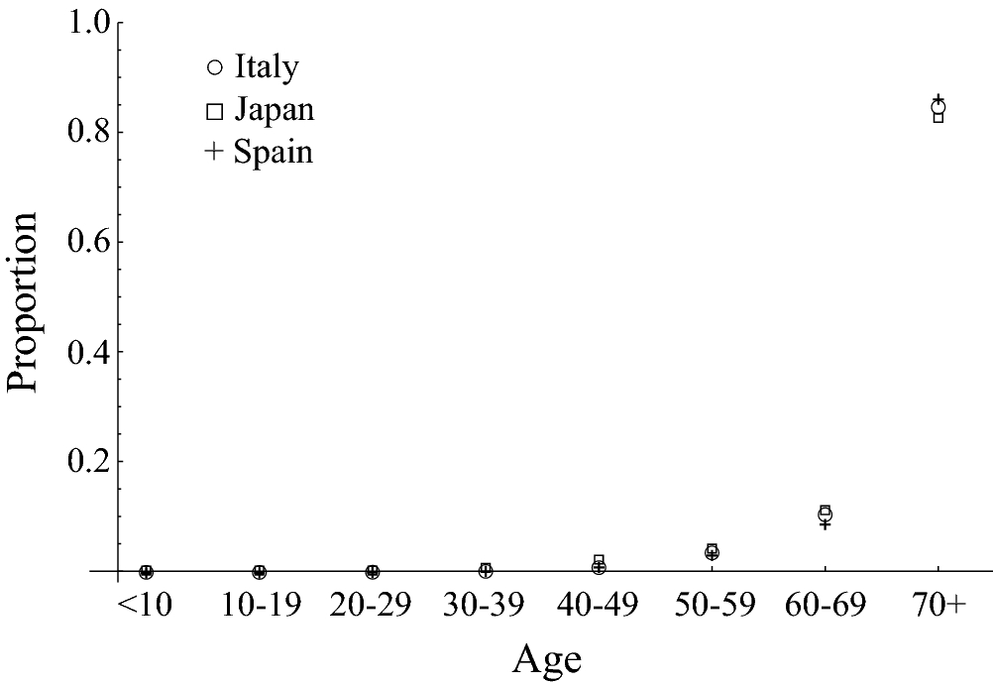
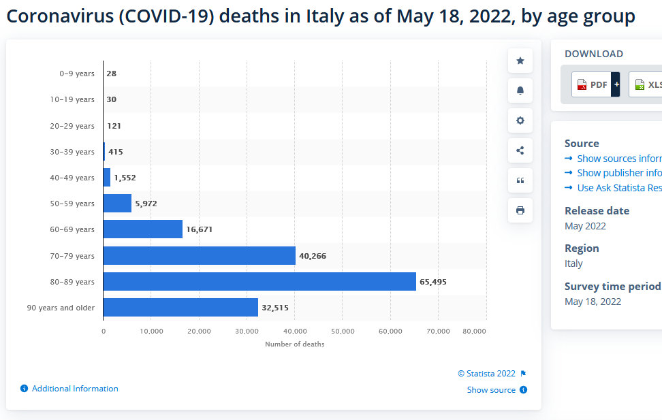
Italy, Japan, Spain Covid 19 Statistics May 2020
154,947/163,065 = 95.02%
https://www.nature.com/articles/s41598-020-73777-8/figures/1
David Redman LCol (Retired)
Former Head of Emergency Management Alberta

Slide 23
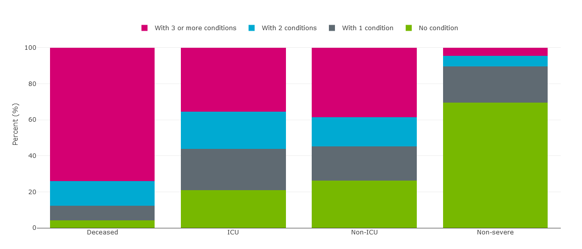
Alberta Covid 19 Statistics
February 23, 2022 https://www.alberta.ca/stats/covid-19-alberta-statistics.htm#severe-outcomes
Data no longer Published
73.8%
13.8%
8.3%
4.1%
David Redman LCol (Retired)
Former Head of Emergency Management Alberta

Slide 24
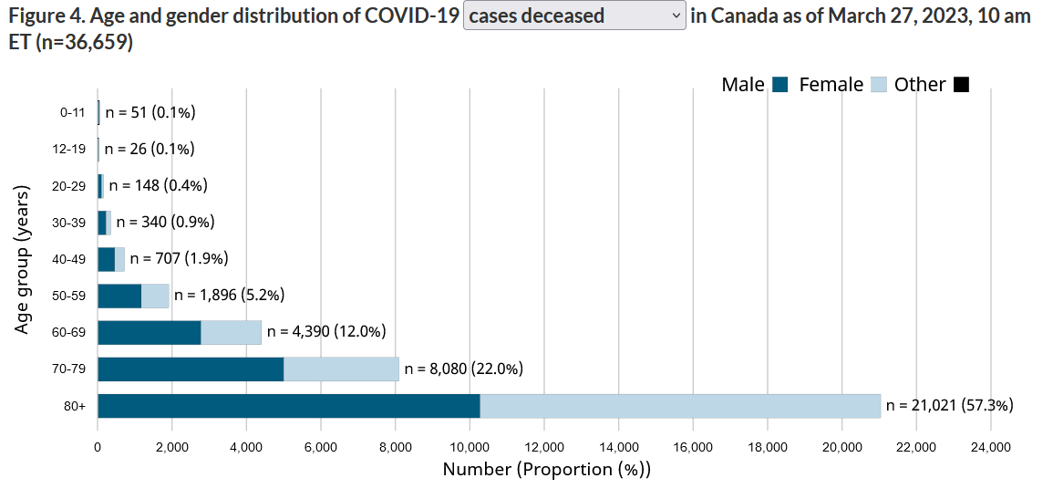
Emergency Management Process
Hazard Assessment
We should have immediately developed options for the protection of our seniors over 60 with co-morbidities.
Canada ranked LAST in the protection of their seniors in the OECD. When last published,
73% of all Canadian deaths occurred in LTC Homes
As of March 27, 2023, in Canada, 91.3% of our deaths have been in seniors, over the age of 60, with severe multiple co-morbidities. See Figure 4 below, updated weekly by Health Canada.
For those under 60 years old the risk diminishes rapidly, becoming less than seasonal flu. This represents less than 8.7% of the “Covid” deaths, a pattern like pneumonia in Canada. We knew this all along!
https://health-infobase.canada.ca/covid-19/epidemiological-summary-covid-19-cases.html
1,272
David Redman LCol (Retired)
Former Head of Emergency Management Alberta

Slide 25
Emergency Management Process
Aim
Governance
Hazard Assessment
Mission Analysis
Feedback on Results
Situational
Awareness
Monitoring
HAZARD(S)
Options
Feedback on Implementation
Cost Benefit Analysis
Supervision
Decision
With all Partners, by Phases
Implementation
Written Plan Publicly Issued
David Redman LCol (Retired)
Former Head of Emergency Management Alberta

Slide 26
Goals in a Pandemic
The four goals “Learned” from previous Pandemics have been clearly defined:
Controlling the spread of influenza disease and reducing illness (morbidity) and death (mortality) by providing access to “appropriate” prevention measures, care, and treatment.
Mitigating societal disruption in Alberta through ensuring the “continuity” and recovery of critical services.
“Minimizing” adverse economic impact.
Supporting an efficient and effective use of resources during response and recovery
https://www.alberta.ca/pandemic-influenza.aspx#toc-1
David Redman LCol (Retired)
Former Head of Emergency Management Alberta

Slide 27
Mission Analysis in a Pandemic
Goal 1 – Implied Tasks
Care of those most at risk (those over 60 with multiple comorbidities):
Living in LTC homes
Living alone
Living in multi-generation homes
Living in other situations
Assurance of ALL medical capacity including (real NEW surge capacity, if/as required)
Infrastructure
Staff
Equipment
Supplies
Assurance of continuing care for other high-risk diseases
Heart Disease
Diabetes
Dementia
Cancer
Etc.
Monitoring of COVID-19
Shifts
Patterns
Zoonotic behavior
Research of treatments for Covid and implementation as found
Testing for COVID-19
rapid
in depth
cross population to determine actual Infection Fatality Rate (IFR)
Produce risk analysis for population for family practitioner advice to population (like the cancer risk analysis provided to new cancer patients, e.g., age vs operation vs chemo vs radiation vs drug therapy)
by age
by comorbidity
by other health conditions (including obesity)
Provision of confidence-based medical advice, placing SARS CoV-2 into perspective
Government
Private sector
Not for profit organizations
General public
Develop medical examiner and mortuary services to ensure capacity and caring response if/when required
Special medical attention to Mental Health, caused by Fear in Emergencies
Etc.
David Redman LCol (Retired)
Former Head of Emergency Management Alberta

Slide 28
Mission Analysis in a Pandemic
Goal 2 – Implied Tasks
Confirmation of critical infrastructure by sector
Energy
Electricity
Oil
Gas
Water supply
Food supply
Agriculture
Livestock (zoonotic transfer concern)
Farming
Transportation
Etc.
Confirmation/CONTINUITY of critical services
Education
Schools **********
Public schools
Separate schools
Charter schools
Private schools
Home schooling
Other
Undergraduate
Pandemic related specialties
Other
Postgraduate
Pandemic related specialties
Other
Mental Health
Existing services
Additional services needed during pandemic
Societal Health
Existing services
Additional services needed during pandemic
Financial Services
Etc.
Etc.
David Redman LCol (Retired)
Former Head of Emergency Management Alberta

Slide 29
Mission Analysis in a Pandemic
Goal 3 – Implied Tasks
• Implied tasks:
Ensure maximum CONTINUITY of the economy (Affected by illness not CLOSURE)
Manufacturing
Resource sector
Forestry
Fishing
Farming
Livestock
Energy
Etc.
Financial Institutions
Construction
Wholesale
Retail
Small Business
Tourism
Etc.
When continuity is not possible due to COVID-19 (i.e. Tourism)
Replacement of business
Assurance of return
Support mechanisms for impacted systems and personnel
Etc.
Etc.
David Redman LCol (Retired)
Former Head of Emergency Management Alberta

Slide 30
Mission Analysis in a Pandemic
Goal 4 – Implied Tasks
Identification of resources for Response and Recovery:
Critical Resources
Government
Private sector
NGOs
Citizens
Necessary Resources
Government
Private Sector
NGOs
Citizens
Morale resources
Same as above
Management of Resources by Criticality
Procurement
Transportation
Warehousing
Distribution
Accounting and Control Systems
Etc.
Etc.
David Redman LCol (Retired)
Former Head of Emergency Management Alberta

Slide 31
Mission Analysis in a Pandemic
Other Implied Tasks
Support of Confidence in Government
Establishment of push information systems, involving the Premier
Establishment of pull Information systems
Protection of Charter Rights and Freedoms
Management of dis-information
Management of FEAR
Support of the Governance Task Force
When impacted by the pandemic
Routine support
Scheduled and emergency briefings
Information and messaging support
Etc.
Operations
Operation of the cross-Government Operations Center (GEOC)
Operation of sector specific operations centers linked to the GEOC
Operation of EM in support of other hazards and emergencies (COVID-19 will not be the only emergency during the pandemic)
Etc.
Plans
Pandemic related
Non-pandemic related
Intelligence
COVID-19 related
Identification of required information
Identification of sources of information
Gathering
Assessment of information
Collation of information
Distribution of information
COVID-19 Impacts related
Same as above
Etc.
Communications
Support of government
Identification spokesperson
Methodologies
Systems
Materials
Personnel
Support of private sector (bullets as above)
Support of NGOs (bullets as above)
Support of public (bullets as above)
Financial Management
Pandemic COVID-19 related
Pandemic collateral effects
Routine but potential impacted personnel continuity plans
Etc.

Slide 32
Emergency Management Process
Aim
Governance
Hazard Assessment
Mission Analysis
Feedback on Results
Situational
Awareness
Monitoring
HAZARD(S)
Options
Feedback on Implementation
Cost Benefit Analysis
Supervision
Decision
With all Partners, by Phases
Implementation
Written Plan Publicly Issued
David Redman LCol (Retired)
Former Head of Emergency Management Alberta

Slide 33
Emergency Management Process
We had written plans for Pandemics in all the P/Ts and Federal Government – written together with the EMOs and Public Health Agencies and other stakeholders
These Plans were based on hard learned lessons from previous pandemics.
These plans, and lessons learned documents, discussed the use of Non-Pharmaceutical Interventions (NPIs) and their DANGERS.
David Redman LCol (Retired)
Former Head of Emergency Management Alberta

Slide 34
Lack of any Cost Benefit Analysis
One Example: Non-Pharmaceutical Measures (NPIs) “Lockdowns”
Hand Hygiene
Respiratory etiquette
Isolation of Sick individuals
Other environmental measures
Surface and Object cleaning
Face Masks
Avoiding Crowding
Travel Advice
Contact Tracing
Quarantine of Exposed Individuals
Workplace Measures and Closures
School Measures and Closures
Entry and Exit Screening
Internal Travel Restrictions
Border Closures
Most found to be largely ineffective in reducing the spread of the virus but can cause significant collateral damage
https://apps.who.int/iris/bitstream/handle/10665/329438/9789241516839-eng.pdf
David Redman LCol (Retired)
Former Head of Emergency Management Alberta

Slide 35
Lack of Cost Benefit Analysis = A Lesson Relearned The Hard Way
European Journal of Clinical Investigation
Assessing mandatory stay‐at‐home and business closure effects on the spread of COVID‐19 Methods
Eran Bendavid, Christopher Oh, Jay Bhattacharya, John P. A. Ioannidis
We first estimate COVID‐19 case growth in relation to any NPI implementation in subnational regions of 10 countries: England, France, Germany, Iran, Italy, Netherlands, Spain, South Korea, Sweden and the United States. Using first‐difference models with fixed effects, we isolate the effects of mrNPIs by subtracting the combined effects of lrNPIs and epidemic dynamics from all NPIs. We use case growth in Sweden and South Korea, 2 countries that did not implement mandatory stay‐at‐home and business closures, as comparison countries for the other 8 countries (16 total comparisons).
Conclusions
While small benefits cannot be excluded, we do not find significant benefits on case growth of more restrictive NPIs. Similar reductions in case growth may be achievable with less‐restrictive interventions.
https://onlinelibrary.wiley.com/doi/10.1111/eci.13484
https://www.aier.org/article/lockdowns-do-not-control-the-coronavirus-the-evidence/
David Redman LCol (Retired)
Former Head of Emergency Management Alberta

Slide 36
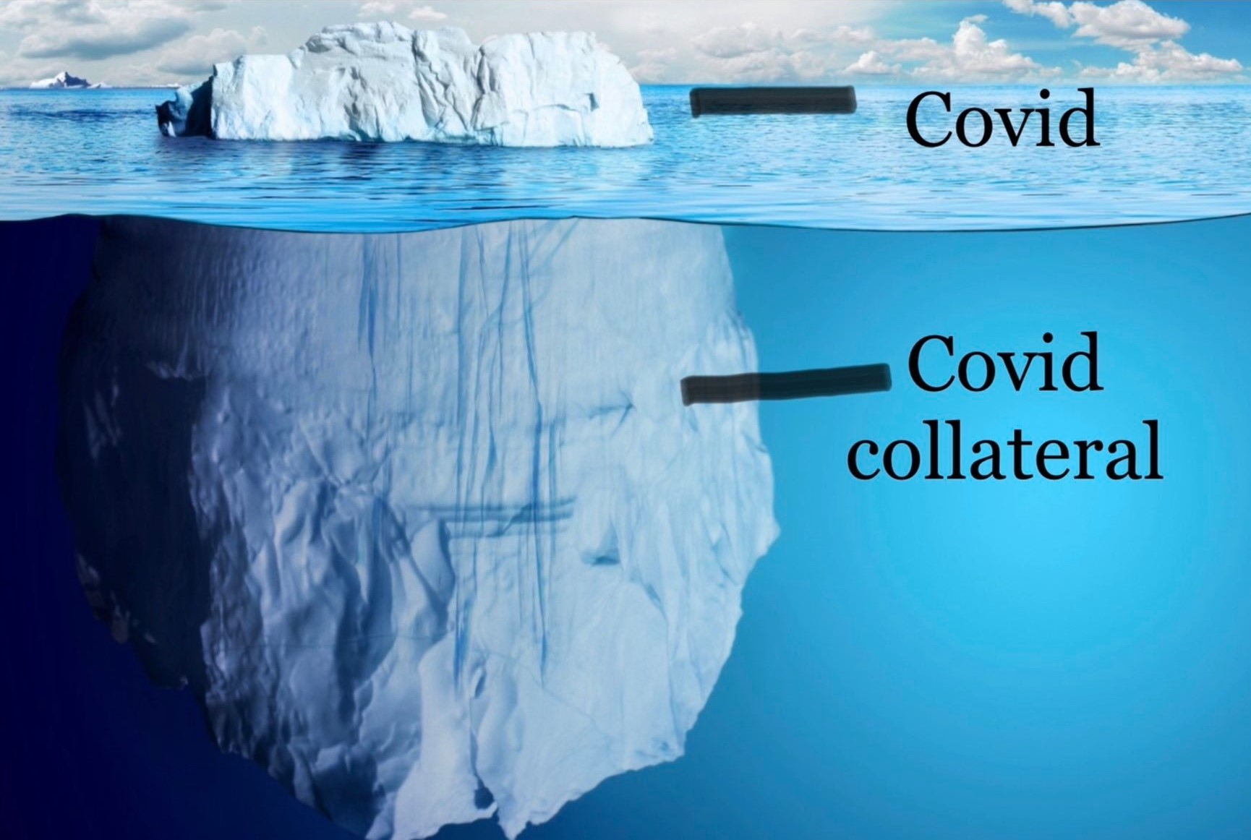
from “Lockdowns”

Slide 37
Ignoring Lessons Learned and Skipping the Cost Benefit Analysis
The results are predicable: Deadly Consequences from Using “Lockdowns” (NPIs)
NPI Collateral damage includes, but is not limited to, massive damage to:
our individual Mental health,
our Social fabric,
other Severe Health conditions,
our Children’s development, education and socialization, and
our Economic Well Being as individuals, in businesses, and as a nation
https://www.jccf.ca/published_reports/flying-blind-governments-hasty-decisions-to-lock-down-canadians-while-damaging-public-health-and-the-economy/
https://www.frontiersin.org/articles/10.3389/fpubh.2021.625778/full - Dr Ari Joffe
http://www.sfu.ca/~allen/LockdownReport.pdf
https://collateralglobal.org/
https://brownstone.org/articles/more-than-400-studies-on-the-failure-of-compulsory-covid-interventions/
David Redman LCol (Retired)
Former Head of Emergency Management Alberta

Slide 38
Emergency Management Process
Aim
Governance
Hazard Assessment
Mission Analysis
Feedback on Results
Situational
Awareness
Monitoring
HAZARD(S)
Options
Feedback on Implementation
Cost Benefit Analysis
Supervision
Decision
With all Partners, by Phases
Implementation
Written Plan Publicly Issued
David Redman LCol (Retired)
Former Head of Emergency Management Alberta

Slide 39
Presentation Overview
An Emergency Management Doctrinal Framework
Pandemic Emergency Management Process
Concluding Remarks
David Redman LCol (Retired)
Former Head of Emergency Management Alberta

Slide 40
Perspective
Modelling. The Imperial College of London model was known from previous use (Bird Flu 2005, Swine Flu 2009) to be terribly flawed. Yet it was used in Canada and many other countries to create fear of the SARS CoV-2 virus, out of all reason. https://brownstone.org/articles/modeling-gone-bad/
Evidence. Month by month the evidence proved the model wrong, but wave after wave the model data was used to create new fear. https://www.aier.org/article/the-failure-of-imperial-college-modeling-is-far-worse-than-we-knew/
Infection Fatality Rate (IFR). Actual evidence of the IFR was ignored. Covid death rates were never given in context to other regular causes of death. https://www.acsh.org/news/2020/11/18/covid-infection-fatality-rates-sex-and-age-15163 https://medium.com/@sallmart/the-confusion-over-flu-cfr-ifr-and-all-cause-pneumonia-fe5d8f7bb577
Daily Death Count. Covid death counts were stated daily by MOH and Premiers/PM to create fear, but with no perspective to other diseases or causes of annual deaths.
Non-Lockdown Results. The MOH(s), Premier(s)/PM, and the media either ignored the evidence from or personally attacked the leaders of “non-lockdown” responses; such as: Sweden, other countries where “lockdowns” were simply not possible due to poverty, and USA States where “lockdowns were not used.
Saving our Medical System. The mantra that our hospitals were going to be overwhelmed was built by giving raw numbers of Acute care beds and ICU beds in use, never stating the total available. For example, in Ontario, at the peak of the second wave the Premier of Ontario bemoaned that there were over 1,700 acute care beds with Covid Patients. He failed to ever mention that Ontario has over 22,300 Acute care beds. https://www.fao-on.org/en/Blog/Publications/health-2020
Perspective was intentionally suppressed.
David Redman LCol (Retired)
Former Head of Emergency Management Alberta

Slide 41
Belief in Lockdowns is not Science
https://www.rasmussenreports.com/public_content/political_commentary/commentary_by_stephen_moore/in_the_end_sweden_did_it_right
https://unherd.com/2022/06/sweden-saved-children-from-lockdown/
https://brownstone.org/articles/swedens-strategy-once-again-proven-correct/

Slide 42
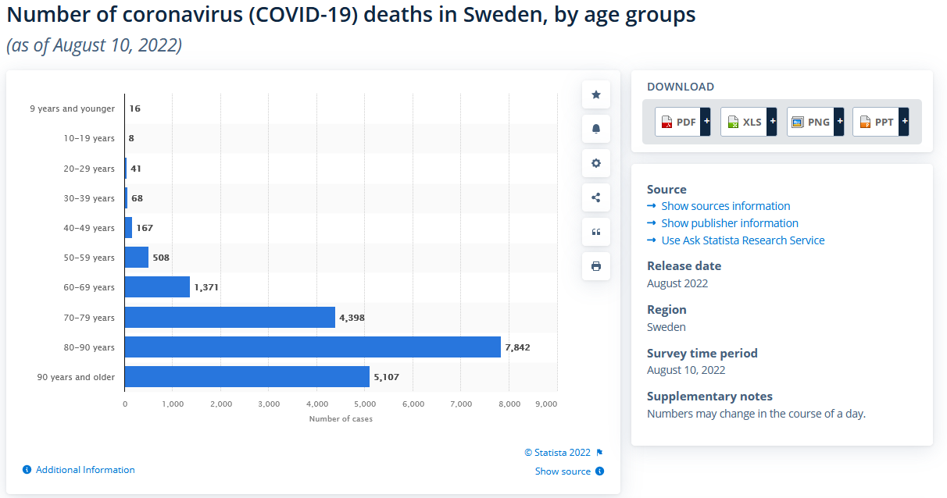
Did not use:
Masks
School Closures
Work Closures
Social distancing: recommended 1 meter if possible
Does not have:
Increase in Mental Health Issues
Increase in Societal Health issues
Increase in other severe illness and disease
Destruction of their childrens socialization and education
Does have:
the best post pandemic economic outcome of the European countries to defray the pandemic costs.
https://www.statista.com/statistics/1107913/number-of-coronavirus-deaths-in-sweden-by-age-groups/

Slide 43
Comparison Sweden to Alberta – Covid Deaths by Age groups
Age | Alberta Deaths Feb 2022 | Alberta Deaths Sep 2022 | Alberta Deaths Sep 2022 x 2.3 | Sweden Deaths Aug 2022
0 – 9 | 3 | 3 | 7 | 16
10 - 19 | 2 | 2 | 5 | 8
20 - 29 | 19 | 20 | 46 | 41
30 - 39 | 44 | 45 | 103 | 68
40 - 49 | 98 | 109 | 251 | 176
50 - 59 | 242 | 288 | 662 | 508
60 – 69 | 530 | 657 | 1511 | 1371
70 + | 2946 | 3748 | 8620 | 17347
In ages 0 – 69, comparative deaths,
Sweden = 2,188
Alberta = 2,585
Lockdowns did NOT stop Covid deaths for those under 70 years old
In ages over 70,
Sweden = 20% of Population is over 65 years old
Alberta = 14% of Population is over 65 years old
95% of deaths occurred in those over 60 years old worldwide
Populations:
Sweden 10.55 M
Alberta 4.5 M
Sweden Pop = Alberta Pop x 2.33

Slide 44
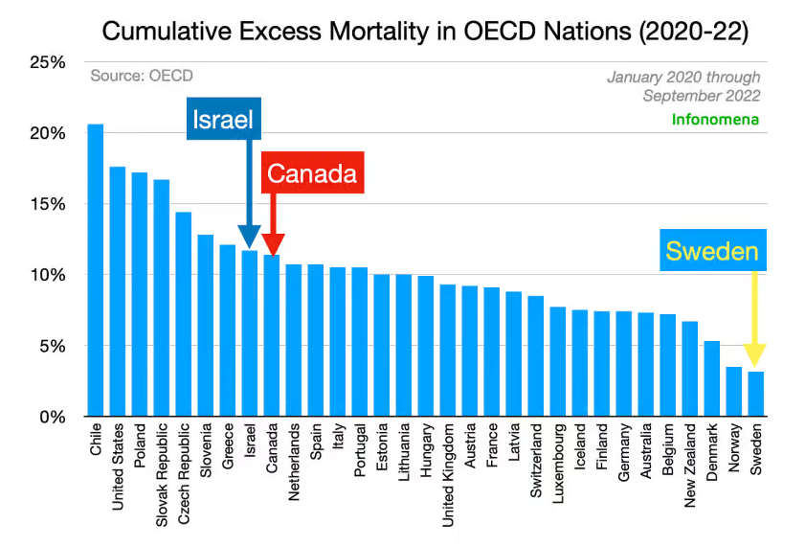
Did not use:
Masks
School Closures
Work Closures
Social distancing: recommended 1 meter if possible
Does not have:
Increase in Mental Health Issues
Increase in Societal Health issues
Increase in other severe illness and disease
Destruction of their children’s socialization and education
Does have:
the best post pandemic economic outcome of the European countries to defray the pandemic costs.

Slide 45
Comparison Canada to India – Covid Deaths - October 13, 2022
India
Population 1,406.6 Million
Deaths per Million – 376
Canada
Population 38.4 Million
Deaths per Million 1,190
Could not use mandated:
Masks
School Closures
Work Closures
Social distancing
Other Facts
2.8 % of the population vaccinated when Delta wave hit
36 x the population of Canada
1/3 the Covid deaths of Canada
https://www.worldometers.info/coronavirus/

Slide 46
Comparison to Other Causes of Death on an Annual Basis (March 31, 2023)
Canada Age 0-60 years - Vehicle Collision Fatality
COVID-19 = 424
Vehicle fatality = 1331
“Over 3 times more likely to die as a vehicle collision fatality than to die from COVID-19”
Canada Age 20-40 years – Vehicle Collision Fatality
COVID-19 = 162
Vehicle Fatality = 630
"Well over 3.5 times more likely to as a vehicle collision fatality than to die from COVID-19".
Canada Age 20-40 years – Heart Disease
Heart disease = 315
COVID-19 = 162
“Two times more likely to die of heart disease than to die from COVID-19”.
Canada Age 40-60 years – Heart Disease
Heart Disease = 3701
COVID-19 = 868
“Over 4 times more likely to die of heart disease than to die from COVID-19”.
Canada Age 60-70 years – Heart Disease
Heart Disease = 6642
COVID-19 = 1463
“Over 4.5 times more likely to die of heart disease than to die of COVID-19”.
Canada Age 70 years and up – Heart Disease
Heart Disease = 41,844
COVID-19 = 9,700
“Well over 4 times likely to die of heart disease than to die of COVID-19”.
References:
https://tc.canada.ca/en/road-transportation/motor-vehicle-safety/canadian-motor-vehicle-traffic-collision-statistics-2018
https://www150.statcan.gc.ca/t1/tbl1/en/tv.action?pid=1310039401&pickMembers%5B0%5D=2.13&pickMembers%5B1%5D=3.1&cubeTimeFrame.startYear=2017&cubeTimeFrame.endYear=2019&referencePeriods=20170101%2C20190101
https://health-infobase.canada.ca/covid-19/epidemiological-summary-covid-19-cases.html

Slide 47
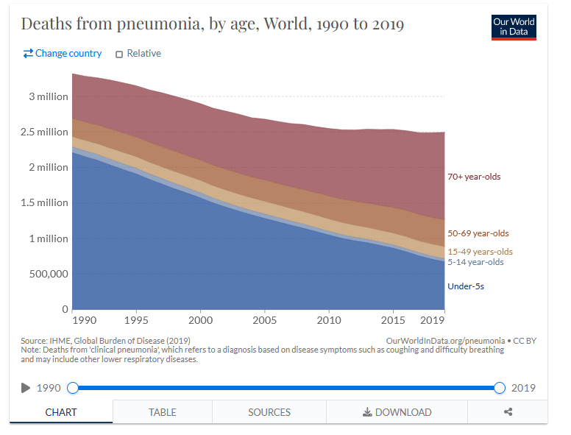
Comparison Pneumonia Deaths Annually compared to Covid Deaths As of March 31, 2023
https://www.worldometers.info/coronavirus/
https://www.worldometers.info/coronavirus/
Covid-19 Deaths
6.83 M in 36 months or 190.0 K per month
Pneumonia Deaths
2.50 M in 12 months or 208.3 K per month
2.5 M
The world did not:
Close Borders
Close Schools
Close Business
Wear Masks
Destroy Democracies

Slide 48
Conclusions
Discarding the Emergency Management System to coordinate the response to this Pandemic has been deadly, and the deaths and damage will likely continue for 60 years.
The Aim of the Response has been continuously wrong. It should have been to minimize the impact of SARS CoV-2 on our society, NOT to protect the medical System.
The Hazard Assessment, to this day, showed who was most at risk; i.e. those over 60 with multiple severe comorbidities. Lockdowns did not save our seniors. A Targeted Response, based on those who were most at risk, could have.
The Lessons Learned from previous pandemics, both in the Emergency Management community and the Health community, were ignored.
The use of Lockdowns (NPIs) did not have significant impact on the spread of COVID-19 in countries like Canada. We knew they would not from Lessons Learned before COVID-19. Using them in the first wave is, at best, gross negligence. After the first wave it is criminal negligence.
Lockdowns have caused massive collateral death and damage, many times more that the virus itself. We new the dangers of using NPIs before COVID-19. No Cost Benefit Analysis was done, ever. This is criminal negligence.
Our Prime Minister, our Premiers and MOHs are responsible for the Deadly Response to COVID-19 and the continuing fear. They need to be held accountable.
If we do not revert to our emergency management systems and the immediately and vigorously remove the false belief in lockdowns, our society and our democracy are in deadly jeopardy.
David Redman LCol (Retired)
Former Head of Emergency Management Alberta

Slide 49
References
Canada’s Deadly Response to COVID-19
https://fcpp.org/2021/07/19/canadas-deadly-response-to-covid-19/
An Emergency Management Doctrine https://www.preprints.org/manuscript/202102.0367/v1
The SARS-CoV-2 Pandemic in High Income Countries Such as Canada:
A Better Way Forward Without Lockdowns
https://www.frontiersin.org/articles/10.3389/fpubh.2021.715904/full
Dr Ramesh Thakur – State Power and Covid Crimes
https://brownstone.org/articles/state-power-and-covid-crimes-part-1/
Canadian Research Site
https://pandemicalternative.org/
Further Reading on Emergency Management of a Pandemic
https://fcpp.org/authors/david-redman/
Masks
https://brownstone.org/articles/more-than-150-comparative-studies-and-articles-on-mask-ineffectiveness-and-harms/
https://brownstone.org/articles/the-mask-studies-you-should-know/
Lockdowns – Known Deadly Results for No Gains
https://www.wsj.com/articles/fauci-and-walensky-double-down-on-failure-covid-pandemic-evidence-data-lockdowns-mask-mandates-restrictions-public-health-experts-11660855180
David Redman LCol (Retired)
Former Head of Emergency Management Alberta

Slide 50
Questions ?
David Redman LCol (Retired)
Former Head of Emergency Management Alberta

Slide 51
Confidence in Government – How to Achieve It
Produce a written Covid 19 Pandemic Plan including but not limited to:
Situate the Disease and Province in a National concept
Define the Mission – To ensure minimum impact of Covid 19 on <province>
Clearly defined Governance
Clearly defined Phases
Clearly defined Objective and tasks by Organizations
Outline Critical Support
Define Communications for
Support of Citizens
Support of the Public sector
Support of the Private sector
Define How you will Protect those most at risk
A separate Plan for Long Term Care (LTC) homes
A Plan for care of those with multiple co-morbidities not in LTC Homes
How the Public can help and interact
Define how you will ensure operation of Critical infrastructure
Place Covid hospitalizations/ICU usage in context with total capacity and plans for surge capacity
Assurance of electricity, water, food and essential supplies
Show that you know what is most important and how the public can help
Define how you will ensure the continued care for those with other life-threatening illnesses
Define a Plan for Mental Health issues related to the Pandemic
Define a Plan for the assurance of in class learning for our youth with appropriate safety measures and mental health aides
Place this virus in Context
To other diseases (Pneumonia for Example)
To other causes of death annually
Testing for Covid 19
Rapid
In depth
cross population to determine actual Infection Fatality Rate
Produce risk analysis for population for FP advice to population (similar to the Cancer risk analysis provided to new Cancer patients age vs operation vs chemo vs radiation vs drug therapy)
by age
by co-morbidity
by other health conditions (including obesity)
Define exactly how the Public can send ideas and feedback to the Government
Show the public you have a Plan and are READY
David Redman LCol (Retired)
Former Head of Emergency Management Alberta

Slide 52
Surge Capacity
Produce and implement a written surge capacity plan:
for all critical infrastructure (CI) including:
Surge staff of all types
Surge infrastructure
Surge equipment
Surge supplies
Surge Information Communication technology (ICT)
Surge staff can be developed by using the Operational Planning Process (OPP) with a full team of experts to consider:
Recall of willing retirees
Requests to other jurisdictions by individual specialty if an abundance in one area or P/T can be made available.
Rapid training programs for less skilled positions
Evaluation of minimum requirements for each task, use volunteers with basic skills
Use of appropriate students
Using infected but asymptomatic staff in areas where possible
A provincial declaration of a State of Emergency allows certain requirements to be modified, but only for a specific period and specific needs. Due diligence must be shown (i.e. a written plan and written with the personnel who are the experts in a specific need.)
David Redman LCol (Retired)
Former Head of Emergency Management Alberta

Slide 53
Normal
Situation
RESPONSE
Hazard Emerges
Conduct Operational Planning Process for Response
Mission Analysis
Factors
Courses Open/Options
Advantages/Disadvantages (Cost Benefit Analysis)
Gather Data
Issue Written Response Plan
Adjust Response Plan
Hazard Changes
New Data
Feedback
Leadership Decision
Implement Response Plan
Hazard Assessment
Establish Governance for Emergency Response
Feedback
Hazard Under Response
Conduct Operational Planning Process for Recovery
Mission Analysis
Factors
Courses Open/Options
Advantages/Disadvantages (Cost Benefit Analysis)
Gather Data
Issue Written Recovery Plan
Adjust Recovery Plan
Hazard Changes
New Data
Feedback
Leadership Decision
Implement Recovery Plan
Shared Hazard Assessment
Establish Governance for Recovery
Feedback
RECOVERY
Returned to Normal
Notes:
Describe the process very briefly

Slide 54
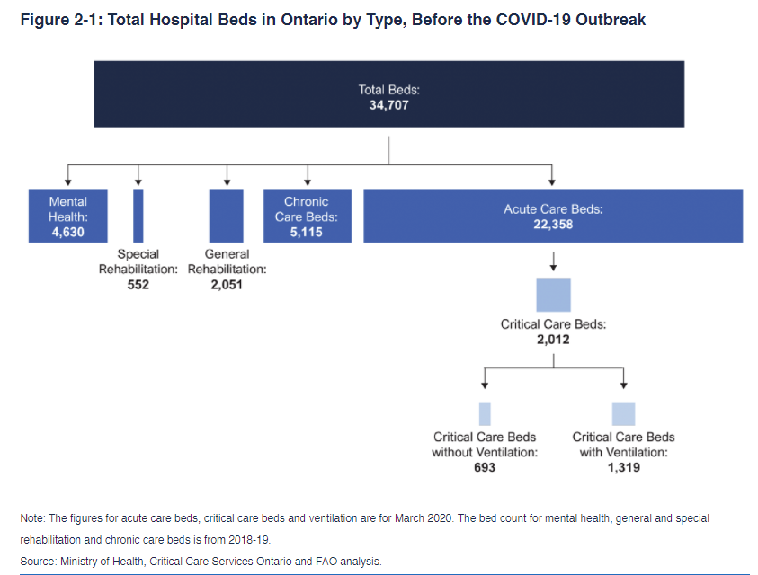
Ontario Covid 19 Statistics
https://www.fao-on.org/en/Blog/Publications/health-2020

